Slide 1
‘'Social Care - friends when in need; company when alone; being there for you'
Jill Manthorpe,
Social Care Workforce Research Unit,
King’s College London
15 June 2018
@scwru
Notes:
INTRODUCE SELF → Going to talk about some different studies on social care
(TITLE) …… ‘xxx is what xx interviewed said in an interview.

Slide 2
What I’m going to talk about
Background – social care – a loneliness service
Study illustrations - day centres, care homes & home care, not forgetting family carers
What this might mean for voluntary sector groups?
Notes:
Recognise that some pple CHOOSE NOT TO use DCs
But this pres is based on a study of pple who DID use DCs.
- Backgrnd - The study - How DCs enriched attenders’ lives - Q&A

Slide 3
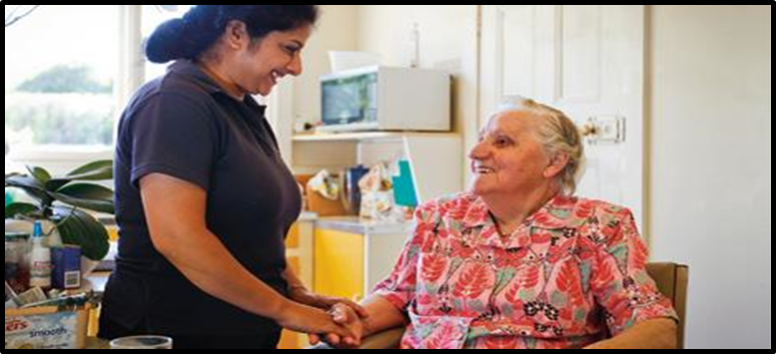
Social care
Not just cleaning and cooking
Home care, day care, care homes
Under pressure
Gets a bad press
Key loneliness service
Much unmet need among care users & carers

Slide 4
Examples of voluntary sector linking up with care homes
Enhancing volunteering in care homes
Limited but needed as can be ‘lonely in a crowd’
Sometimes limited mutual trust
Traditional volunteering + new ideas eg time banks, time credits, group volunteering, employer based volunteering
Learning from stellar examples

Slide 5
So what can the voluntary sector do?
Advocate for the care sector
Ask care sector what it would like/need?
See care sector as support base
Work out relationships & communications
Ask if it would like to work more with volunteers
Befriend the sector
Set out ambitions

Slide 6
Day centres – this section draws on a recent study by Katherine Orellana
Largest out-of-home service used by 10% of publicly funded (by councils) older people – others pay what’s charged
½ physically frail and/or disabled
⅕ dementia

Slide 7
Why people start going to day centres? Orellana’s study
Day centre attendance
Social isolation
Feeling the need for activity
Loss of mobility
Poor mental health or wellbeing
Feeling a need to get out of the house
Carer-related matters

Slide 8
A usual week – not much going on
Bob lived with his son
Went to day centre twice weekly
food shopping once a week - with son or alone.

Slide 9
Life-enriching gateway
For people unable to get out of their home without support
‘stuck’ at home and/or socially isolated
Centres focused on wellbeing and quality of life outcomes (‘higher order’ outcomes)

Slide 10
For maintenance (of head above water?)
In the face of loss (health, partner, social contacts etc)
When using community facilities is no longer possible (e.g. library, leisure centre)
Almost everyone gained something they would not have experienced if not attending the day centre

Slide 11
Social activity & companionship
You look forward to seeing friends again, you know. (Elizabeth)
We sit together and play together, like cards or any other games or … the memory class, and of course, the exercise. (Mariana)
I get conversation instead of talking to myself… And I’m mixing with human beings. (Nellie)

Slide 12
How are day centres relevant to loneliness?
Day centres provided some of the things valued by older people
The constant group environment enabled relationships to develop & offered opportunities for reciprocity
Attendance added something to (vulnerable) people’s lives
Isolation at home
Reduced family availability
Fewer support services readily available
Attendance improved quality of life

Slide 13
So what can voluntary sector do?
If running day (or similar) services
Recognise loneliness
Talk about loneliness
Signpost to services
Measure what you do and with whom – not least for ££ + data on equalities
Think about social prescribing
Tell commissioners this is what you do!

Slide 14
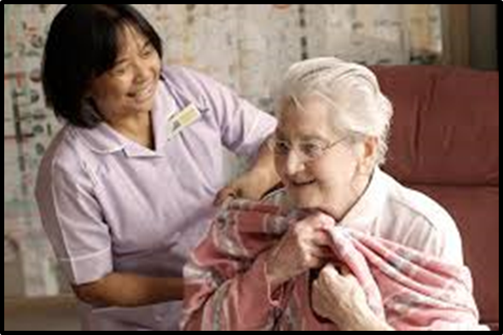
Meanwhile at home…
People with dementia dying at home – home care providing human contact, relief and company for family, being there and being known
Home care workers can feel on their own – under pressure – work alone – not much support

Slide 15
“One day, I was down washing her knees and things like that and her legs, and all of a sudden, I could feel her touch me and she went like this all down my face [strokes face], and gave me a beautiful smile. It was wonderful. It’s as if to say, I know what you are doing and thank you. It was lovely”
(Female homecare worker, 9 months in current role, aged over 60) Home care at end of life study Manthorpe et al, King’s College London, funded by Dunhill Medical Trust

Slide 16
So what can the voluntary sector do?
Befriend local care agencies
Befriend care workers
Work complementary
Communicate

Slide 17
Finally – at end of Carers’ Week NB most carers are now older people

Slide 18
But Carers can be lonely too
‘My mother’s condition means she is living more in the past than the present most days and is unable to remember what I tell her or what is planned for the day. This makes some days very lonely and also frustrating as I repeat for the tenth time what I have planned for dinner. But she is also sometimes a complete joy.’ (carer in Carer workers study – Moriarty & Manthorpe)

Slide 19
So what can the voluntary sector do?
Carers’ may need social time
- not just education or training
Ask carers how they are
Carry on… but highlight this element of work more strongly

Slide 20
Key messages
Social care needs support – it’s part of helping lonely people
Some care work is lonely
Carers can be lonely too
Volunteers are a great support – potential to show that they make the difference in preventing loneliness, reducing the risks and responding to it.

Slide 21
Please do get in touch
for more details
of the studies mentioned
Jill Manthorpe jill.manthorpe@kcl.ac.uk
Katharine Orellana katharine.e.orellana@kcl.ac.uk
Jo Moriarty jo.moriarty@kcl.ac.uk
Kritika Samsi kritika.samsi@kcl.ac.uk

Slide 22
Thank you for listening.
It’s time for questions.

