Slide 1
Eat, Drink, Live Well
Bitesize Training Series
Introduction to
Nutrition and Hydration
in the Older Population
Notes:
This is the Bitesize Training Series developed by Age Uk Salford and the Greater Manchester Nutrition and Hydration Programme:.
It is an Introduction to Nutrition and Hydration in the Older Population

Slide 2
Welcome to the Nutrition and Hydration Bitesize series!
There are 5 parts in this series that will help you to:
Recognise the risk factors and signs and symptoms of malnutrition and dehydration in older people
Identify ways to prevent malnutrition and dehydration
Give guidance to those at risk
There will be a 2-3 questions in each section to reflect on your learning.
Each session will take less than 10 minutes and at the end of each Bitesize there will be a link to the next one.
Notes:
Read the slide

Slide 3
Format of the Bitesize series
1 | Introduction to Nutrition and Hydration | Aims of the Nutrition and Hydration Programme Benefits of Good Nutrition and Hydration Causes of Malnutrition and Dehydration
2 | Introduction to Dehydration | Definition Sign and Symptoms Prevalence and consequences
3 | Drink Well: Tips to prevent dehydration | Recap signs and symptoms 3 Cs: Conversations, Check, Care.
4 | Introduction to Malnutrition | Definition Prevalence Sign and Symptoms Why focus on malnutrition
5 | Eat Well: Tips to prevent malnutrition | Recap signs and symptoms 3 Cs: Conversations, Check, Care. Resources Embedding the 3Cs Final messages Progression
*Malnutrition refers to ‘undernutrition’ in older people.
Notes:
Here is the Format of the Bitesize series. There are 5 parts to this series
Read only the titles in each box and the note about malnutrition

Slide 4
1 | Introduction to Nutrition and Hydration | Aims of the Nutrition and Hydration Programme Benefits of Good Nutrition and Hydration Causes of Malnutrition and Dehydration
Notes:
Read the slide

Slide 5
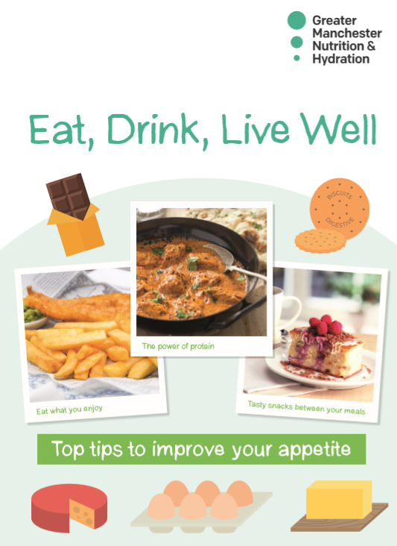
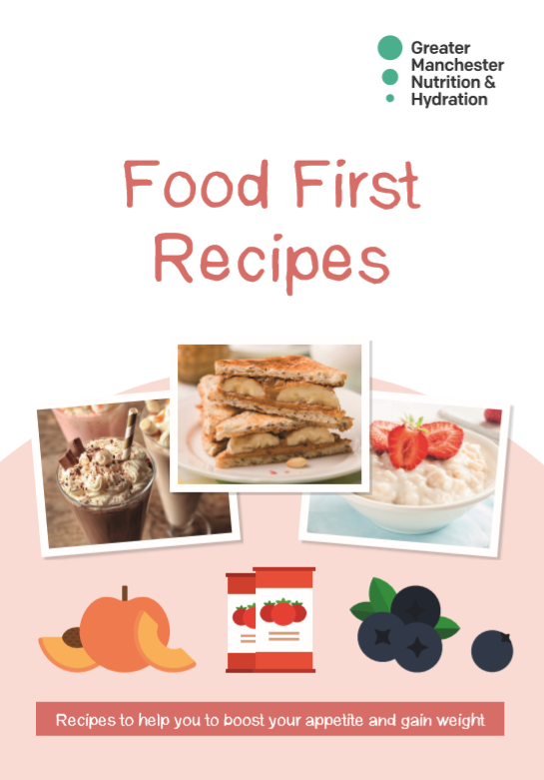
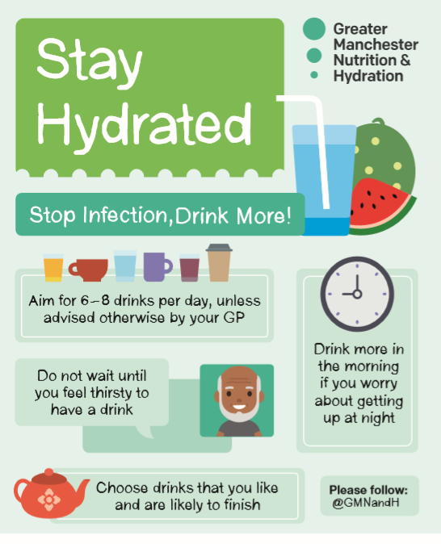
The Nutrition and Hydration Programme aims to reduce risk factors of malnutrition and dehydration through early intervention by:
Helping carers and community workers
to open up a conversation with an individual
about appetite and unplanned weight loss.
Using an innovative non-intrusive tool,
the ‘Paperweight Armband©’,
Using a ‘Food First’ approach with those identified at risk
Notes:
READ the slide

Slide 6
Benefits of Good Nutrition and Hydration
Good nutrition and hydration contribute to good health and wellbeing.
When a person is not eating and drinking well, they are at risk of malnutrition and dehydration.
Malnutrition and dehydration contribute to a range of adverse health issues, including those that compromise the immune system and impair the body’s ability to fight infection.
Notes:
Read the slide except the title

Slide 7
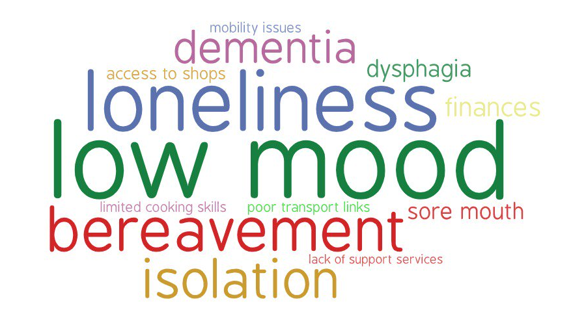
Notes:
There are a number of reasons why older people become malnourished. Some examples include loneliness and not wanting to cook for one person. Poor oral health can impact on whether a person eats properly and poor mobility may make it difficult to access or prepare food independently. There are some medical conditions that can prevent a person from eating and drinking well including Crohn's disease, Cancer and Dementia. The good news is in many case it is preventable and treatable and not a natural consequence of old age. It is important to remember that people can become malnourished if they don’t eat enough for 2-3 days.

Slide 8
Questions
How long does it take an older person to become malnourished, if they do not eat enough?
2. Why might an older person not eat and drink enough?
2-3 hours
2-3 days
2-3 weeks
2-3 months
Because they are lonely
Because they have an illness
Because they have mobility issues
All reasons are correct
Notes:
Here are your questions to reflect on your learning. Read the questions but not the options. When you are ready to move on click the mouse.

Slide 9
Well done!
You have completed Bitesize 1 –
‘Introduction to Nutrition and Hydration
To move onto Bitesize 2 –
‘Introduction to Dehydration’
follow the link here. Link here
Or press ‘Esc’ on your keyboard to finish
Notes:
Read the slide.

Slide 11
That’s right!
Go to the next question
Or if you have completed both questions, click here

Slide 12
That’s Wrong,
try again

