Slide 1
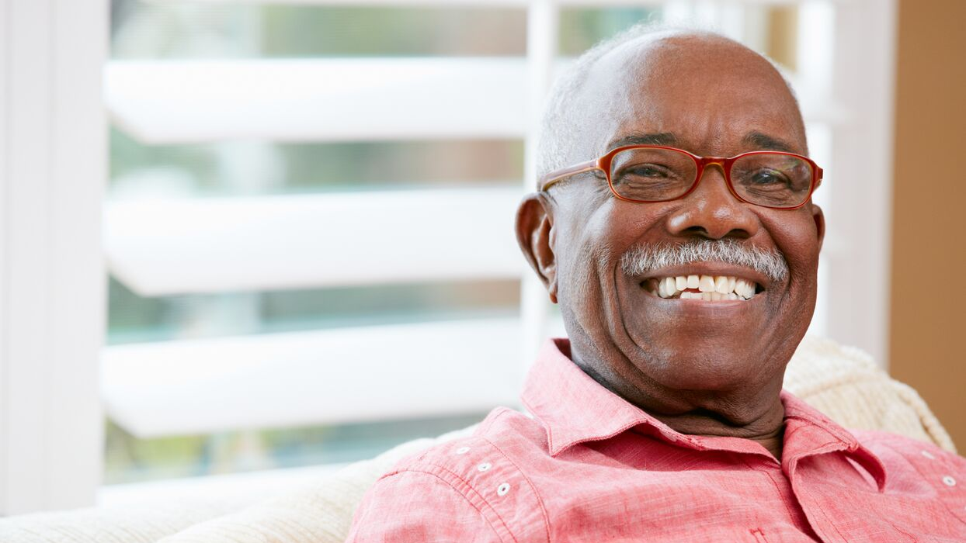
We are your local independent charity working with and for older people across Cambridgeshire and Peterborough
Our objectives are to help older people to maintain their independence, health and
well-being, by providing services that meet individual needs
0300 666 9860
infoandadvice@ageukcap.org.uk
www.ageukcap.co.uk

Slide 2
INFORMATION SERVICES
Information & Advice.
0300 6669860 infoandadvice@ageukcap.org.uk
Girton Older Residents’ Co-Ordinator
07469 660866 GORC@ageukcap.org.uk
www.ageukcap.co.uk

Slide 3
SOCIAL OPPORTUNITIES
Day Services and Friendship Clubs
0797 016 8043 dayservices@ageukcap.org.uk
Sharing Time and Telephone Befriending
01733 554963 sharingtime@ageukcap.org.uk
Volunteering
01223 221925 volunteering@ageukcap.org.uk
www.ageukcap.co.uk

Slide 4
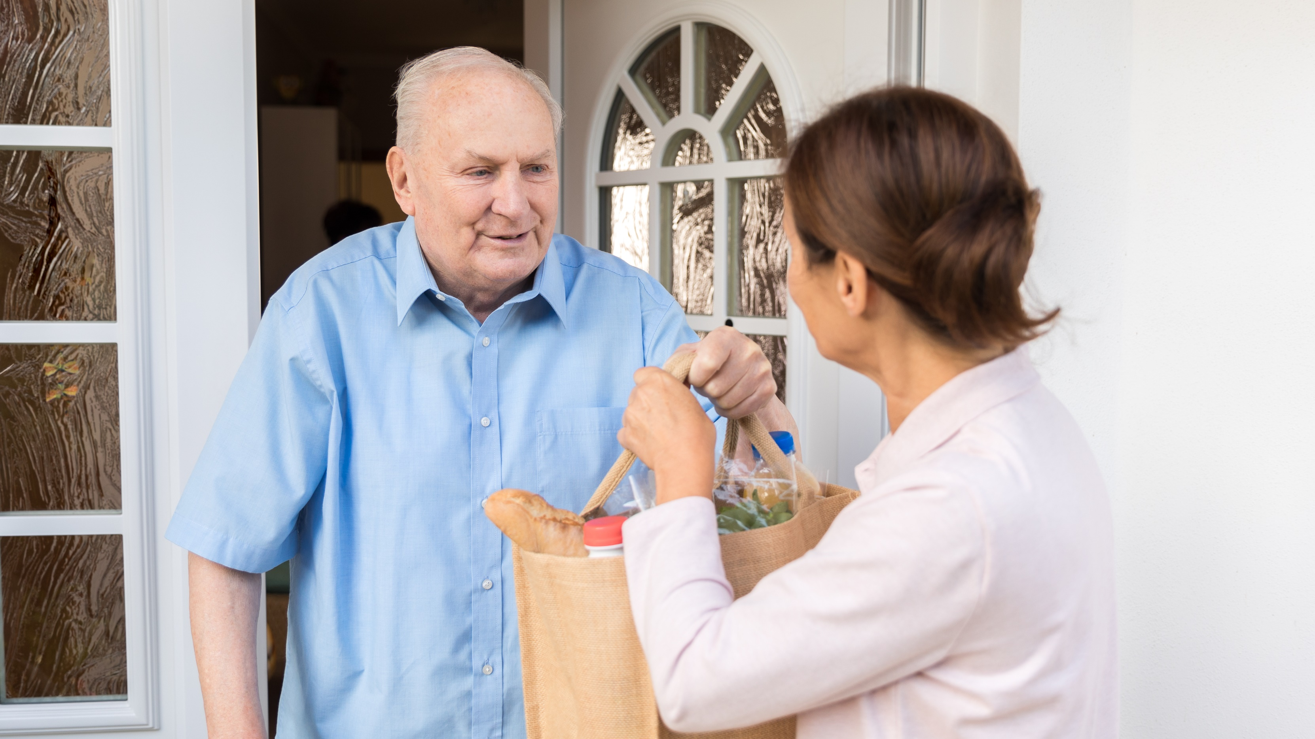
PRACTICAL SUPPORT
Handy Person and Home Checks
01480 700205 chp@ageukcap.org.uk
Community Wardens
07944 181307 wardens@ageukcap.org.uk
Home Support
01733 557353 homes@ageukcap.org.uk
Hospital Discharge and Hospital Admission Avoidance Support
01354 691896 HDsupport@ageukcap.org.uk
www.ageukcap.co.uk

Slide 5
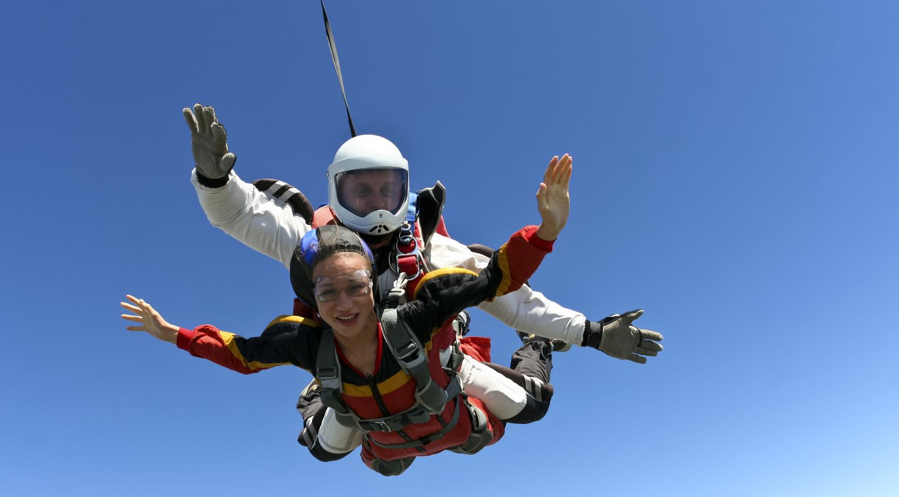
Get Involved
Why not get involved?
You can support us by:
Volunteering
Fundraising
Make a Donation
Leave a legacy
0300 666 9860
infoandadvice@ageukcap.org.uk
Make a Difference!
www.ageukcap.co.uk

