Slide 1

Feedback Summary
15.11.2024

Slide 2
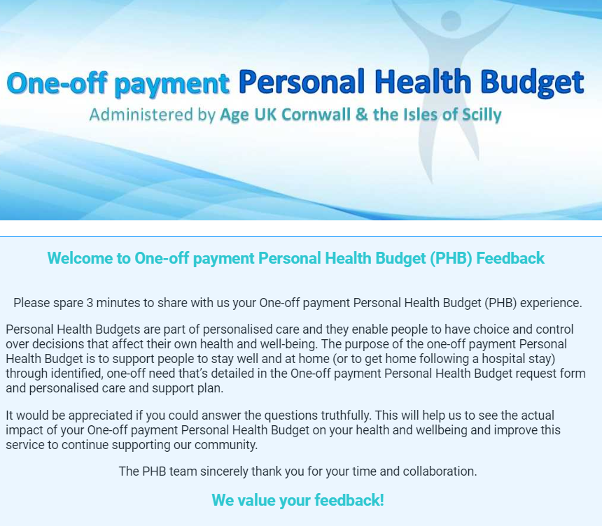
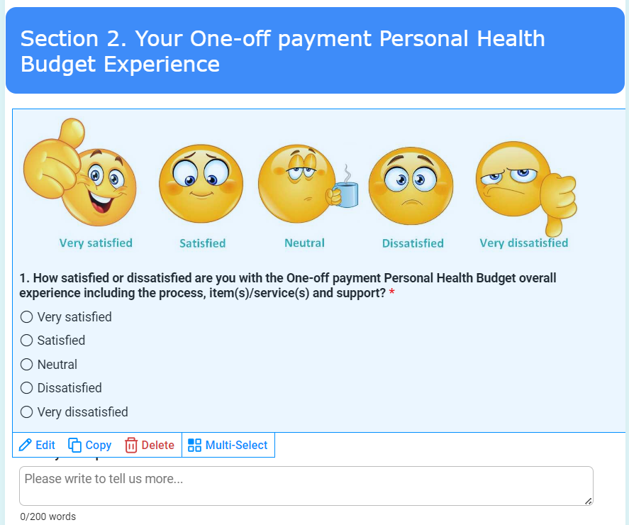
Feedback Format
Sent to applicant following their PHB support
- other than those who did not agree to provide feedback due to health or other reasons.
Distributed 309 feedback invitations
Received 64 completed forms, achieved 21% response rate as of 15.11.2024
Form includes 10 questions with optional answer and open space for comments
Feedback Form

Slide 3
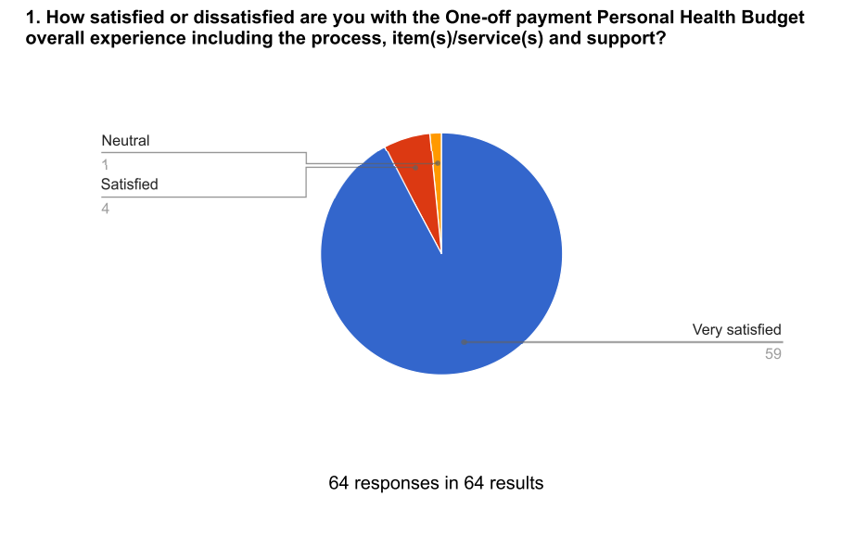
Feedback Summary
Q1
Neutral | 2%
Satisfied | 6%
Very Satisfied | 92%
Dissatisfied | 0%
Very Dissatisfied | 0%
 | 100%

Slide 4
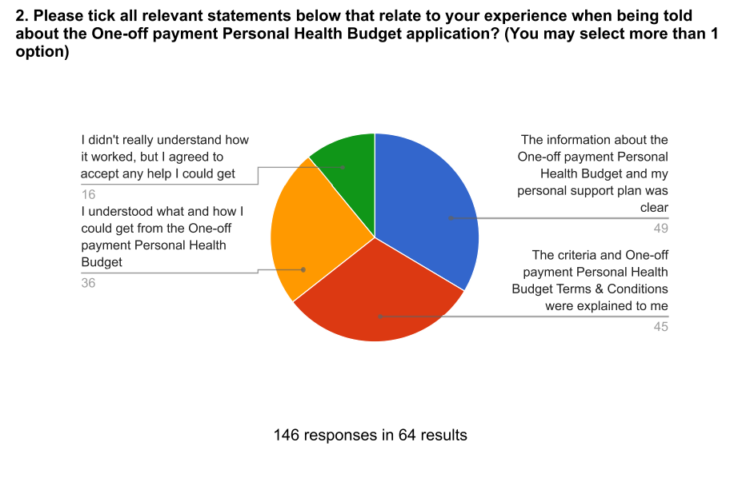
Feedback Summary
Q2 multi-options allowed
PHB Information is clear | 33%
PHB terms and conditions were explalined | 31%
Understand PHB support | 25%
Didn't really understand how it worked | 11%
Didn't explan anything to me | 0%
None of the above | 0%
 | 100%

Slide 5
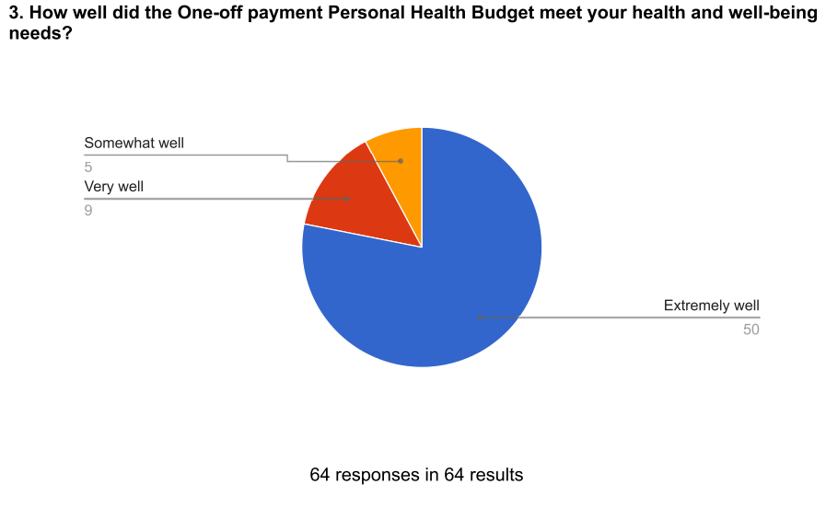
Feedback Summary
Q3
Extremely well | 78%
Very well | 14%
Somewhat well | 8%
Not so well | 0%
Not at all well | 0%
 | 100%

Slide 6
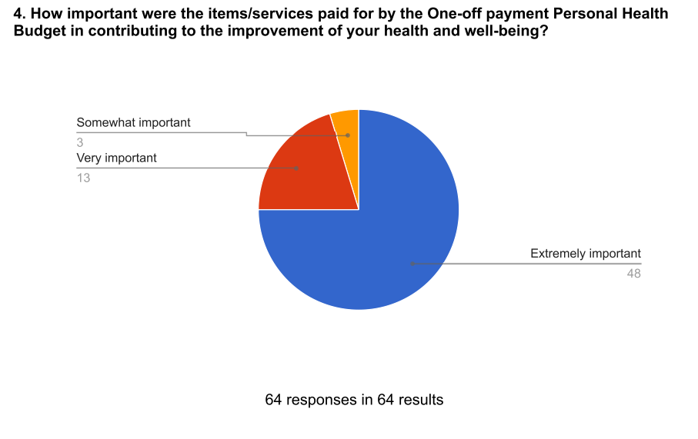
Feedback Summary
Q4
Extremely important | 75%
Very important | 20%
Somewhat important | 5%
Not so important | 0%
Not at all important | 0%
 | 100%

Slide 7
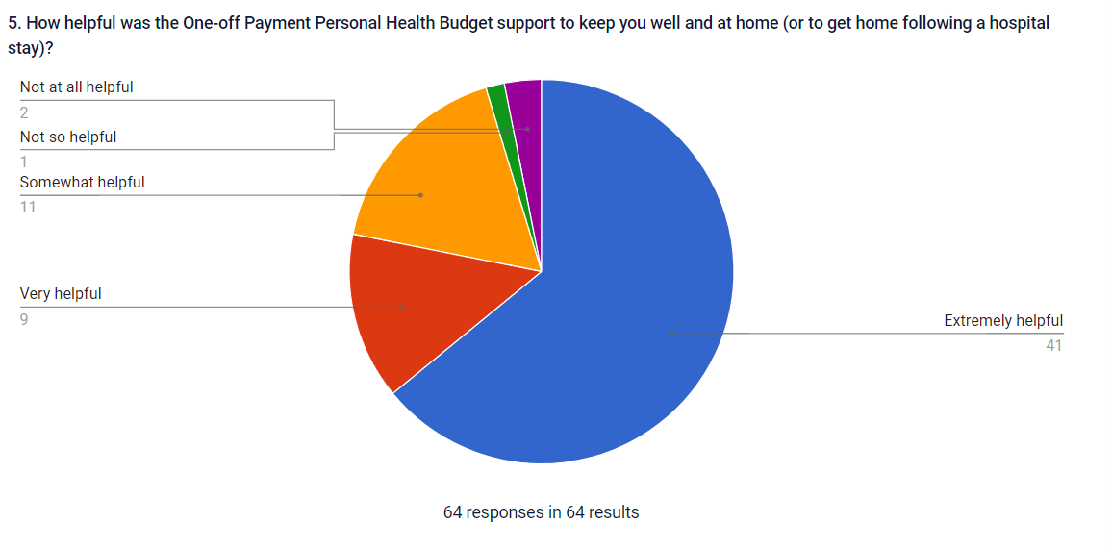
Feedback Summary
Q5
Extremely helpful | 64%
Very helpful | 14%
Somewhat helpful | 17%
Not so helpful | 2%
Not at all helpful | 3%
 | 100%

Slide 8
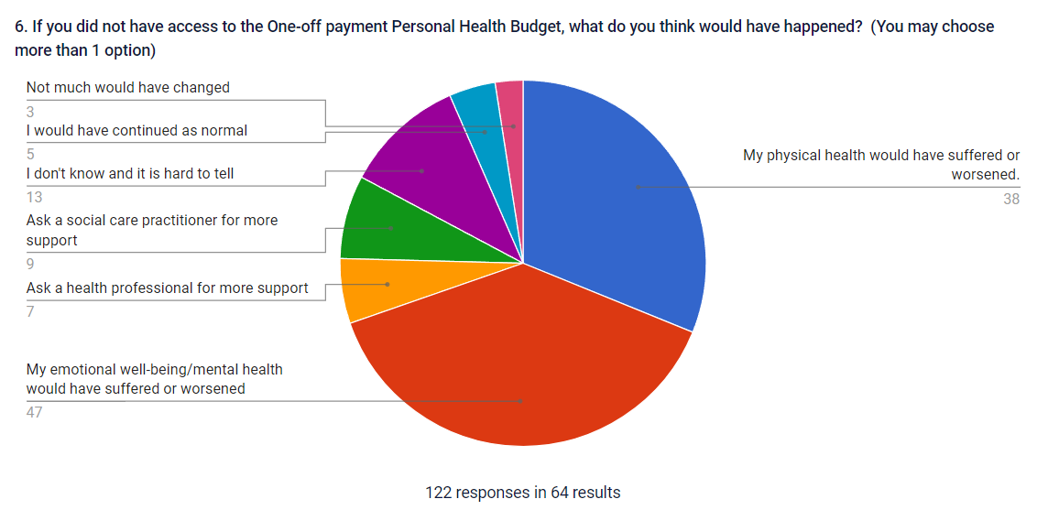
Feedback Summary
Q6 multi-options allowed
Physical health suffered or worsened | 31%
Emotion/mental health suffered or worsened | 39%
Ask support from health professional | 6%
Ask support from social care practitioner | 7%
Don't know | 11%
Continued as normal | 4%
Not much changed | 2%
 | 100%

Slide 9
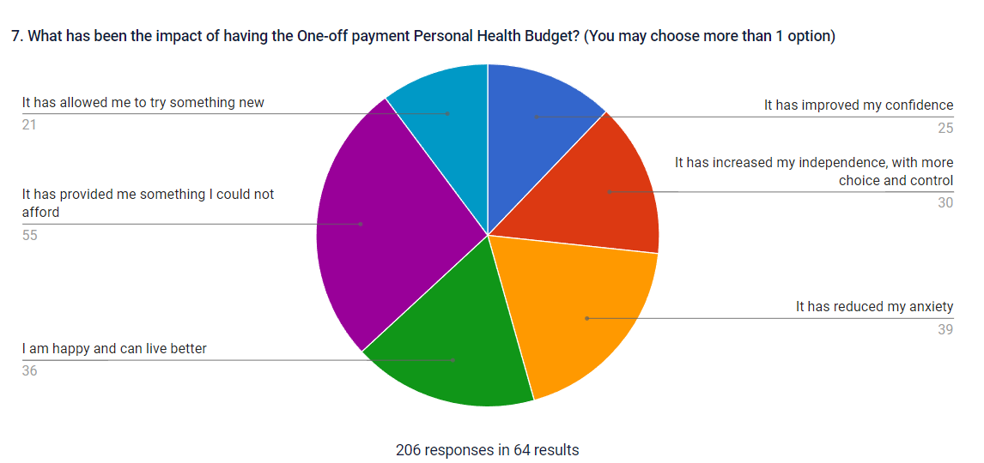
Feedback Summary
Q7 multi-options allowed
Improved my confidence | 12%
Increased my independence and more control | 15%
Reduced my anxiety | 19%
Am happy and live better | 17%
Provide something I could not afford | 27%
Allow me to try something new | 10%
No difference | 0%
 | 100%

Slide 10
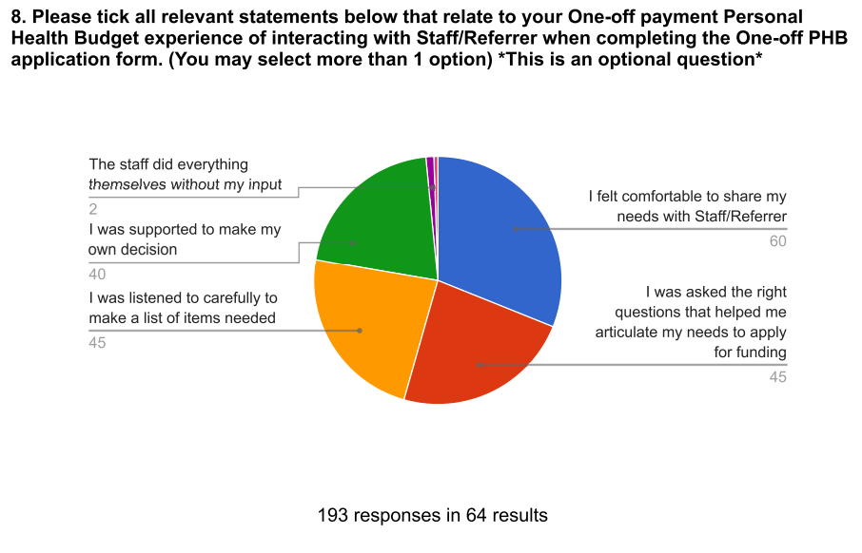
Feedback Summary
Q8 multi-options allowed (optional question)
Feel comfortable to share with staff/referrer | 31%
Was asked the right questions to my needs | 23%
Was listened carefully for the request | 23%
Was supported to my decision | 21%
Staff did everything without my input | 1%
Did not explain anything to me | 0%
Nothing to add | 1%
 | 100%

Slide 11
Feedback Summary
You're absolutely amazing!
very happy. still can't believe that I have an e-bike. I would never have known about PHB's unless I saw my social prescriber. Im very grateful, thank you very much.
I am so pleased this grant is available to people like me. I did not know about it prior to meeting the advisor and didn’t actually believe anything would come of it until it was approved. Financially, it may not seem like a lot of money to some people but to me it was out of my financial reach. For what some people may consider a relatively small amount of money, it has actually made a massive positive impact on my, and my family’s, daily life. I’m sure the nhs could save billions every year if they took this approach to healthcare. I cannot thank the advisor, nor the funders who make the final decision, highly enough. Thank you so much
I could not be more happy with the service I received and the improvements the purchases have made to my life. I could never have afforded all the items. The person who was helping me was so kind, patient and an absolute credit to the service.
Just want to say a huge thank you to everyone involved, it’s been a huge turning point for me having access to this funding.
It’s really helped me get out of the rut I found myself in & Pentreath has been so supportive.
Huge thank you for helping me to walk and sit as and when, life changing help!
Thank you PHB. This is a fantastic service, and I am so grateful. I received a sofa bed which has helped tremendously with my back. I had no washing machine due to mine breaking which you then provided me with. There was no way I could afford them. A huge thank you, you've made a positive difference in my life. 🙂
I feel that this has been an amazing opportunity which has improved my self believe and given me the confidence to achieve small wins now and going forward.
I would like to thank you for having this money to enable me to get the treatment that I could not otherwise afford at the present time. Having had a second head injury, things are a bit worse for me at the moment and the therapy is going to help.
Can't fault it, from the excellent way I was looked after to provide something that makes a huge difference. Thank you.
It has been a life saver, and avoided true crisis point (meaning suicide).
Going forward, 8 sessions is a start, but I am likely to need further support and intervention unless my tribunal to get PIP reinstated is successful at a rate that would enable me to continue with this therapy
I am hugely grateful to Age UK to have received the Personal Health Budget. This is having a positive impact.
In terms of the overall NHS support system after an operation it is a shame that there was so much less support available this time than after my operation in 2023 than I had in 2011. This is therefore a concern for others who may need your support but don't find it.
Thank you so much for this chair. I could not have afforded it my self. I just used to lay awake at night worrying my old chair would either tip me over or stop working. It gave me headaches and made my arms ache. I am so grateful and happy for the PHB and the Community Health worker for applying for this for me. It has changed my life. It has been like winning the lottery! I have my life back, my social life and confidence to stay independent!
Thank you PHB for all your help and support, it's made my life better by 90%.

Slide 12
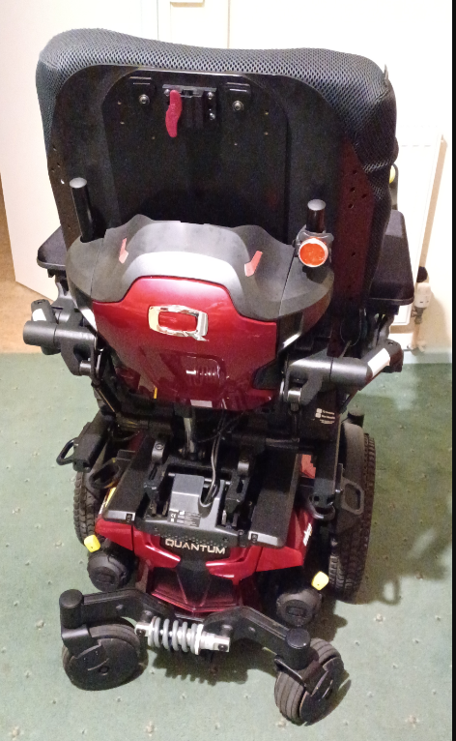
Feedback Summary
One response received.
From an applicant who received a wheelchair according to her health conditions and poor mobility:
Receiving the payment has made a massive difference to me. It's fantastic because the new wheelchair doesn't tip or loose balance and it's very comfortable. It doesn't cause me more pain and discomfort like the wheelchair from the Health service did for so long.
I want to thank everyone involved with getting the necessary funding and promotility for doing all the complicated paperwork to order my new powered wheelchair and fitting it. Without the grant I would have been stuck between a rock and a hard place.

Slide 13

We will continue our work to better support our community

