Slide 1
Trustee Information Pack

Slide 2
Welcome
We are delighted that you are interested in becoming a charity trustee of Age UK Enfield and hope that this document, on the basis that you will want to proceed, provides the necessary information for your application.
There are three sections to the document:
1) About US - the role Age UK Enfield plays in reaching out to over 7,000 older people in the Borough every year through a broad range of services (care, advice, exercise and practical support), delivered with professionalism and commitment to meet our clients’ needs.
2) How We Deliver – the current strategy for the charity and how we plan to meet our objectives.
3) About Being A Charity Trustee – some background information on what it means to be a trustee and expectations of the role.
Further information can also be found on our website - www.ageukenfield.org.uk
Elaine Adkin
Chair, Board of Trustees

Slide 3
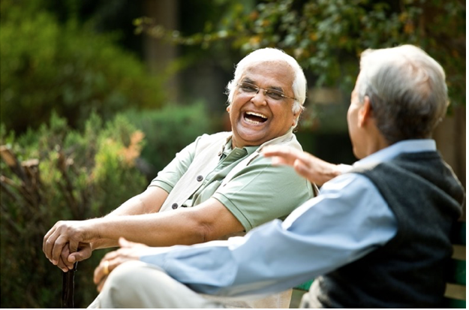
Section 1
About Us

Slide 4
‏‏‎Our Vision‏‏‎‎
‏‏‎ An age friendly Enfield‏‏‎ ‎where
‏‏‎‎ everyone can love later life‏‏‎ ‎‎
‎Our Mission‎
To improve the lives of‏‏‎ ‎‎older people in Enfield by
ensuring‏‎ ‎they are valued, active, connected, ‏‏‎
‎ and able to live the life they choose ‏‏‎

Slide 5
Our Values
People-Centred
We put people’s needs and preferences at the heart of all we do.​
Kind
We are welcoming, respectful, and empathetic.​
Inclusive
We celebrate and value the diverse communities of Enfield and the contributions they bring.​
Creative
We work together to find new solutions to challenges facing older people.
Professional
We are dedicated to delivering the highest quality services and activities​.
Collaborative
We believe teamwork and partnerships are central to achieving our vision.

Slide 6
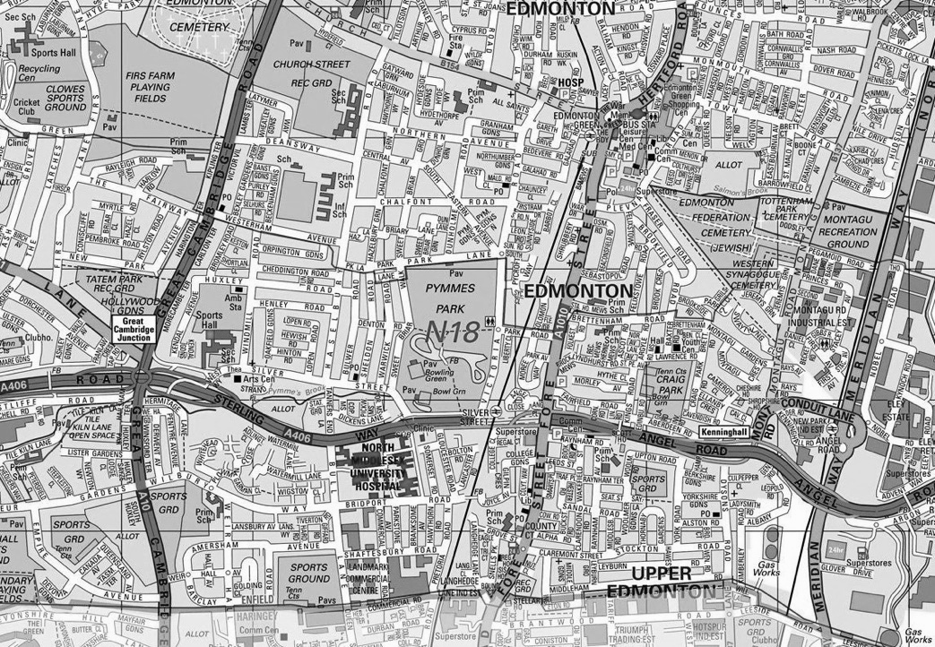
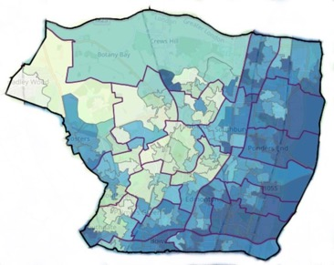
About Enfield
Total Population
of Enfield:
333,600
23%
forecast growth in 65+ age group to 2025
Cockfosters, Highlands and Grange wards have highest proportions of older residents:
19% over 65s
10%
households occupied by a single person aged 65+
2nd
highest 65+ cardiovascular disease death rate in London
Deprivation affecting older people
(darker areas are more deprived)
The east of the borough has several areas which are in the 10% most deprived areas of England
2nd
highest dementia diagnosis rate in London
Sources:
NOMIS
Enfield JSNA
Enfield Council 2020 Borough Profile
Productive Healthy Ageing Profile (PHE)

Slide 7
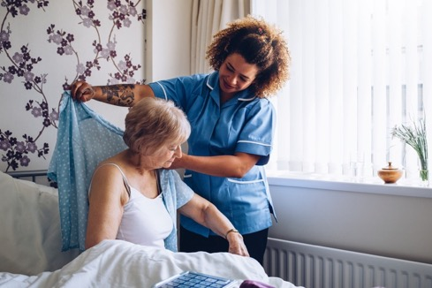
Our Services and Activities
The services and activities delivered by Age UK Enfield and in partnership with other organisations, is ultimately dependent on grants and funding to cover costs; the following is summary of current programmes.
Parker Centre Dementia Day Care
The Parker Centre is a specialist dementia care day centre in Edmonton, providing high quality day care, activities and events for people with early memory problems, to advanced dementia, as well as respite for their carers.
Home Care and Support
Age UK Enfield’s award-winning Home Care and Support Service provides bespoke in-home care and support from trained, professional and friendly staff, enabling people to build confidence, and continue to live safely and independently in their own homes.
Home from Hospital
The Home from Hospital supports local residents leaving hospital and require some extra help and support for up to three weeks. The service can help with shopping, domestic tasks, basic food preparation and medication collection.
“'Very important, it gives me a break, makes a big difference in our lifestyles… she’s got friends there and the staff are absolutely A1.”
Mrs L, Parker Centre Client’s family member

Slide 8
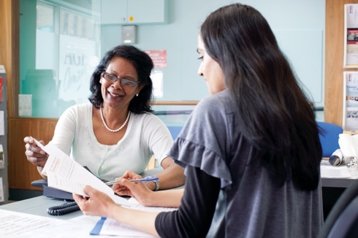
Our Services and Activities
Information, Advice and Advocacy (IAA)
Provides support to residents on a wide range of issues including welfare benefit checks, applying for accessible transport, housing and pensions, and much more.
Planning for Later Life
Provides information sessions and one-to-one advice on a wide variety of later life issues, including funerals, wills, advanced decisions, how to care for your pets, bereavement services, and much more.
Digital Inclusion
Providing awareness sessions of benefits of using digital technology, one to one support and digital drop ins. Our worker is available 1 day a week for booked appointments.
“I’m very satisfied with the service given from Age UK Enfield advisors. I feel relieved each time when leaving the office.”
Mrs B, Information and Advice Client

Slide 9
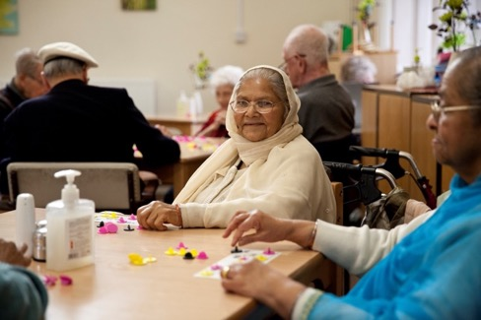
Our Services and Activities
iCan
iCan is a community navigation service, supporting adults who may be facing social or economic challenges, have a long-term health conditions or are socially isolated . A consortia led by Age UK Enfield, with Alpha Care, Attend and Enfield Carers Centre. Ican Navigators offer monthly activities across the borough. Tea & Chatter, Stroke Café, Diabetes group and more.
Enfield Wellbeing Network (EWN)
EWN is a collaboration between Mind in Enfield, Enfield Carers Centre and Age UK Enfield. Health & Wellbeing workers work with residents to set and achieve realistic goals to improve their health and wellbeing. Volunteers can support people to help them to access community activities and events.
“I wish I'd spoken to someone sooner. The iCan navigator really took time to listen to my concerns and provided me with so much information, things I didn't know before. I'm really grateful for the help.”
Mrs P, ICAN Client

Slide 10
Our Services and Activities
Fall Stop Service
Provides a range of information, advice, exercises and activities on falls prevention to help people who have had a fall or are at risk of falling . We deliver exercise sessions across the borough. Navigators assist with benefit checks, and applications for travel concessions.
“When I first came along to Fall Stop I couldn't walk to the end of my road, I was breathless and unsteady. I can now attend longer walks and talks, I've lost weight and my GP is happy.”
Mr R, Fall Stop Service User

Slide 11
Our Services and Activities
Memory Care Navigation
Supports people newly diagnosed with dementia, or who are seeking diagnosis, offering information and advice on living with dementia, connect to others and how to navigate the many support services available.
Memory Meet Ups
Regular social and activity groups, supporting people with dementia, and their carers in various venues across the borough.

Slide 12
Our Services and Activities
Social Singing
Monthly singing session for all – dementia friendly activity.
Art Journalling sessions
Art Journalling Session monthly at Southgate Library.
Movement as Medicine
A 6 -week programme FREE beginners' course for all. Delivered quarterly at MSK Hub, Forest Road.

Slide 13
Our Services and Activities
Men’s Sheds
Our 1st shed is based in John Jackson Library and is open Tuesdays and Thursdays. We offer group creative activities, encourage people to make new friendships, and learn new creative skills.
Veterans’ Support Service
Supports anyone who has served in the Armed Forces or National Service and their families, through social events, making connections with others, as well as information and advice and much more.
Cycling Project
Suitable for all, every week in Bush Hill Park teaching people to learn to ride accessible bikes. Runs summer time only - restarts June 2024.

Slide 14
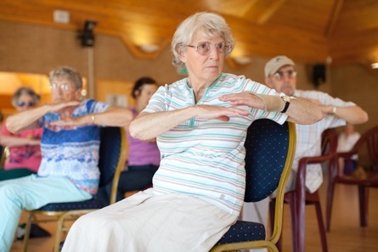
Our Services and Activities
Fit for Life
Our Fit for Life project has been running for nearly 20 years in the borough. It provides a wide variety of exercise classes, activities and walks at a range of community venues across the borough.
Our classes are suitable for all, from gentle exercise to Zumba, and challenging country park walks.
Classes are fun, friendly and welcoming, and some provide the opportunity for refreshments and socialising after the class.
“Thank you to all at Age UK Enfield for encouraging us to keep fit. Walks are so important for us all - not only the physical benefits but on the social side for our mental health.”
Mrs A, Fit for Life Walk Participant

Slide 15
The Nest Community Hub
Breakfast Club is a weekly session with a nutritious free home cooked breakfast for all residents over 50. Members enjoy games, talks and information from visiting professionals.
We’re funded until July 2024.

Slide 16
Section 2
Our Strategic Approach

Slide 17
Introduction
This plan sets out Age UK Enfield’s priorities for 2022-2025.
Our previous strategic plan, which ran from 2018, served us well. We are proud of our achievements: the support we gave to older people throughout the lockdowns, the local partnerships we have developed and strengthened, the new services and activities we have launched, and the improvement to our overall financial position. In 2021, we were delighted to receive two Great British Care Awards recognising the dedication, skill and care of our staff and volunteers.
The world is a very different place today than it was in 2018. The global pandemic, cost of living crisis, changes to health and social care, and increased demand for our services locally have led us to take a fresh look at the services and activities we provide in Enfield.
Throughout 2021, we consulted widely with clients, staff, and volunteers. We listened carefully to what they said was important to them, where they felt we should build, and where they believed we could improve. We did this both formally, through surveys and independently-run workshops, and informally, through our regular groups and activities.
We pulled together all we heard into six priorities, which are set out in this plan. Within each of these priority areas, we identified several key objectives which we aspire to achieve over the coming three years.
At Age UK Enfield, we are working towards an age-friendly Enfield where everyone can love later life. And we look forward to working with you to make it happen.

Slide 18
Strategic Priorities 2022-2025
1. Developing our Services
2. Participation and Influence
3. Partnerships and Collaboration
4. Measuring our Impact
5. Developing our People
6. Income Generation and Sustainability

Slide 19
We will be recognised as a centre of excellence for dementia services
We will build on our success in delivering services that combat loneliness and isolation
We will increase our capacity to provide information and advice
We will ensure our services are delivered to the highest possible quality
We will ensure our services and activities are delivered from settings and locations that meet the needs of the community and our people
We will make it even easier for people to access clear and up-to-date information on how to access our services
Priority 1:
Developing Our Services
Expanding our service offer to ensure we are there to support, advise, connect and inspire older people across the borough

Slide 20
We will expand the opportunities for older people to influence the planning and delivery of our services
We will further our reach into the diverse communities of Enfield, ensuring we are accessible and inclusive in all we do
We will develop a strong volunteer base from across the community
We will speak up on issues that concern older people
Priority 2:
Participation & Influence
Amplifying the voices of older people in the running of our charity and their influence
in our communities and throughout Enfield

Slide 21
Priority 3:
Partnerships & Collaboration
Further developing our partnerships with statutory services, funders, other VCS organisations, and community groups
We will build on our collaborations with local voluntary sector organisations and develop new relationships with organisations who add value to the local community
We will continue to influence older people’s services locally through our relationships with the local authority and health services
We will explore opportunities to develop our work with neighbouring Age UKs

Slide 22
Priority 4:
Measuring our Impact
Measuring the difference we make to the lives of people who come into contact with us, and using that evidence to improve the services we offer to older people
We will take a consistent approach to monitoring and evaluating our impact
We will listen to older people, using data and their feedback to help us understand what older people in Enfield want
We will learn and improve based on the evidence we gather, and be transparent with our findings

Slide 23
We will ensure our mission, vision and values are embedded in all that we do
We will invest in our people to ensure we are rewarding people fairly for the work they do
We will take positive steps to ensure our organisation is diverse, equitable and inclusive
We will ensure our internal communications are clear and consistent
We will enhance the knowledge and skills of our trustees, staff and volunteers
Priority 5:
Developing our People
Focusing on promoting diversity, providing training and development, and recognising and rewarding all our staff and volunteers

Slide 24
We will ensure all our services and activities are financially viable and achieve full cost recovery
We will develop new sustainable and diverse income sources
We will ensure our governance is effective and efficient
We will enhance our operational capability by investing in people, processes and systems
We will aim to be environmentally responsible in our operations
Priority 6:
Income Generation & Sustainability
Ensuring a secure future for the charity, so we can continue to support older people in Enfield

Slide 25
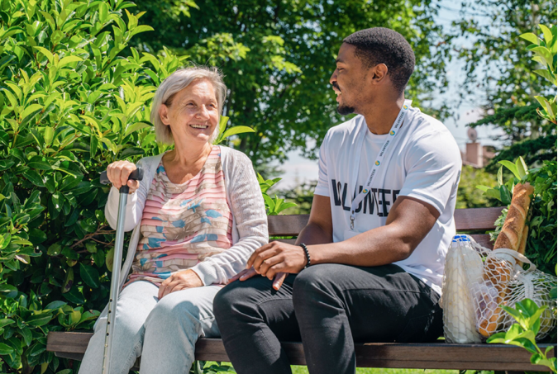
Section 3
About Being A Charity Trustee

Slide 26
A Trustee’s Role
Trustees are responsible for the governance, direction and management of the charity (No: 1063693) as well as acting as ambassadors for the organisation. Age UK Enfield is a limited company (03352062) of which Trustees are Directors.
The Trustees ensure there is a clear focus for the charity and that well developed business plans are in place to help ensure that objectives set within the regularly updated five-year strategy are aligned and achievable. The Board of Trustees aim to protect the financial and other assets of the charity, that legal, governance and safeguarding requirements are met and that the organisation is carrying out its purpose for the public benefit.
The day to day running of Age UK Enfield is delegated to the Chief Executive Officer and, through them, to the Senior Leadership Team.
Trustees are appointed for a three year term that may be renewed for a further two terms. They are recruited on the basis of their skills and experience to ensure that there is an appropriate role of expertise and diversity on the Board.
A useful guide called “The Essential Trustee” is available on the Charity Commission website.

Slide 27
Time Commitment
The Board meets four to six times a year – currently early evening and usually on-line although there will be the occasional face-to-face to meeting.
Additionally, the Board meets for a day or two half days a year as an “awayday” to discuss and prepare plans for the Charity’s future but could also include governance, the management and delivery review of services.
Trustees are expected to sit on at least one of the Committees of the Board: currently including Finance and Operations and People and Culture. These Committees generally meet every two to three months.
Board papers are sent out one week before the Board meeting along with Sub-Committee papers. Trustees are expected to review these beforehand and engage in discussions around their content at the meeting and make decisions.
Whenever possible, Trustees are encouraged to assist with specific activities where their relevant expertise would be helpful and to generally support fundraising and other key events.

Slide 28
Becoming A Trustee
If you are interested in becoming a trustee, the first step would be to email the Chief Executive: peter.glass@ageukenfield.org.uk to arrange an informal chat.
There will be an informal interview with the Chair – after which you will be invited to apply using the application form which can be emailed to you or downloaded from our website.
An interview with up to three trustees online or in-person will then take place and you will have the option to sit in at the next Board meeting as a guest to enable a greater understanding of the remit and work of the Board members.
Should you wish to continue the process, references will be taken up along with an Enhanced DBS.
Your formal appointment will take place at the next Board meeting following which a full induction programme for new trustees will be given. This will include a visit to the charity’s dementia care centre and programmes run by us which may be for example activity, exercise or talks.

Slide 29
A Final Note!
Thank you again for your interest in Age UK Enfield and we very much hope that you will want to continue your journey to become a Trustee.
If however you don’t think it is the role for you at this time but you would like to get involved, there are lots of things you can do.
Whether you want to give your time by donating, remembering us in your will, volunteering, or helping with our campaigns, your help would be much appreciated.
For more information, visit: www.ageuk.org.uk/enfield/get-involved/

Slide 30
Age UK Enfield
John Jackson Library
35 Agricola Place
Bush Hill Park
Enfield
EN1 1DW
www.ageukenfield.org.uk
020 8375 4120
e: peter.glass@ageukenfield.org.uk
Registered charity number 1063696
Company number 3352062.

