Slide 1

Connect to Work
Sheila Hart
Specialist Employment Manager
Philip Henderson
Project Manager

Slide 3

Warm Up
What was your first job?
What was your hourly pay rate in that role?
How did you find or secure that job?
Was it your dream job?

Slide 4
Let’s talk about employment for people aged 50+
Today, our conversation will explore…
Statistics about employment
The changing workplace
Representation
Barriers to employment
The benefits
Connect to Work

Slide 5

Overall Employment Rate
Around 71–72% of people aged 50+ are in employment
This is lower than 35–49 (~85%)
The gap is 13% points
There is a clear “employment age gap” despite many over 50s wanting to work.

Slide 6

Economic Inactivity
Around 25–30% of people aged 50–64 are inactive
Women aged 50–64 have higher inactivity (~30% vs ~22% for men)
Since the pandemic, inactivity has increased
A significant proportion of over 50s are not working and not actively job seeking

Slide 7

Employment Declines with Age
Employment rates drop sharply with age:
  Around 87% (men) / 79% (women) at age 50
  Around 68% / 59% by age 60
  Around 20% / 15% by late 60s
There is a steep drop-off as people approach retirement age, highlighting the importance of retention and re-engagement.

Slide 8

Representation
Over 50s make up a significant and growing part of the workforce
In some sectors, they represent around 30%+ of workers
The workforce is ageing. Supporting workers aged 50+ is now an economic priority, not just a social issue.

Slide 9

Over 65s Still Working
Around 1.4 million people aged 65+ are in employment
Many work part-time or flexibly
Work does not stop at retirement age. Flexible, part-time roles are key.

Slide 10

Impact of COVID
Employment rates fell after the pandemic and have not fully recovered
Nearly 1 million more older people are economically inactive than before COVID
There is still a “missing workforce” of over 50s post-pandemic

Slide 11

Self-Employment and Flexible Work
Nearly 1 million people aged 60+ are self-employed
Around half of all self-employed workers are aged 50+
Older workers often move into flexible or self-employed roles rather than traditional employment

Slide 12
Summary
~72% employment rate (50–64)
~25–30% economically inactive
13% employment gap vs younger workers
1.4 million aged 65+ still working
Significant post-COVID drop in participation

Slide 13
How has the workplace changed in the last 30-35 years?
Technology → from paper to digital to smartphones.
More flexible work → fewer fixed hours, more remote and gig roles.
Different skills needed → communication and problem‑solving valued more than physical skills.
More diversity & equality → especially in gender and education access.
Greater focus on wellbeing → mental health, balance, supportive workplaces.
Shift in job sectors → growth in services; decline in manufacturing.

Slide 14
How are people aged 50+ are represented in the workplace?
What % of Islington Council aged 50+?
50–64 age band is the biggest group
39.11% of the total workforce

Slide 15
What barriers do people aged 50+ face with employment?
Barrier | Description
Ageism | Hiring bias, negative stereotypes.
Health conditions | Primary reason for leaving work early.
Disability employment gap | Employment rates drop sharply with age.
Lack of flexible work | Limits ability to stay in work; major unmet need
Caring responsibilities | Many juggle care roles without employer support.
Few retraining options | Funding and programmes skew toward younger workers.
Recruitment barriers | Biased adverts, processes, and low success in employment programmes.
Financial pressures | Cost of living pushes some back to work, but re‑entry is difficult.

Slide 16
Why employers should hire people aged 50+
Experience
Reliability
Strong work ethic
Problem‑solving ability
Leadership skills
Loyalty and low turnover
Good communication
Mentoring capability
Broad professional networks
Positive impact on workplace culture

Slide 17
What is Connect to Work (CTW) ?
Islington Council is one of 12 Central London boroughs delivering the programme.
Central London Forward (CLF) acts as the accountable body for the partnership.
Islington Council is strengthening its existing employment support team to deliver Connect to Work locally

Slide 18
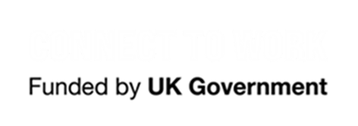
How the C2W Supports Residents
CTW uses the proven Supported Employment model: “place, train and maintain.”
Out of Work Clients: Up to 12 months of support to find a job
In Work Retention Clients: 4 months of support
In Work Support to support work retention
Our Employment Specialists work in the community and integrate with a range of support services.
The service is fully funded by the government and is voluntary.

Slide 19
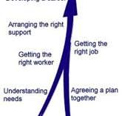
Key Features of Support
Dedicated One‑to‑One Coaching
Vocational Profiling & Personalised Action
Planning
Employer Engagement
Job Matching
Specialist Interventions
Workplace Adjustments
Sustained In‑Work Support

Slide 20




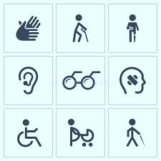

Eligibility Criteria for Connect to Work programme
Is not on a DWP funded programme i.e., Reestart
Economically inactive or at risk of losing their job
Or belong to one of the target group listed on the next page, and experiencing significant barriers to employment
18 and over
Health condition
Or, Disability

Slide 21


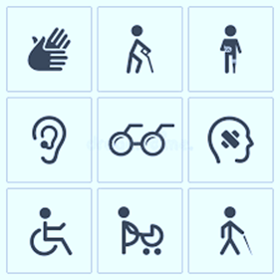




Who can Connect to Work help?
Health condition
Disability
Carers
Refugees
People seeking asylum with the Right to work
Young people known to the Youth Justice system
Additional groups that may be supported through specialist delivery packages include;
homeless, ex offenders and ex armed forces

Slide 22
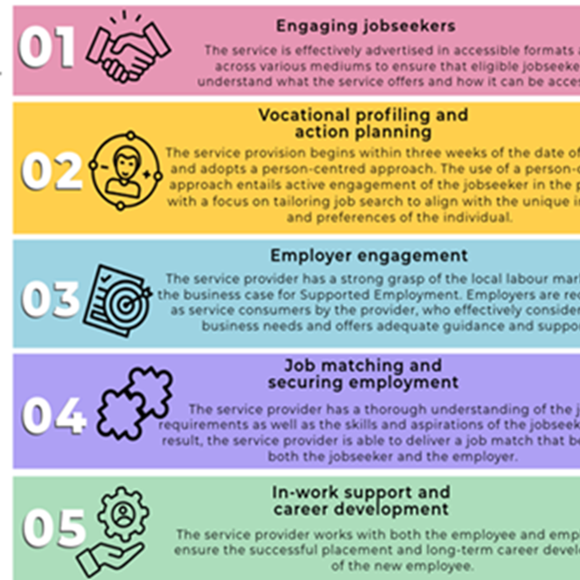
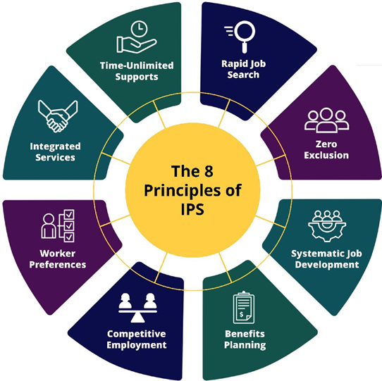
Individual Placement Support (IPS)
Supported employment Quality framework (SEQF)

Slide 23
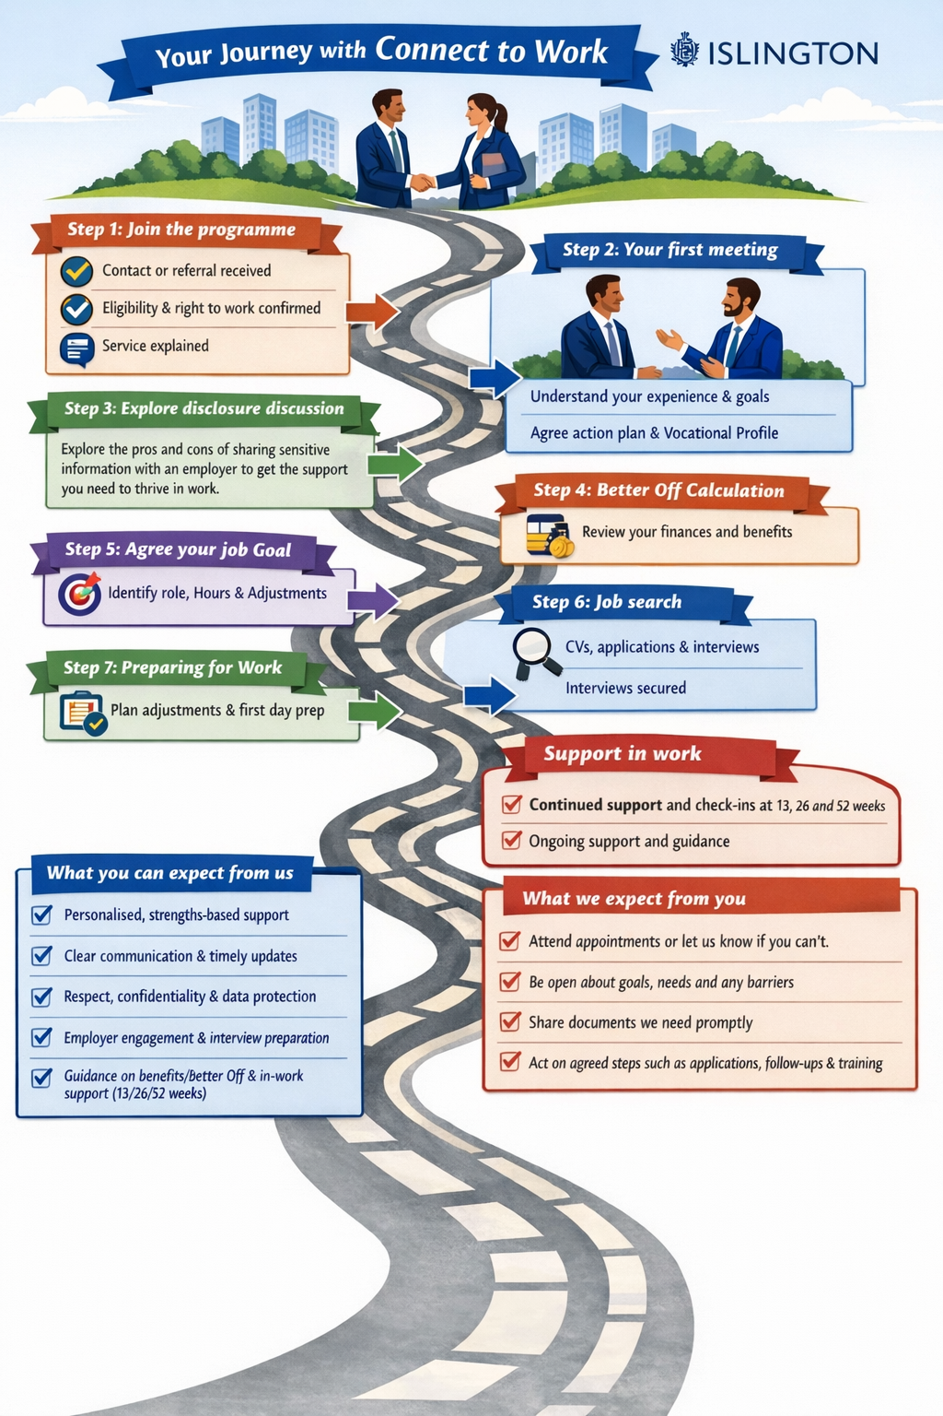
Client Journey
Connect to work is driven by client choice and preference.

Slide 24
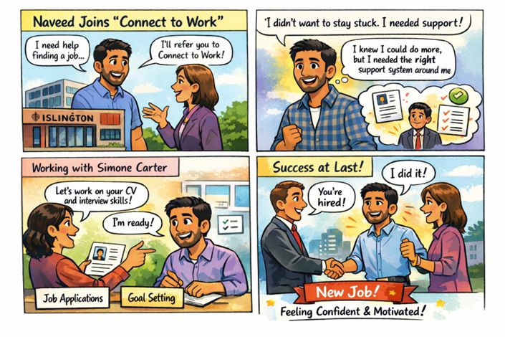
Good News Story

Slide 25
Top Tips
✔️ Personalised coaching (Jobcentre Plus, community organisations) ✔️ Confidence‑building support (Wise Age, Centre for Ageing Better) ✔️ Free skills training (Bootcamps, apprenticeships, SWAPs) ✔️ Financial support for job‑seeking costs (Flexible Support Fund) ✔️ Flexible work options ✔️Trusted employment websites targeted to 50+ workers (e.g. Restless) ✔️Access to work (Support with disability and adjustments)
Remove age clues: No date of birth, no old education dates.
Modern CV: Focus on recent skills and achievements.
Show adaptability: Highlight recent training or digital skills.
Network: Use LinkedIn and past contacts.
Be positive: Emphasise experience, reliability, and value.

Slide 26



Referral Pathway
A referral can be made from Central London Forward website to any of the twelve-borough including Islington Council:
Connect to Work - Support Request - Central London Forward
A referral can be submitted through the Islington Council website
Islington Council CTW Referral Form
Connect to Work team in Islington
connecttowork@islington.gov.uk
Philip.Henderson@Islington.gov.uk

