Slide 1
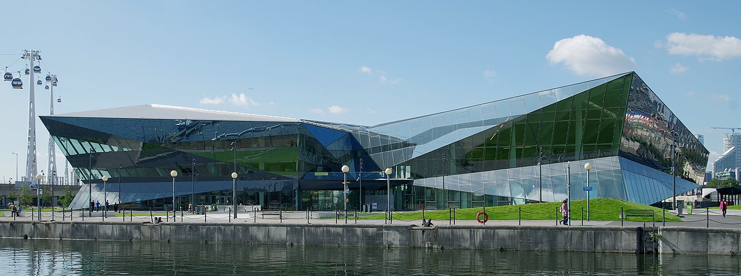
Achieving an Age Friendly London 16th April 2024

Slide 2
AGE-FRIENDLY LONDON AND THE ACTION PLAN
ROSEMARY MAYES
London Network of U3As representative on the London Age Friendly Forum (LAFF)

Slide 3
About the London Age Friendly Forum
Forum body made up of organizations led by and representing older Londoners.
It was established to develop the voluntary and community sector’s contribution to making London more age friendly.
Member organizations include Age UK London, Civil Service Pensioners Alliance, Greater London Forum for Older People, London region of u3as, Positive Aging in London, Wise Age and members of the National Pensioners Convention.
Representatives of each organization sit on a committee which meets once a month.

Slide 4
Aims of the London Age Friendly Forum
To develop and facilitate the contribution of older Londoners to the London Age Friendly programme.
To build successful partnerships with key agencies and together to work positively to making London an age friendly city.

Slide 6
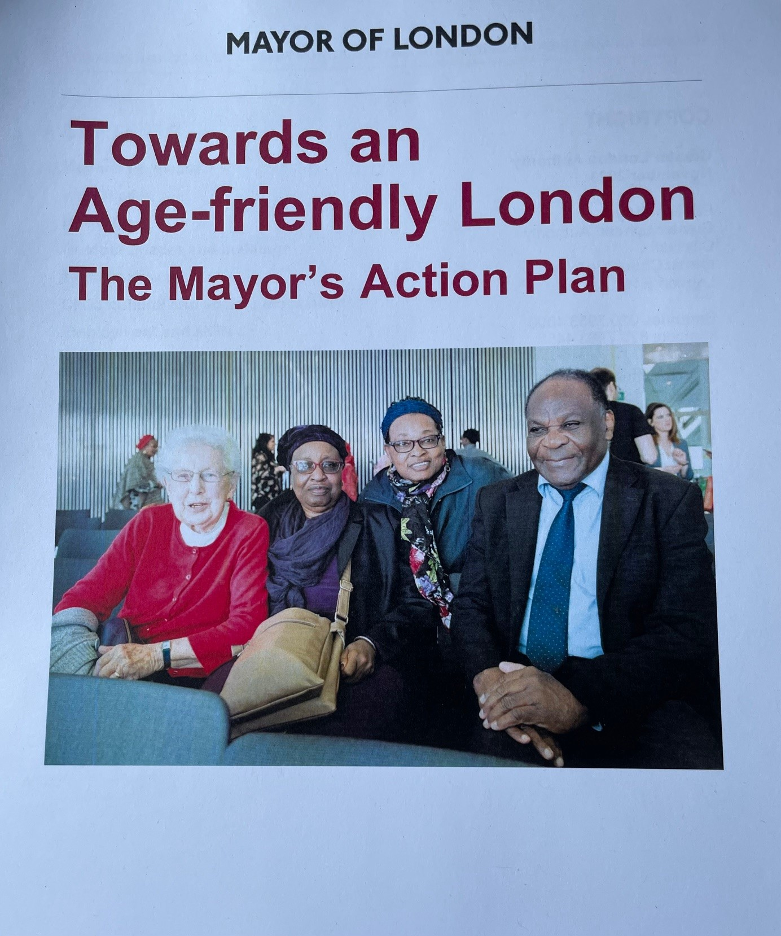
Towards an Age-friendly London. The Mayor’s Action Plan
Towards an age-friendly London: the Mayor's action plan | London City Hall
Towards and age-friendly London: the Mayor’s action plan’ was published in November 2023
The plan is part of the London age-friendly programme which began in 2018 when the Mayor signed London up to be a member of the WHO’s Global Network of Age-friendly Cities and Communities.

Slide 7
The Plan’s Age-friendly domains and examples of ‘actions’
Housing: Access to affordable housing that meets the needs of older Londoners.
Outdoor spaces and buildings: Create public spaces that are inclusive of older Londoners.
Transportation: Protect older Londoners’ Freedom Pass.
Civic, cultural and social participation: Support older Londoners civic participation.
Employment and skills: Provide training and employment support to older workers and job seekers.
Health: Healthy Ageing London Network.
Communication and information: Address digital exclusion amongst older Londoners.
Respect and social inclusion: Ensure older Londoners are supported and valued.

Slide 8
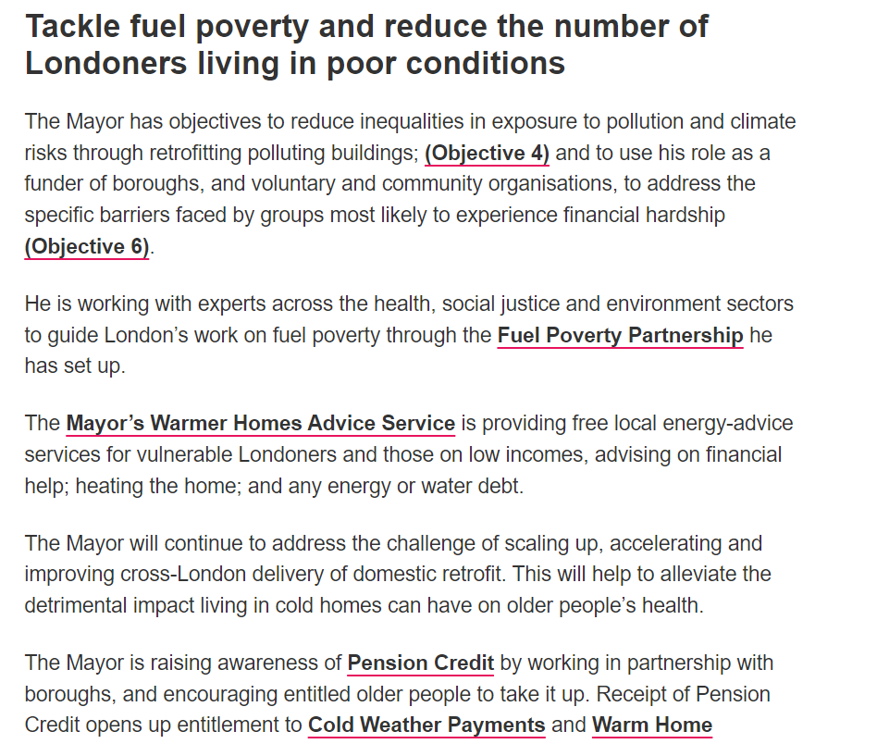

Slide 9
The Age Friendly London Action Plan and the role of London Age Friendly Forum
LAFF is now focussing on how to engage in implementation of the plan and measuring outcomes.
LAFF commented extensively on iterative drafts of this prior to publication.

Slide 10
The Age Friendly London Action Plan and the role of London Age Friendly Forum
Areas of main focus for LAFF in the Plan include poverty, employment and skills.
Activity to concentrate on monitoring and holding the Mayor to account on delivery and impact of actions.
Meeting with other UK cities /areas where age-friendly plas have been successfully launched.

Slide 11
The Age Friendly London Action Plan and the role of London Age Friendly Forum
Good news: There is a plan after many years of work and lobbying and London can be added to the map of age-friendly cities.
But... will the plan make a difference and how will we be able to judge whether it has done so?

Slide 12
Some criteria for success
The plan needs to be genuinely ‘live’ within the GLA from the top down.
The plan is only the starting point in a broader process of ensuring policy making and services across London truly reflect older people’s needs.
The plan must be owned and scrutinised by older Londoners and arrangements put in place so that they are effectively involved.
Hard measures of whether actions are working so that comparisons can be made between current base lines and future outcomes.

Slide 13
Some criteria for success
Need for more London boroughs to sign up to the plan to ensure that it is truly Londonwide.
Regular monitoring and evaluation are crucial as are regular reports on progress. Last, but most of all…
… how is implementation of the plan reflecting in GLA policy making and strategic planning as a whole?
Are levels of age awareness sufficient amongst the GLA staff responsible for implementation?
The plan is only the starting point in a broader process of ensuring policy making and services across London truly reflect older people’s needs.
The plan must be owned and scrutinised by older Londoners and arrangements put in place so that they are effectively involved.
Hard measures of whether actions are working so that comparisons can be made between current base lines and future outcomes.

Slide 14
Some criteria for success
The plan is only the starting point in a broader process of ensuring policy making and services across London truly reflect older people’s needs.
The plan must be owned and scrutinised by older Londoners and arrangements put in place so that they are effectively involved.
Hard measures of whether actions are working so that comparisons can be made between current base lines and future outcomes.

Slide 15
Remember
The title of this plan is ‘Towards’ an Age Friendly London’. Achieving the actuality of an age-friendly London presents many challenges but at least the plan provides a way ahead, to better planning and policy making for older Londoners.

Slide 16
www.london.gov.uk/programames-strategies/communities-and-social-justice/older-people/mayors-action-plan-age-friendly-london
The Action Plan online

Slide 17
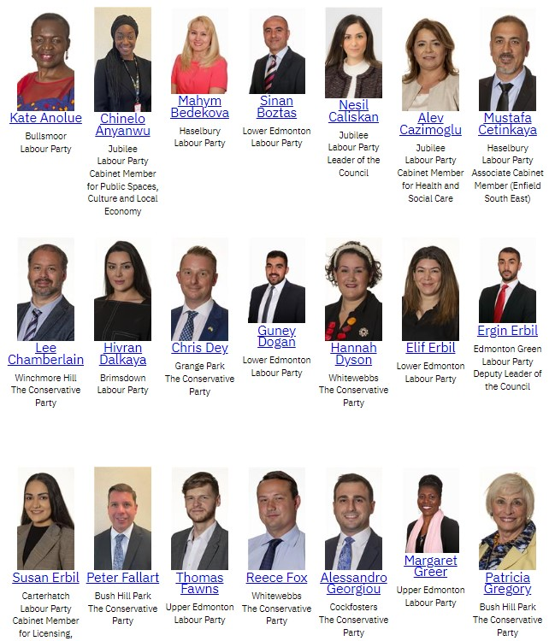
Councillors: Finding out who your councillors are and how to contact them using
On the homepage of your local council website you can: - Search ‘councillors’ in the search. - Or, navigate the website. First look for a section often called ‘Democracy’ or ‘Decision making’.

Slide 18
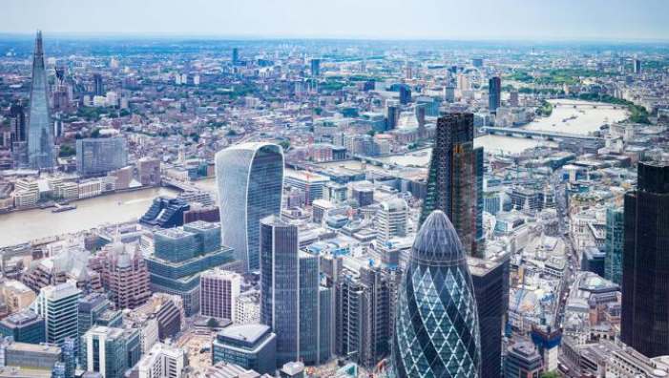
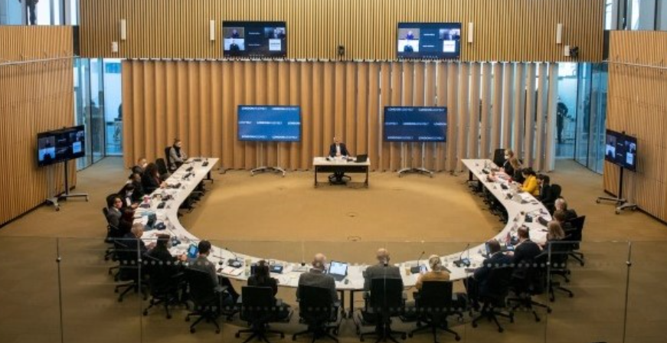
Getting election ready Elections for the Mayor of London and London Assembly. Thursday 2nd May 2024

Slide 19
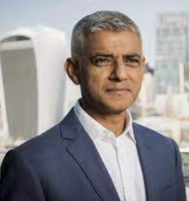
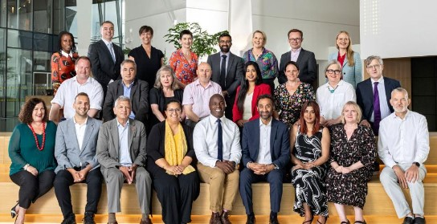
Greater London Authority
Mayor of London
London Assembly
Functional bodies
London Fire Commissioner
Notes:
The campaign focused on the GLA which has 2 political arms;
The Mayor of London – who has powers in relation to (for example) transport; housing and strategic planning as well the ability to convene and lobby.
The London Assembly, comprised on 25, Assembly Members (14 represent constituencies, 11 are Londonwide) – the current political make up is 11 Labour, 9 Conservatives, 3 Greens, 2 Liberal Democrat. - There are 12 committees including the Transport committee,
Assembly Members have limited decision making power, there role is instead to hold the Mayor to account, which they do through questioning, investigations, passing motions and voting on the Mayors budget each tear
The GLA has some functional bodies such as Transport for London.

Slide 20
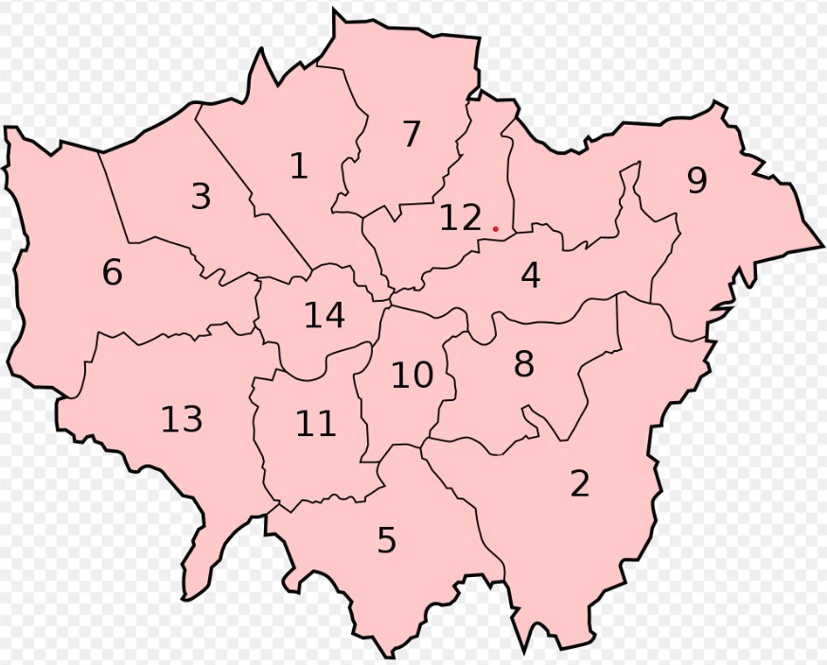
14 of the 25 Assembly Members represent constituencies.
These ‘super-constituencies’ can incorporate up to 3 boroughs
Notes:
Barnet and Camden - - Bexley and Bromley - - Brent and Harrow - - City and East(Barking and Dagenham, NewhamTower Hamlets) - - Croydon and Sutton - - Ealing and Hillingdon - - Enfield and Haringey - - Greenwich and Lewisham - - Havering and Redbridge - - Lambeth and Southwark Merton and Wandsworth - - North East (Hackney, Islington, Waltham Forest) - - South West (Hounslow, Kingston, Richmond - - West Central (Hammersmith and Fulham, Kensington and Chelsea, Westminster)

Slide 21
London Assembly Constituencies
Barnet and Camden | Greenwich and Lewisham
Bexley and Bromley | Havering and Redbridge
Brent and Harrow | Lambeth and Southwark
City and East (Barking and Dagenham, City of London, Newham, and Tower Hamlets) | Merton and Wandsworth
Croydon and Sutton | North East (Hackney, Islington, and Waltham Forest)
Ealing and Hillingdon | South West (Hounslow, Kingston, and Richmond)
Enfield and Haringey | West Central (Hammersmith and Fulham, Kensington, Chelsea, and Westminster)

Slide 22
What’s changed?
Photo ID
You must now present a form of accepted photo ID when voting at a polling station on election day.
A UK Passport
A driving license issued in the UK, any of the Channel Islands, the Isle of Man, or an EEA state
A passport from a country in the EEA or Commonwealth
An Older persons Freedom Pass
A Disabled Persons Freedom Pass
A 60+ Oyster Card
A Blue Badge
An Older persons Bus Pass (UK)

Slide 23
What’s changed?
Photo ID
Form of ID still valid if past expiration date.
But must bear a good enough resemblance to you – at polling station staff discretion.

Slide 24
What’s changed?
Voter Authority Certificate
A free form of identification, should you not hold any accepted photo ID.
Apply online: https://voter-authority-certificate.service.gov.uk
When applying you will need to provide:
A photo of yourself
Your date of birth
Your National Insurance number

Slide 25
What’s changed?
All Mayoral elections now use first-past-the-post.
• A single ‘X’ next to one candidate only, on your pink ballot paper.
• Indicating multiple preferences could now result in your vote not being counted.
Voting for London Assembly Members is unchanged
• A single ‘X’ next to your preferred constituency candidate on your yellow ballot paper.
• A single ‘X’ next to your preferred London-wide candidate on your orange ballot paper.
All Mayoral elections now use first-past-the-post.

Slide 26
Alternative methods of voting
Postal vote
No need to present a form of photo ID or Voter Authority Certificate.
Apply online: www.gov.uk/apply-postal-vote
You will need to provide:
The address where you are registered to vote.
Your National Insurance number, or other identifying documents (e.g. passport).
The specific date of the election you want to make a postal vote.
A photo of your handwritten signature in black ink on plain white paper.

Slide 27
Alternative methods of voting
Proxy vote
Nominate someone else to cast a vote at the polling station, in your place.
Apply online: www.gov.uk/apply-proxy-vote
You will need your proxy voter’s permission, in addition to:
Your National Insurance number.
The address at which your proxy voter is registered to vote.
Your proxy voter’s contact details.
A photo of your handwritten signature.
Your proxy voter will need to provide photo ID of themselves – not of you.

Slide 28
Not online?
Offline access
Contact your local council and ask for your local Electoral Registration Office
Request paper forms for voter registration, applying for proxy/postal vote/Voter Authority Certificate
Forms to be completed and posted to your Electoral Registration Office
Some local authorities may allow you to fill the requested forms in-person at your local council.
For any queries, Electoral Commission helpline 0800 328 0280

Slide 29
Key deadlines
16th April 2024 – Register to vote
17th April 2024 – Register for a postal vote
24th April 2024 – Apply for a free Voter Authority Certificate / Register for a proxy vote
2nd May 2024 – Polling day

Slide 30
Councillors: Finding out who your councillors are and how to contact them using
On the homepage of your local council website you can: - Search ‘councillors’ in the search. - Or, navigate the website. First look for a section often called ‘Democracy’ or ‘Decision making’.

Slide 31
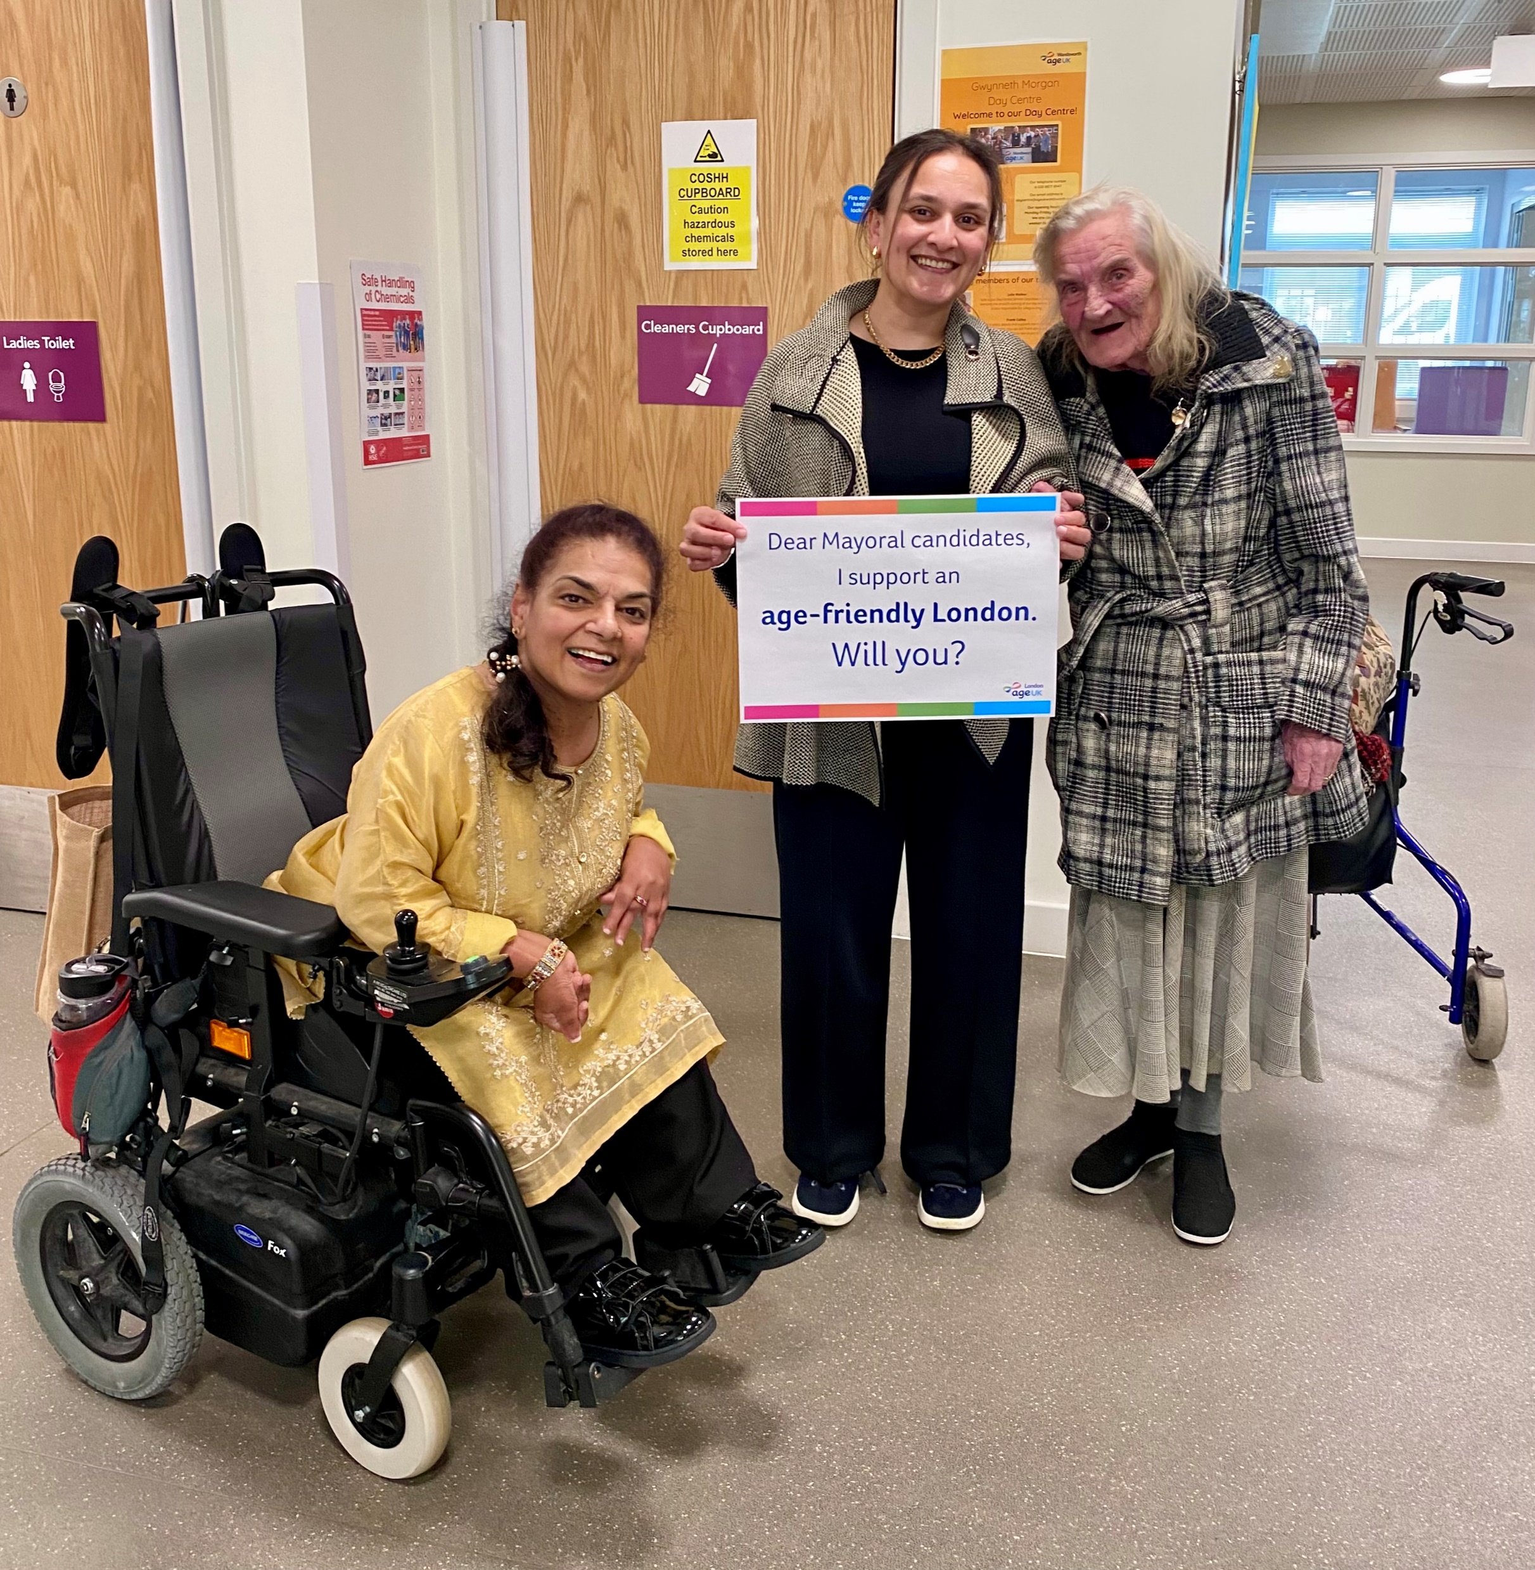
Elections for the Mayor of London and London Assembly. Get more involved

Slide 32
Contacting your local candidates for the London Assembly using www.whocanivotefor.co.uk
Step 1. Find out who your local candidates are by going to www.whocanivotefor.co.uk. Search with your postcode. On the next page, click on the link: ‘London Assembly elections (Constituencies): [Name of your constituency].’
Step 2. Select the candidates you wish to email. For most candidates there is a section on the webpage called ‘[Name of candidate] online.’ Here you will find an email address for the candidate.
If you cannot find an email address for a candidate, or have any questions about this, please email campaigns@ageuklondon.org.uk.

Slide 33
Contacting your local candidates for the London Assembly using www.whocanivotefor.co.uk
Step 3. Email your candidates using the template email text. You do not need to use all the text, but we would be grateful if you could include the bullet points under the title ‘What you can do.’
If you are emailing on behalf of a local Forum or community group, you may wish to include one or two sentences about your work. You could ask them to speak at a meeting if elected or meet with you so that they can learn more about supporting older people in the local area.
Step 4. Please email Dom dtaylor@ageuklondon.org.uk ) to let us know if you have contacted any candidates.

Slide 34
Contacting your local candidates for the London Assembly using www.whocanivotefor.co.uk
“Before polling day
Please read Age UK London’s manifesto https://bit.ly/2024manifesto.
Ensure your campaign events are age-friendly and that you have opportunities to speak with older voters.
If you are elected
Please stand up alongside older Londoners: Use your voice in the Assembly to ensure Mayoral strategies, action plans and activities meaningfully include older Londoners and that the Age-friendly London Action Plan is delivered in full.
Ensure older Londoners are not left behind when it comes to action to support those most affected by poverty and the cost-of-living crisis.
Contact your local Age UK or Older People’s Forum to ask how you can support them as their Assembly Member.”

Slide 35
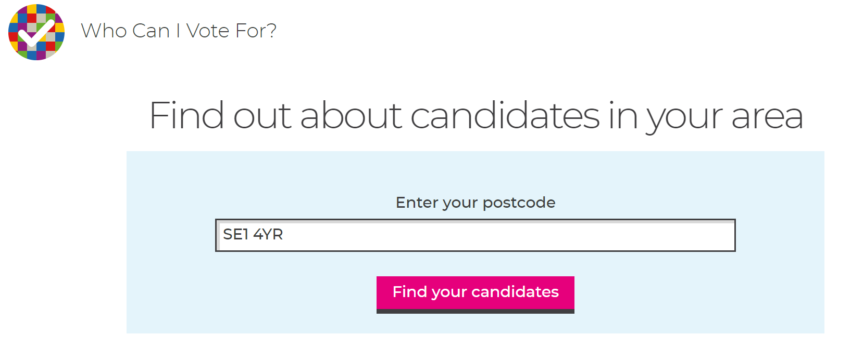

Slide 36
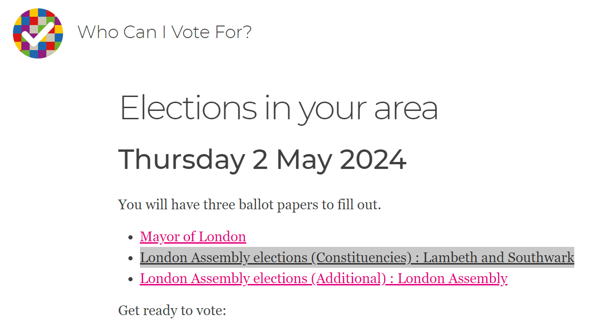

Slide 37
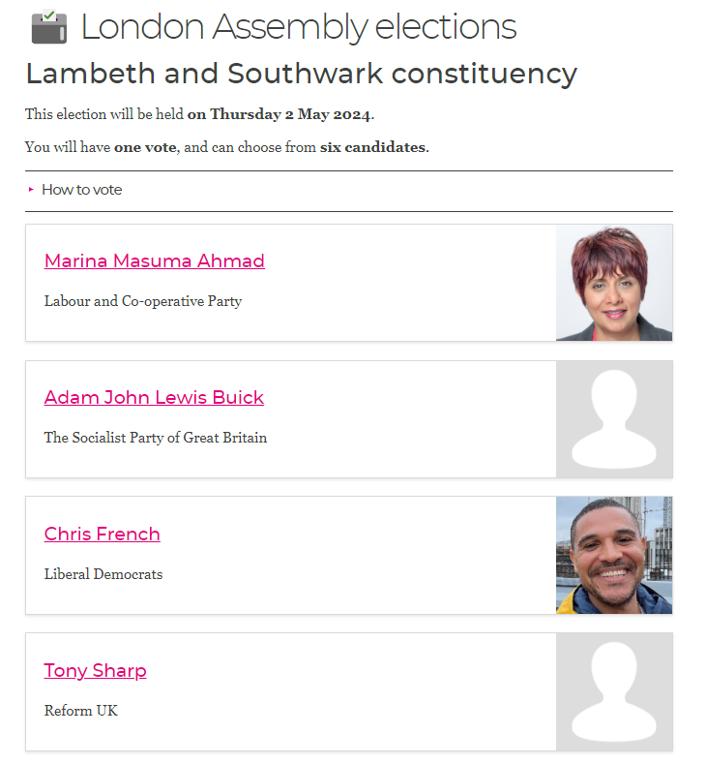

Slide 38
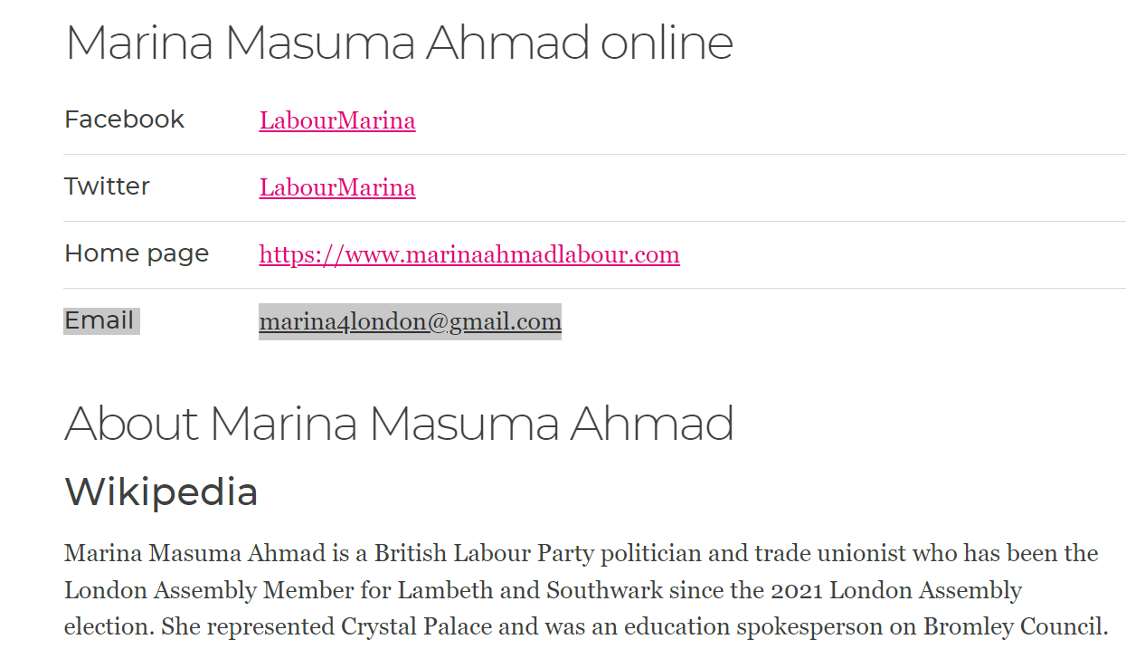

Slide 39
Other ways of raising the importance of an age-friendly London in the run up to the election
Send a letter to the local newspaper: Use the template text in the election pack and email your letter to the editor.
Raise awareness on social media: Use the template tweets (‘X posts’) or facebook posts to draw attention to candidate’s attention the importance of making London more Age-friendly.

Slide 40
Keep a copy of the Age UK London manifesto by your front door. So you can raise issues or ask a question if a canvasser knocks on your door.

Slide 41
After the election

Slide 42
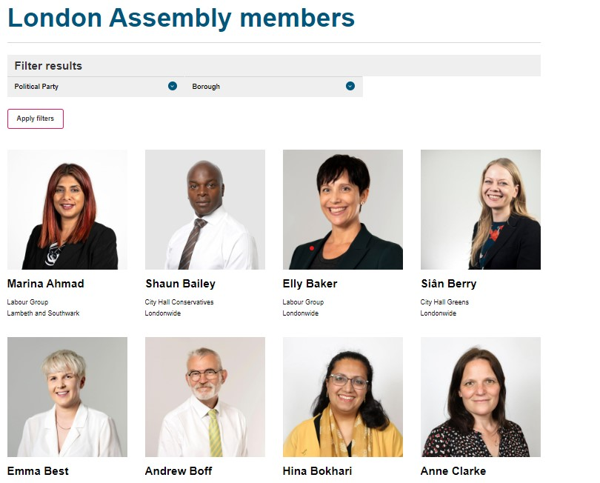
London Assembly Members: Finding out who your Assembly Members are and how to contact them
Go to https://www.london.gov.uk/who-we-are/what-london-assembly-does/london-assembly-members

Slide 43
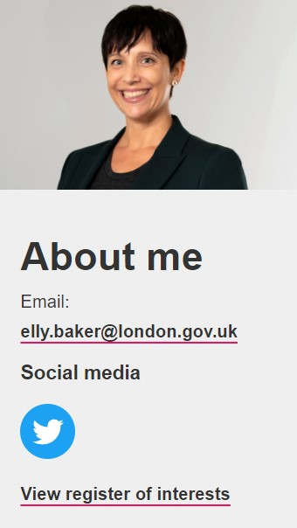
About your Assembly Member
Once you’ve found the Assembly Member (AM) you were looking for you can click on their photo to find out more information about them such as which committees they are on.
As well as your constituency Assembly Member there are ‘Londonwide’ AMs you can contact.
Notes:
https://www.london.gov.uk/who-we-are/what-london-assembly-does/london-assembly-members/elly-baker

Slide 44
Your Assembly Member’s email
This is always
Firstname.surname@london.gov.uk

Slide 45
You can also use:
Write To Them. https://www.writetothem.com/
Notes:
https://directory.londoncouncils.gov.uk/

Slide 46
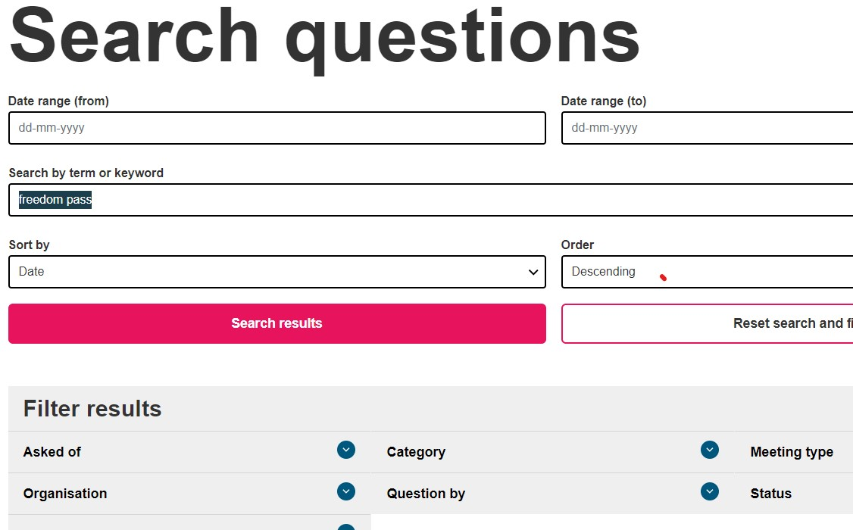
Find an answer to a previously asked question
https://www.london.gov.uk/who-we-are/what-london-assembly-does/questions-mayor/find-an-answer
You can search thousands of questions asked over the past 10 years

Slide 47
Suggestaquestion@london.gov.uk https://www.london.gov.uk/who-we-are/what-london-assembly-does/questions-mayor
Notes:
https://www.london.gov.uk/about-us/londonassembly/meetings/mgCalendarMonthView.aspx?

Slide 48
