Slide 1
Digital Campaigning Using social media to get your voice heard AUKL Workshop
Friday 24th February, 2023
In partnership with

Slide 2
Programme
What is Digital Campaigning and Why is it important?
Why use social media?
Ethics online and Staying safe online
Social media platforms – Twitter, Facebook, WhatsApp
Examples
Resources
Notes:
Stress can only cover some of Social Media – if you want more let us know in evaluations

Slide 3
What is digital campaigning and why is it important?
Digital campaigning uses technology to create change, whether through emails and petitions or platforms such as Facebook, Twitter, Instagram, WhatsApp and more.
Deepen your engagement with your members
Get your message out to a wider audience
You can immerse yourself in local community chatter. Neighbourhood groups, local council, local papers all part of the conversation, make sure you are too

Slide 4
Why use Social Media?
Reach a new, local audience e.g. Older people, their organisations, councillors, media, funders - all on Social
Raise awareness of the vital campaigning work you are doing – it’s important to show off
You can bring your campaign to the attention of those you want to influence
Journalists look for stories on social media.
It's free!
You can link to webpages with more information about your campaign

Slide 5
Ethics online
Consider the implications on individuals & society
Be transparent DO GOOD – AVOID HARM
Explicability: clear, understandable, transparent
When using statistics or data, ensure that you select, analyse or report in a fair & non-judgmental way and promote equality in accordance with the Equality Act.
Be aware of any personal conflicts of interest or barriers that may affect your integrity or objectivity.

Slide 6
Online Safety
Get latest anti-virus / firewall software
Update your internet browser
Create strong, passwords, Change/don’t share
Learn to spot fake emails and websites
Log out from services
Beware of phishing attacks.
Keep Your Privacy Settings On
Make Sure Your Internet Connection is Secure

Slide 7
Can you name any social media platforms?

Slide 8
Today we will focus on…
Facebook
Twitter
WhatsApp
LinkedIn
Instagram
TikTok
YouTube
Notes:
Don’t show slide
Write up on Flip chart as they call out
Then show slide

Slide 9
Facebook
Online social media and social networking service
Owned by Meta
2.93 billion active monthly users globally
66% of the UK population are users
1.62 billion people visit every day
Ranked 3rd social media platform worldwide
Most downloaded App of the 2010’s
Majority users are male, Highest age group 24-35
Notes:
Ask who has a Facebook page

Slide 10
Facebook
Age UK London Facebook page - send a live post
How to like/share
#hashtags
Notes:
Opening AUKL Facebook Page to actually show

Slide 11
Twitter
“Twitter is what’s happening and what people
are talking about right now”
353.9 million users worldwide
Ranks as the 15th social media platform behind Facebook, Instagram and TikTok
500m Tweets are sent every day
48% use Twitter to get the latest news
UK 19.05m have Twitter accounts (Oct 2021)
Over half Twitter accounts owned by males

Slide 12
Twitter
Age UK London twitter page - how to send a live tweet
How to share
Hashtags #
How to like, retweet
How to send a direct message (DM)
Notes:
Show participants how to do this

Slide 13
Exercise 1
Search
Search for a Twitter page - Age UK London or Mayor of London or other
Follow
Follow a page
Like
Like or retweet a post

Slide 14
WhatsApp
Over 2.24 billion active users globally.
WhatsApp is the most used instant messaging app in the world
100 billion messages are exchanged on WhatsApp every day
India has the most WhatsApp users.
Most popular app in over 100 nations.

Slide 15
Accessing WhatsApp Online
You can access your WhatsApp and send messages from your laptop or tablet at WhatsApp Web
Visit: https://www.whatsapp.com/ and click on WhatsApp Web
Open WhatsApp on your phone
Tap Menu or Settings and select Linked Devices
Tap on Link a device
Point your phone to the screen to capture the
QR code - your message will open on screen

Slide 16
Example Dial-a-Ride Twitter
Notes:
Dependent on time – show examples – one or more

Slide 17
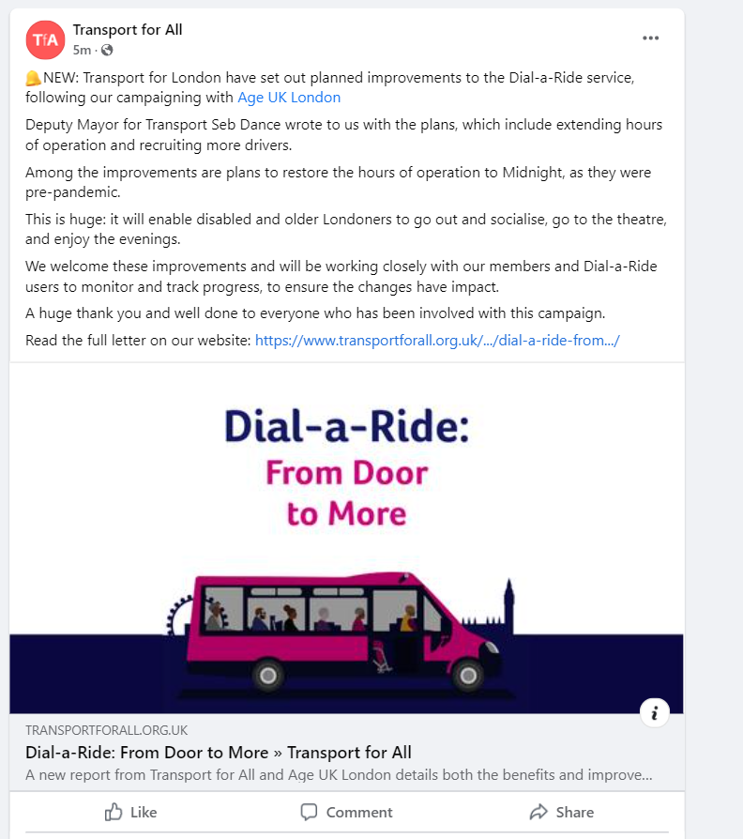
Example Dial-a-Ride Facebook

Slide 18
Access Denied Facebook

Slide 19
Access Denied Twitter

Slide 20
Exercise 2
Like a Facebook page
Share a post
Comment on a post
Suggestions / improvements

Slide 21
TIPS: Using social media in your campaign
Be engaging: include photos, powerful stats, quotes.
Purpose of your posts - what one thing do you want’ ‘someone to do' as a result of seeing your post?
Who do you want to see your posts? - are you using the right language?
Are you including the correct links to take actions?

Slide 22
TIPS: Using social media in your campaign
Join the conversation: Use search function, e.g. #hashtags on twitter to find others talking about issues related to your campaign.
Avoid getting pulled into arguments
Remember you maybe representing the campaign or organisation so be respectful and polite even with those you don't agree with.
Post regularly and consistently

Slide 23
Example of Engaging online
Talk London - an active online community
A place to discuss London's big issues and shape and steer the policy decisions of the future
The online feedback, along with other research, is used to influence policy for London and so it is a good example of how people can get involved digitally to make a difference
http://talklondon.london.gov.uk

Slide 24
Who to follow
Age UK London
Your local London borough Age UK
Local press
Local MP
Local Councillor

Slide 25
Summary
Range of resources available on campaigning – see age UK London website
Don’t be afraid to ask how to use a tool
Share your successes and learning – let us know
Evaluation form & Equalities monitoring form

