Slide 1
Integrating public toilet strategic ambition with Age Friendly commitments
London Loos (Age UK London) and London Councils
18th April 2023
Cardiff Council

Slide 2
Public Health (Wales) Act 2017
The Public Health (Wales) Act 2017 received Royal Assent on 3 July 2017. The Act aims to address a number of specific public health concerns, and to create social conditions that are conducive to good health and where avoidable harms can be prevented.
Part 8 – Provision of Toilets
Under the Act, each local authority in Wales will be required to prepare and publish a local toilets strategy for its area. This must include an assessment of their community’s need for toilets (including changing facilities for babies and changing places facilities for disabled people) and must set out how the local authority proposes to meet this need. Local authorities will be required to consult with interested parties on their draft strategies. The Welsh Government must issue guidance to local authorities about the preparation, review and publication of strategies, which local authorities must have regard to. The Act does not place a duty on local authorities to provide or maintain public toilets, nor is there a specific requirement for local authorities to implement their toilet strategies. It is envisaged that local authorities will consider a ‘full range of options’ for making facilities available to the public.
Local Toilet Strategies
Notes:
Source: HIV (who.int)

Slide 3
Age Friendly Cardiff
Launch of Welsh Government's 'Age friendly Wales: our strategy for an ageing society' – December 2021
Welsh Government ambition for all 22 Local Authorities to join World Health Organisation Global Network for Age Friendly Cities and Communities
7 month build of application including detailed action plan - layered consultation with older people
Notes:
Source: HIV (who.int)

Slide 4
Age Friendly Cardiff
Became evident that Public toilet provision was a key concern and impacted on older people’s ability to stay connected to their communities and reduce the health impacts that social isolation can cause – became key area for action
“If you know you can’t find the toilet, you don’t want to go out….it’s linked to health, linked to loneliness, everything you know. It stops me going to the places that I love best”
Vision
'Cardiff is a great place to grow older and a place where older people are more empowered, healthy and happy'
Notes:
Source: HIV (who.int)

Slide 5
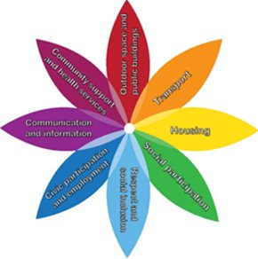
8 Domains
Housing​
Transport​
Social participation​
Outdoor spaces and public buildings​
Community support and health services​
Communication and information​
Civic participation and employment ​
Respect and social inclusion
Toilets
Formal acceptance March 2022 (currently the only Local Authority in Wales)
Notes:
Source: HIV (who.int)

Slide 6
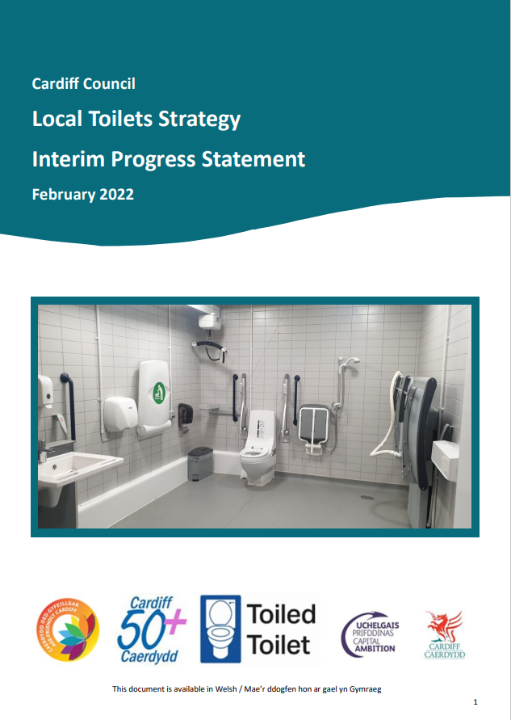
Publications to date
Notes:
Source: HIV (who.int)

Slide 7
Cardiff's Community Toilet Scheme
Initial review of existing locations
Sticker redesign
Expansion of scheme via:
Simple sign-up Teams form
Promotional materials produced and distributed (digital and paper)
Social media
Targeted approach – engaging directly with businesses and organisations
Notes:
Source: HIV (who.int)

Slide 8
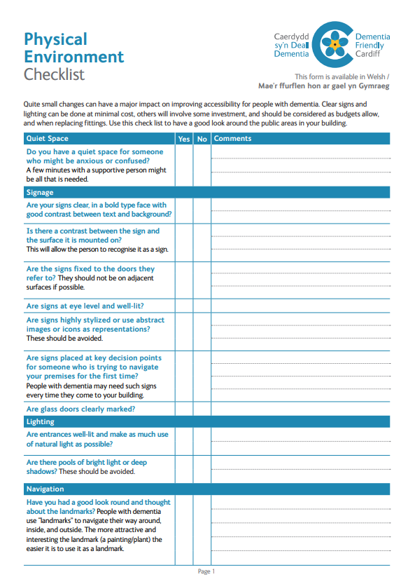
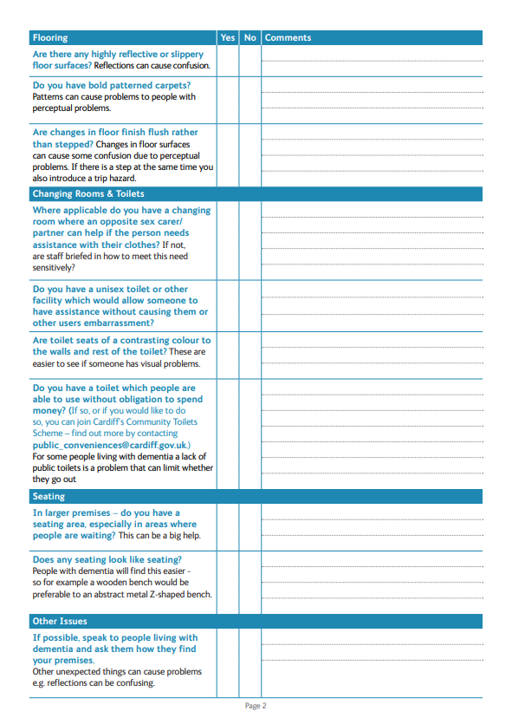
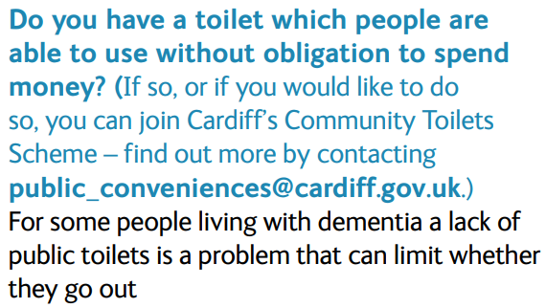
Integration with linked initiatives
Dementia Friendly Communities
Notes:
Source: HIV (who.int)

Slide 9
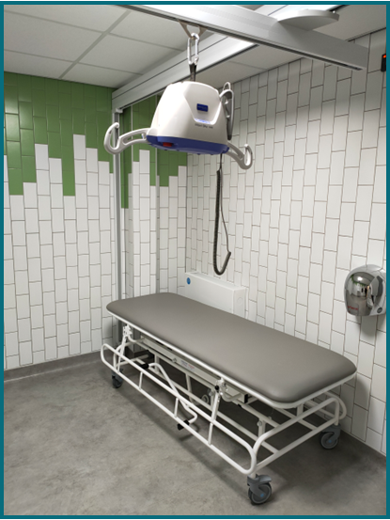
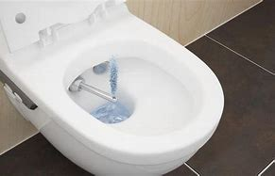
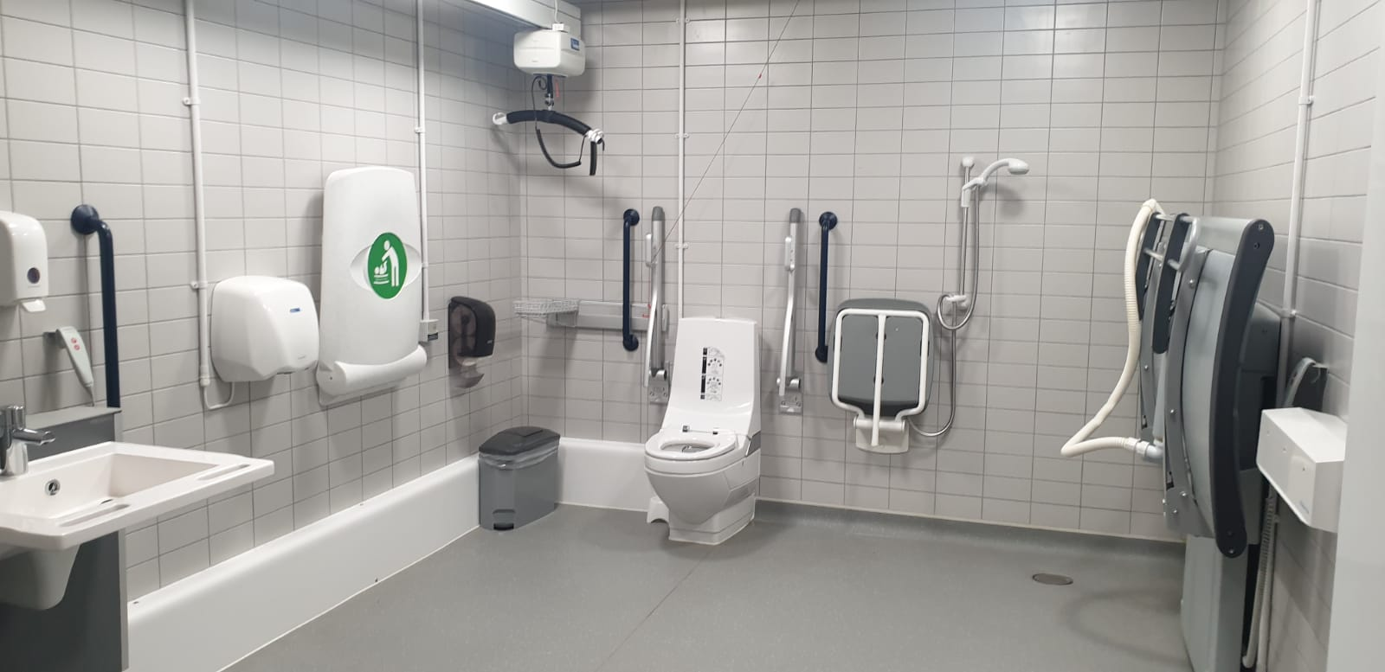
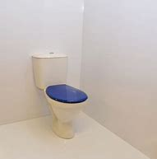
Our own changes
Enhanced provision within our Hubs
Dementia-friendly audit carried out and contrasting toilet seats installed – around 160!
Handheld bidet device pilot – consideration of cultural needs
Installation of Closomat (bidet-style) toilets in selected locations
Ensured Changing Places are registered with www.changingplaces.org for maximum visibility
Notes:
Source: HIV (who.int)

Slide 10
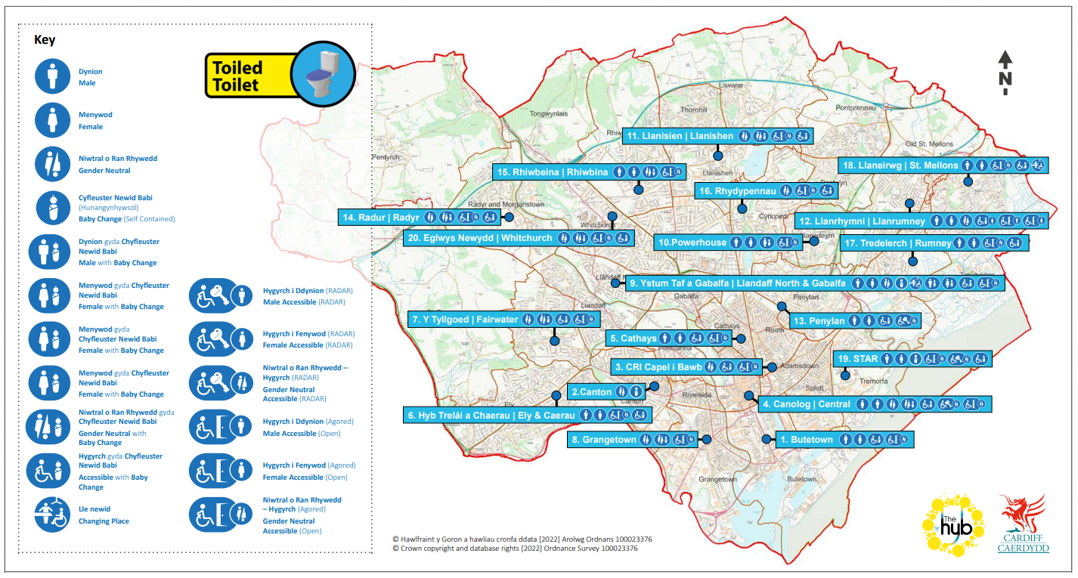
Raising Awareness
Non-digital formats
Notes:
Source: HIV (who.int)

Slide 11
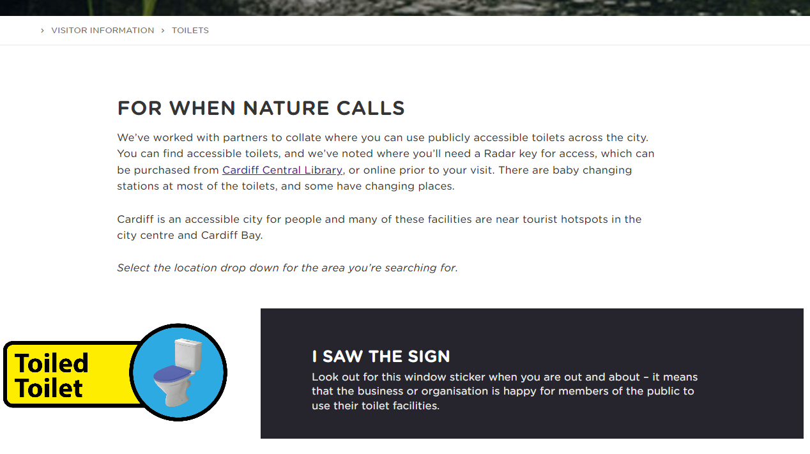
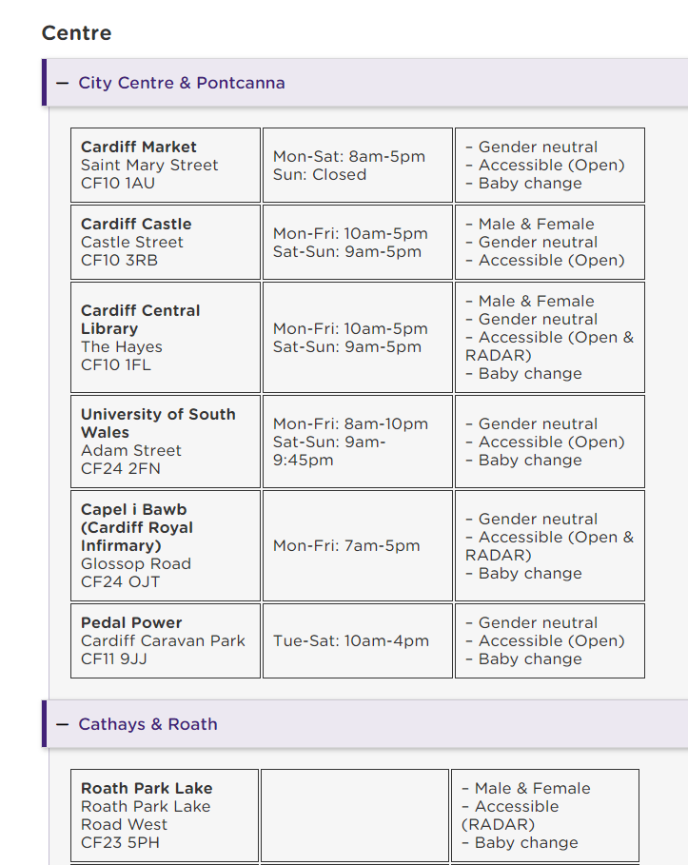
Raising Awareness
Digital formats
Visit Cardiff Website
Notes:
Source: HIV (who.int)

Slide 12
What We've Learnt
Link in with Age Friendly and Dementia Friendly work – networks? joined up working? volunteers? budget?
What can you do internally – within Local Authority infrastructure in terms of toilets (Libraries) and platform for communication (Visit Cardiff, Economic Development, Media Department etc)?
Expect negativity directed towards the Local Authority – particularly on social media! :-(
Don't forget about toilet progress – probably not your only area of work so pop a fortnightly catch up in Outlook and work on a few actions!
Look out for grant applications to develop the work!
Can this work be supported? Corporate Trainee etc.
Notes:
Source: HIV (who.int)

Slide 13
What's Next?
End of period Progress Statement of Local Toilets Strategy
Physical signage in city centre – promoting and directing
Installation of 7 Closomat hands free toilets in Community Hubs
Continue promoting Community Toilet Scheme
Case studies of organisations who have joined the scheme to use in promotion – some organisations think huge influx of people using toilets/drugs!
Follow up any grant opportunities. Ideas include:–
purchasing a 'mobiloo'?
incentives for organisations to join scheme including increasing accessibility?
an app (could it be scaled up for Wales?)?
Pop-up toilet for city centre (night time economy)
Notes:
Source: HIV (who.int)

Slide 14
Questions?
Notes:
Source: HIV (who.int)

