Slide 1
Celebrating local campaigning to improve public toilet provision 18th May 2023

Slide 2
Agenda
- Setting the scene (11:00-11:10)
Loos for Islington (11:10-11:25)
More Loos for Merton (11:25-11:40)
Loos for Haringey (11:40-11:55)
Break (11:55-12:05)
Discussion and questions (12:05-12:25)
Other public toilet campaigns (12:05-12:25)
What’s next (12:05-12:25)
Notes:
Housekeeping - Breaks

Slide 3
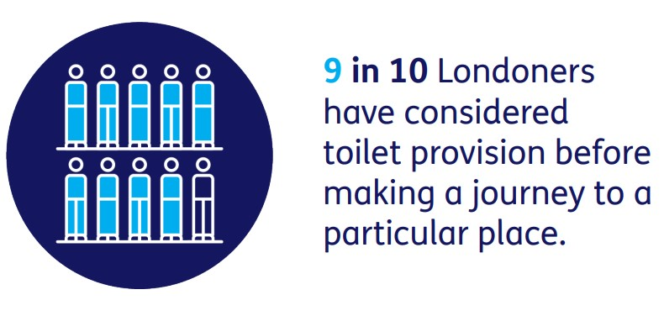
Notes:
637 members of the public completed our London Loos survey from May to July 2022. This was a self-selecting survey carried out online using the Survey Monkey platform. 96% of respondents lived in London with all boroughs and the City of London represented. 93% of respondents were over the age of 50 and 86% over the age of 60.

Slide 5
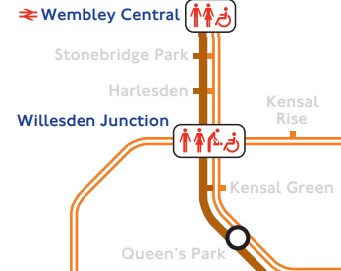
London Loos The campaign so far
March 2022 - Campaign champions meet TfL to discuss how they can improve public information about toilets on the TfL network (locations and availability). July
- 637 Londoners take part in our survey September
- London Loos report launched and sent to every councillors in London. The report has nine recommendations for councils. October
- Publication of three policy briefings for councils (Toilet Strategies; Community Toilet Schemes; Toilets and planning policy).
Notes:
Thank you to Caroline Russell for your support on this.

Slide 6
Conference for Council staff

Slide 7
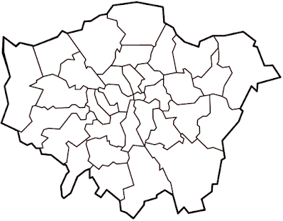
Local campaign groups
•
•
Haringey
•
Islington
•
Merton
•
Barnet
Southwark

Slide 8
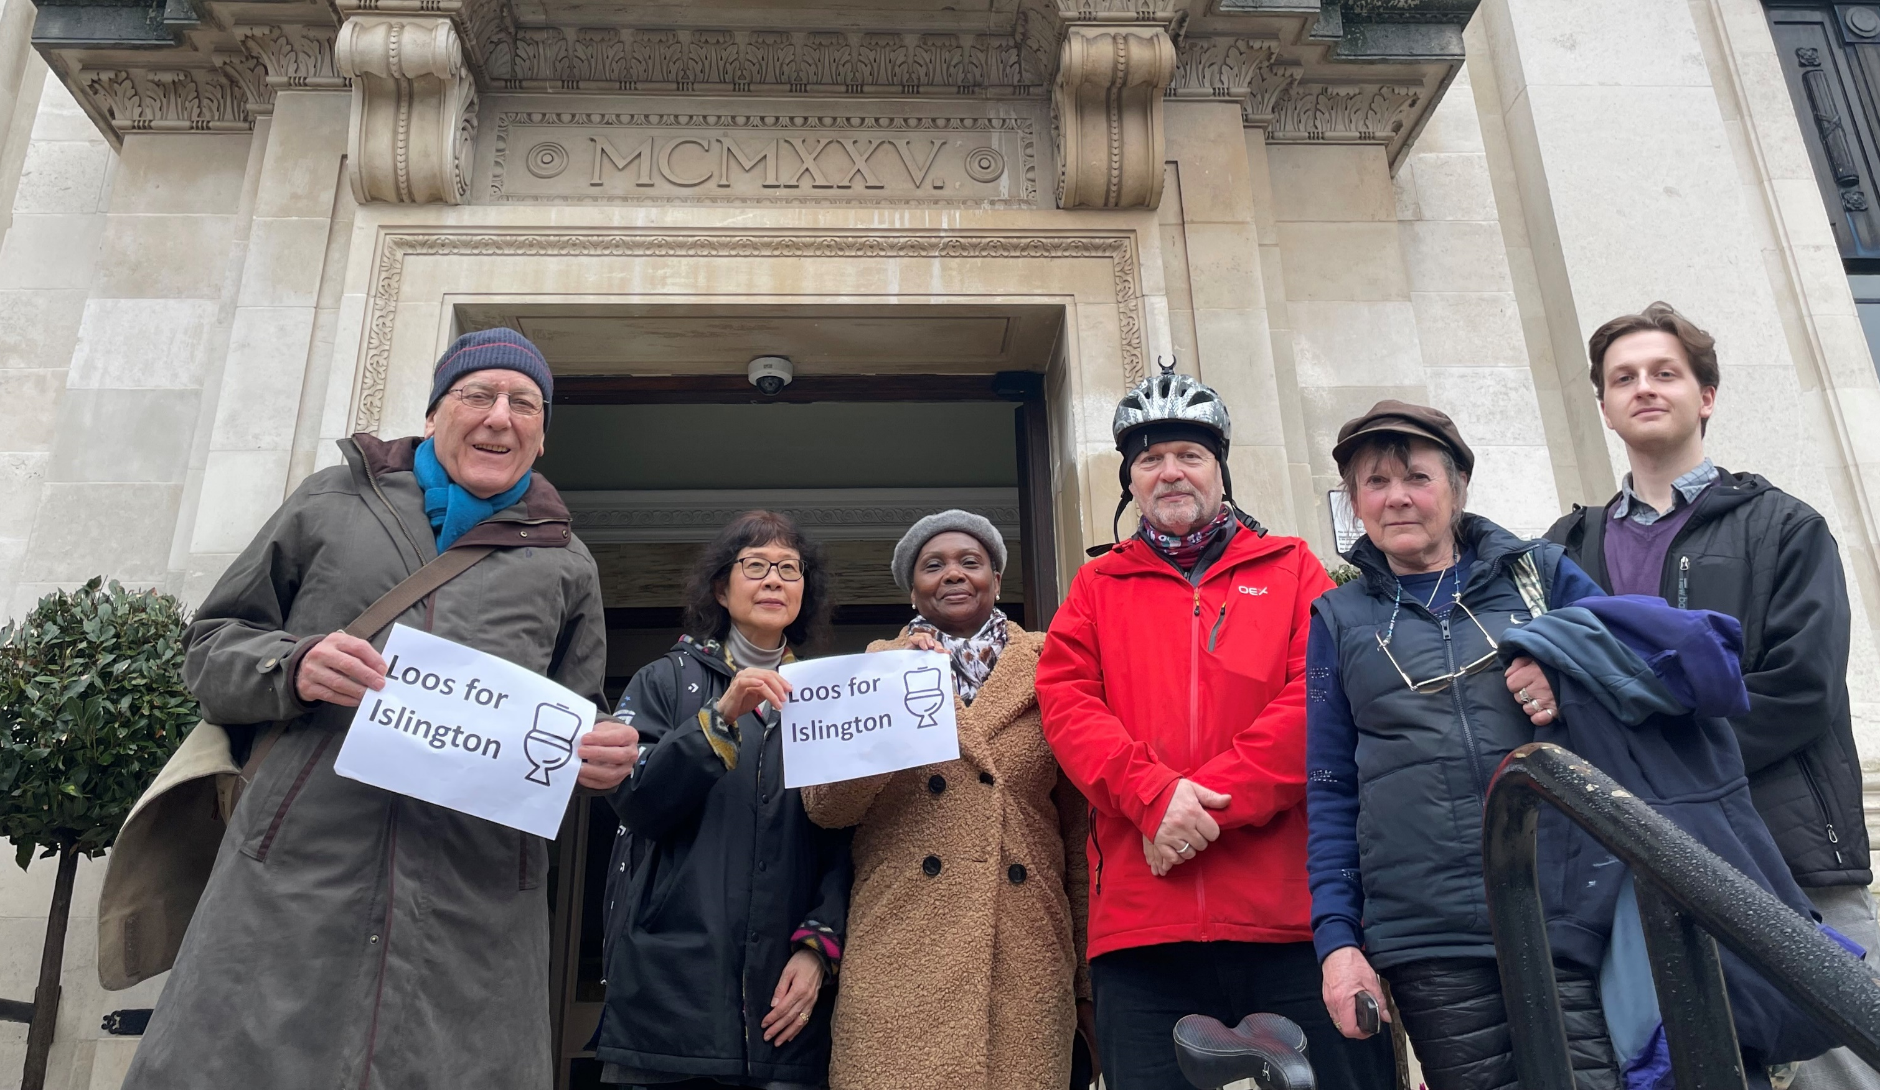
Loos for Islington

Slide 9
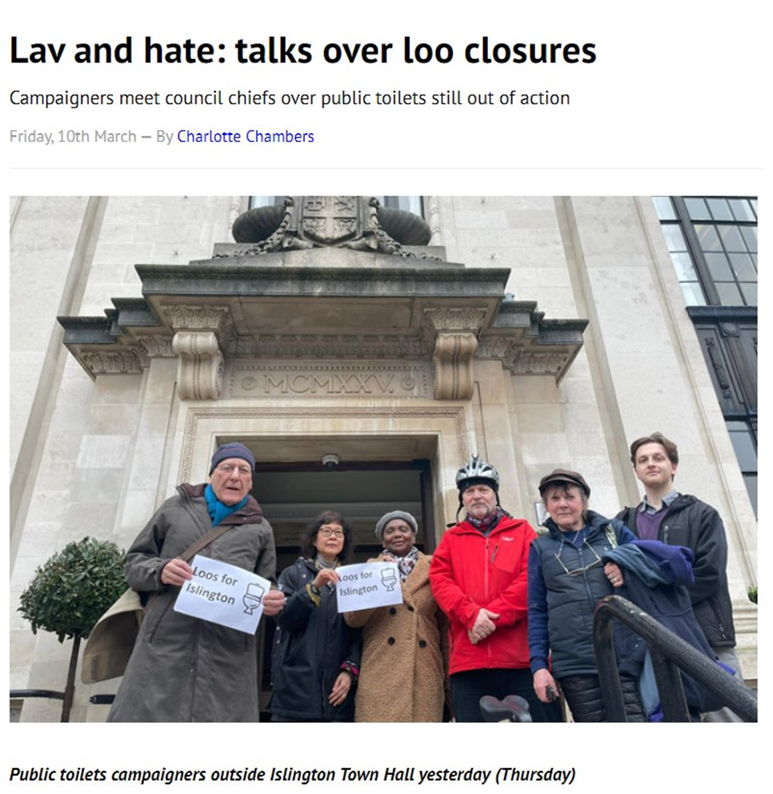
Loos for Islington

Slide 10
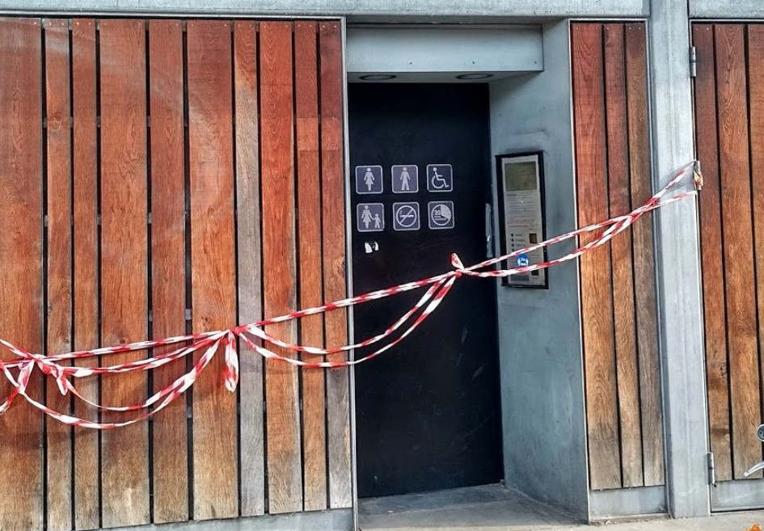
What did you want the council to do?
Provide a list of locations for ‘public toilets’ in Islington.
Consult residents about the replacement of the automated public toilets in the borough.
In the longterm
To have a strategy to radically improve provision.
To significantly improve public communication about locations.
To have a named officer to take responsibility.

Slide 11
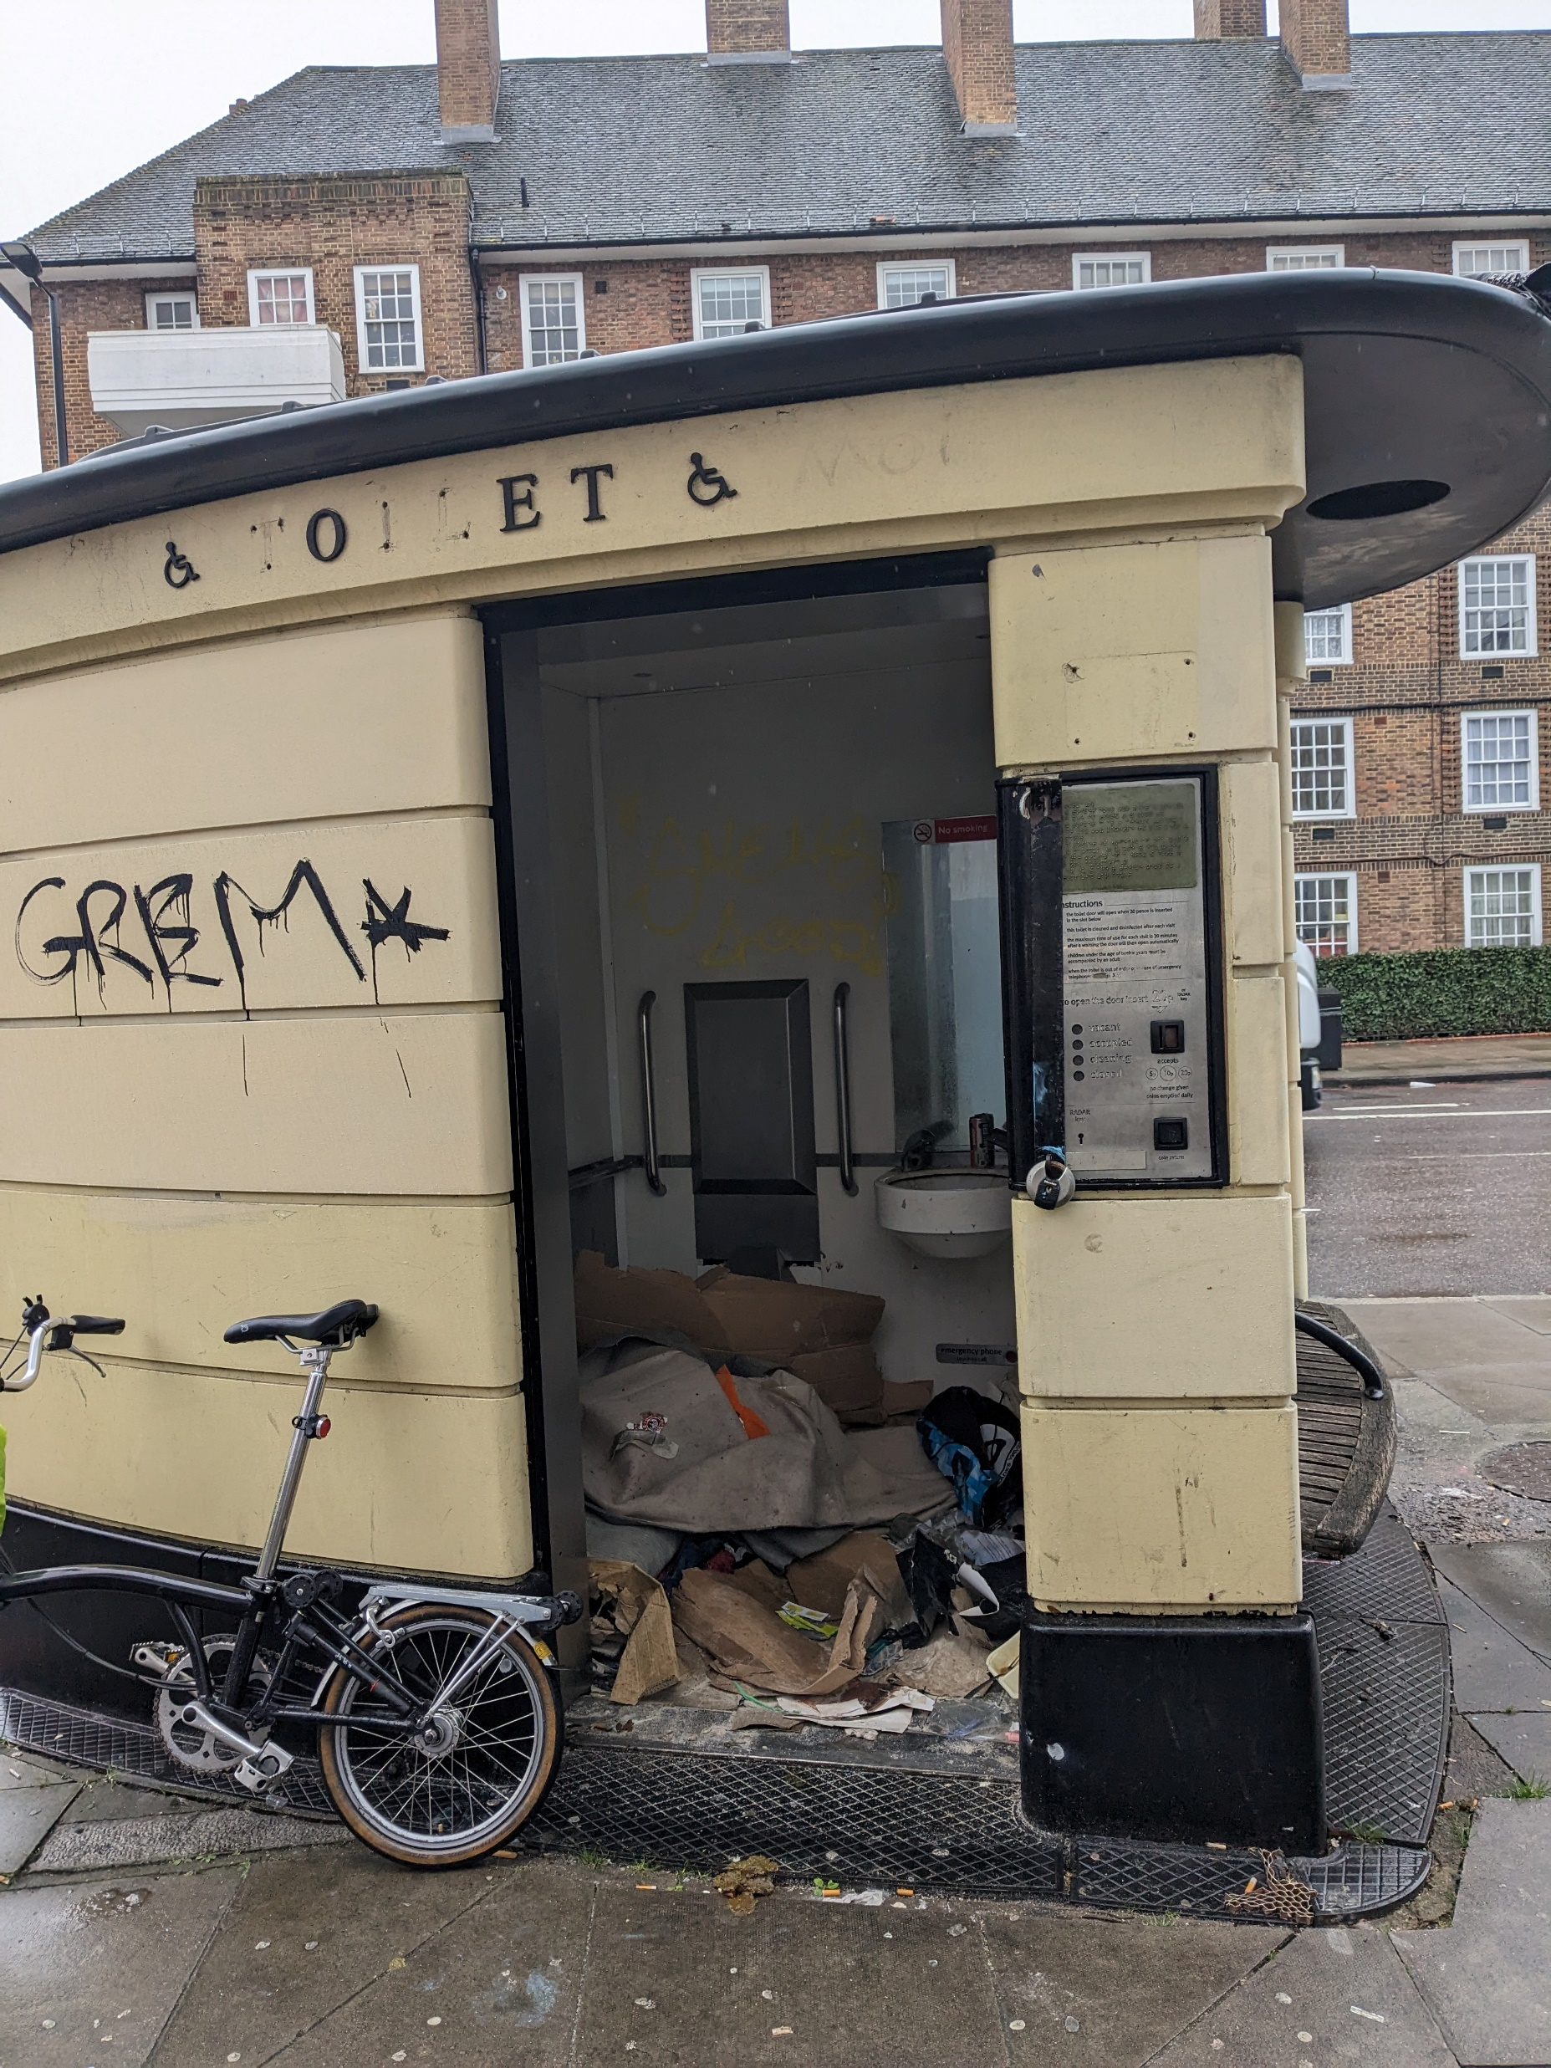
Activities.
2 cycle-tour audits of the council run automated public toilets.
2 articles and 1 letter in the Islington Tribune.
5 questions submitted and answered at a Council meeting.
Face to face meeting with 3 Executive Members and Directors at the council.

Slide 12
Achievements so far.
Council has agreed to continue to meet with us (next meeting in June)
They have provided a list of locations of toilets. Print-outs will be sent to libraries.
Committed to some engagement around the replacement of the automated public toilets.
Committed to start developing an access to loos scheme that may develop into a community toilets scheme.
Reflections on the campaign

Slide 13
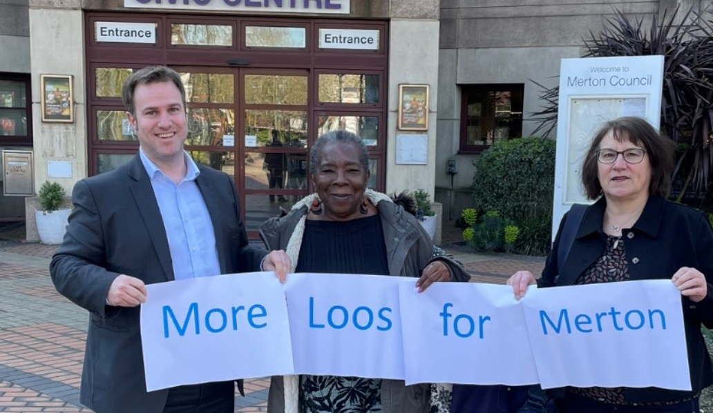
More Loos for Merton

Slide 14
Loos for Islington

Slide 15
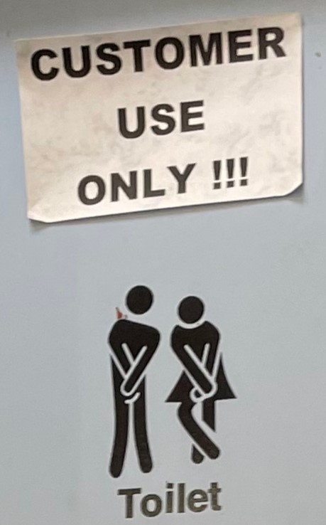
What did you want the council to do?
A comprehensive audit of public toilets in the borough
To have a Toilet Strategy for Merton.
Significant improvements to Merton’s Community Toilet Scheme.
The delivery of a communications and community engagement strategy.
Significant improvements in mapping and public realm signage.

Slide 16
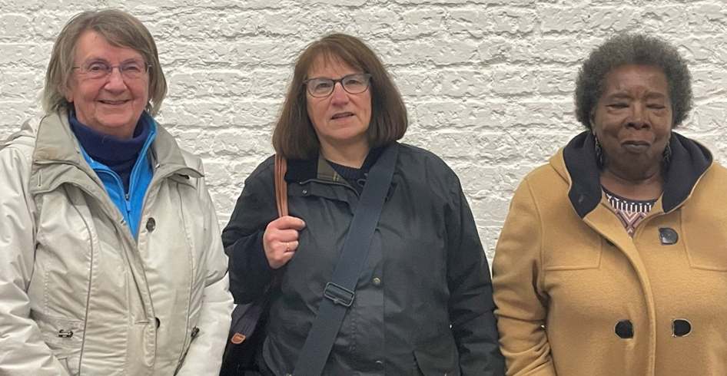
Activities.
Meeting with councillor undertaking independent scrutiny review
Meeting with Deputy Leader of the Council
Auditing of 34 toilets in Merton (mainly thanks to ace campaigner Julie Mathers).
Promotion of public survey

Slide 17
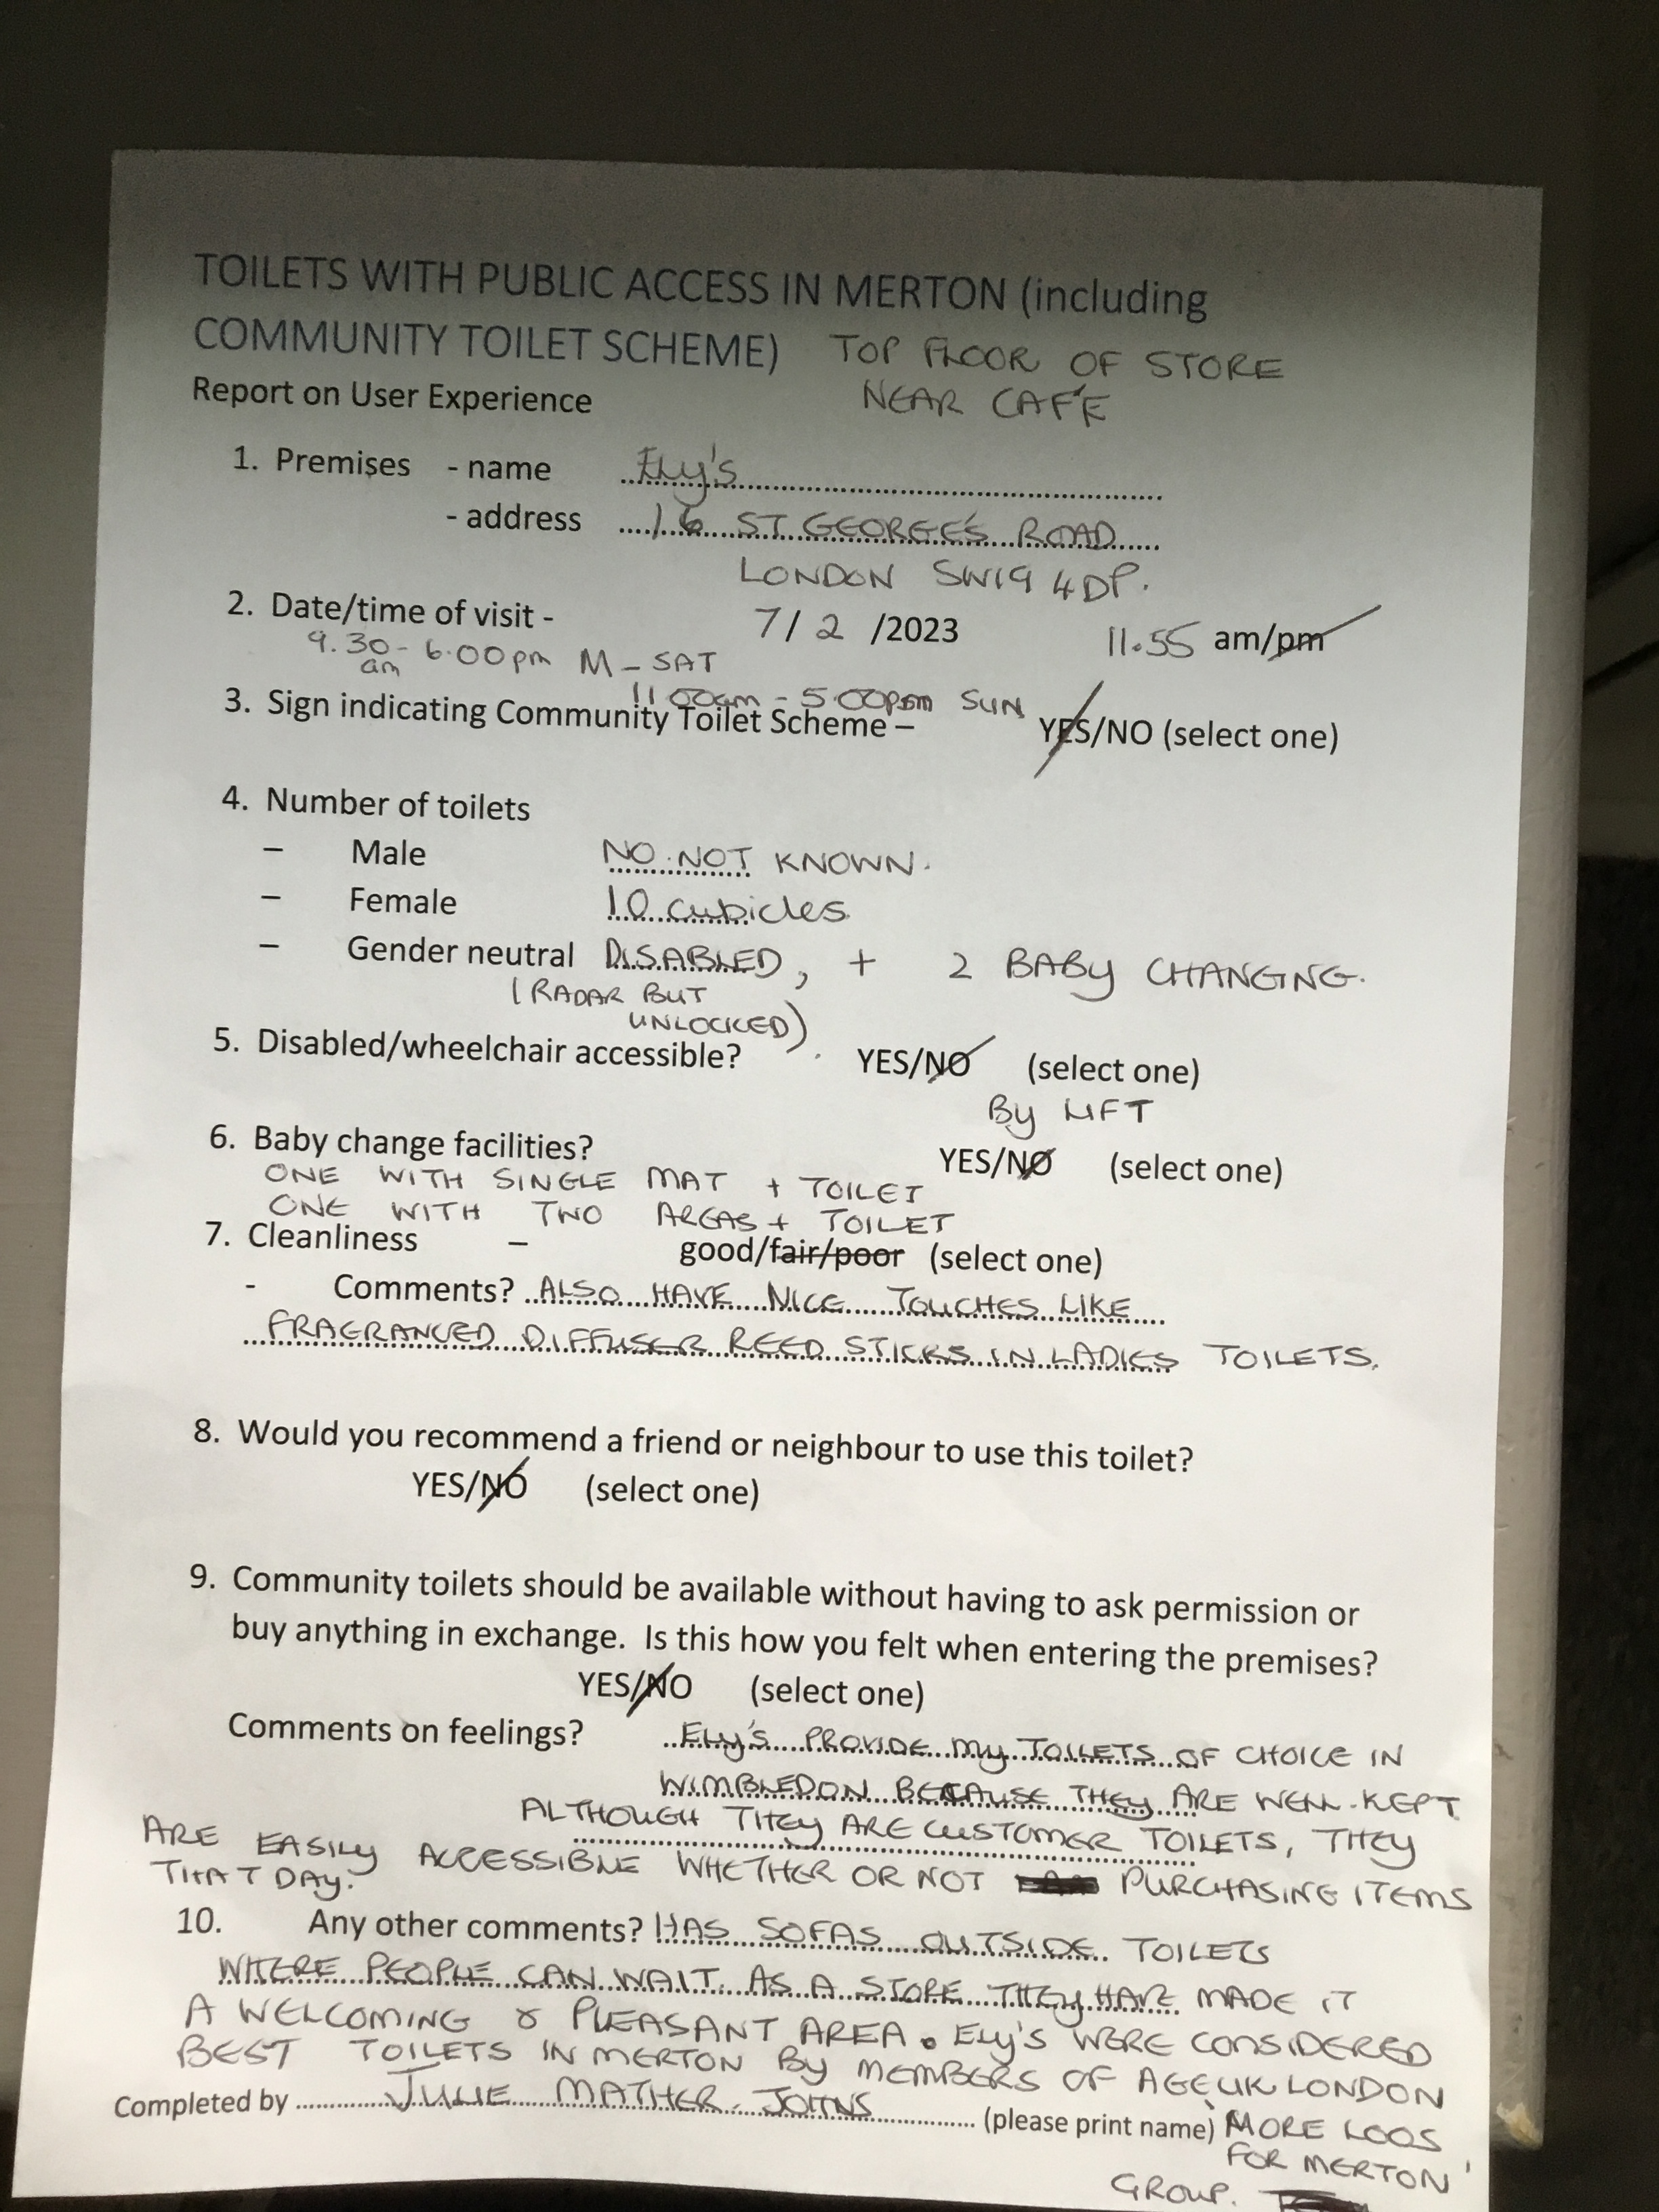
Achievements so far.
Influenced the questions asked in the council’s public survey
Created a unique evidence base about provision in Merton, which is being used to demonstrate to the council that they could significantly improve provision in Merton.
Council have recognised the need to radically improve the current Community Toilet Scheme.
London Assembly interest in improving the situation in Mordern with possible tube station toilet.
Reflections on the campaign

Slide 18
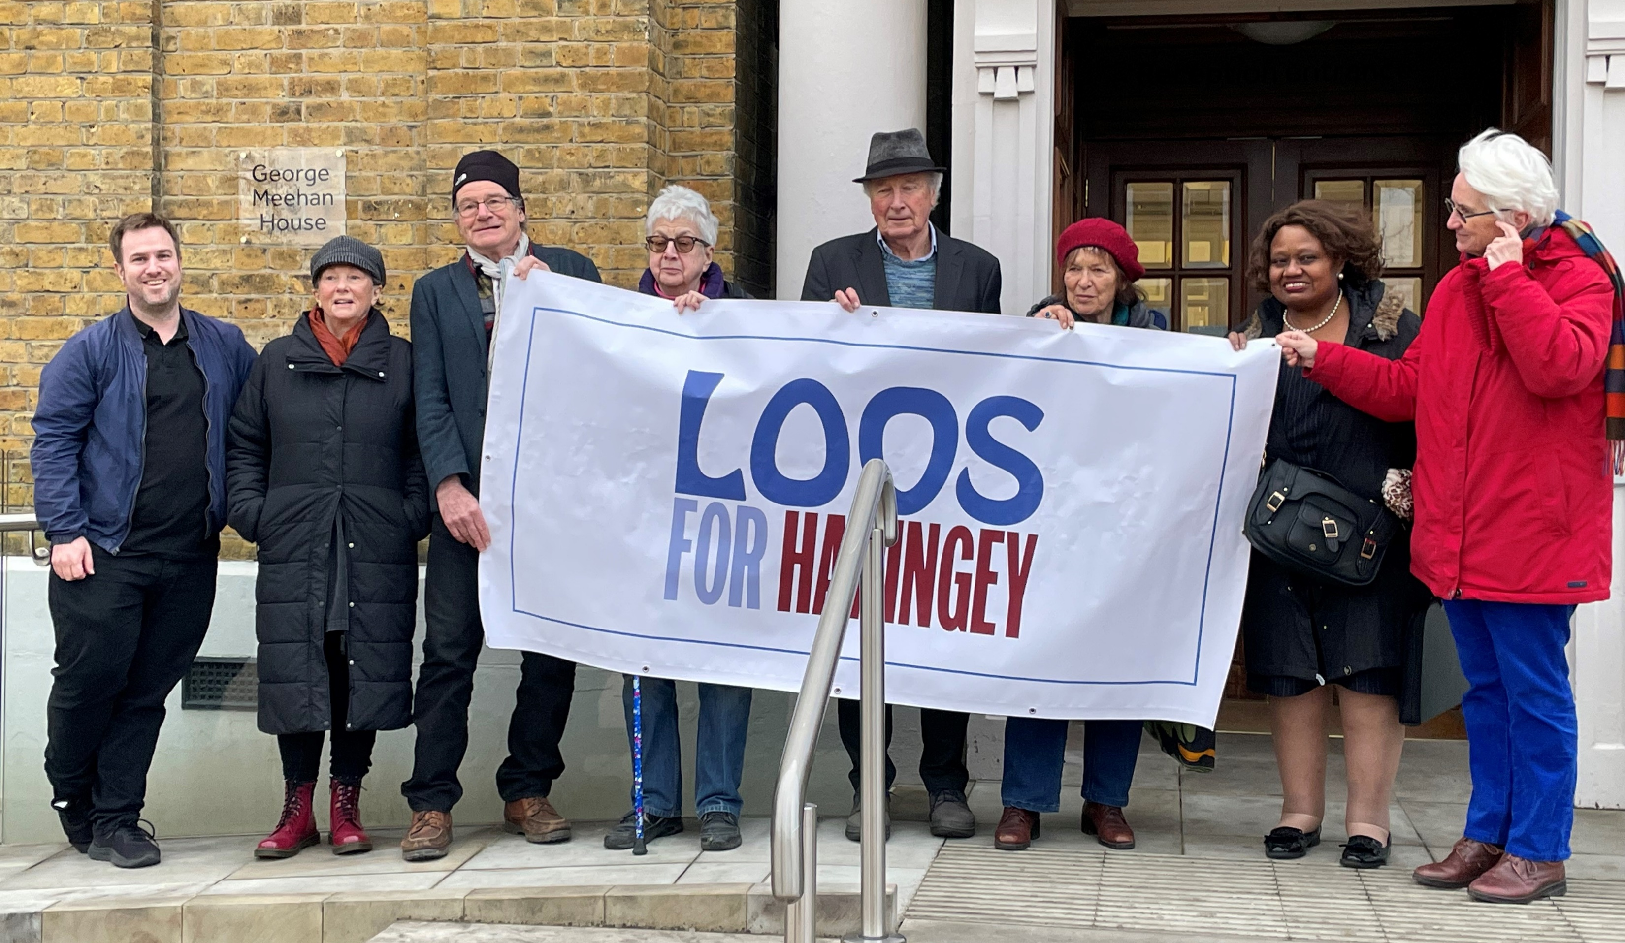
Loos for Haringey

Slide 19
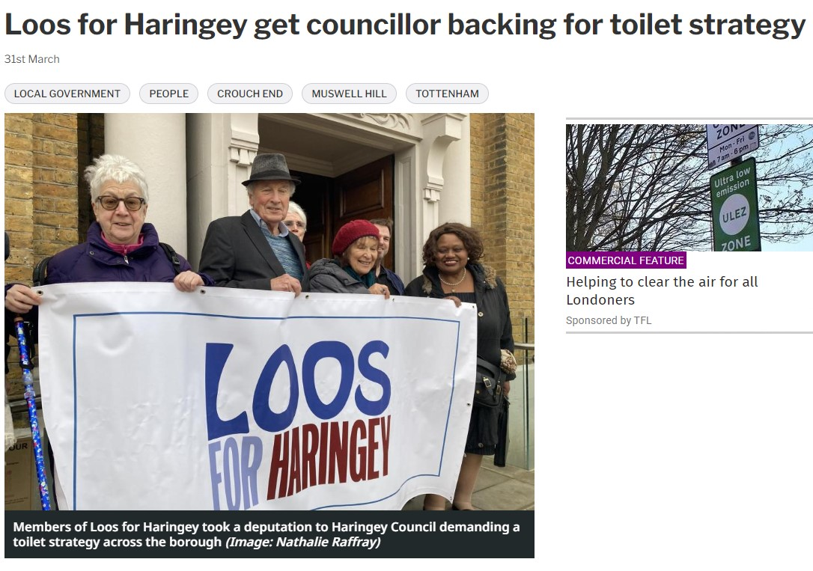
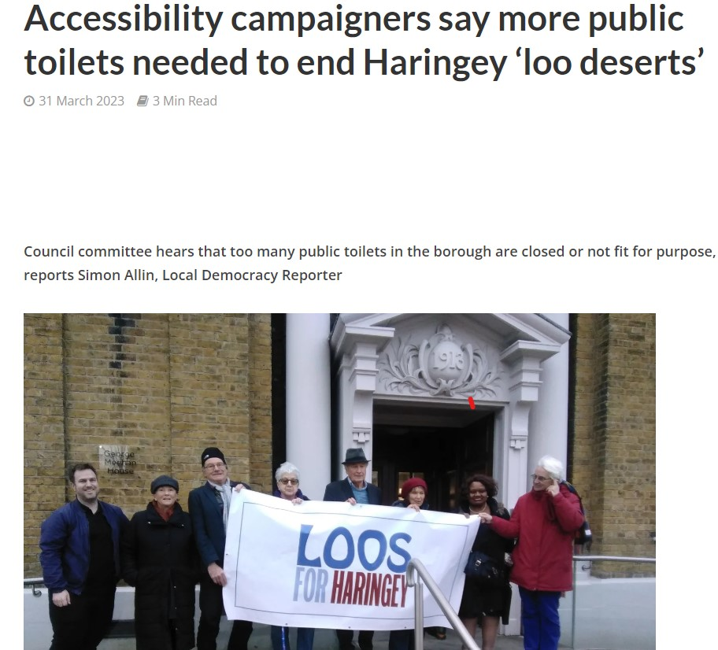
Loos for Islington

Slide 20
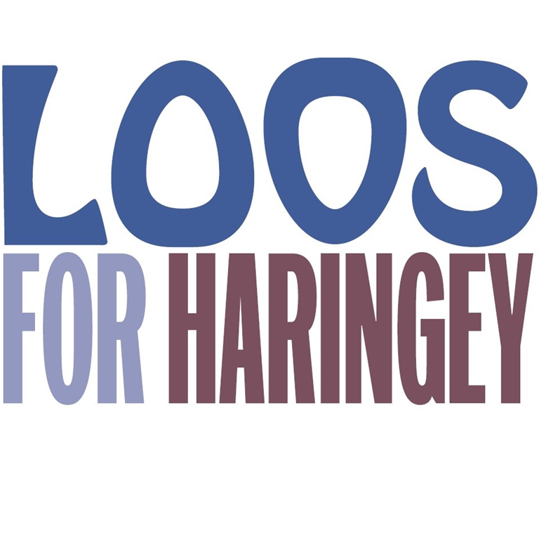
What did you want the council to do?
A meeting with a nominated Cabinet Member to discuss our serious concerns.
London Borough of Haringey to develop and implement a strategy for improving the provision of public toilets in the borough, and to report early in 2023-24 financial year on interim improvements.

Slide 21
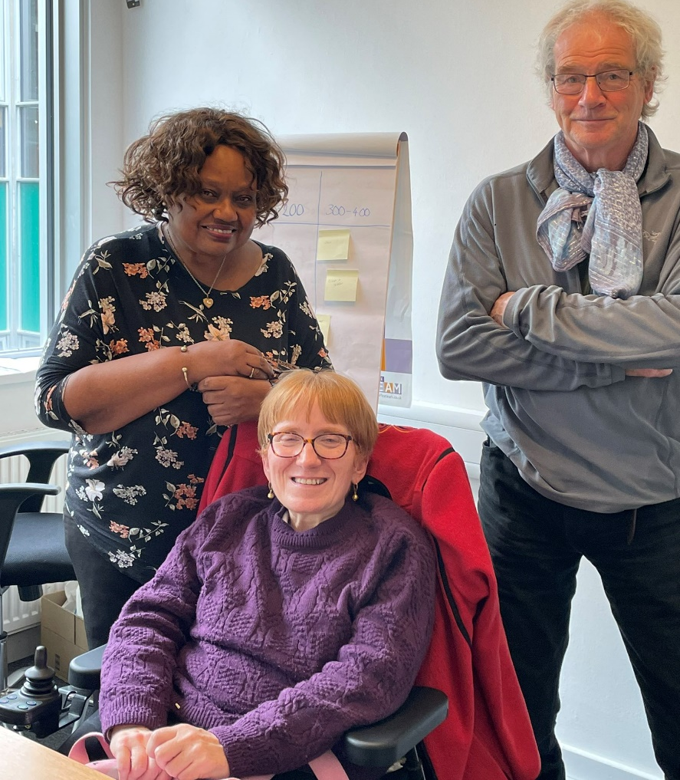
Activities
Deputation at Overview and Scrutiny Committee.
2 x local press articles.
Meeting with Cabinet Member for Health and Director for Public Health.
Case studies of Haringey ‘loo deserts’ and applying pressure for action at Tottenham Hale retail park.

Slide 22
Achievements so far.
Council has agreed to produce a public toilets strategy with short-term and longer-term actions.
Agreement for Loos for Haringey to be on steering committee.
Council to carry out detailed needs assessment
Council to review the current advertised community toilet scheme.
Reflections on the campaign

Slide 23
Discussion

Slide 24
What makes a good campaign? What was effective? Anything you would do differently?

Slide 25
Other campaigns
Notes:
CAMPAIGNS - - KOVE – YVONNE – LYNNE FRIEDLI – ACORN NEWCASTLE – ACORN BRISTOL
INNITIATIVES – TMLG – MARGIT – GREENWICH (JANE HOPKINS) - GREAT BRITISH PUBLIOC TOILET MAP

Slide 26
Next steps with the London Loos campaign
New groups in barnet and southwark
ASKING COUNCILLORS TO SUBMIT CAMPAIGN MOTION
More work to engage councils

