Slide 1
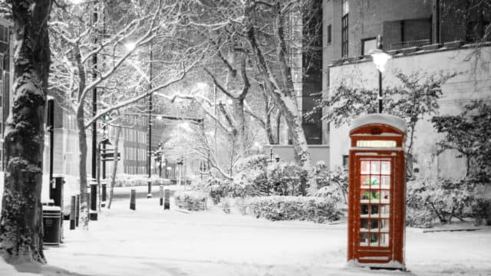


Keep well this winter
With
Dr Oge Ilozue
GP Partner and Trainer
Clinical Advisor, Vaccination Programme NHSE London region

Slide 2

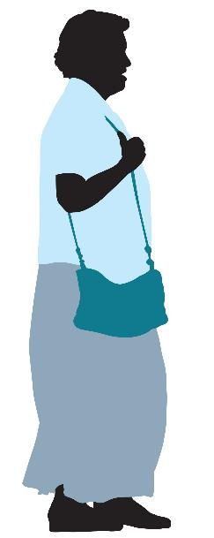
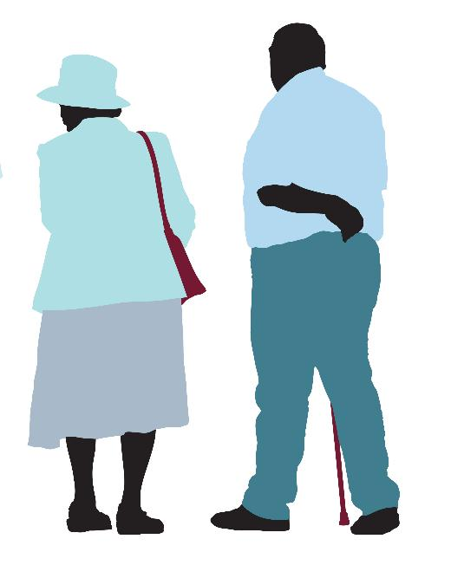
Flu occurs every winter which is why it’s often called seasonal flu
If you’re worried about your health, or your family’s health, don’t delay, get the care you need this winter.
Winter conditions can be bad for our health, especially for older people and people with long-term conditions.
Being cold can raise the risk of increased blood pressure, heart attacks and strokes. The cold and damp weather can all aggravate any existing health problems and make us more vulnerable to respiratory winter illnesses.
Staying in more can affect our mental health.
There are lots of things you can do to stay well this winter…

Slide 3




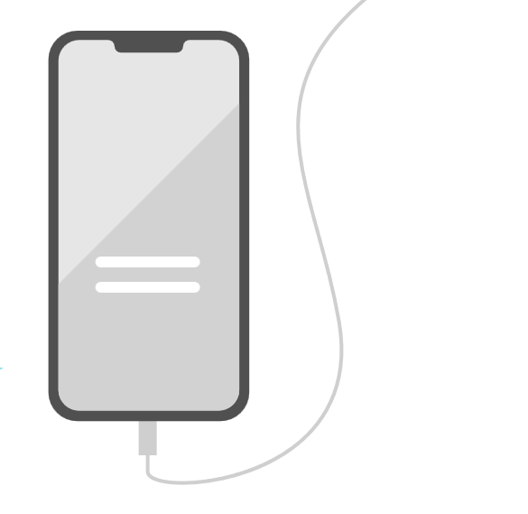
Look after your mental health
Eat well
Keep in touch
Here to help
111
Keep in touch with your friends, neighbours and family. Reach out if you need any practical help and tell somebody if you’re feeling under the weather.
When you have visitors, it can help stop the spread of germs to ventilate the room for a few minutes before and after they arrive if it’s not too cold.
The winter months can take a toll on our mental wellbeing.
If you are feeling down, speak to someone – a friend, family member, or a healthcare professional like your doctor.
Don’t hesitate if you are worried about your health or feeling down, contact your local pharmacist, 111 or your GP, who will all be able to offer advice and support.
In an emergency dial 999.
Try to eat at least one hot meal a day.
Eat a balanced diet with lots of seasonal fruit and vegetables.
Stay hydrated. Regular meals and hot drinks can help you keep warm.

Slide 4
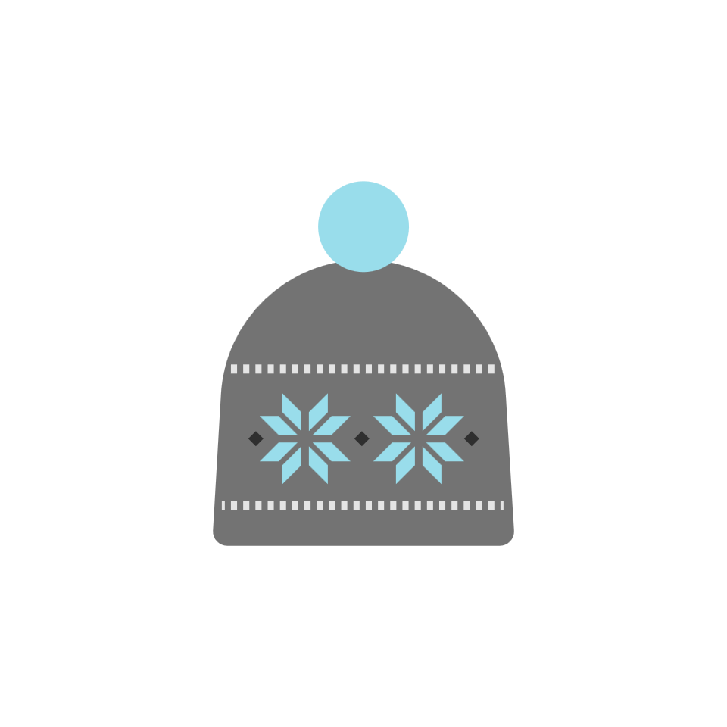


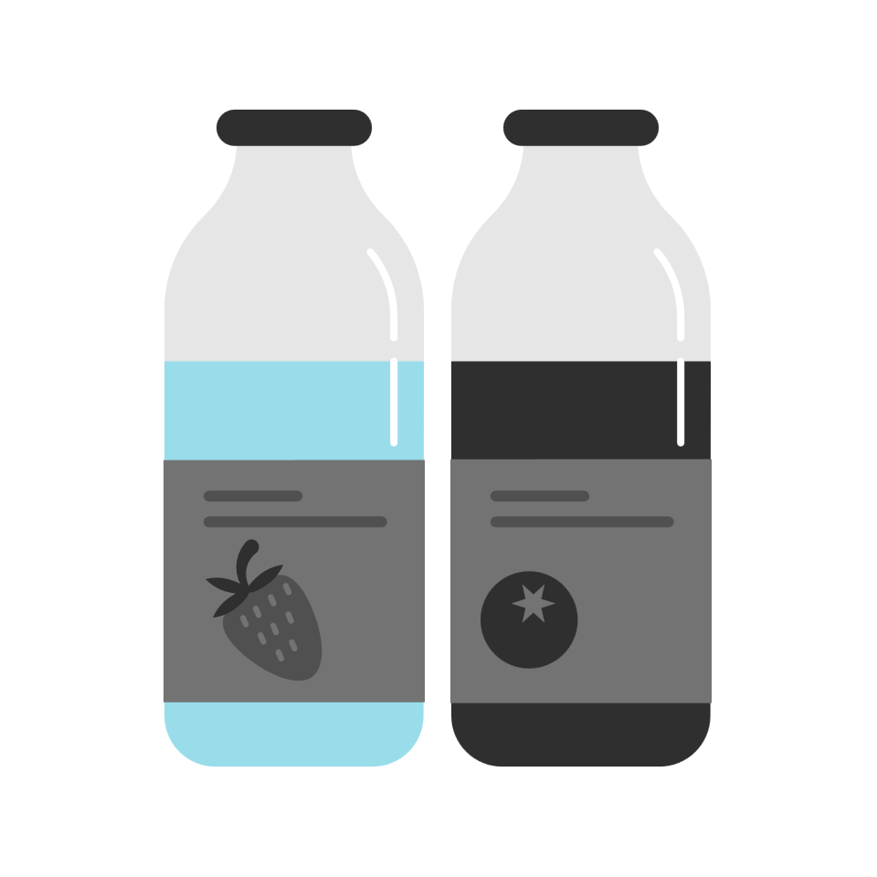
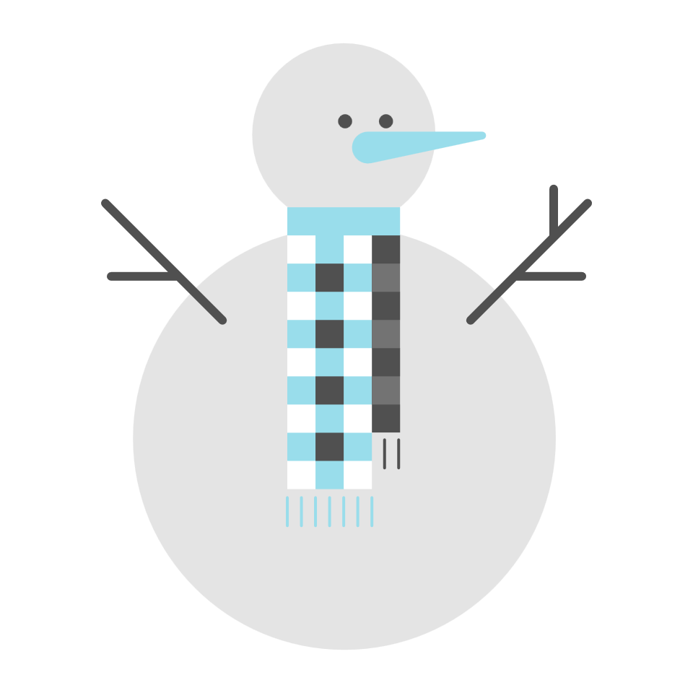

Stay warm
Stay active
Stay well
Stay safe
Regular exercise can help improve your physical and mental health and there’s evidence that people who are inactive have an increased risk of heart disease, stroke, type 2 diabetes, some cancers, depression and dementia.
Try to make sure everyone in your family moves around indoors and avoids sitting for more than one hour.
Wrap up in lots of layers of thin clothes, even when you go to bed. Keep doors and windows closed to block draughts.
Try to heat rooms you regularly use to at least 18°C.
Make sure you're getting the help you're entitled to with your heating costs by calling Citizens Advice on 0808 223 1133.
It's important to be careful when out and about. In the autumn, fallen leaves and rain can make the ground very slippery. And in winter, ice and slow can seriously increase your risk of falls.
You might find that shoes with non-slip soles or with a good grip are helpful. Consider keeping salt and sand mixture handy to grit paths. You could ask your neighbours for help to clear paths or driveways in bad weather.
Don’t delay treating minor winter ailments like colds or sore throats. Ask your local pharmacist for advice on treatment.
If bad weather is forecast, make sure you have enough medication and food in case it’s harder to leave the house.

Slide 5

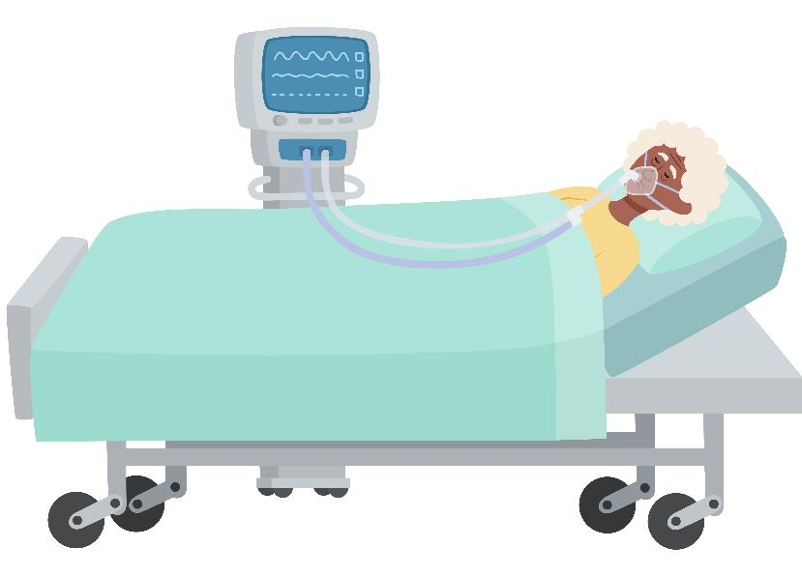
Viruses spread more easily in colder months because we spend more time indoors with others.
We are already seeing many potentially serious viruses circulating in our communities including flu, and getting vaccinated ahead of winter is by far our best defence.
In previous winters, over 49,000 people were hospitalised with flu and 2,000 were admitted to an intensive care unit.
(Source: UKHSA)

Slide 6

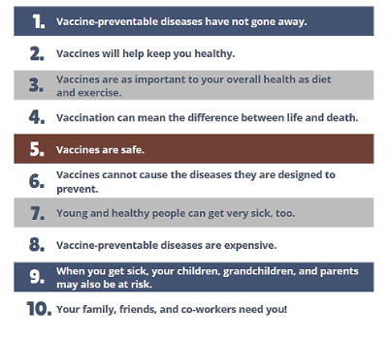
The ten benefits of vaccination
Flu vaccines help protect against the DIFFERENT types of flu viruses circulating EVERY year.
are indeed preventable.
neighbours and community need you!

Slide 7
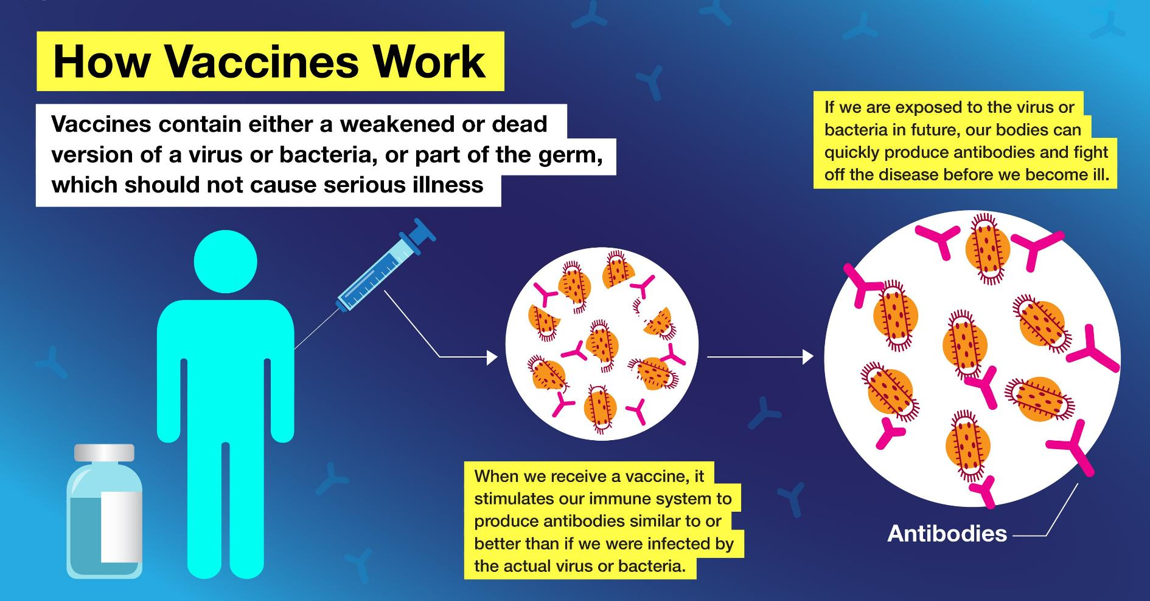

Slide 8


You can get your free NHS flu vaccine
From 1 October 2025 until the 31 March 2026 if you are:
aged 65 years and over
in a clinically at risk group
in long-stay residential care homes
a carer in receipt of carer’s allowance
the main carer of an elderly or disabled person
a close contact of an immunocompromised individual

Slide 9
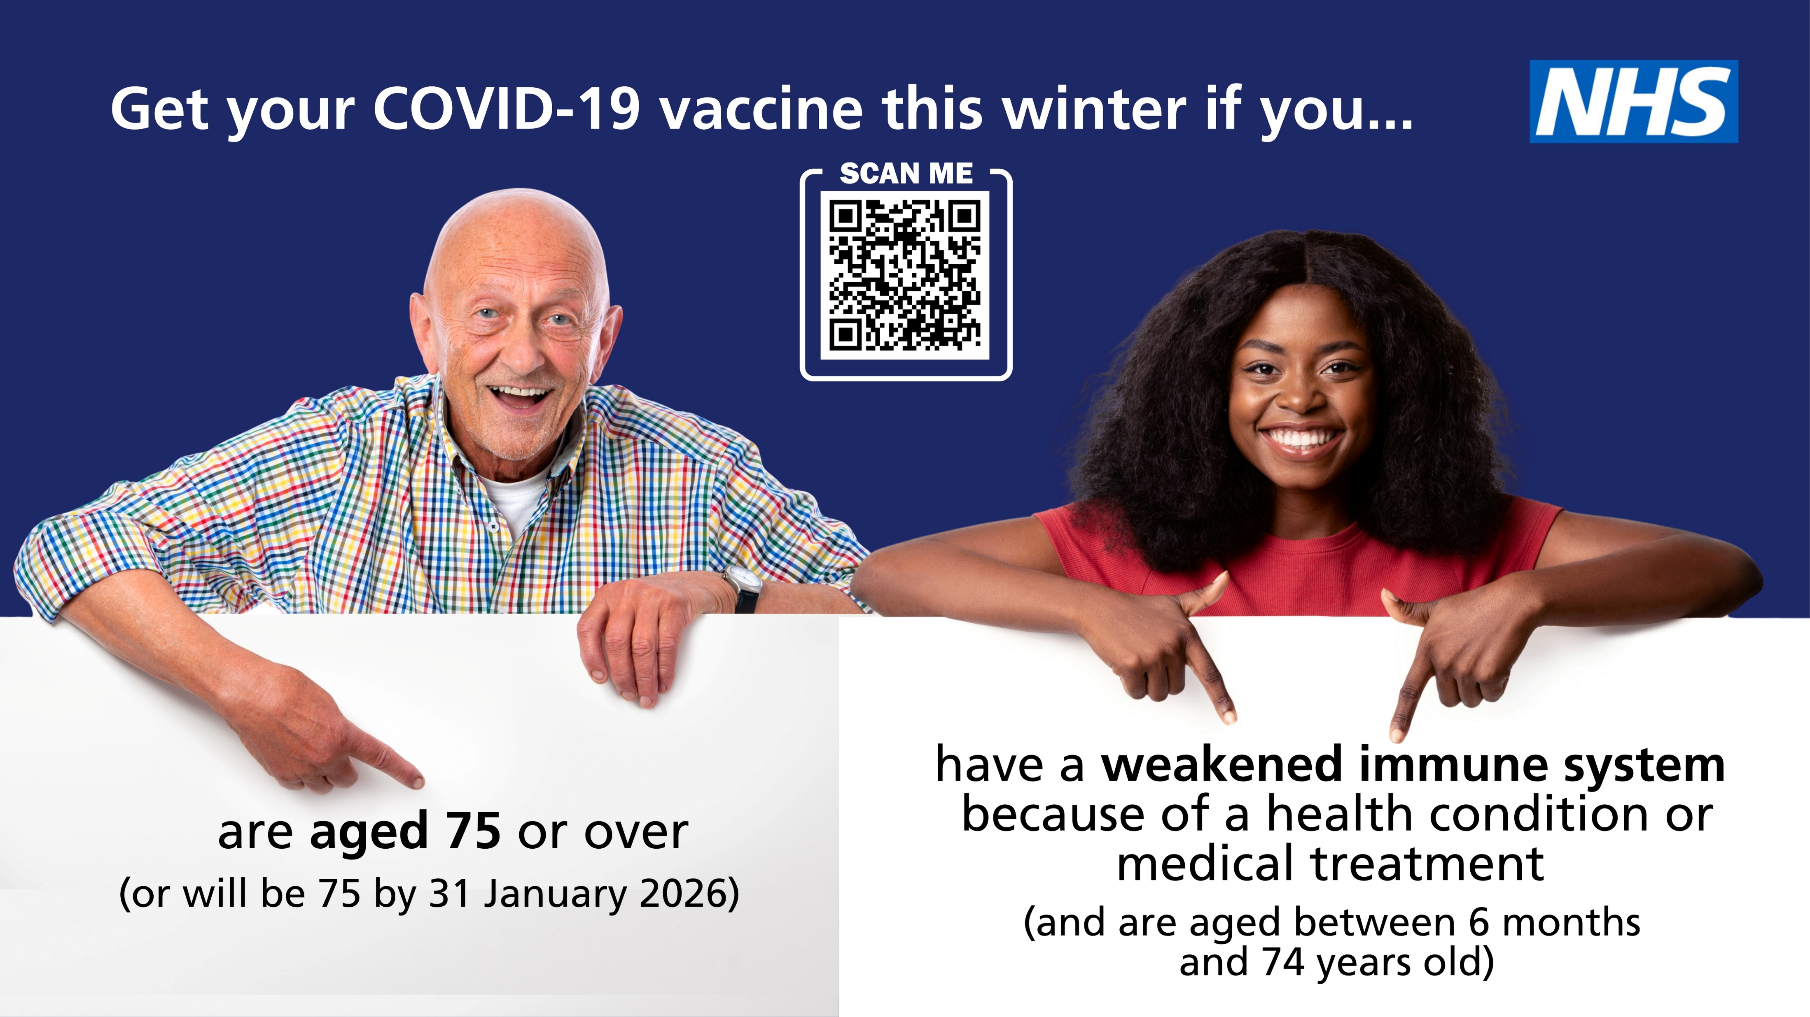

Slide 10

Flu is caused by influenza viruses that infect the windpipe and lungs
ADULT VACCINE | LONG-TERM HEALTH CONDITIONS | SEVERLY WEAKENED IMMUNE SYSTEM | OVER 65 | OVER 75
RSV |  |  |  | Yes (75-79)
FLU | Yes Plus, older or disabled person’s main carer | Yes Plus, close contacts of the person with a severely weakened immune system | Yes | Yes
SHINGLES |  | Yes over 18 | Yes | Yes (75-79)
COVID-19 |  | Yes |  | Yes
Respiratory Syncytial Virus (RSV) is a common lung virus which can cause pneumonia and infant bronchiolitis.

Slide 11


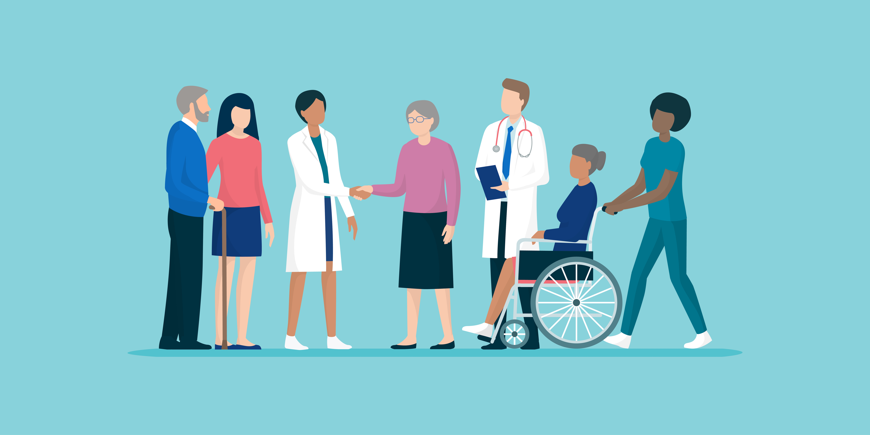
The injected winter vaccines DO NOT contain any live virus so CANNOT give you flu or covid
These vaccines have been rigorously tested, are constantly monitored and we know that the benefits of having the vaccinations far outweigh any risk.
It is completely understandable to have questions or concerns about whether or not it is right for them to receive the vaccines.
But there is so much misinformation out there. So, if you do have questions or concerns, I encourage you to speak to a trusted healthcare professional. This can be your GP, pharmacist, practice nurse, health visitor or consultant, all of whom can provide evidence-based information.

