Slide 1

How will Parliament scrutinise Brexit?
17/05/2017
@YourUKParl

Slide 2
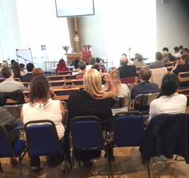
Outreach and Engagement Service
A service from the Houses of Parliament
Politically neutral
Aim is to increase the public’s knowledge and engagement with work and processes of Parliament
Not an alternative to MPs

Slide 3
Session objectives
By the end of this session, you will know:
What is Parliament
What does Parliament do?
What are Select Committees?
What do Select Committees do?
How does Parliament scrutinise the work of the Government with regards to Brexit
Notes:
http://www.parliament.uk/education/about-your-parliament/introduction/
Stop at Your Voice

Slide 4
1. Parliament is made up of:
a) House of Commons and House of Lords
b) House of Commons and Government
c) Government and Monarch
d) House of Commons, House of Lords and Monarch

Slide 5
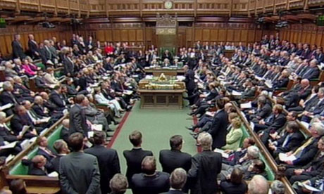
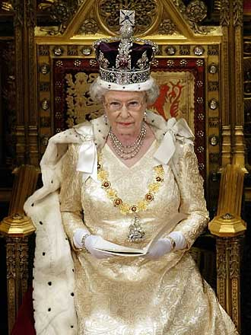
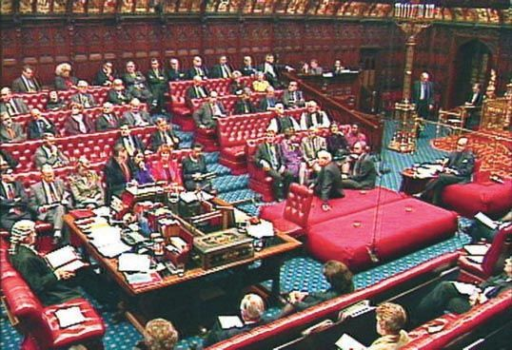
House of Commons (MPs)
Monarch
House of Lords
(Peers)
Notes:
Lets remind ourselves of what Parliament is made up of
There are three parts…

Slide 6
2. Which TWO answers describe the work of Parliament?
a) running Government departments
b) checking up on the work of Government
c) being the highest court of appeal in the UK
d) making new laws

Slide 7
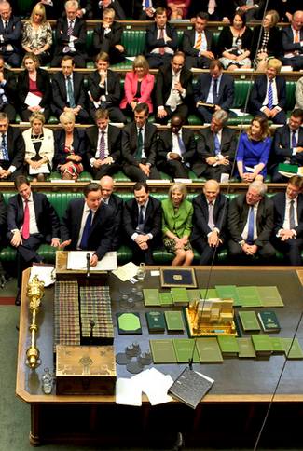
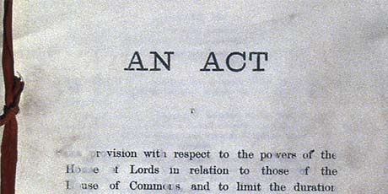
What does Parliament do?
Makes and passes laws
(Legislation)
Holds Government to account (Scrutiny), including enabling them to set taxes
Raises key issues
Notes:
Legislation must be approved by both houses (for the most part). Proposed legislation will go through the same stages/ levels of scrutiny in both houses.
Both houses play a key role in this.
Taxation: this is something that only the House of Commons is involved in. This is because (since 1911) only elected members have had a say in financial matters.

Slide 8
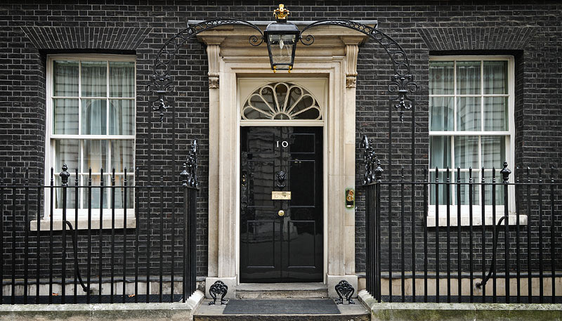
The Government
The party/parties who can command the
confidence of the House of Commons
forms the Government.
The Government:
runs public departments i.e. The Home Office, NHS
proposes new laws to Parliament
is accountable to Parliament

Slide 9
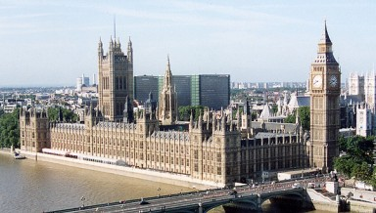

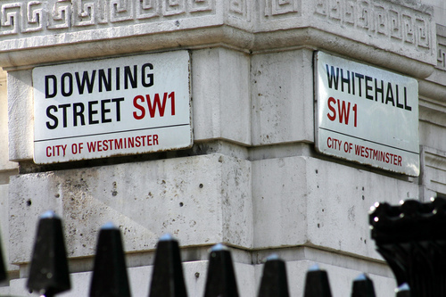

Parliament
(Westminster)
Government
(Whitehall)
Commons, Lords, Monarch
Holds Government to account
Passes laws
Enables taxation
Represents public
Raises key issues
Some MPs and some Lords
Chosen by the Prime Minister
Runs Government departments and public services
Accountable to Parliament

Slide 10
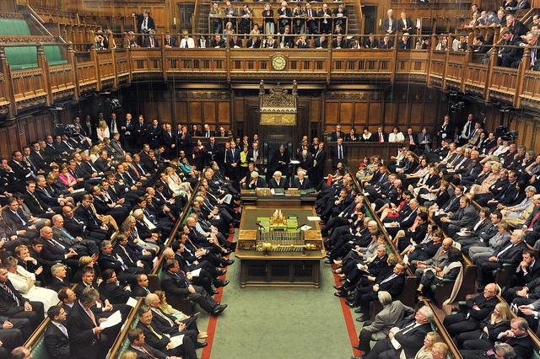
3. How many MPs are there in the House of Commons?
a) 678
b) 664
c) 650
d) 659

Slide 11
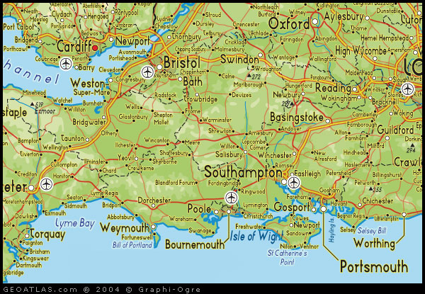
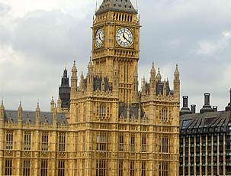
The Work of an MP
Helps constituents with problems
Visits groups and individuals to hear issues/ concerns
Represents constituents to various bodies
Campaigns
Represents their constituency
Raises issues on behalf of constituents
Passes new laws
Scrutinises the work of Government
In constituency
In Westminster

Slide 12
6. How can people become members of the House of Lords?
a) Members of the public nominate them
b) An independent Commission recommends them
c) The Prime Minister chooses them
d) Their titles are passed down to them
through their family
e) All of the above

Slide 13
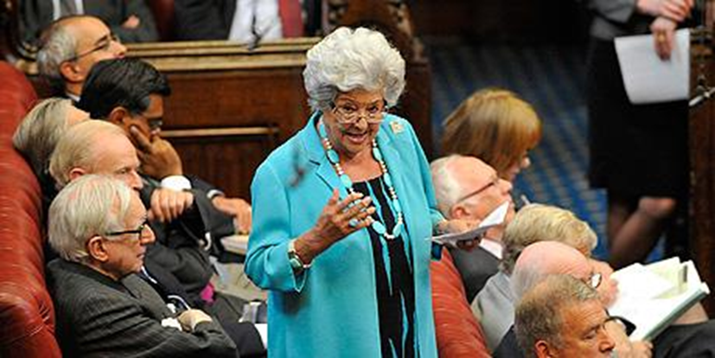
The House of Lords
The House of Lords is the second chamber of Parliament, often known as the revising House
There are currently 809 Members (as at December 2016)
These include:
  692 Life Peers
  92 Hereditary Peers
  26 Bishops

Slide 14
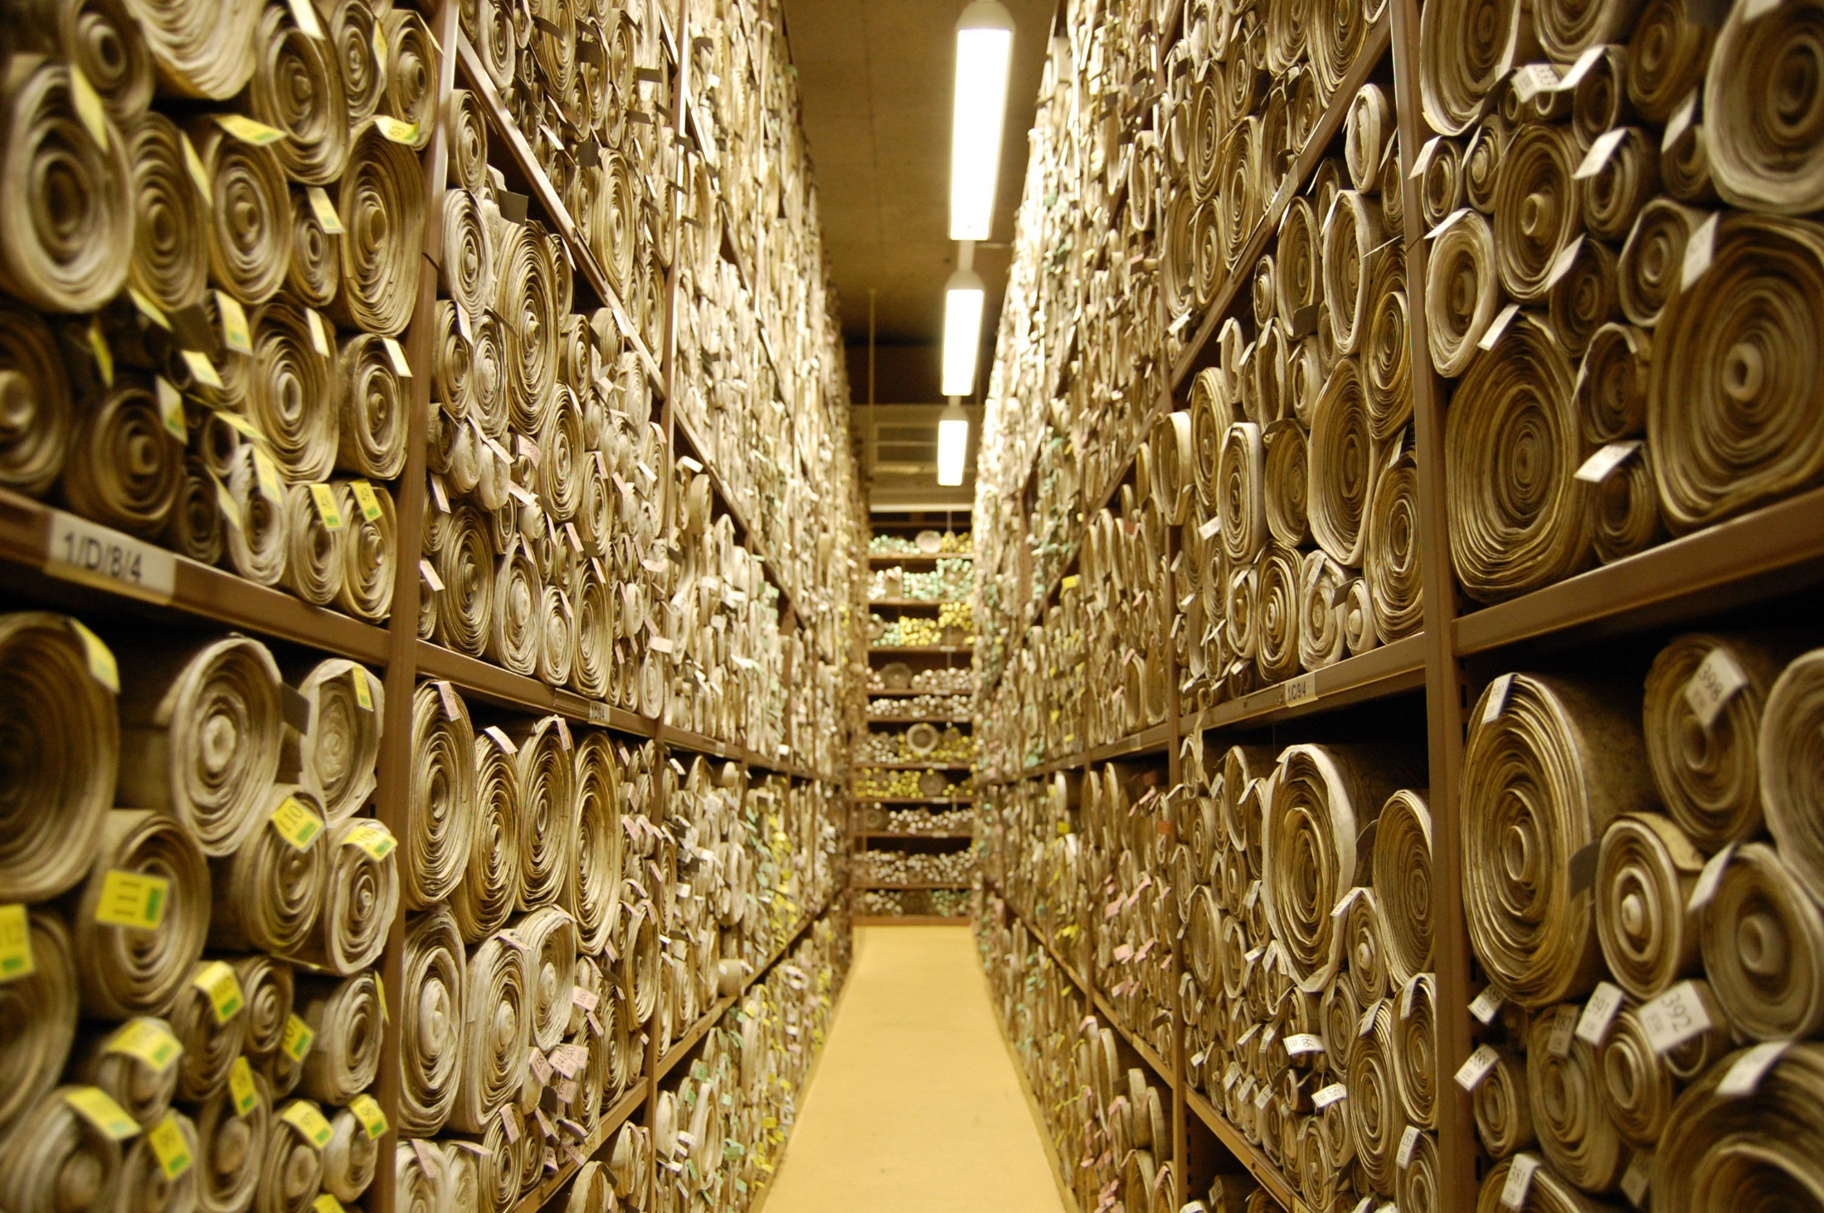
www.parliament.uk/get-involved

Slide 15
What are Select Committees?
Select Committees scrutinise the work, policies and spending of the UK Government
They run in-depth inquiries
They want to hear public’s views and experiences
The Government must respond to their reports (after 2 months)
Notes:
Select Committees
An inquiry will begin with the committee in question announcing the subject of an inquiry, and making a call to any groups or organisations with an interest in the inquiry subject to submit written evidence. In making the call for evidence, the committee will ask a number of questions that it wants groups to answer in their evidence. The call for evidence will also come with a deadline.
After the deadline for written evidence, the committee will then call a selected number of people to give oral evidence in Parliament. We should emphasise the majority of people that submit written evidence do not get called to an oral evidence session due to the sheer number of people submitting evidence.
The written and oral evidence will then be collated, which summarises the evidence received, and makes a number of recommendations. The report is then sent to the relevant Government department who will make a formal response.
They are a great way for groups and organisations to give their views and experiences directly to Parliament.
You may occasionally hear news reports refer to ‘an influential group of MPs’. These are usually Select Committees. They can often have a direct influence on Government policies.
House of Lords Select Committees draw on the experience of their members to conduct internationally respected investigations into specialist public and policy issues.
Unlike House of Commons committees, House of Lords committees take a broader, issues-focused perspective (eg communications, economic affairs, science and technology), not limited to the work of particular Government departments.
Membership
The majority of Commons Select Committee Chairs are now elected by their fellow MPs.
This applies to departmental committees and the Environmental Audit, Political and Constitutional Reform, Procedure, Public Administration and Public Accounts committees.
The other Committee members are nominated by their party after internal party elections.
http://www.parliament.uk/business/committees/committees-a-z/commons-select/international-development-committee/inquiries/parliament-2010/vaw/

Slide 16
What do Select Committees NOT do?
They do not directly make new legislation
They do not directly make amendments or changes to legislation
Not to be confused with Public Bill Committees

Slide 17
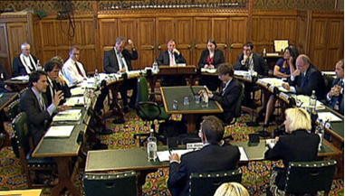
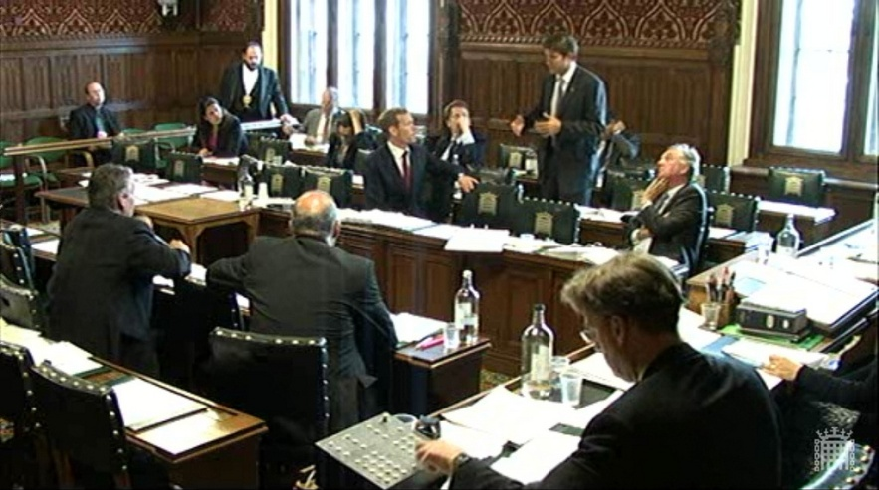
Deliberation versus debate
Select committee:
consensual horseshoe
General committee:
adversarial benches

Slide 18
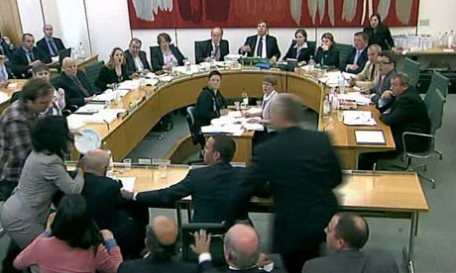
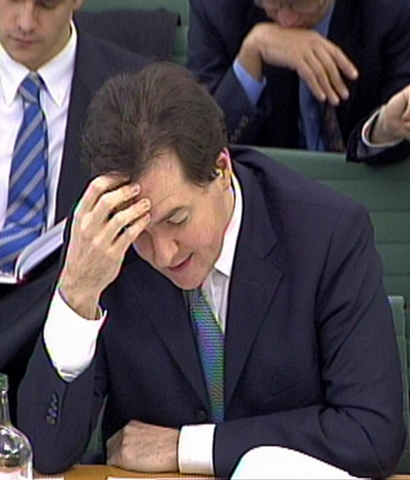
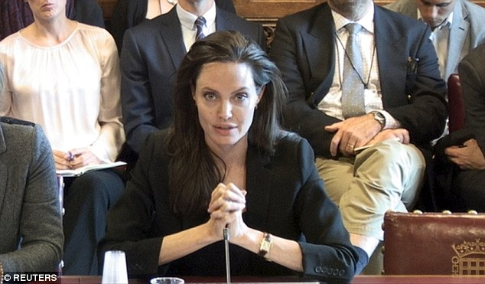
What do Committees do?

Slide 19
House of Commons Select Committees
There is one committee for each Government Department
They look into spending, policies and work of that dept.
The membership reflects the composition of the House of Commons
Notes:
Select Committees
An inquiry will begin with the committee in question announcing the subject of an inquiry, and making a call to any groups or organisations with an interest in the inquiry subject to submit written evidence. In making the call for evidence, the committee will ask a number of questions that it wants groups to answer in their evidence. The call for evidence will also come with a deadline.
After the deadline for written evidence, the committee will then call a selected number of people to give oral evidence in Parliament. We should emphasise the majority of people that submit written evidence do not get called to an oral evidence session due to the sheer number of people submitting evidence.
The written and oral evidence will then be collated, which summarises the evidence received, and makes a number of recommendations. The report is then sent to the relevant Government department who will make a formal response.
They are a great way for groups and organisations to give their views and experiences directly to Parliament.
You may occasionally hear news reports refer to ‘an influential group of MPs’. These are usually Select Committees. They can often have a direct influence on Government policies.
House of Lords Select Committees draw on the experience of their members to conduct internationally respected investigations into specialist public and policy issues.
Unlike House of Commons committees, House of Lords committees take a broader, issues-focused perspective (eg communications, economic affairs, science and technology), not limited to the work of particular Government departments.
Membership
The majority of Commons Select Committee Chairs are now elected by their fellow MPs.
This applies to departmental committees and the Environmental Audit, Political and Constitutional Reform, Procedure, Public Administration and Public Accounts committees.
The other Committee members are nominated by their party after internal party elections.
http://www.parliament.uk/business/committees/committees-a-z/commons-select/international-development-committee/inquiries/parliament-2010/vaw/

Slide 20
House of Commons Select Committees
Elected Chairs – elected by all MPs in a Secret Ballot
Normally 11 Members
Other members elected by MPs in their party

Slide 21
House of Lords Select Committees
Committees investigate policy areas rather than Government Depts.
European Union
Science and Technology
Communications
Constitution
Economic Affairs
The Lords also set up temporary committees to investigate specialist subjects
There is no set political composition

Slide 22
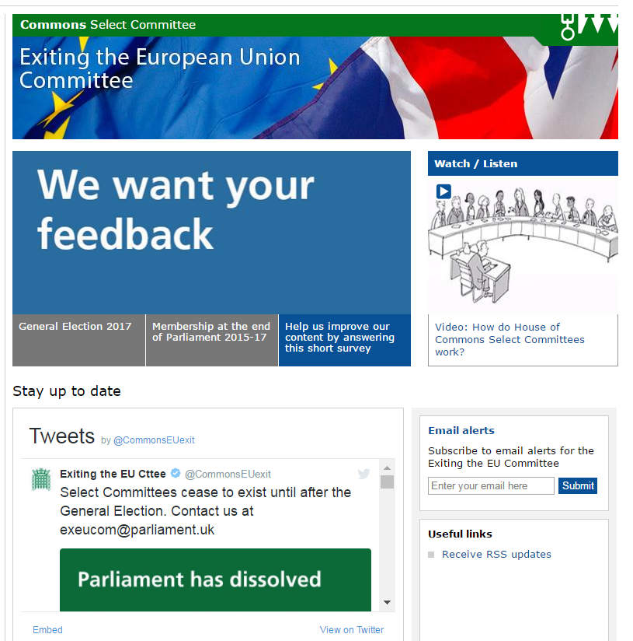
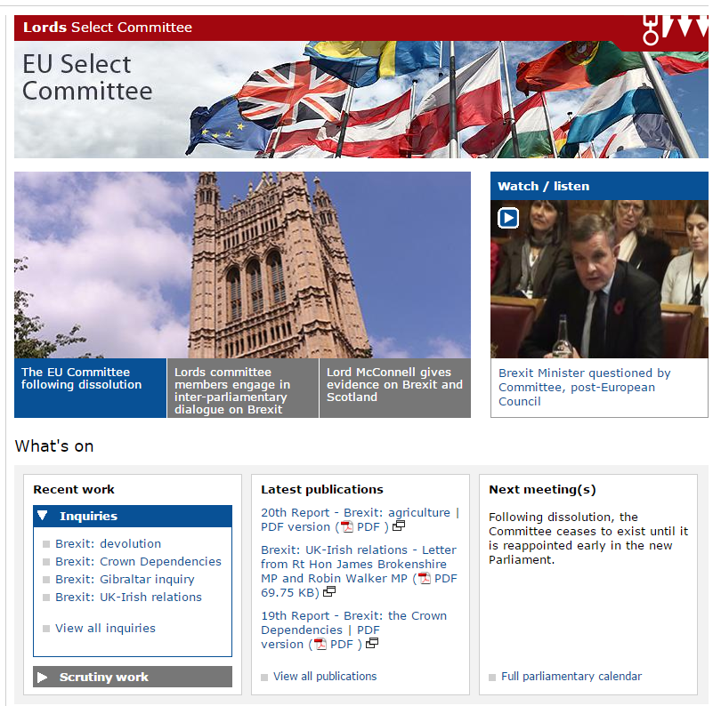

Slide 23
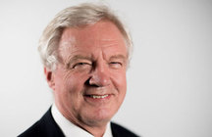

Secretary of State for Exiting the EU
?
Right Honourable David Davis (Con)
Sir Keir Starmer (Lab)

Slide 24
The Committee staff team
Clerk
Second Clerk
Inquiry manager
Specialist
Senior Committee Assistant
Committee Assistant
Committee Support Assistant
Specialist Advisers
Secondees, interns and external support

Slide 25
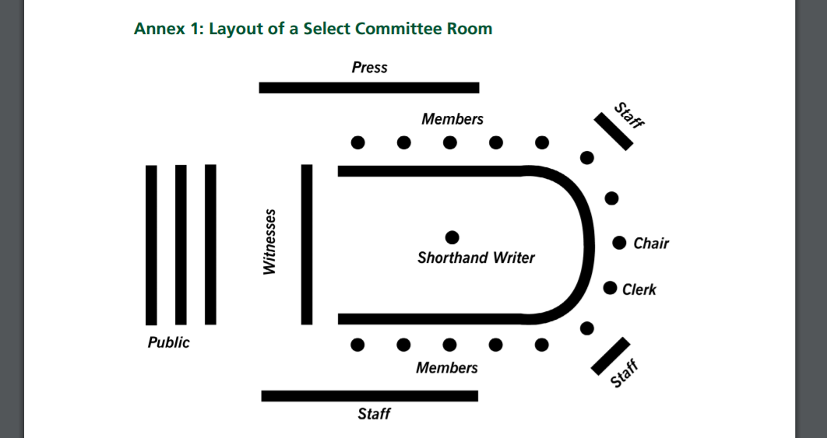

Slide 26
Inquiry Announced
Call for Evidence
Written Evidence Deadline
Oral Evidence Session
Report Preparation
Publication of Report
Government Response

Slide 27
Brexit: Agriculture Enquiry
The EU Energy and Environment Sub-Committee (Lords)
Terms of Reference: The EU Energy and Environment Sub-Committee is investigating the implications of Brexit for UK agriculture and food
Written Evidence Oral Evidence: -
National Farmers’ Union
National Office of Animal Health (NOAH)
Food Ethics Council
Campaign to protect Rural England
Professor Alan Matthews, Professor Emeritus of European Agricultural Policy and Former President of the European Association of Agricultural Economists
Professor Joseph McMahon, Professor of Law, Dean of Sutherland School of Law, University College, Dublin
Collate Evidence and produce report: Summary of conclusions and recommendations
Notes:
The EU Energy and Environment Sub-Committee is investigating the implications of Brexit for UK agriculture and food.
The Committee will be taking evidence from key industry representatives, academic experts and Government in order to identify priorities for a post-Brexit relationship with the EU.
The inquiry aims to inform the Government, the House and the wider public on the most important priorities for UK agriculture, in advance of the commencement of Brexit negotiations.

Slide 28
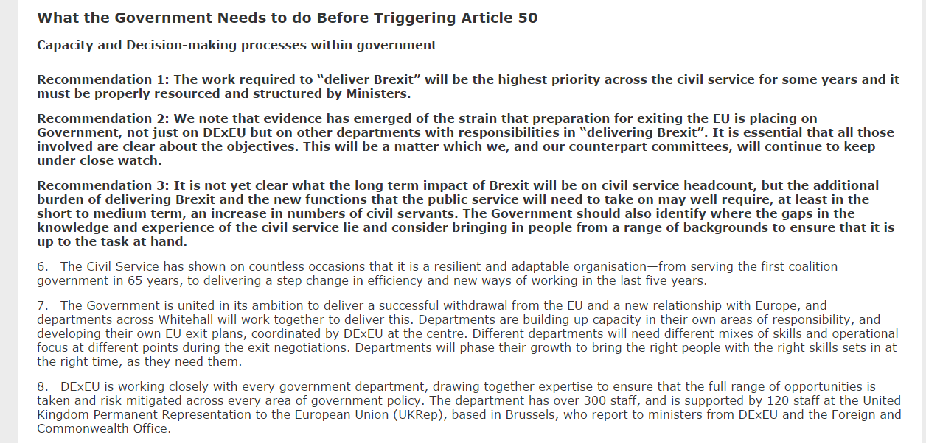
Example Government Response
The process for exiting the European Union and the Government's negotiating objectives: Government Response to the Committee's First Report

Slide 29
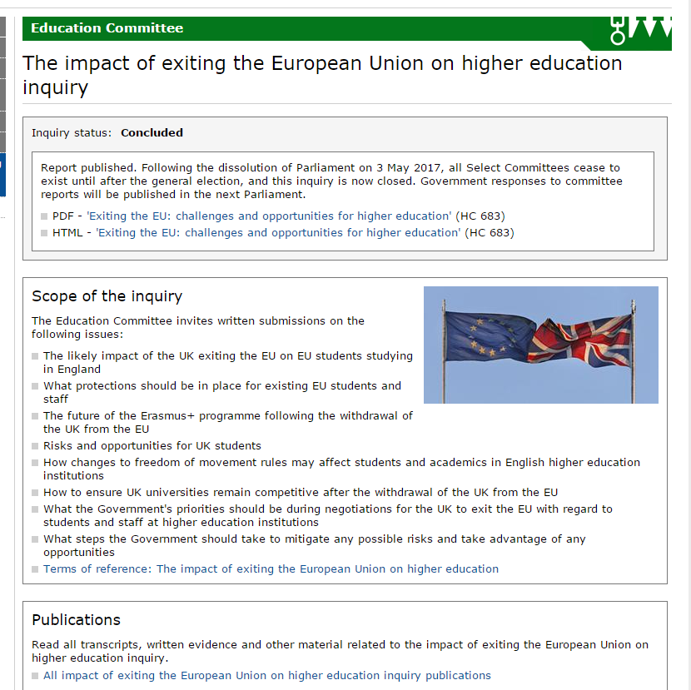
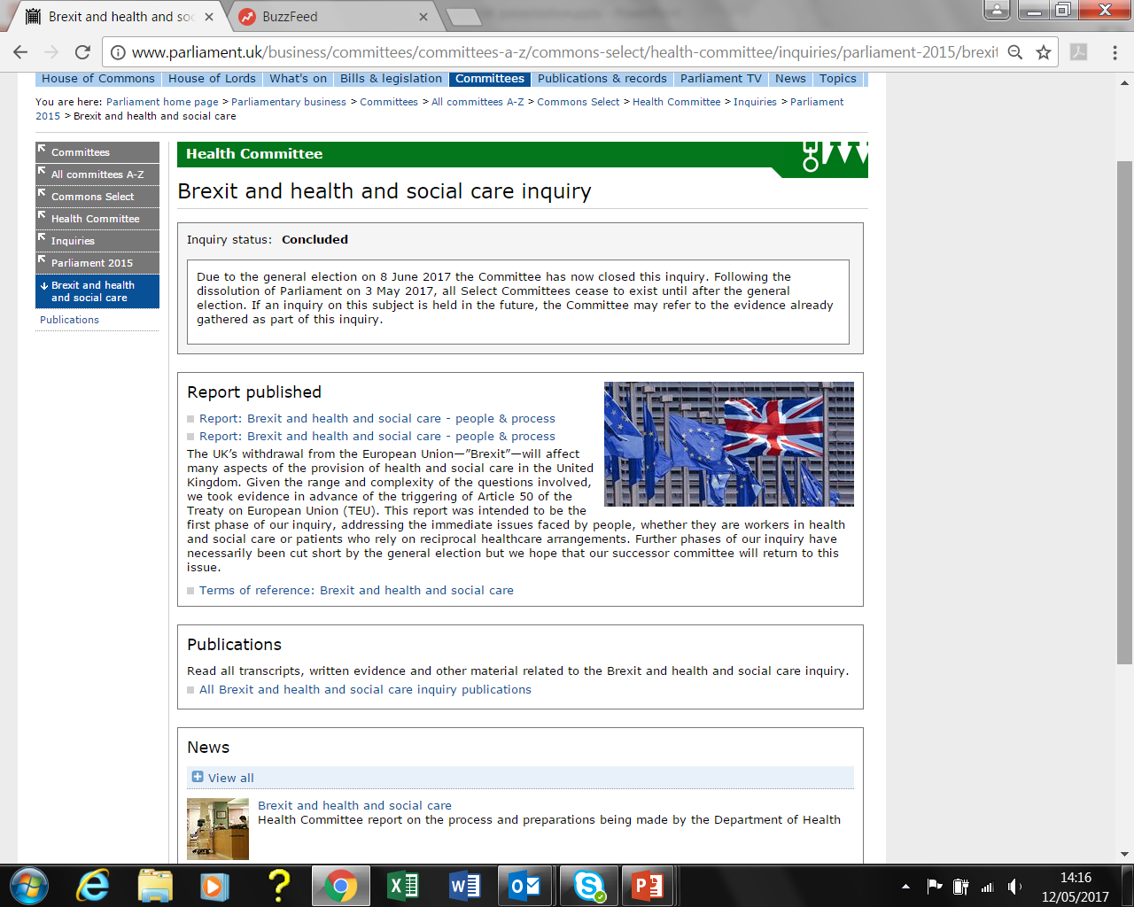

Slide 30
Parliamentary Questions
Written or spoken questions asked by MPs and Lords, directed at UK Government.
Can be used to:
Obtain information – statistics, policies, positions
Press for action
Raise constituency issues
Challenge Government policy

Slide 31
Mike Wood (Dudley South) (Con)
Will the Secretary of State consider holding a west midlands Brexit summit with the new mayor of the west midlands—who we hope will be Andy Street—and with key regional businesses, so that we can ensure that the interests of the west midlands are considered in the Brexit negotiations and that Brexit delivers for the west midlands as well as for the rest of the country?

Slide 32
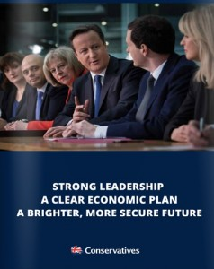
Government Bills
Are given majority of time
Are always Public Bills
Sources/ Influences:
Manifesto
Current events
Policy developments
Finance/ administration

Slide 33
Where can I get information?
www.parliament.uk and @yourUKParl
Commons Enquiry Service
  0800 112 4272 (Freephone) or 020 7219 4272 hcinfo@parliament.uk
Lords Information Office
  020 7219 3107 hlinfo@parliament.uk
UK Parliament Outreach and Engagement Service
  020 7219 1650 outreach@parliament.uk
Notes:
Feedback forms!

