Slide 1
Living well with diabetes
Age UK London
28 July 2017
Roz Rosenblatt
London Region Head

Slide 2
Diabetes is serious
Notes:
Something that is obvious but often underappreciated - diabetes is serious.
More than 3.5 million have been diagnosed with diabetes and the likelihood of developing diabetes grows with age - Over 60% of people with diabetes are aged over 60 (That’s 2m across UK; how many in London?). 472,000 in London.
Type 1 is an autoimmune condition that often appears in childhood but can develop at any stage of life.
In Type 2 diabetes, the body doesn’t make enough insulin, or the insulin it makes doesn’t work properly, meaning glucose builds up in the blood.
Type 2 diabetes is caused by a complex interplay of genetic and environmental factors. Type 2 diabetes usually occurs in middle-aged or older people.

Slide 3
Diabetes is serious
And there are 11.9 million people at increased risk of developing Type 2 diabetes
Notes:
And the complications that can arise from poor management of diabetes are staggering.
Vision loss
Dementia
Not only are complications enormously costly on a personal level…

Slide 4
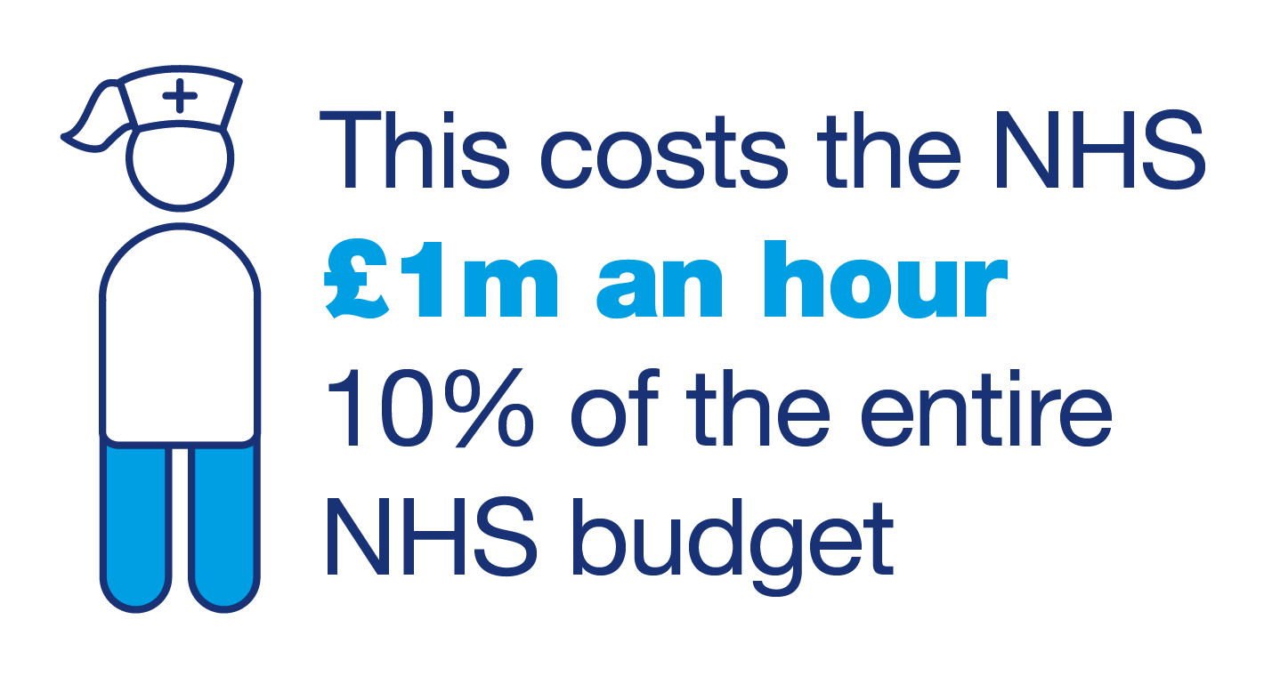
Notes:
They also cost the NHS a staggering £1m an hour.
But much of this could be prevented.
Effective and properly supported self-management plays an important role in this. Poorly controlled diabetes increases the risks of complications.

Slide 5
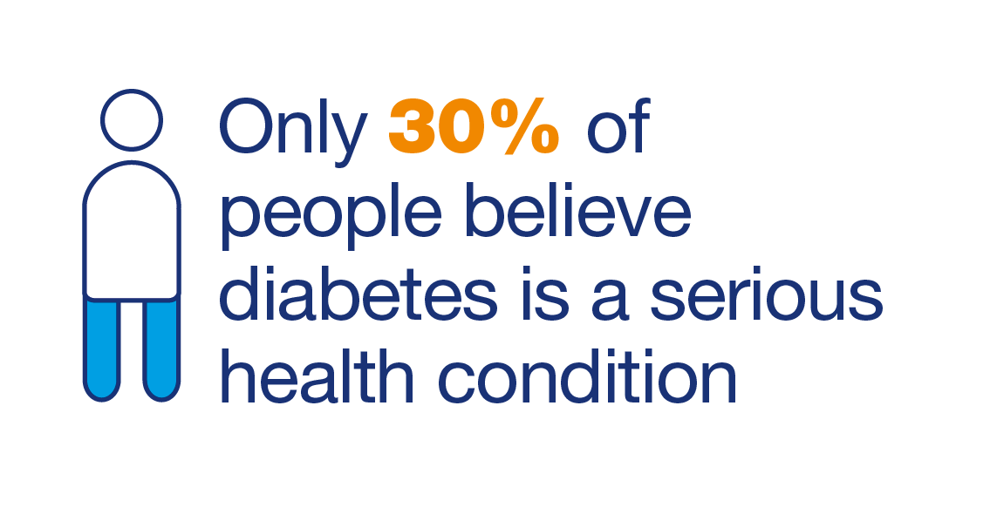
Notes:
We talked earlier about how serious people think the condition is… this needs to change. We need people to know more about the condition, understanding more about the seriousness and join us to fight for better care and fight against the stigma
Because ultimately we need more people to support us financially if we’re going to achieve a world where diabetes can do no harm

Slide 6
Self-care: National policy
‘long term conditions are now a central task of the NHS; caring for these needs requires a partnership with patients over the longer term rather than providing single, unconnected “episodes” of care’
Notes:
The future direction for NHS England’s approach to self-management for long term conditions was set out in the Five Year Forward View in 2014. This recognises that there is a greater need for supported self-care. It says ‘long term conditions are now a central task of the NHS; caring for these needs requires a partnership with patients over the longer term rather than providing single, unconnected “episodes” of care’. This should also involve things such as self-management education courses and peer support.
We know that both of these can make a big different to the self-management of diabetes.

Slide 7
Self-care: National policy
- NHS needs to adapt to older people’s needs
- Promoting healthy communities
- Voluntary sector collaboration
- A common, equitable approach to self-care
Notes:
Earlier this year, the NHS set out its next steps for the Forward View. This explicitly recognises that the NHS needs to adapt to the needs of our ageing population, and contains a commitment to promote healthy communities for people with long term conditions, based around collaborative working between the voluntary sector and primary care.
This is, in principle, an encouraging policy landscape. However, we know that too many people with diabetes do not always get the support they need to manage their condition as well as possible.

Slide 8
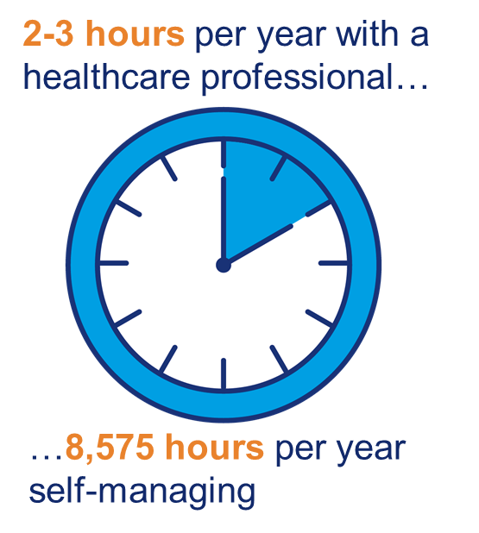
Self-managing diabetes
Notes:
Most areas of diabetes care and self-management will be the same for older people as they would be across other age groups.
Effective self-management is very important. People with diabetes spend only a few hours each year receiving direct support for their diabetes from healthcare professionals. Managing diabetes can be tough. People tell us that it can feel like a full-time job that you never go home from.
Getting the right care is therefore essential to maintaining wellbeing. There are 15 vital checks and services that everyone with diabetes should get for free from their healthcare team – some of these will be even more relevant for older people, whereas some will not apply (e.g. pregnancy advice). We encourage people to use this list to talk to their healthcare team about their individual needs as part of their annual care planning review.

Slide 9
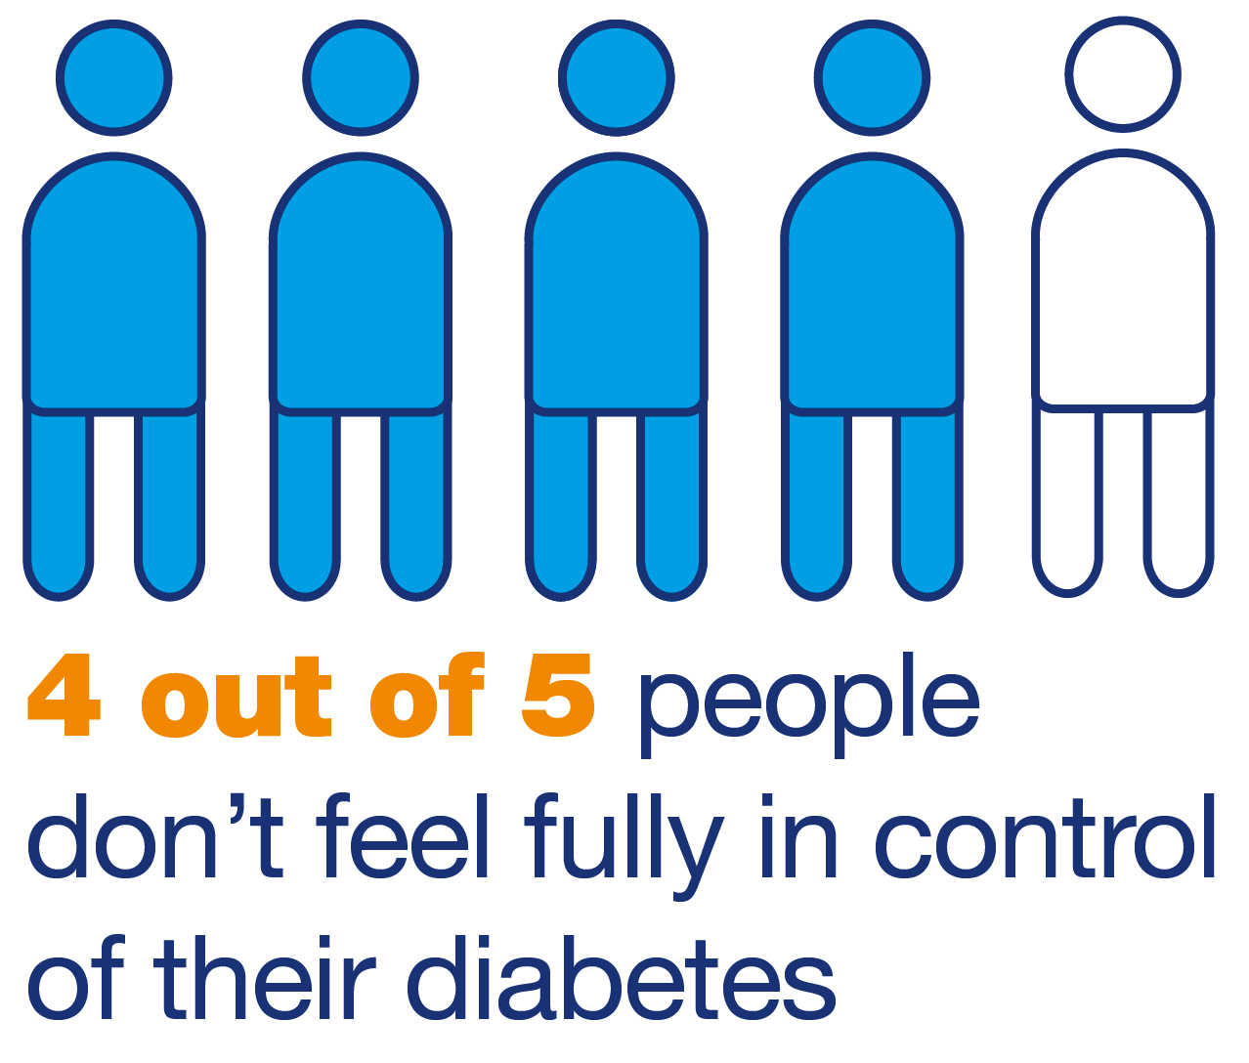
Notes:
With 80% of people not feeling fully in control of their diabetes it’s vital we help

Slide 10

Challenge: Diabetes education
All adults with diabetes should be offered a structured education programme
Should be part of the treatment of the condition
Older age is associated with poor uptake of education
Notes:
One of the 15 healthcare essentials which comes from NICE guidelines is to be offered a diabetes education course when diagnosed or as part of a yearly refresher.
People with both types of diabetes are living longer, and many people with type 2 diabetes progress to insulin treatment. At the same time, we know that living with diabetes for a long time is a risk factor for diabetes distress, which can have a negative impact on self-management and quality of life. Therefore it is really important that older people with diabetes are given the skills and knowledge they need to manage their diabetes as well as possible.
http://diabetesfrail.org/portfolio-of-work/global-initiative-in-diabetes-for-older-people/

Slide 11
Challenge: Personal
Long term condition which is progressive
Diet may be different from what they have eaten before
Life has changed
Complications may mean reduced social contact
May have multiple hospital appointments
You need to be an ‘expert’ with your diabetes
Notes:
http://diabetesfrail.org/portfolio-of-work/global-initiative-in-diabetes-for-older-people/
Depression, leg ulcers, amputation, loss of vision
Way society views Type 2 diabetes

Slide 12
Challenge: Lifestyle
Diet – having to think about what you eat not just about sugar
Not a ‘diabetic diet’
Diet should be low in fat, sugar and salt
At least 5 fruit and veg a day
Balanced diet
Exercise
Notes:
http://diabetesfrail.org/portfolio-of-work/global-initiative-in-diabetes-for-older-people/
Diet – the same as we all should be eating
Exercise doesn’t mean the gym. May be limited by other conditions

Slide 13
Challenge: Clinical
Integrated, holistic approach needed
Co-morbidities can be challenging
Multiple drugs
Glucose control needs to be right for that person
Reducing risk of secondary complications
End of life care
Notes:
http://diabetesfrail.org/portfolio-of-work/global-initiative-in-diabetes-for-older-people/
People should have a care plan
Polypharmacy – may be taking a large number of drugs – all with their own side effects
Too tight control – hypos – falls - #s

Slide 14

Nine Annual Care Processes for all people with diabetes aged 12 and over
Responsibility of diabetes care providers
1 - HbA1c
2 - Blood Pressure
3 - Serum Cholesterol
4 - Serum Creatinine
5 - Urine Albumin/Creatinine Ratio
6 - Foot Risk Surveillance
7 - Body Mass Index
8 - Smoking History
Responsibility of NHS Diabetes Eye Screening (screening register drawn from practices)
9 - Digital Retinal Screening Photograph of back of the eye risk
Notes:
8 responsibility of diabetes care providers (including in the NDA 8 Care Processes)
1 - HbA1c
(blood test for glucose control) 5 - Urine Albumin/Creatinine Ratio
(urine test for kidney function)
2 - Blood Pressure
(measurement for cardiovascular risk) 6 - Foot Risk Surveillance
(foot examination for foot ulcer risk)
3 - Serum Cholesterol
(blood test for cardiovascular risk) 7 - Body Mass Index
(measurement for cardiovascular risk)
4 - Serum Creatinine
(blood test for kidney function) 8 - Smoking History
(question for cardiovascular risk)
Responsibility of NHS Diabetes Eye Screening (screening register drawn from practices) 9 - Digital Retinal Screening
Photographic eye test for eye risk

Slide 15
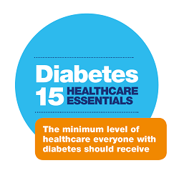
Emotions
Blood Pressure
Kidneys
Diet
Eyes
Cholesterol
Education
Feet
Specialist HCPs
Flu vaccination
Sexual problems
Weight/BMI
Stop smoking
Specialist care if planning a baby
In-patient care
Notes:
Links with the NICE Quality Standards for diabetes
Get your blood glucose levels measured (HbA1c blood test)
2. Have your blood pressure measured
3. Have your blood fats measured
4. Have your eyes screened for signs of retinopathy
5. Have your feet and legs checked
6. Have your kidney function monitored
7. Get ongoing, individual dietary advice
8. Get emotional and psychological support
9. Be offered a local education course
10. See specialist healthcare professionals
11. Get a free flu vaccination
12. Receive high-quality care if admitted to hospital
13. Have the chance to talk about any sexual problems
14. If you smoke, get support to quit
15. Get information and specialist care if you are planning to have a baby

Slide 16
Challenge: Care homes
1: 4 residents have diabetes
Our 2013 audit showed
More than ½ were at moderate or high risk of foot disease
Hospital admission often the result of poor management
Notes:
Diabetes effects up to 1 in 4 people in care homes, but research shows diabetes is often poorly managed and poorly understood in care homes. An audit of care homes in 2013 found that more than half of residents were at moderate or high risk of foot disease, and hospital admissions often result from poor diabetes management, for example, because of hypoglycaemia (low BG).
Broad aims for residents in care homes (DUK 2010 clinical guidelines for care homes:
to maintain the highest degree of quality of life and wellbeing without subjecting residents to unnecessary and inappropriate medical and therapeutic interventions
b) to provide sufficient support and opportunity to enable residents to manage their own diabetes where this is a feasible and worthwhile option
c) to ensure that residents with diabetes have individualised diabetes care and that follow-up specialist care is easily available depending on clinical need

Slide 17
Challenge: Care homes
Institute of Diabetes for Older People (IDOP) also audited that year
Some of the key findings were:
Over a third (35.17%) of residents do not know about signs and symptoms of hypoglycaemia
17% (203) homes had no system in place to check whether those who self-medicate had taken their medication
64.5% homes had no policy for screening for diabetes
36.7% homes had no written policy for managing hypoglycaemia
63.2% of homes had no designated staff member with responsibility for diabetes management
Notes:
Assumption that those in care homes have Type 2 diabetes
Who does the annual checks if people housebound

Slide 18
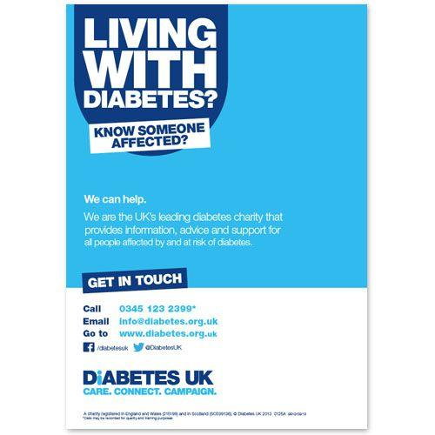
Helpline/Advocacy/Support/Information/Diabetes UK Groups
0345 123 2399 Monday-Friday 9am to 6pm
Notes:
0345 123 2399 Monday – Friday 9am-6pm
30 groups in London

