Slide 1
British Lung Foundation Self Care

Slide 2
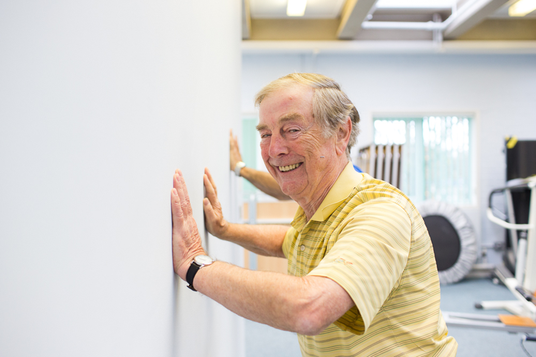
Self-management aims
Every person with a lung disease knows about the importance of self-management in improving health and well-being, maintaining current levels of health, or managing deteriorating health, and has access to a co-ordinated local range of appropriate, affordable and fun evidence-based activity
Notes:
Explain what team I work in and that we want to…
Empower patients to SM their condition by providing evidence based, accessible and appropriate services.
I’ll talk through these services in detail as we go along.

Slide 3
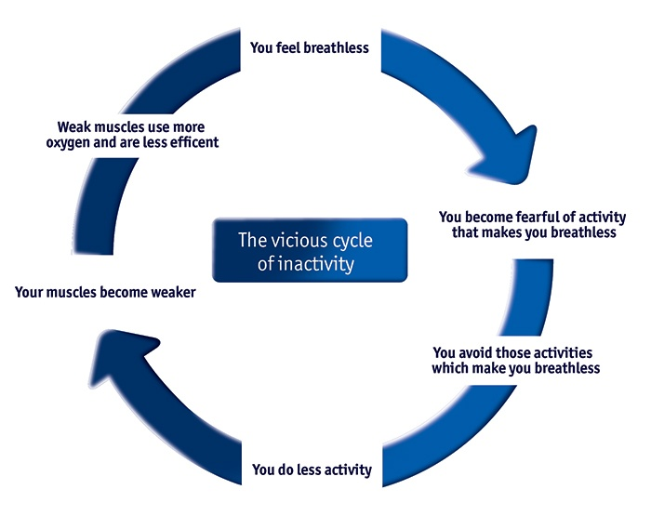
Cycle of Inactivity
BREATHLESSNESS
ACTIVITY
Notes:
Feeling breathless, huge anxiety for patients, very real fear. But we want to encourage patients where possible to manage their breathlessness by engaging in different services.
People become breathless, they do less, become more isolated, physically their muscles lessen – use more oxygen to do even the smallest of tasks like make a cup of coffee, which causes people to do less and less, and their breathlessness becomes more severe.
Through the range of services we offer, we aim to break this cycle of inactivity to reduce social isolation, increase physical and psychological wellbeing to have a better quality of life.

Slide 4
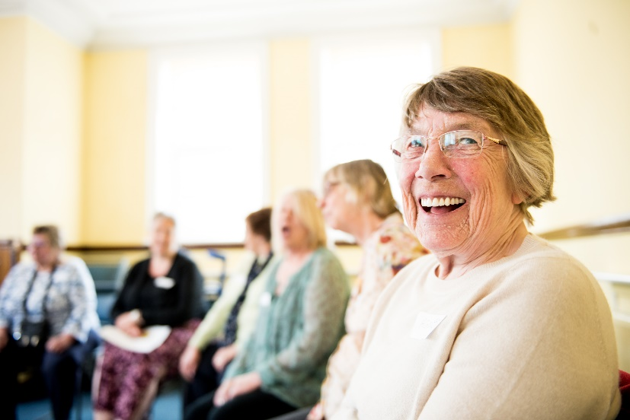
Breathe Easy
Peer Support, social contact and Information
Led by volunteers with support from BLF
Healthcare professionals input into monthly meetings
230 groups across the UK
Innovative activities (singing, exercise)
“Make new friends and learn more about living with a lung condition”
Notes:
Breathe Easy is one of our longest running programme.
They are peer support groups lead by volunteers and are open to anyone living with a lung condition and their carer.
Usually meet monthly and have a speaker or activity, offer support to one another.
Addresses that reduction in social isolation on that cycle of inactivity.
BE groups have been such a wonderful support for patients, so we wanted to build on this and develop a new approach which could get more people involved. Developed IBE…

Slide 5
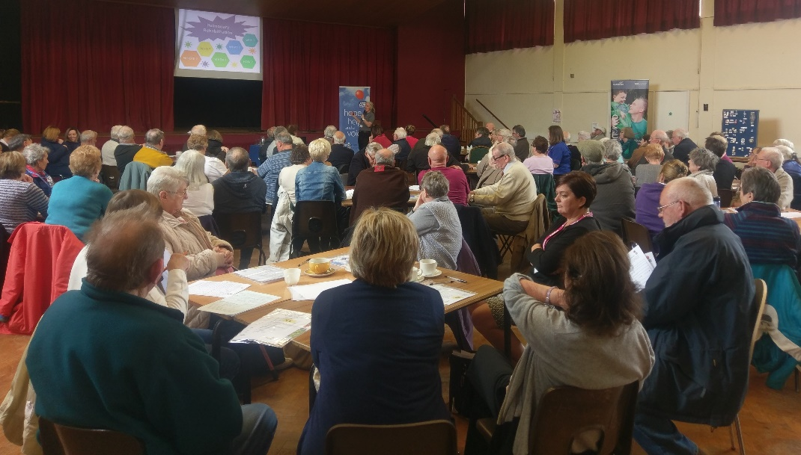
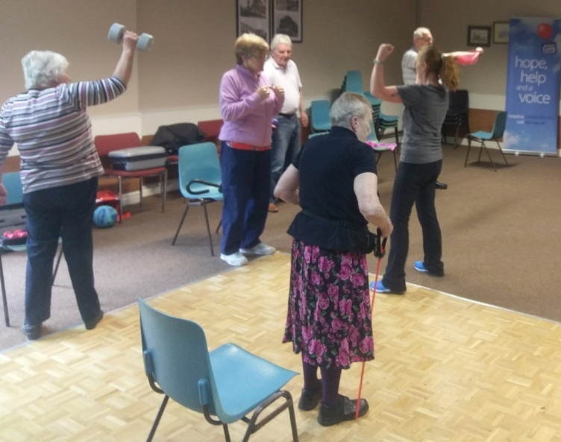
Integrated Breathe Easy
Formal partnership between groups and respiratory services
Working together to engage more people
Embedded into respiratory pathways
Offering a choice of activity and support
Notes:
IBE places BE groups at the hub of the community.
It forms partnerships between groups and respiratory services allowing it to be integrated into respiratory pathway and community provision.
Increase menu of opportunity.

Slide 6
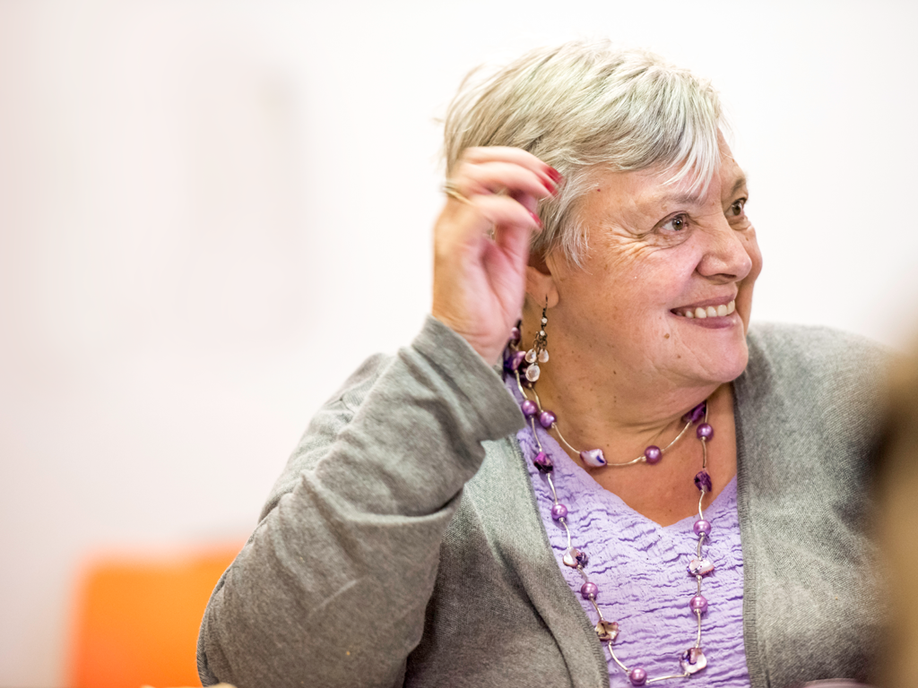
Attendees at IBE groups are more confident managing their lung condition than in groups not integrated into local health pathways.
Notes:
Better condition management reported in groups that were integrated

Slide 7
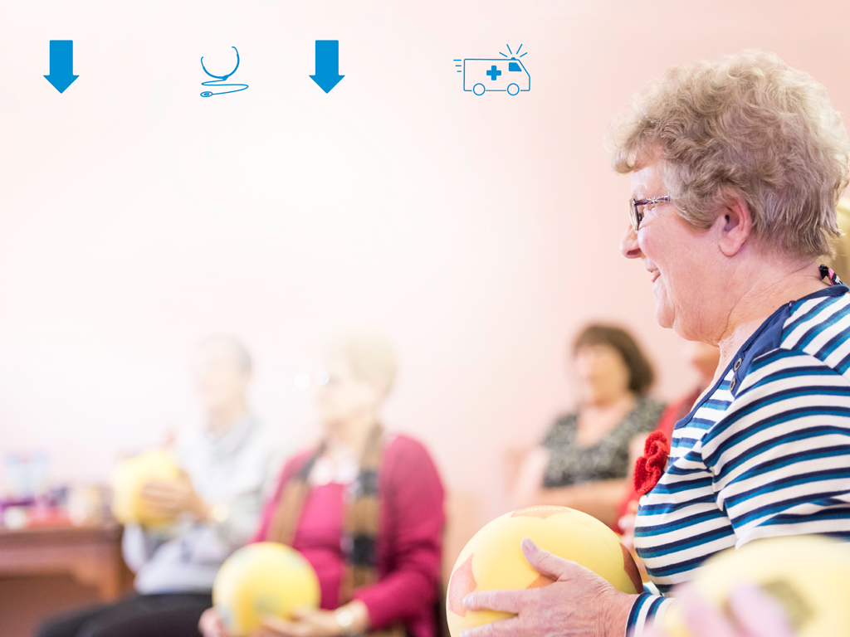
42%
57%
reduction in rates of unplanned GP visits
reduction in emergency hospital admissions
Notes:
Helps to relieve pressures on NHS services.
If we think back to that cycle of inactivity BE helps to reduce isolation and increase physical activity, people are managing their breathlessness and becoming more confident, therefore decreases the risk of infection/having an exacerbation, making them less reliant on their medication and in turn reduces need to visit their GP.

Slide 8
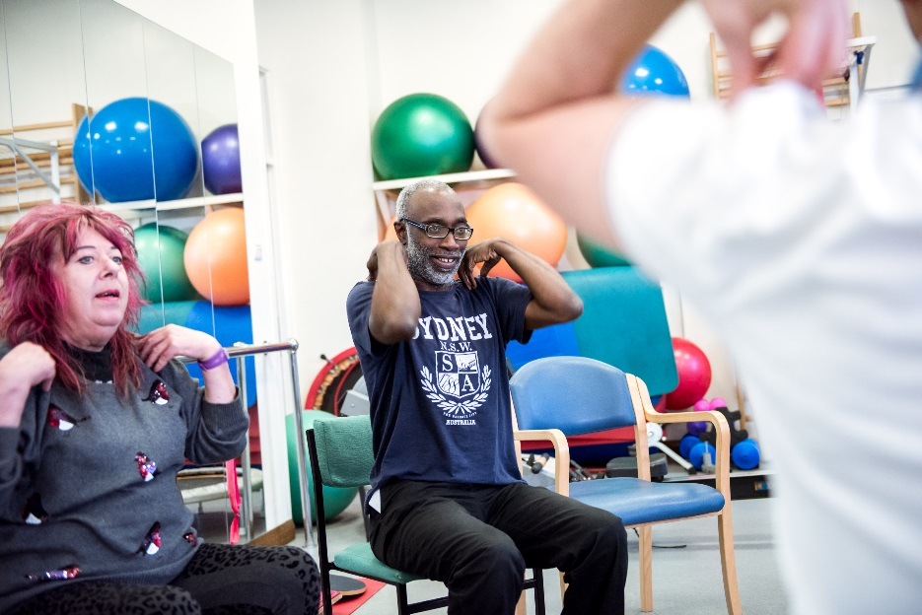
BLF Active
Exercise is one of the best things you can do to manage your lung condition
BLF Active provides people finishing pulmonary rehabilitation with the opportunity to continue exercising safely
There are around 130 respiratory
exercise classes running each week,
with more than 1,300 people enjoying
the health benefits of these classes.
Notes:
Exercise one of best ways to manage your lung condition – link back to cycle of inactivity.
Born out of idea that people finished PR didn’t have somewhere to go to safely exercise, the programme is run by respiratory exercise specialist and delivered in community.
We have approx. 130 classes running every week across the UK.

Slide 9
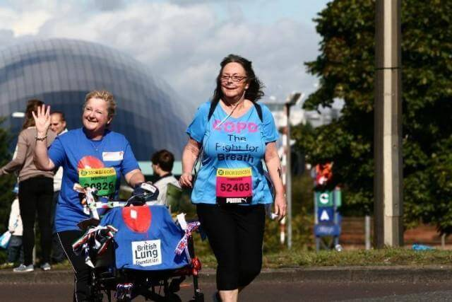
BLF Active
“Exercise is such good medicine for those of us with COPD. Never underestimate what it can do for you. If you can only manage a few steps that's fine - just make sure you do them as often and as regularly as you can and soon you will be surprising yourself” Vanessa
Notes:
We get lots of stories about how exercise has changed peoples lives and Vanessa’s is quite an exceptional case, this is her completing a half marathon. It’s by sharing these stories that help to encourage others into exercise.
However, not everyone is like Vanessa and will be as motivated to manage their condition, which is why we developed…

Slide 10
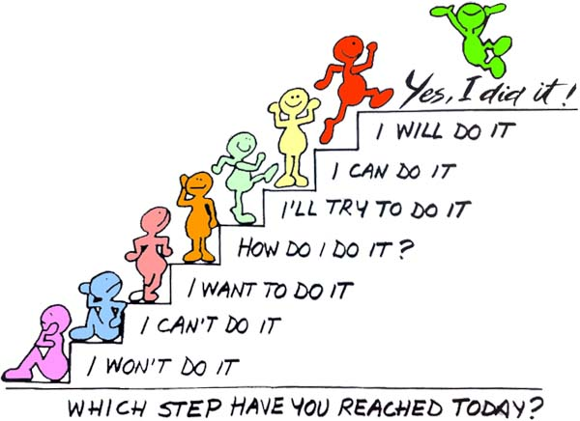
Keep Active, Keep Well
Notes:
We recognise some people need support to change their behaviours, just telling someone what to do, doesn’t necessarily result in a change in behaviour.
KAKW is a psychological intervention using behaviour change techniques to support people to understand why being active is good for them. It’s a non-judgemental approach to exploring what people do and don’t like and ultimately how we can help people to take up and maintain activity in a way that’s right for them.

Slide 11
Programme Model
NHS Service
Primary Care Referral
Pulmonary Rehab
KAKW Service
Patient Assessment
Behaviour Change Course
Maintenance
BLF Active
Primary Care Referral
Self Referral
Motivational Interview
Only
Local Sport & Exercise
KEY
PATIENT PATHWAY
EXISTING SERVICES
BLF KAKW SERVICE
MRC SCORE DEPENDENT
Ongoing Motivational Interviewing
Notes:
Like IBE, KAKW is integrated into the health care system. Where referrals onto a 12 week programme support people to access community activity.
This is a brief overview, but KAKW is quite a complex project driven by psychological theories, behaviour change techniques and deliver in a motivational interview style.
Each week there is a educational, & exercise component and opportunity to try a community activity.

Slide 12
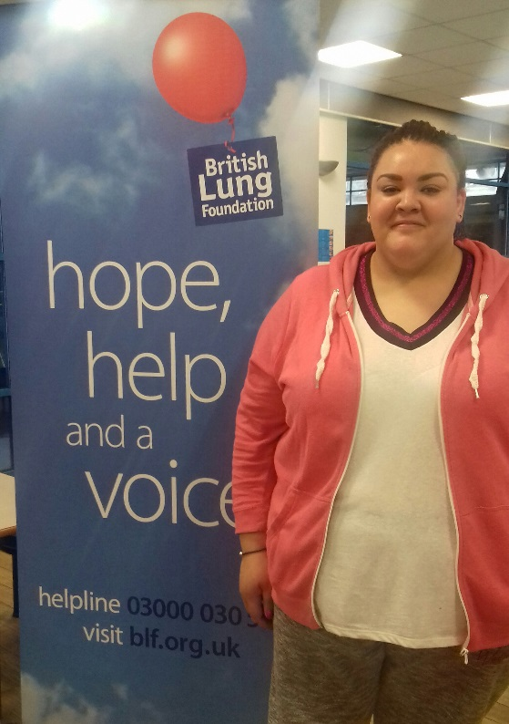
Case Study: Natalie
Natalie was diagnosed with sarcoidosis in October 2012. At 30 years old she said she was relieved to have a reason to explain her symptoms, but this didn’t stop it effecting her life. Natalie had to leave her job in the city, getting to work, or even out of bed was too hard for her. A turning point came when her Healthwise team suggested that she come to Keep Active Keep Well.
‘I felt nervous as I wasn’t in a good place. My doctor had just referred me to the psychiatrist as she thought I had onset depression from my illness’¹
Natalie attend the 12 week course, and has gained more than just improved fitness.
‘I’ve gone from darkness to light. It’s helped me combat the depression, brought back my ability to be active. I feel like I have done a complete 180 and feel better than I have done in years.’
¹ It is estimated that up to one-third of individuals with a serious medical condition experience symptoms of depression.

Slide 13
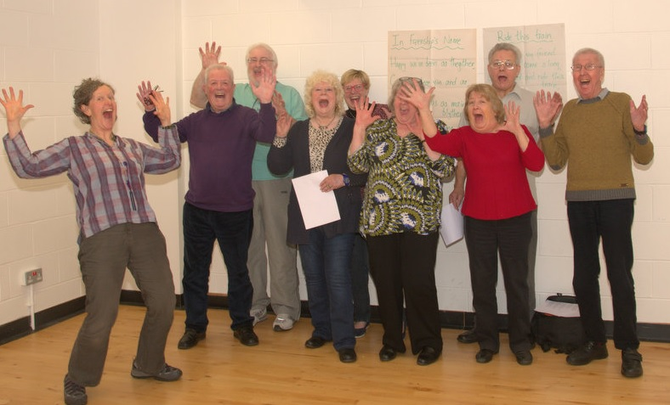
Singing for lung health
Research suggests group singing also has benefits if you have a long-term lung condition;
  reduce your feelings of being short of breath. By strengthening
  the muscles you use when you breathe, you learn to breathe more slowly and deeply
  help you to feel more in control of your breathing
  increase the strength of your voice
  improve your posture
  increase your lung capacity
  boost your body’s response
  to infection
  reduce your use of medication
Notes:
Started project off the back of Sidney de hann research. Both physical and psychological benefits.
What the BLF have done – raised awareness, mapped provision on website, developed training, seed funding
Trained over 50 singing leaders.

Slide 14
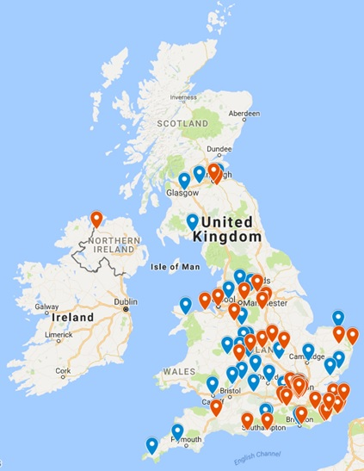
Activity
35 BLF trained groups – 6 BLF supported groups (BE) - 39 Other SFLH groups = 80!
Notes:
Network started out very small, when first mapping about 30 groups and since we started the project there are 80 that we know of, and this will continue to grow as the word spreads what a beneficial and fun intervention this is.
Difference between a SLH group and a wellbeing group or regular singing group.

Slide 15
Evaluation results
3 month qualitative questionnaires:
“The experience has been amazing. Our teacher has been exceptional in trying to understand our conditions, listening to us and helping to overcome our fears with amazing results.”
“I know my lungs are getting a good work out. On a bad day both my depression and breathing feel better for it, I feel more alert and ready for the day.”
Focus Groups:
“The breathing exercises are an important part of it, you don’t normally think about it, but this makes you think.”
“I feel much more confident now; it’s nice not to feel so self-conscious.”
Notes:
These are just some of the results from our SLH programme. It really has helped to improve people’s confidence, wellbeing and breathlessness. So again works to reverse that cycle of inactivity.
Evaluation is an important part of all the programmes we run, as I said earlier we need to make sure all the activities we provide are evidenced based and that there is a real need out there.

Slide 16
Singing Video
Notes:
I’d like to show you how one of our activities look in practice, this is a video we filmed to help promote SLH. Because it can be seen as an ‘alternative’ intervention we wanted to show that anyone can join, whether you think you can sing or not and that it’s a fun way to meet people and manage your condition at the same time.

Slide 17
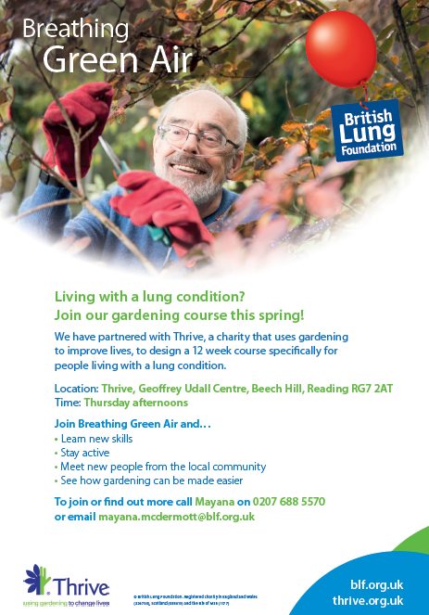
Next Steps
Continuing to develop and
support our existing services
Gardening
Tai Chi
Walking
Notes:
Explore other avenues to support people to become physically active.
Develop a community network to support respiratory patients.
What works for one person may not work for everyone. Person centred.

Slide 18
Stay informed
Sign up to our newsletter:
blf.org.uk/sign-up
Follow us on Twitter:
twitter.com/lunguk

