Slide 1
Effective Community Safety
SM Ben King
4th October 2019

Slide 2
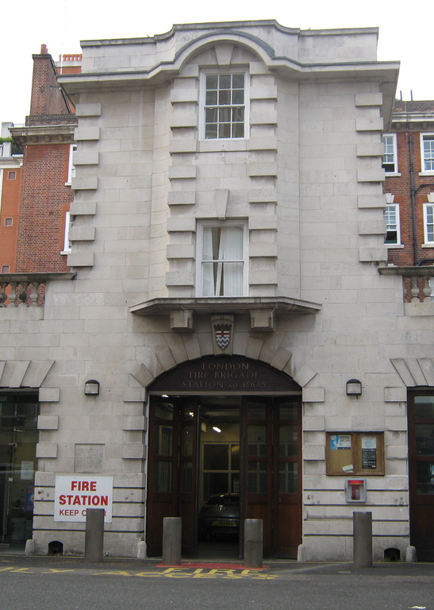
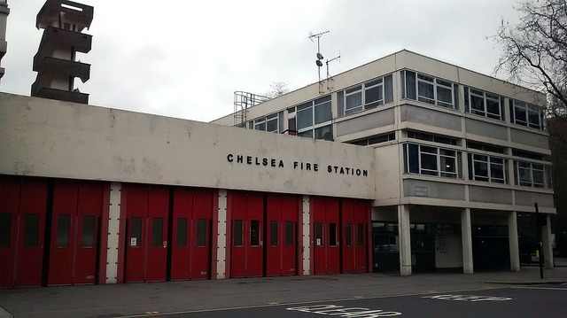
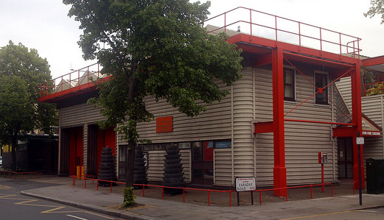
Introduction
Notes:
Who am I?
Where do I work?
K&C
3 Stations
12 Watches
130 Staff
What is my role?
Operational Role
Manage Stations
Community Safety Lead for the Borough – all different activities, talks, school visits, primarily Home Fire Safety

Slide 3
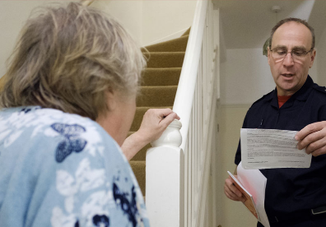
Home Fire Safety
Home Fire Safety Visits
Smoke Detection
Flame-Retardant Bedding
Partnership Working
Notes:
Slide 2 – Community Fire Safety
Primary Intervention Method
Home Fire Safety Visits
Smoke Detection
Flame Retardant Bedding/Throws
Partnership Working

Slide 4
Effective Community Fire Safety
Priority Areas
Priority People
Notes:
Kensington & Chelsea is one of the wealthiest boroughs in London
2 of them have received Home Fire Safety Visits in last 2 years, you’re in good company
However, there are significant numbers of people in the borough vulnerable to the risk of fire
When making CFS Effective – identifying those people for intervention first
Priority Postcode Areas – Driving Down Fires
How they are formed
Small number in Kensington & Chelsea
Definitely high number of vulnerable people – high levels of older people
Priority People – Reducing Harm
Want to identify people and prioritise them
Fatal Fires all occurred in Non-P1 areas
Well known to partners, but not to us

Slide 5

Partnership Working
Notes:
Everyone has a different part of the jigsaw
How to Improve Vulnerable People identification – Partnership Engagement
Needed partnership working to target our delivery
Integrate with safeguarding structures to meet people in need identified
Build relationships with partner agencies to provide training on risk and arranging visits

Slide 6
Partnership Working
Age UK K&C
K&C Forum for Older Residents
Faith Groups
Residents Associations
Dalgarno Trust
Care Leavers
Action Disability K&C
Dementia Action Alliance
Youth Organisations
Notes:
Visit all sheltered housing schemes (39 done)
How did we do it?

Slide 7
Results So Far
Vulnerable Resident Identified
Vulnerable Resident Not Identified
Notes:
Number of HFSVs static as they’re based on the resources we have available in the borough
Success so far – 38% up to 52% - best increase in brigade, scope for more.

Slide 8

Where Next?
Notes:
Building on existing relationships to create a network
Sharing our messages but also those of our partners
Community Engagement Group

Slide 9
How Could You Help?
Get in touch with Your Local LFB
Identify Vulnerable Residents
Refer them for a HFSV
Notes:
Make contact with your local LFB Borough Team
Identify anyone who might have issues with PDE
Refer them to us – smokealarms@london-fire.gov.uk

