Slide 1
London Health Inequalities Strategy
Age UK London Consultation
2nd October 2017
Silvia Schehrer

Slide 2
Background
Cities that are more equal are happier, safer and healthier.
Reducing health inequalities will make a difference to us all.
The differences affect how long people live in good health.
Why a new London Health Inequality Strategy:
National Health Policy Change
London Health Policy Change
Social and economic change
Notes:
National Policy Change:
Health & Social Care Act 2012 reforming the health and public health system
NHS Five Year Forward View establishing a vision for prevention
Introduction of Sustainability and Transformation Plans and place-based planning
London Health Policy Change:
London Health and Social Care devolution
New policy commitments from a new Mayor of London
Better Health for London ten shared ambitions
Social & Economic Change:
Social and economic change
Population growth, and demographic change with more diversity and a younger population
Rising poverty, much driven by housing costs
Changing working patterns and the growth of the gig economy

Slide 3
Role of the Mayor
What the Mayor is trying to achieve:
Better overall health
Reducing the variance between boroughs in years lived in good health
Reducing early deaths from preventable diseases
Less variation between men and women
What the Mayor can do:
Ensuring all the Mayor’s work contributes
Championing work from across London
Directing support from City Hall
Notes:
All Mayors work contributes:
Environment, Planning, Housing, Transport, Economic Development , Culture, Policing
Championing work: speaking out on health inequalities, challenging and championing the health sector to reduce inequalities, generating consensus from others as chair of the London Health Board
Directing support: delivering City Hall Health programmes, consulting and engaging Londoners, reporting on actions and outcomes

Slide 4
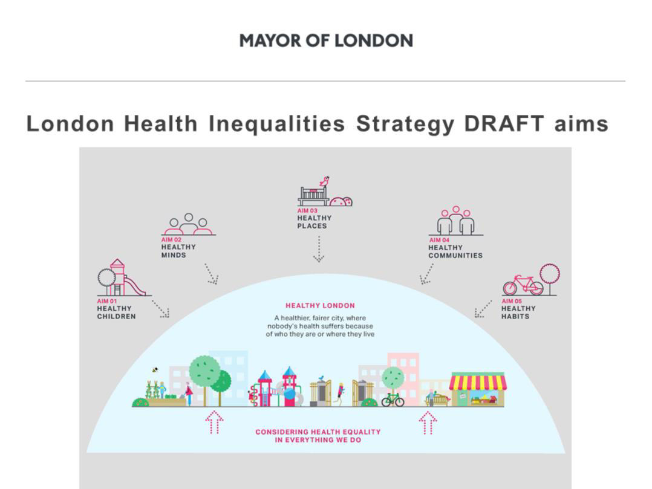

Slide 5
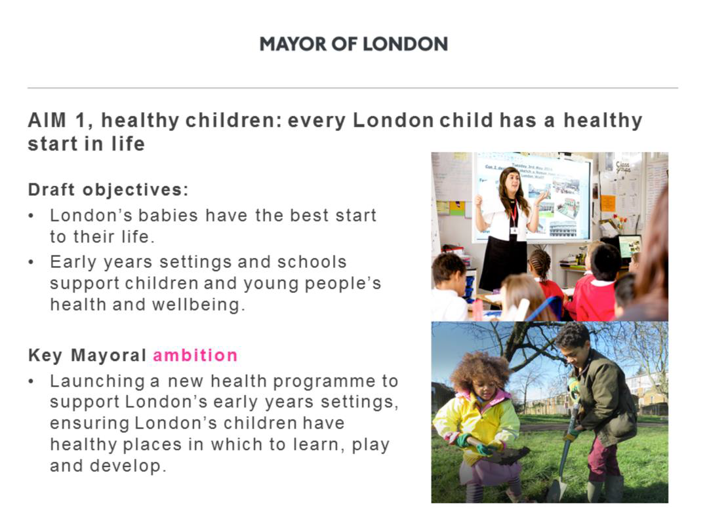

Slide 6
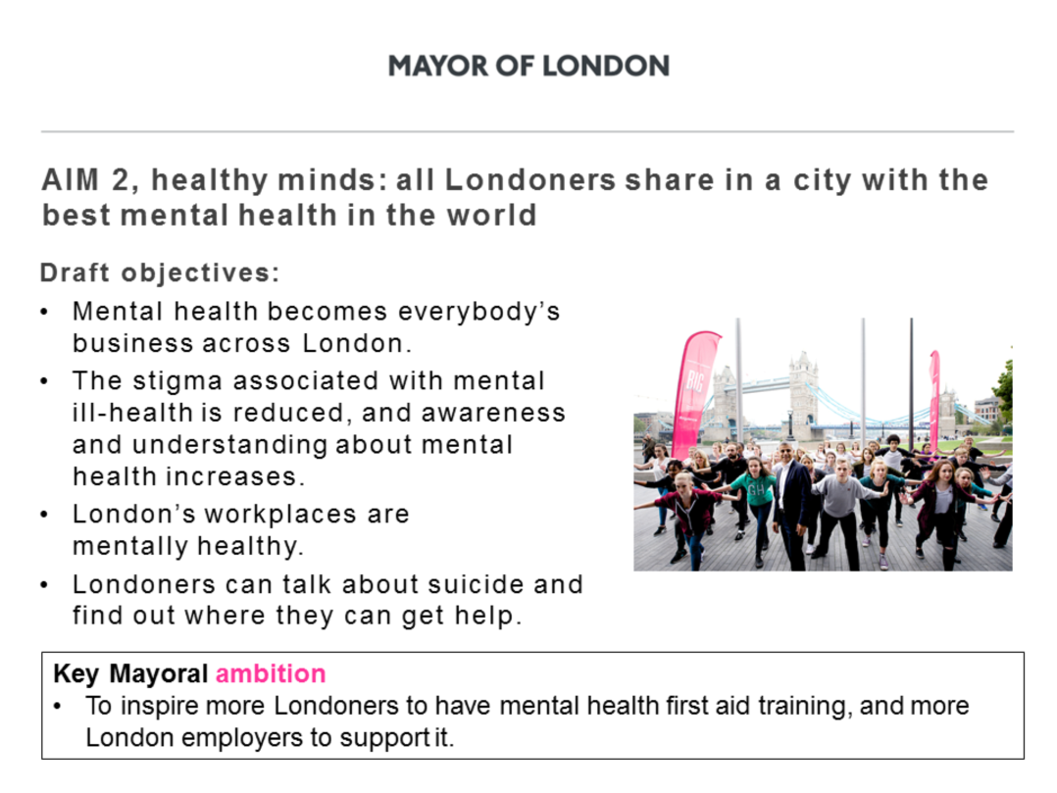

Slide 7
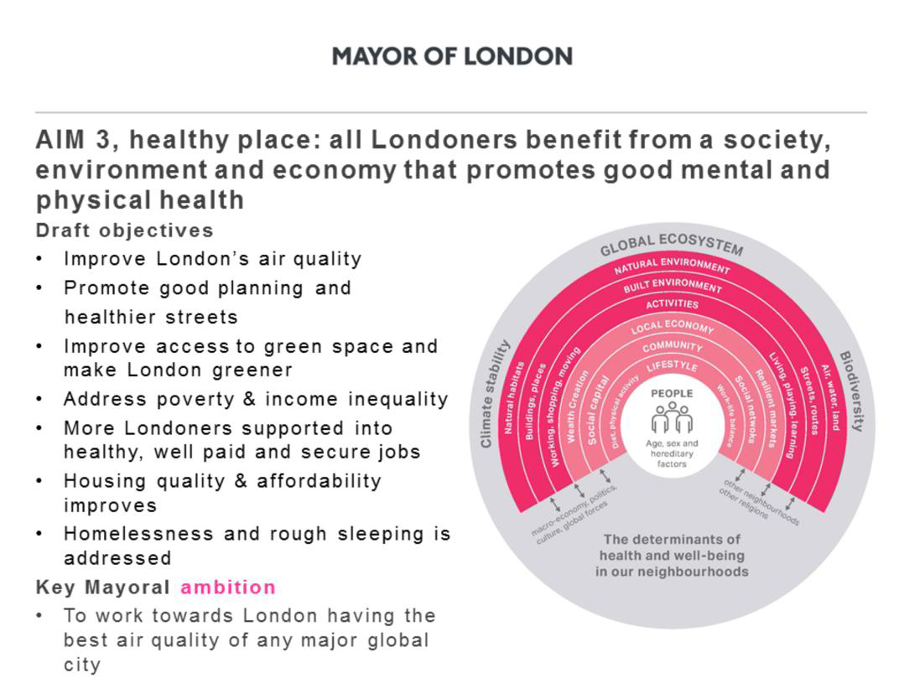

Slide 8
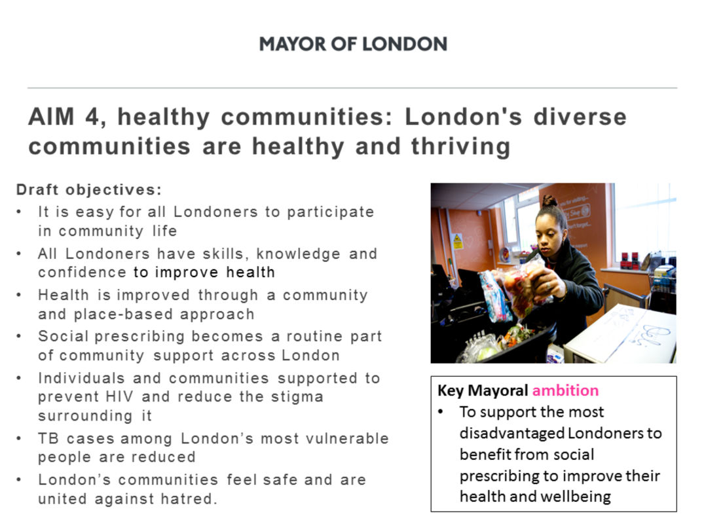

Slide 9
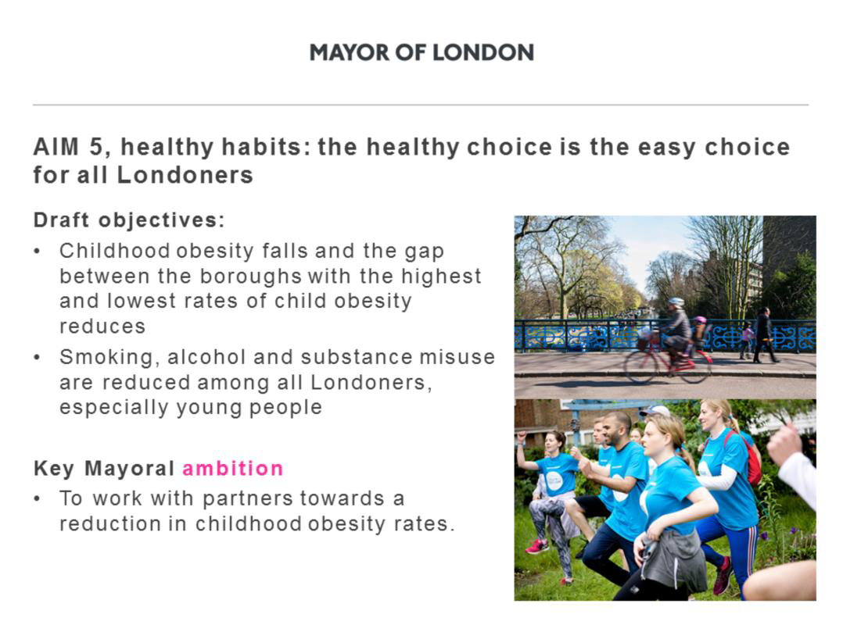

Slide 10
Your Input 1
1. Are the 5 aims the right ones?
Healthy children
Healthy minds
Healthy place
Healthy places
Healthy communities
Is there anything missing that you would like to see?

Slide 11
Your Input 2
1. Do you agree with the draft objectives and the Mayoral ambition?
2. What is missing?
3. What could you do?

