Slide 1
Pain is to be expected at your age: or should it?: Managing pain in long term conditions
Professor Pat Schofield
Positive Ageing Research Institute
Anglia Ruskin University
28th July 2017

Slide 2
In the UK….
10 million people in the UK are over 65 years old. The latest projections are for 5½ million more older people in 20 years time and the number will have nearly doubled to around 19 million by 2050.
There are currently three million people aged more than 80 years and this is projected to almost double by 2030 and reach eight million by 2050.
The pensioner population is expected to rise despite the increase in the women’s state pension age to 65 between 2010 and 2020 and the increase for both men and women from 65 to 68 between 2024 and 2046. In 2008 there were 3.2 people of working age for every person of pensionable age. This ratio is projected to fall to 2.8 by 2033.

Slide 3
Life expectancy
1900 – LE of women at 65 years was 11 years
2014 – LE 21 years
Rising life expectancy makes people older people younger, fitter and healthier

Slide 4

Chronic pain in older adults
Significant chronic pain affects 20% of adults
Breivik et al 2007
  Rising to 62% of those over 75 Elliott et al 1999
Many diseases causing chronic pain increase with age
  E.g. arthritis, diabetes
Many risk factors for chronic pain are associated with ageing
  E.g. reduced physical activity, co-morbidities, reduced social networks Evenson et al 2002, Peat et al 2004

Slide 5
Impact of pain on older adults
Chronic pain is associated with
  Poor general health (physical, psychological, social) Smith et al 2001
  Increased resource use (carers, NHS, benefits) Maniadakis and Gray 1999
In older adults chronic pain is
  Often under-reported Sofaer-Bennet et al 2007
  More likely to be intense, disabling and need treatment Elliott et al 1999
  Particularly likely to cause isolation, disability and depression Citra et al 2006
Notes:
Eg Maniadakis found that back pain alone cost the UK economy £10.7 billion in 1998, of which £1.6 billion was direct healthcare costs

Slide 6
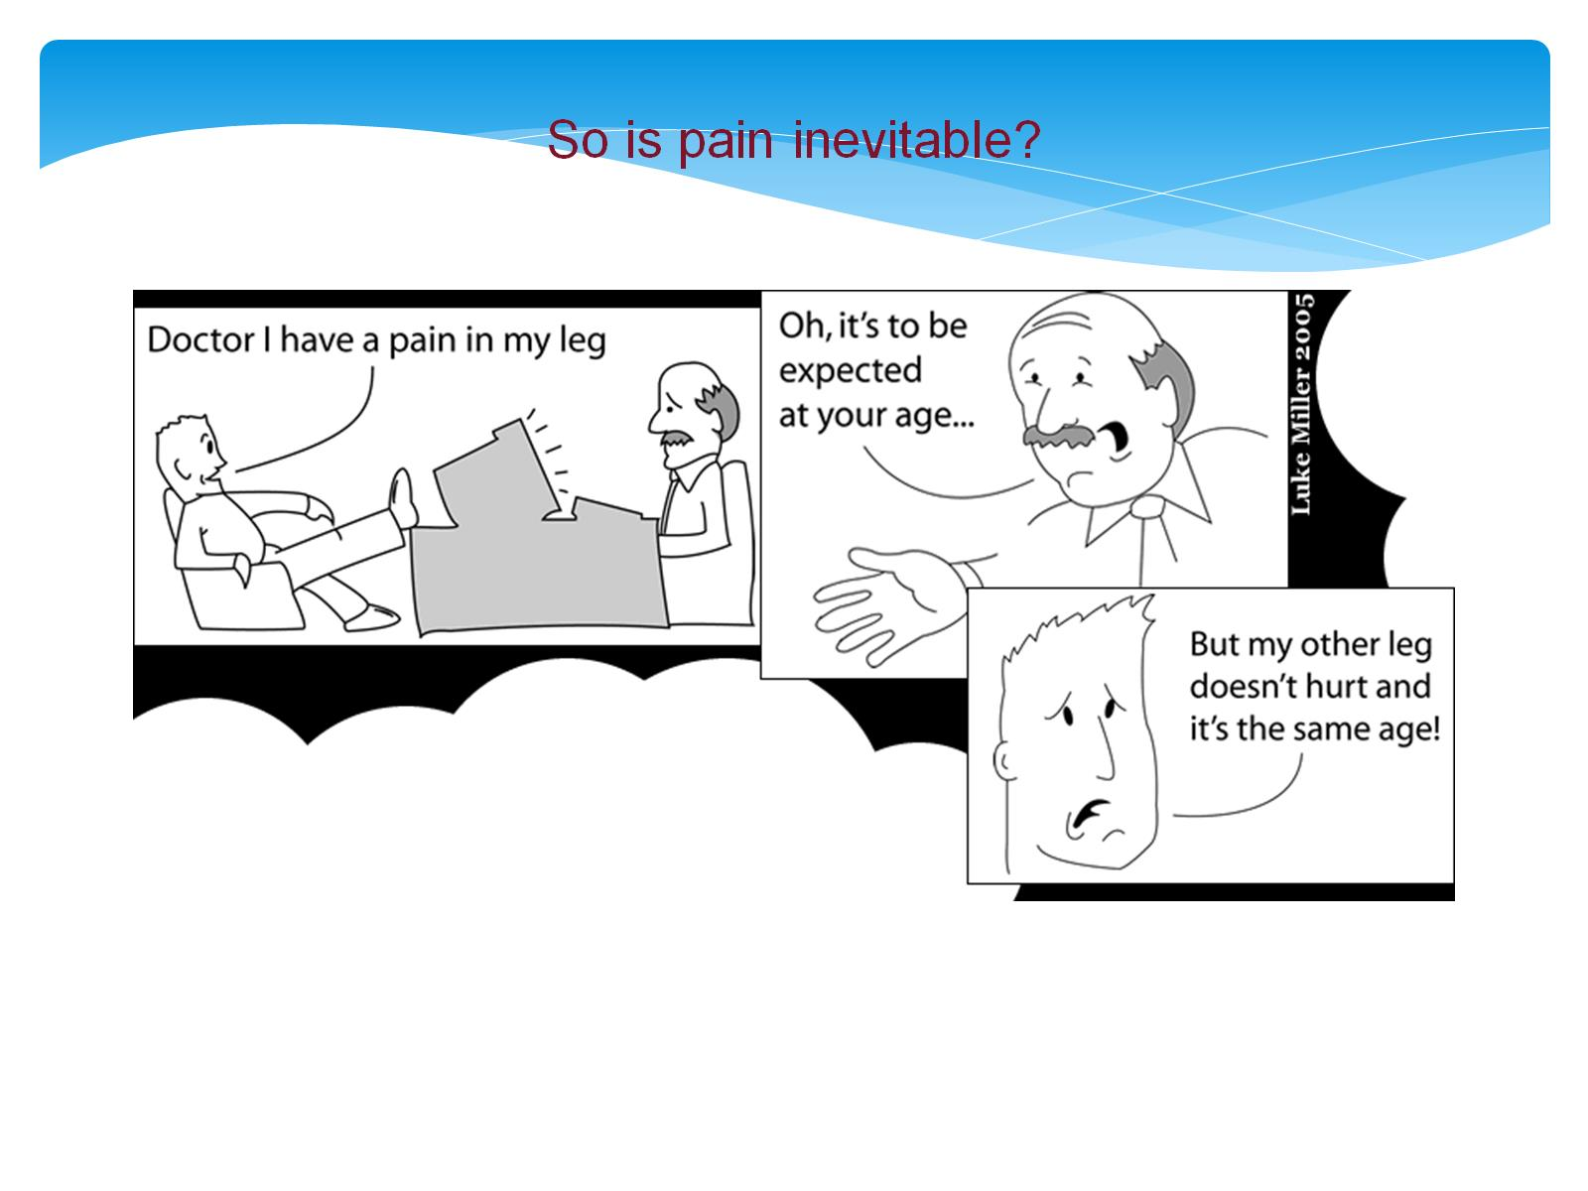

Slide 7
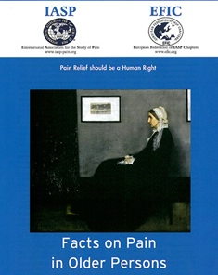
Pain in Residential Aged Care Facilities
Management Strategies
August 2005
The Australian Pain Society

Slide 8
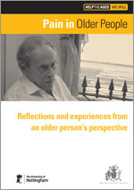

Slide 9
Perspectives from Older People
“Pain is exhausting… You have to walk slowly. You have to stop and make an excuse or pretend to look in a shop window so that you can put your hand on the window and rest a moment. It’s humiliating”.
‘Pain is frustrating because you can’t do things for yourself…Everything’s a challenge.’
‘I get very depressed and anxious about it…it’s frightening, especially when you live on your own.’
‘Pain can make you feel lonely because you feel that you’re the only one that is suffering and can cope with it, and that is a lonely experience.’
Extracts taken from ‘listening events’ and interviews held with older people who suffer pain (Help the Aged )

Slide 10
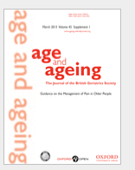
Systematic Review - Management
Guidance on the management of pain in older people (Schofield, Abdulla, Adams, Bone, Elliott, Gaffin, Jones, Knaggs, Martin, Sampson)
Age Ageing (2013) 42 (suppl 1): i1-i57 doi:10.1093/ageing/afs200

Slide 11
Guidelines: Summary
Substantial differences in the population, methods, and definitions used in published research makes it difficult to compare across studies and impossible to determine a single definitive prevalence of pain in older persons.
The prevalence of pain in older persons living in residential care is consistently higher than the prevalence of pain in older persons living in the community, regardless of the definition of pain used.
Older women have higher prevalence rates of pain than older men.
The reported effect of age on pain prevalence in older persons is inconsistent with some studies reporting an increase in prevalence with age and others reporting a decrease in prevalence with age. The effect also varies by gender and site of pain.
The three commonest sites of pain in older persons are the back, leg/knee or hip, and other joints.

Slide 12
Pharmacology
Paracetamol should be considered as first-line treatment for the management of both acute and persistent pain.It is important that the maximum daily dose (4g/24 hours) is not exceeded.
Non-selective non-steroidal anti-inflammatory drugs (NSAIDs) should be used with caution in older people after other safer treatments have not provided sufficient pain relief. The lowest dose should be provided for shortest duration.
All patients with moderate or severe pain should be considered for opioid therapy
Tricyclic antidepressants and anti-epileptic drugs have demonstrated efficacy in several types of neuropathic pain

Slide 13
Invasive
Intra-articular corticosteroid injections in osteoarthritis of the knee are effective in relieving pain in the short term with little risk of complications and/or joint damage. Intra-articular hyaluronic acid is effective and free of systemic adverse effects.
The current evidence for the use of epidural steroid injections in the management of sciatica is conflicting

Slide 14
Non-Invasive
Assistive devices are widely used and ownership of devices increases with age.
A number of complementary therapies have been found to have some efficacy amongst the older population including; acupuncture, TENS and massage.
Guided imagery Biofeedback training, mindfulness training and relaxation, CBT in nursing home populations.
Exercise & physical activity – association with falls
Self management programmes may have benefit.

Slide 15
Managing pain in older adults
65% of people with chronic pain use prescribed medicines
40% of are dissatisfied with their treatment Breivik et al 2006
Particular difficulties with drugs in older adults
  More (dangerous) side effects
  Polypharmacy, with interactions
  Changing physiology
Need to look at non-pharmaceutical management
  Eg self-management, education, CBT
  These interventions may not transfer directly to older adults

Slide 16
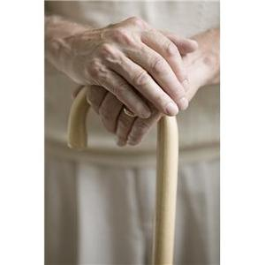

EOPIC
Engaging with Older People and their carers to Develop and Deliver Interventions for the Self-management of Chronic Pain

Slide 17
SELF MANAGEMENT
a single approach or combination of approaches that can be initially taught by any health professional or learned by an individual to enable them to minimise the impact their chronic pain can have on everyday life

Slide 18
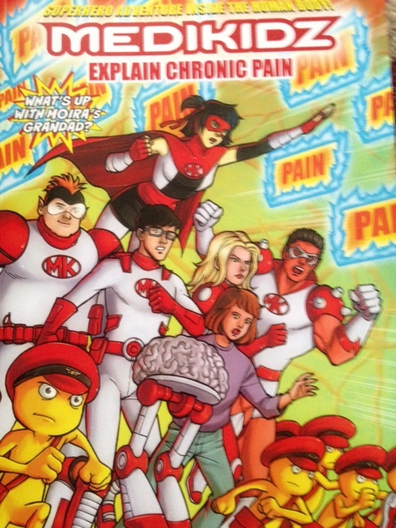

Slide 19
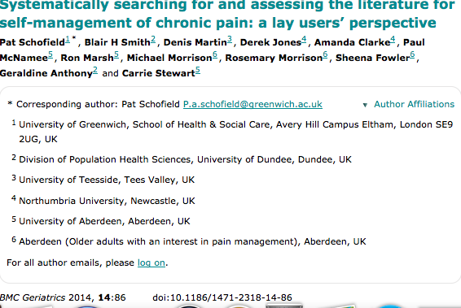
Systematically searching for and assessing the literature for self-management of chronic pain: a lay users’ perspective
BMC Geriatrics 2014, 14:86 doi:10.1186/1471-2318-14-86

Slide 20
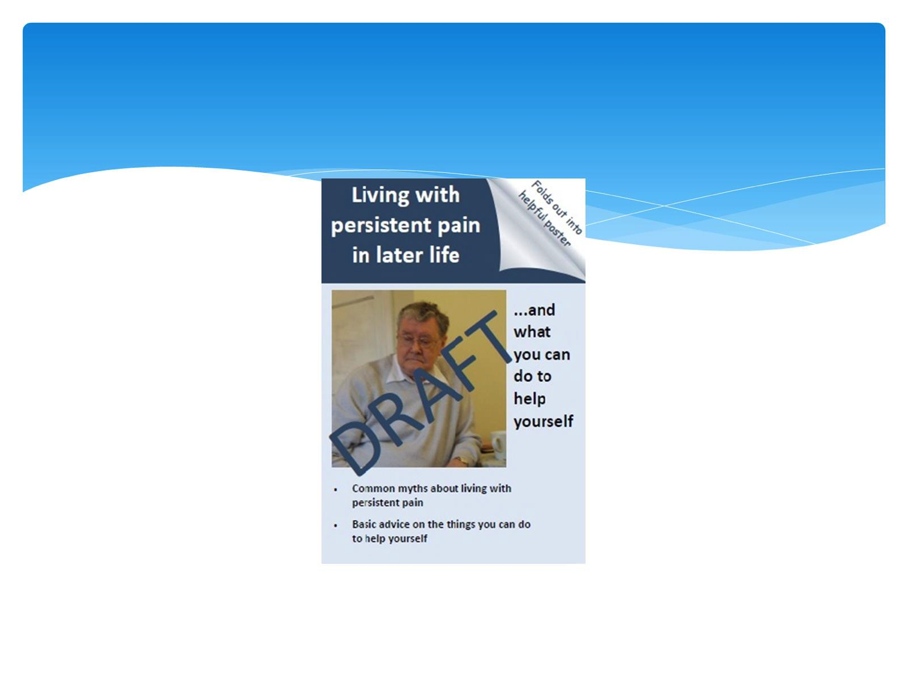

Slide 21
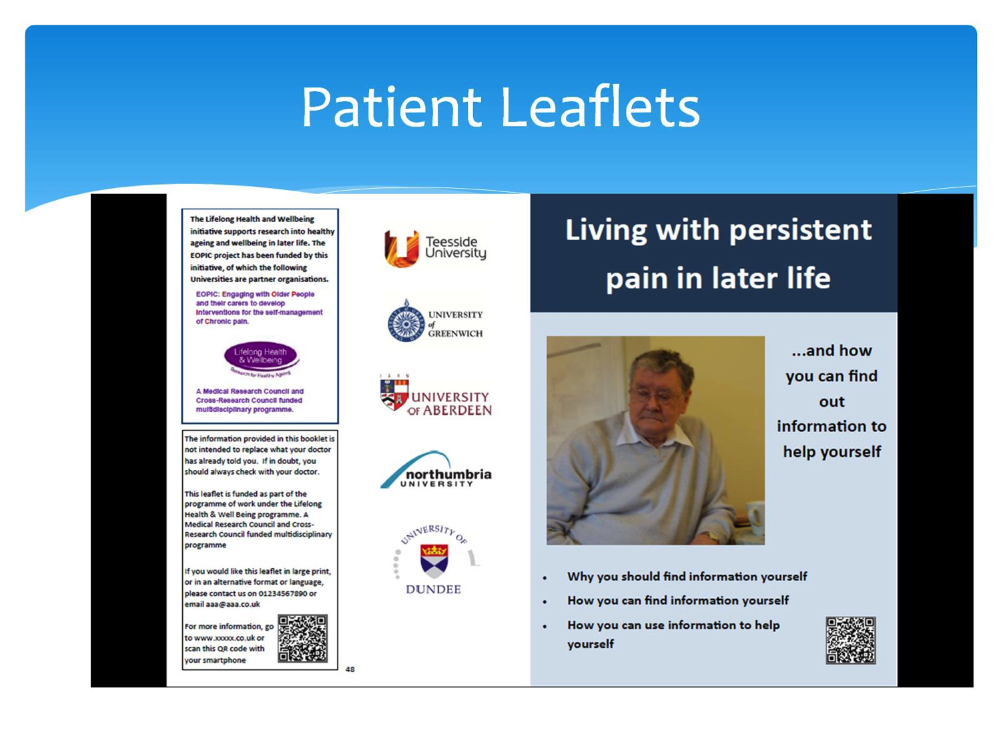

Slide 22
Positive Ageing
What is Positive Ageing?
  Barriers
  Facilitators

Slide 23
Positive Ageing – views of older adults
Being able to get out of bed and carry on with life – does that mean you are not ageing positively if you are bed bound (physical only)
Focus on mindset rather than limitations – living in the now, what could I do from bed (if unable to get up)
Need to not use words like “should” “could” “ought to” – negative expectations, need to develop/learn self-compassion and acceptance.
It’s a mind set – if I rest today, I will be able to carry on tomorrow, but it is OK to stay in bed and read a whole book. Give self permission to have a day off for recovery, do not allow feeling sorry for self for too longAccept and prepare for ailments that may occur – use sticks if they help
Trolleys are only associated with the very old
It is about acceptance and adapting – physical and mental constraints. Knowing that things may change in the future but confidence that could adapt “if decline happens I could cope with it”

Slide 24
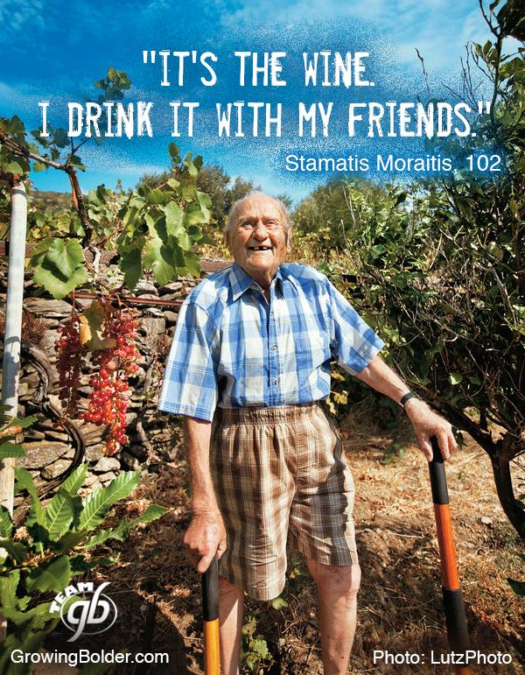
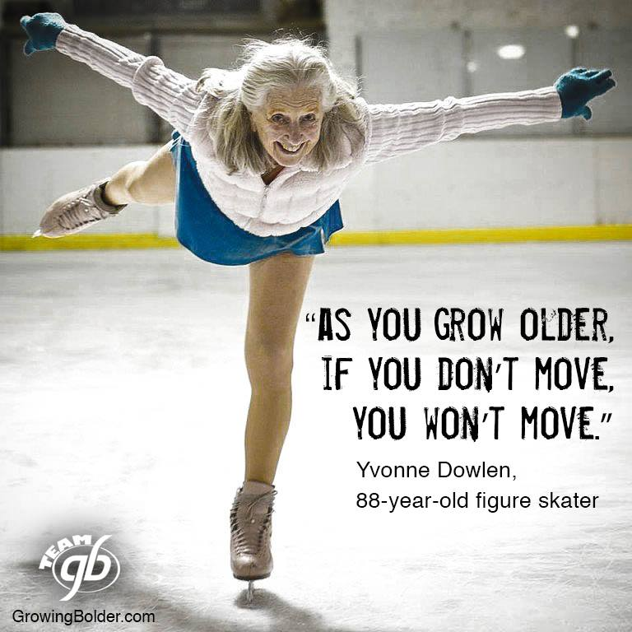
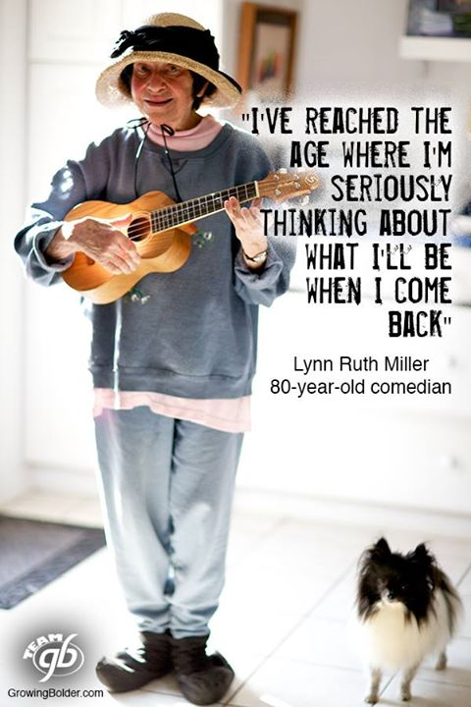
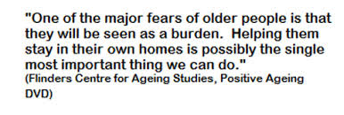
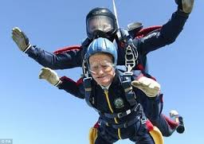
Positive Ageing

Slide 25
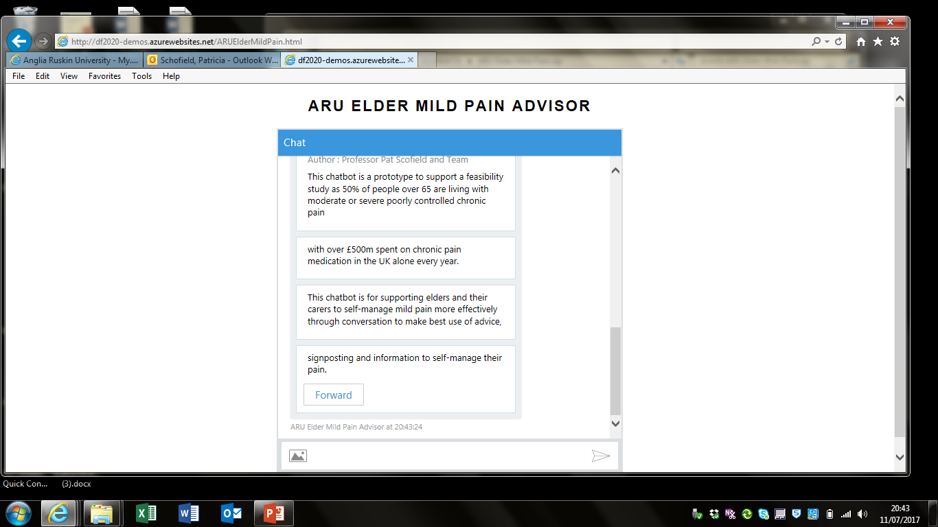
Chat Bot for Pain

Slide 26
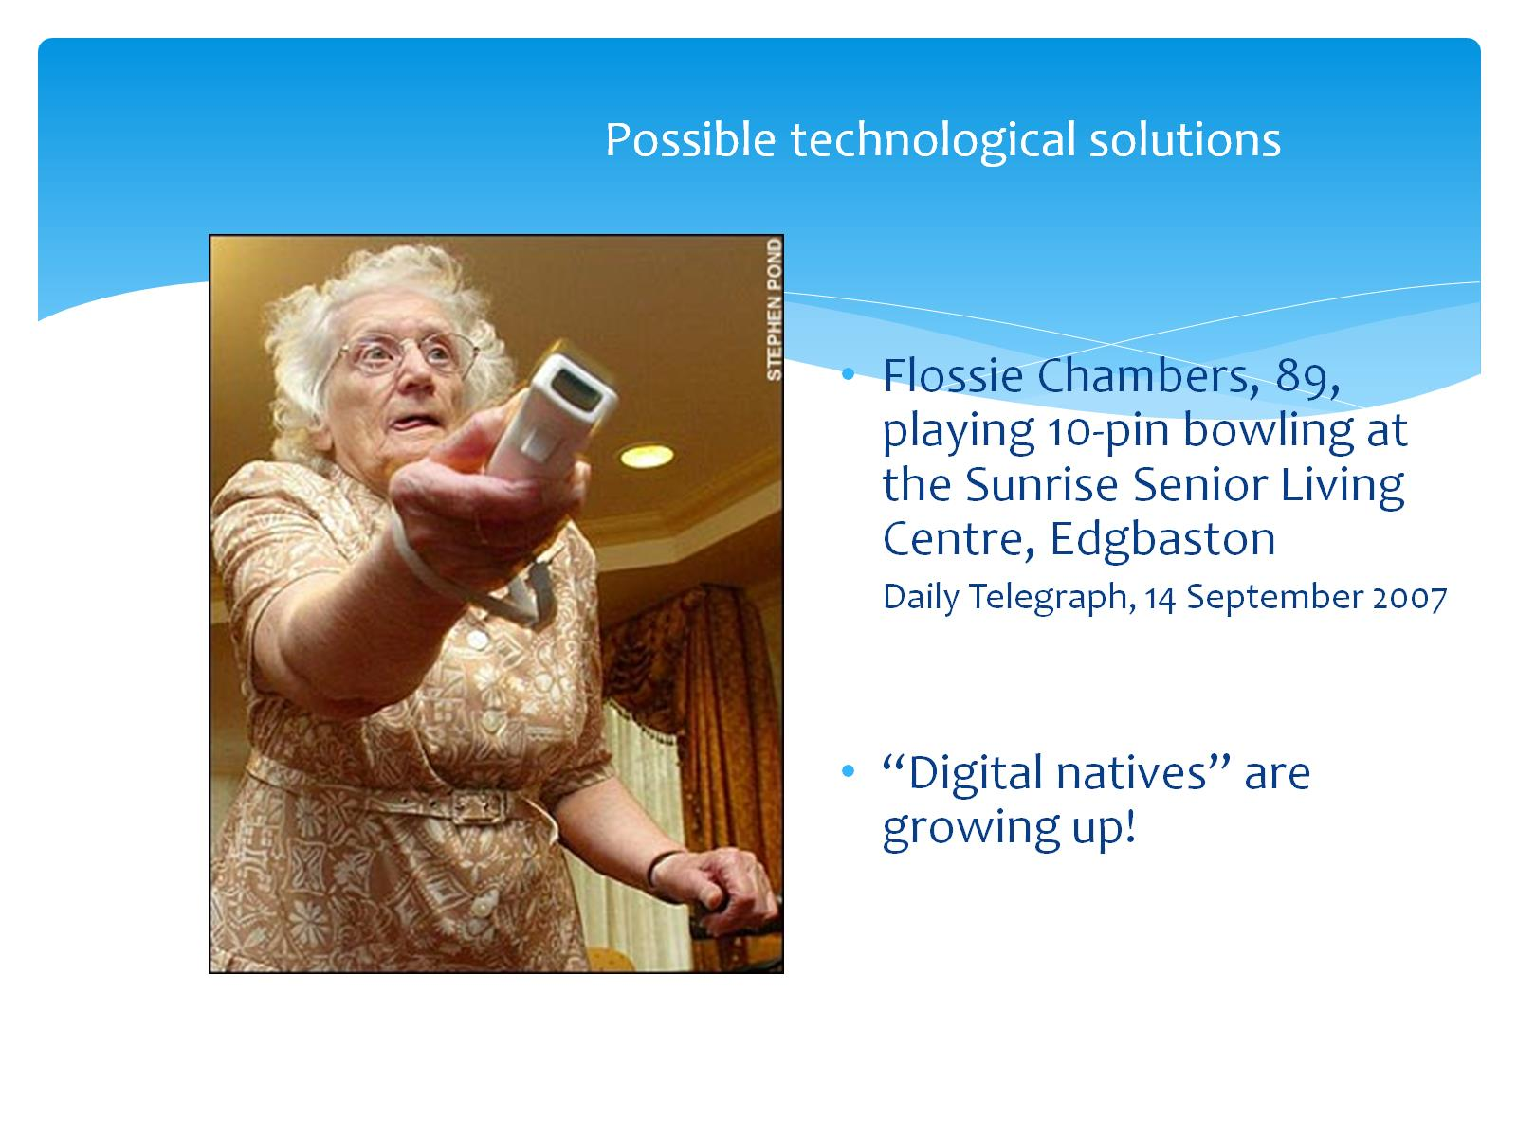
In Summary
Many of the studies looking at pharmacology and invasive interventions have been translated across from younger to older adults. We need age specific studies.
We have a plethora of pain assessment tools that can be used with the older population including those with communication difficulties. We do nt need to develop more.
Our older adults of today are not the older adults of tomorrow, so we need to change our thinking with each age cohort.
Education is a strong message for all health care professionals.

Slide 27
What can you do to help?
Positive Ageing Research Institute
Chatbot
Smart Living Accelerator

Slide 28
Thanks for listening
Patricia.Schofield@Anglia.ac.uk

