Slide 1

The Standing Together Project
Facilitating Later Life self-help groups in extra care / retirement housing schemes –reflections.
Jolie Goodman Later Life Programmes Lead
Notes:
Reflections on who MHF is, the peer work MHF has done, the St project itself, using creativity in the project and future devlopments.

Slide 2
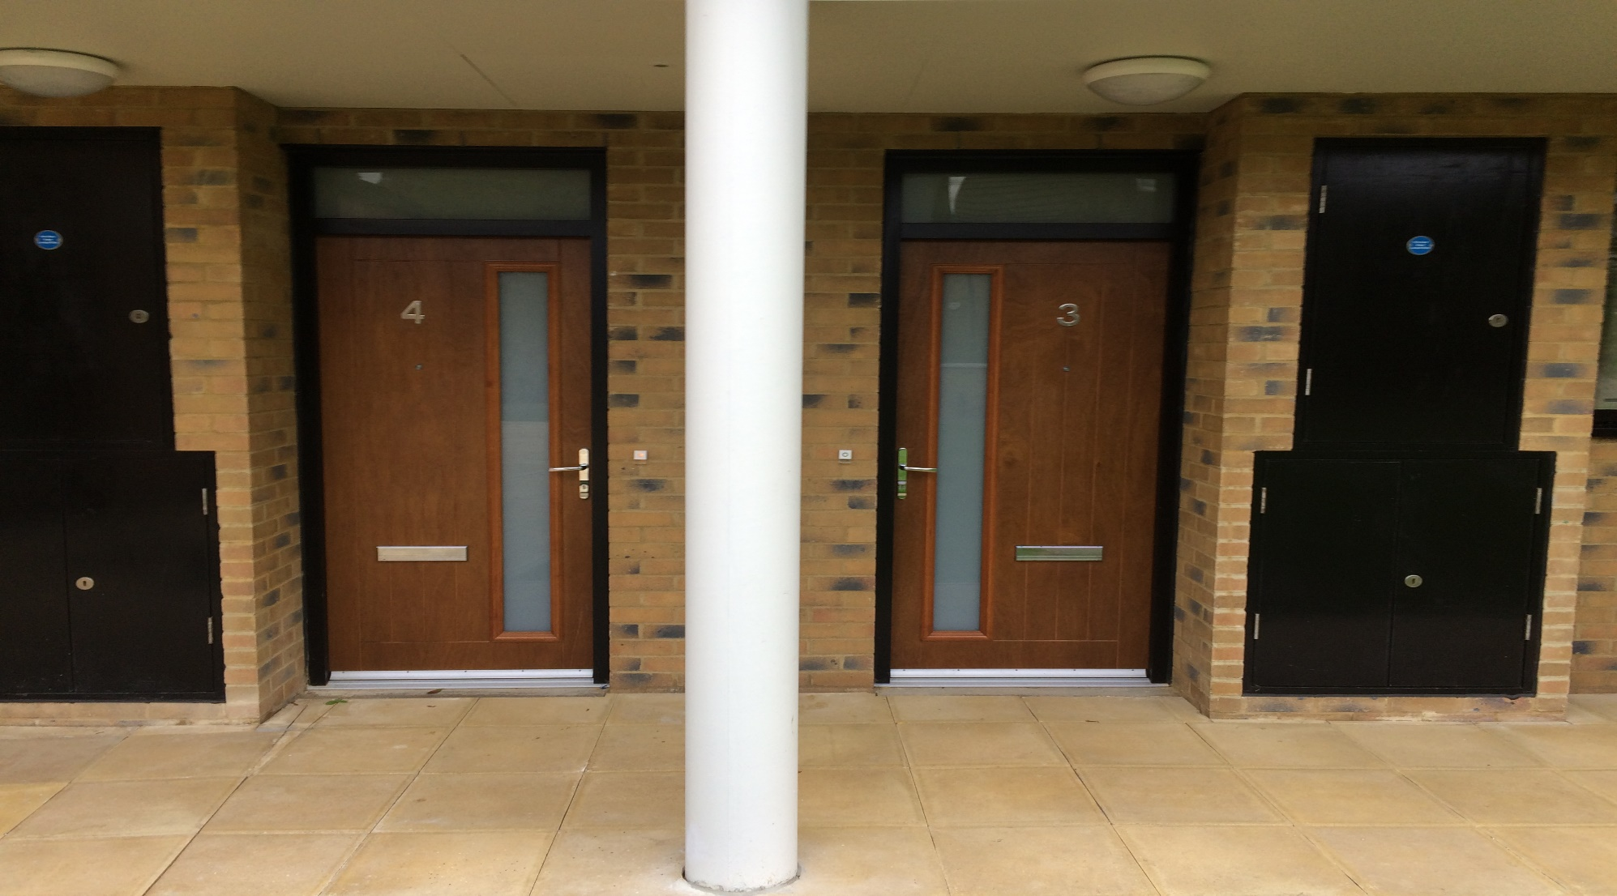
Good housing for people in later life is more than bricks & mortar

Slide 3

Our vision is for a world with good mental health for all
Our mission is to help people understand, protect, and sustain their mental health
Prevention is our priority, across the lifecycle.

Slide 4

Standing Together
About the project
History
Who takes part?
Outcomes & Evaluation
Notes:
Content slide template
Heading:
Font: Arial, bold, All caps (if appropriate)
Size: 40pt (adjust as needed)
Alignment: Centre
Spacing: 6pt between letters (can be adjusted)
Colour: White
Content:
Font: Arial
Size: Change as needed
Alignment: left

Slide 5
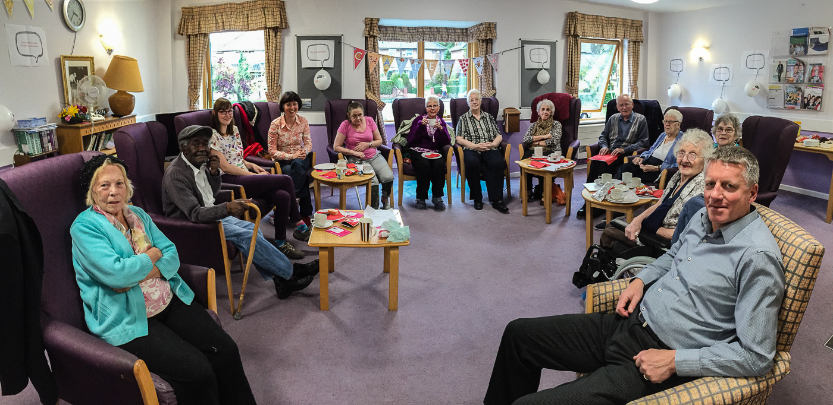
Building Relationships

Slide 6
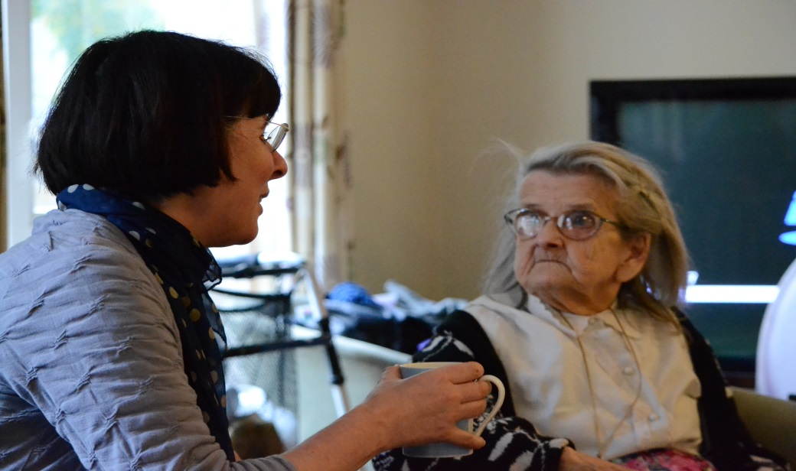
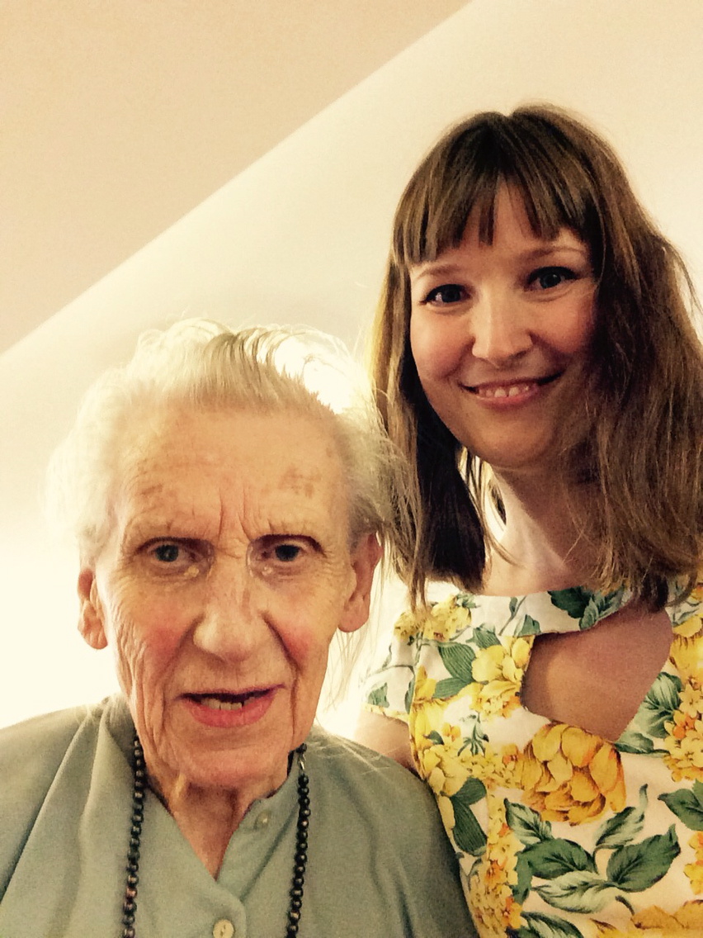
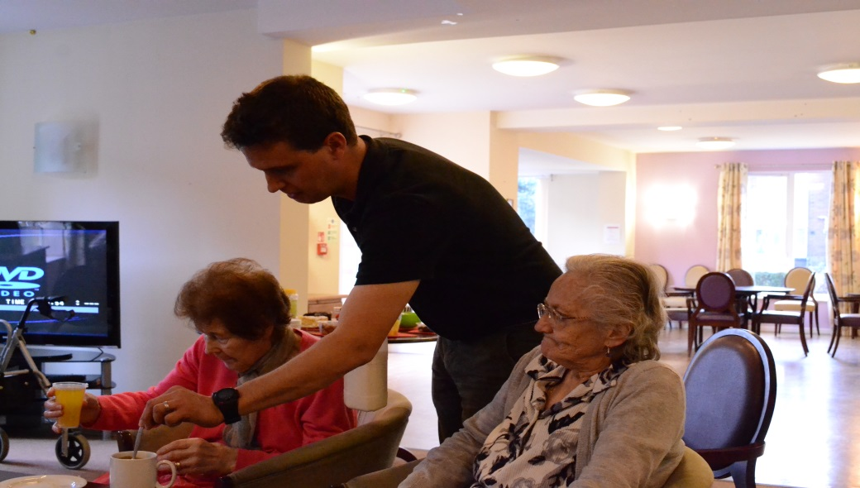
Standing Together Staff team

Slide 7
Standing Together using Creativity
We have just finished the delivery side of the project.
Some of our learning form the very first cohort was about the challenge of ending our involvement well.
A celebration of what everyone in the room brings, including ourselves as facilitators
Using creativity has been a key to this is the following ways:

Slide 8
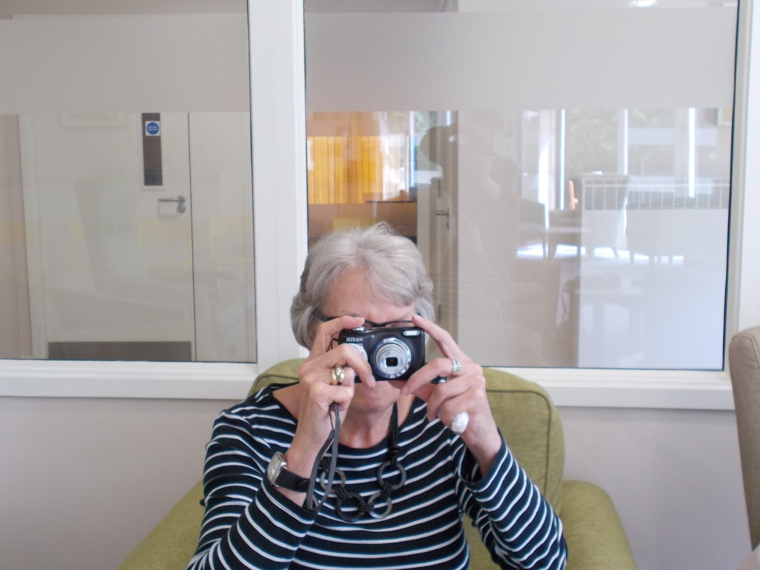
Projects: Photographic Projects

Slide 9
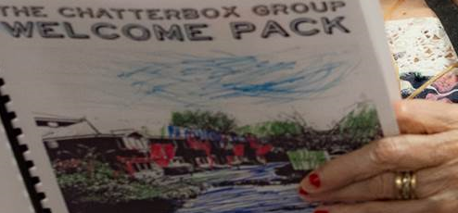
Projects: Welcome Pack

Slide 10
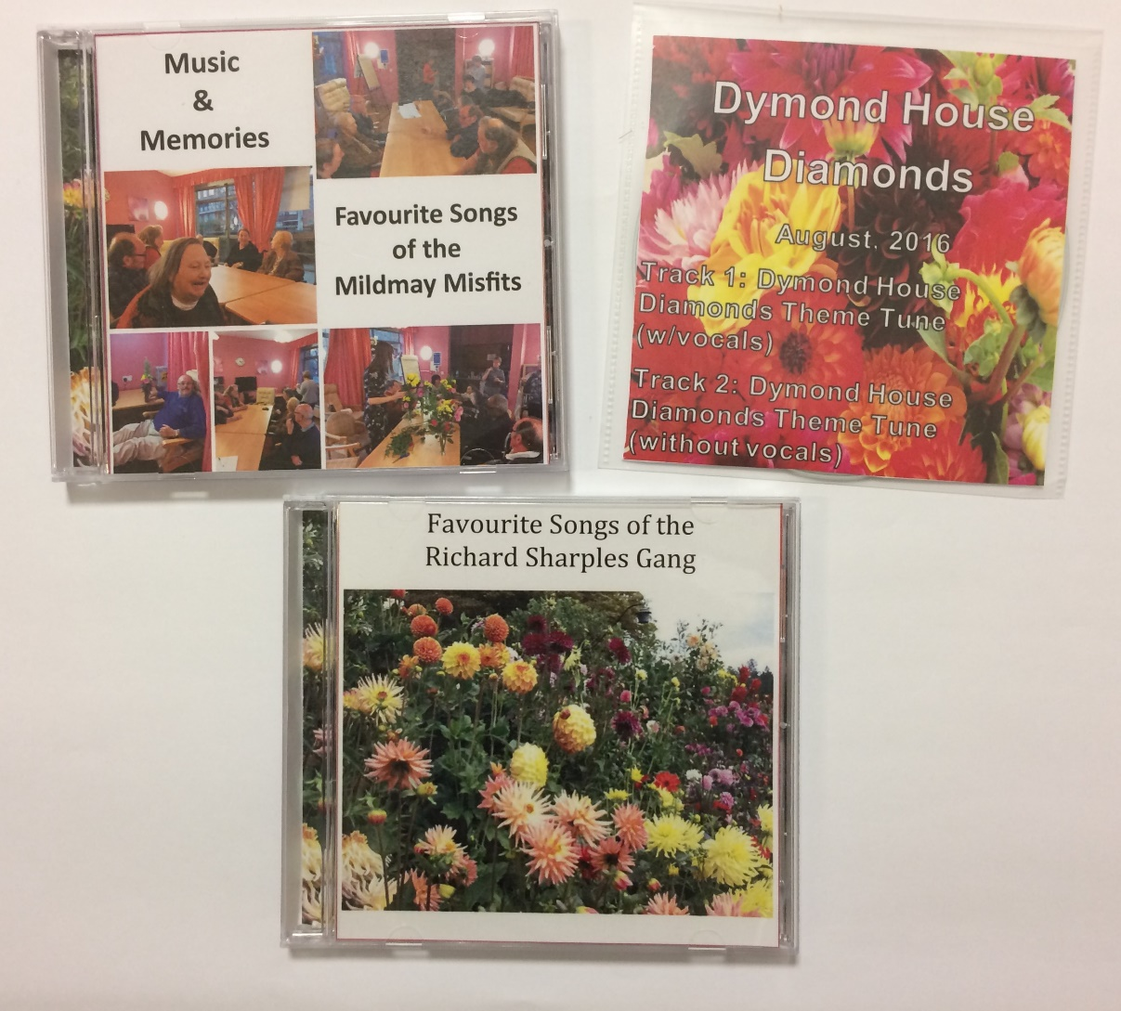
Projects: CDs
Notes:
Other projects include:
Memory boxes we enlarged a photo for a tenant I’ll her call Molly, she was so delighted to see an image of her father enlarged form a tiny photo to A$ that this is what she wrote on the outside of the box
We have also made large collages with the groups about we’ve done over the time, CDs of people favourite songs ,a book and theme tune.

Slide 11
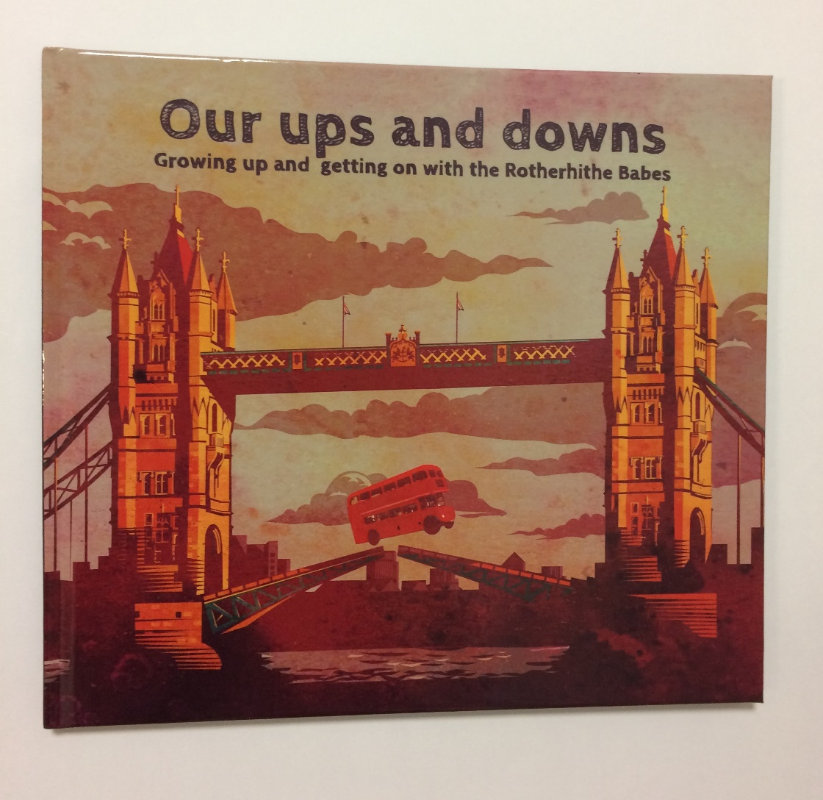
Projects: Co-producing a book
Notes:
Other projects include:
Memory boxes we enlarged a photo for a tenant I’ll her call Molly, she was so delighted to see an image of her father enlarged form a tiny photo to A$ that this is what she wrote on the outside of the box
We have also made large collages with the groups about we’ve done over the time, CDs of people favourite songs ,a book and theme tune.

Slide 12
Standing Together Future
Co-producing the project handbook
Licensing a toolkit
Developing new projects
Aiming to improve quality of life & facilitate cultural change
Notes:
Content slide template
Heading:
Font: Arial, bold, All caps (if appropriate)
Size: 40pt (adjust as needed)
Alignment: Centre
Spacing: 6pt between letters (can be adjusted)
Colour: White
Content:
Font: Arial
Size: Change as needed
Alignment: left

