Slide 1

The value of Advice

Slide 2



Menu
Care
Advice
Funding
INFORMATION AND ADVICE
THE NEED FOR ADVICE
MEETING THE NEED

Slide 3
Information AND Advice FOR CARE
Chapter 3 of the Care and Support Statutory Guidance defines information and advice as:
‘Information’ means the communication of knowledge and facts regarding care and support.
‘Advice’ means helping a person to identify choices and/or providing an opinion or recommendation regarding a course of action in relation to care and support.
3.8

Slide 4
Information OR Advice
Information/Advice or both?
“Don’t eat the pasta in the fridge, it’s for tea”

Slide 5
Independent financial advice
The statutory guidance talks of ‘facilitating access’ to independent financial information or advice (3.50/3.51)
Independent meaning independent of the local authority
This includes ‘Regulated Financial Advice’

Slide 6

REGULATED financial advice
Local Authorities should actively help and direct a person to a choice of financial advisers regulated by the Financial Conduct Authority (FCA) with the appropriate qualifications and accreditation. 3.51

Slide 7
Society of later life advisers (SOLLA)
The Society of Later Life Advisers was founded in 2008 as a not for profit organisation, to meet the need of consumers, advisers and those who provide financial products and services to the later life market.
The aim is to ensure that consumers are better informed about the financial issues of later life and can find a fully accredited adviser quickly and easily.

Slide 8
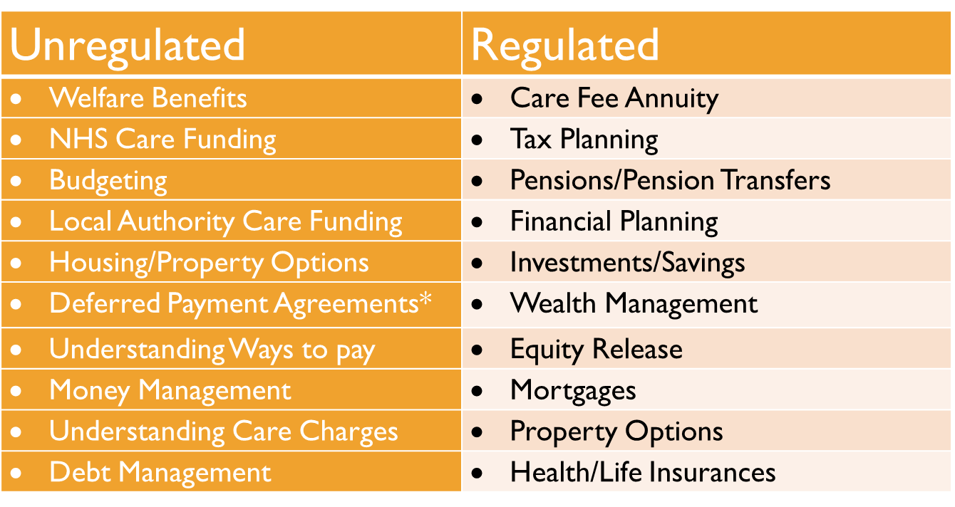
Types of financial advice

Slide 9
The need for advice
During 2013/14 we held a series of ‘Value of Advice’ sessions and asked the attendees to make 1st and 2nd choices from these subjects based on their need for information and advice.
Welfare Benefits
Local Authority Charging
NHS Funding
Choosing Care
Financial Advice
Legal Advice

Slide 10
REGULATED/UNREGULATED

Slide 11
REGULATED/UNREGULATED
11.4% Regulated
88.6% Unregulated

Slide 12



The need FOR ADVICE – DEMAND?
Raised Awareness
Ageing Population
Life Events

Slide 13



MEETING THE NEED – who?
LA - Care Act; Information, Advice, Advocacy
1.63 million jobs in the social care sector (England)
Carers – 5.8 million informal carers
NHS teams deal with 1 million patients every 36 hours
Care providers: Domiciliary and Permanent care
Voluntary Sector: Independent Age, AgeUK, CAB
Disability related organisations: Dementia friends
Care Navigators/Planners/Brokers/Advocates
Legal and Financial Advisers

Slide 14
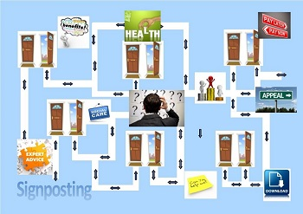
MEETING THE NEED – how?

Slide 15

Jean and albert

Slide 16
THANK YOU
nicola@careadvisernetwork.co.uk 0800 999 25 27

Slide 17
These slides have been prepared for presentation only and whilst we strive to provide accurate information and services with reasonable care and skill the information and material is provided without any guarantees, conditions or warranties as to its accuracy. The Care Adviser Network cannot be held responsible for individual interpretation or decisions made based on the information provided which should not be used for giving specific advice to clients.

