Slide 1
Social media

Slide 2
Why use Social Media?
Reach a new, local audience ranging from beneficiaries to fundraisers to potential corporate partners, they are all on social.
Raise awareness of the vital work you are doing – it’s important to show off!
Immerse yourself in local community chatter. Councils, businesses all part of the conversation, make sure you are too.

Slide 3
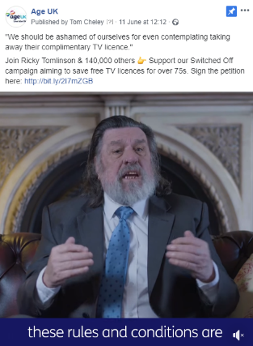
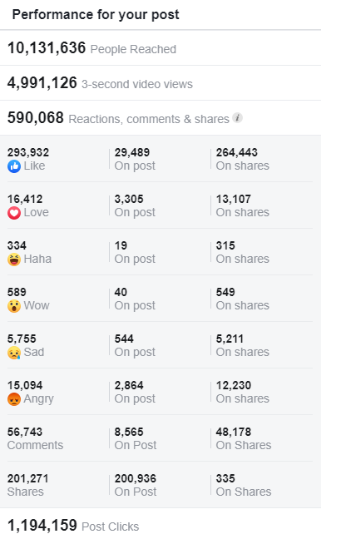
The power of social - #SwitchedOff

Slide 4
Which platform is right for me?
Time on social media is a key issue for many partners. Focus on 2 platforms only.
Facebook & Twitter are the two key platforms you should have a presence on.
If only time for one platform – Twitter is the easy, less time consuming platform.

Slide 5
Twitter Tip 1
Follow, Follow, Follow!
@ageuklondon
Let people know you’re on Twitter!
Other local organisations you work with are a good place to start
Notifications will help spread the word.

Slide 6
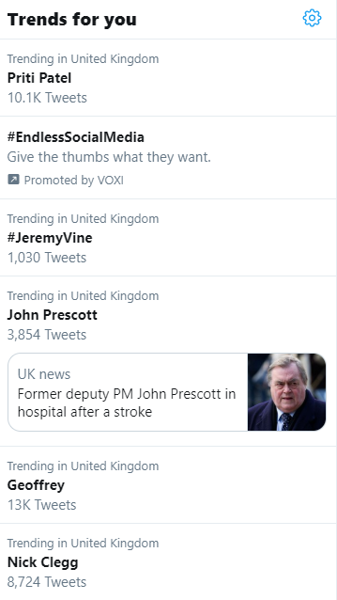
Twitter Tip 2
Utilise trending hashtags
Allows people to discover your content if they aren’t following you.
Can be localised to where you are.
Weekly hashtags are great to get out content.

Slide 7
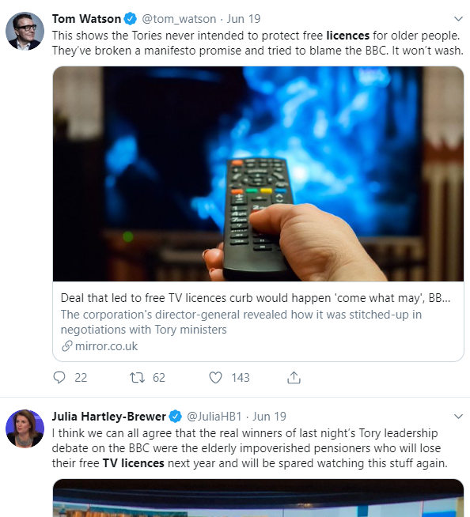
Twitter Tip 3
Keyword Searches
A great way of discovering who is talking about your key topics and how.
It can be time consuming but a great way to start a conversation.
https://twitter.com/search-advanced

Slide 8
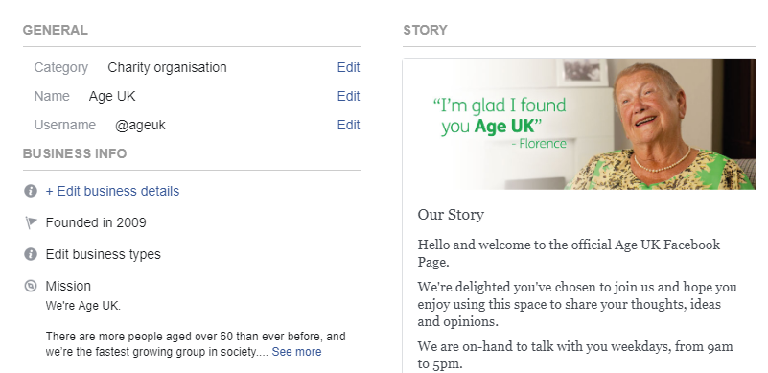
Facebook Tip 1
Get your page information up to date
Add in all the info to your ‘About’ section.
Have 3 or 4 posts already up before you start promoting the page so that it looks active.

Slide 9
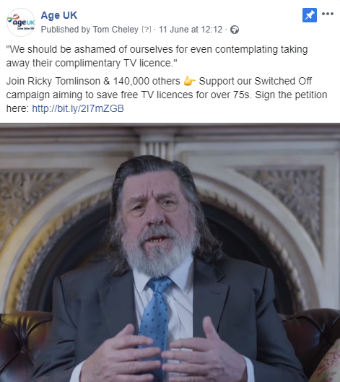
Facebook Tip 2
Populate your page!
Make sure to post a couple of posts promoting your local Age UK and the services offered.
If local people are going to start visiting your page it needs to look active

Slide 10
Facebook Tip 3
Promote your page!
Not just online but in and around your local area.
Have signs up letting people know to like your page on Facebook.
Word of mouth on pages/services can make a big difference

