Slide 1
Solicitors, law firms, and legal services
Jane Malcolm
Executive Director

Slide 2
About us
We are the largest legal services regulator in England and Wales, covering:
180,000+ solicitors
10,000+ law firms and their staff

Slide 3
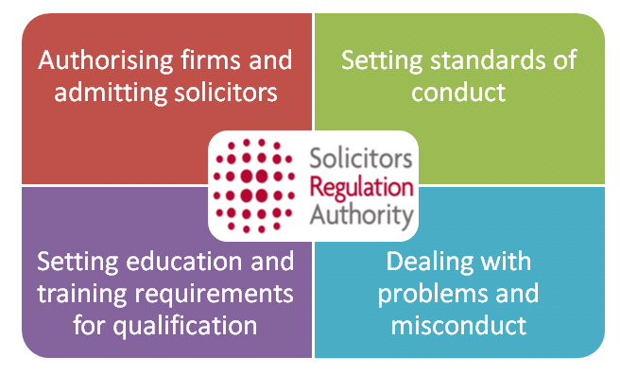
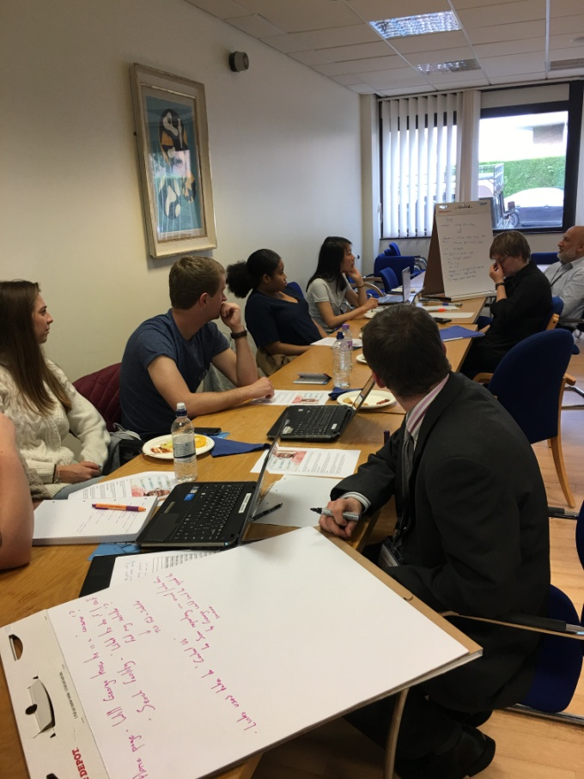
What we do

Slide 4
Older people and legal services
43% of legal services users are 55+
only 33% of people aged 55+ in England and Wales feel they have good knowledge of what lawyers do
15% of people aged 55+ ‘DIY’d some of the legal work themselves when they last used a lawyer

Slide 5
What services do solicitors provide?
litigation work and support during court cases
giving people advice about their rights
helping people buy or sell property
writing, storing and executing wills
creating contracts and other documents
helping people with injury claims
….. and help with many other legal issues

Slide 6
Services to help later-life planning
will writing, including will storage and executor services
making lasting powers of attorney
creating a legal basis for advance decisions / living wills
advising about care funding
making gifts / putting assets into trusts

Slide 7
Finding solicitors
Use ‘Find a Solicitor’
This is a free service available through the Law Society - just Google ‘Find a solicitor’
Other solicitor-finder services include:
Solicitors for the Elderly
Mental Health Lawyers Association
Association of Personal Injury Lawyers
Resolution (family lawyers)

Slide 8
Staying safe - security checks
Anyone calling themselves a solicitor in England and Wales must by law be regulated.
If you aren’t sure you can contact us and we can check for you.

Slide 9
What to expect from a solicitor
We set the standards for solicitors.
This includes requirements for solicitors to:
treat their clients fairly and protect their interests
tell clients about their right to complain and how to do this
provide the best possible information about costs, up-front and during the legal work
Our website has information on what to ask and what to expect.

Slide 10
And if things do go wrong….
Solicitors have to have a complaints procedure available for their clients.
If the service is poor, complain to the firm. If things don’t get resolved, go to the Legal Ombudsman.
If someone wants to report a solicitor’s behaviour or actions, they can contact us (they don’t have to be a client of that solicitor).

Slide 11


Other sources of information

Slide 12
What’s changing
Increasing access to legal services
Better information
Legal Choices

Slide 13
Thankyou for your time

