Slide 1
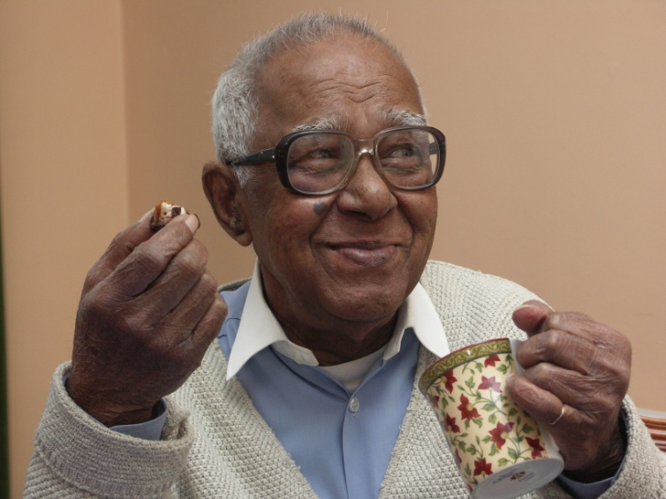
Tackling Loneliness – Older Londoners
Age UK London Mini Conference
15 June 2018
Paul Burstow, Chair, SCIE

Slide 2
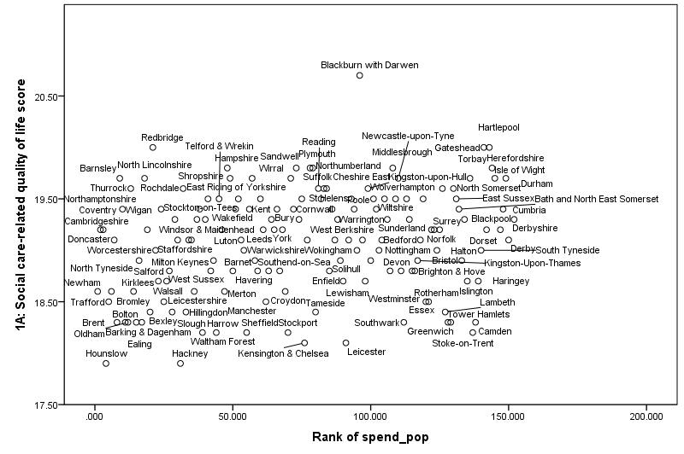
The variation conundrum
Social care-related quality of life score
Source: Analysis of ASCOF data by University of Birmingham
Rank of spend pop

Slide 3
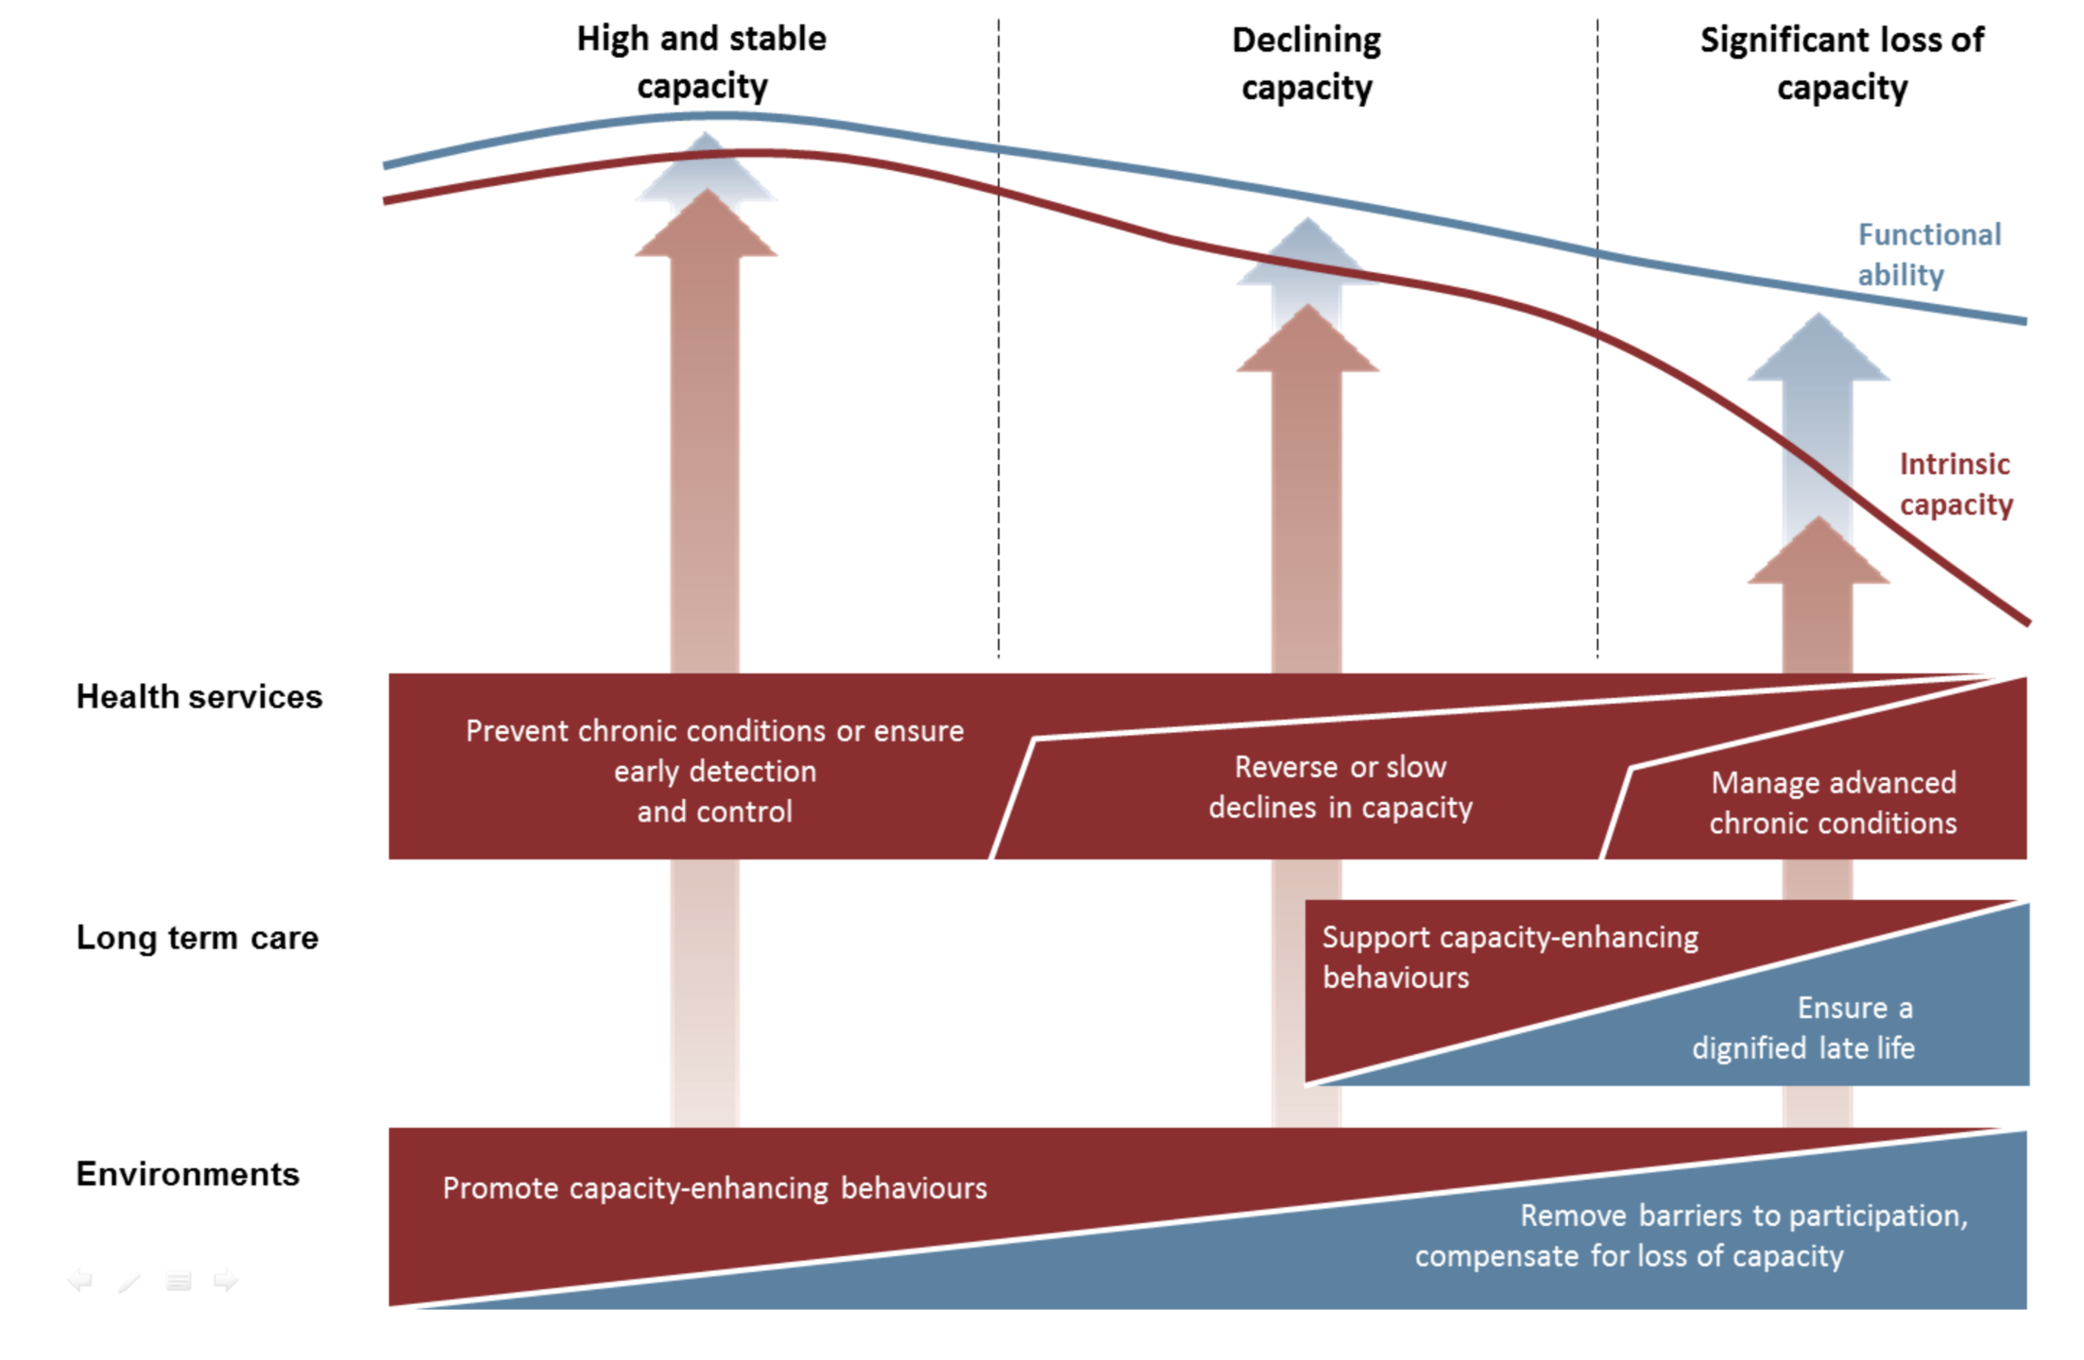
Healthy Ageing Framework
Functional ability has had less attention in public policy.
Loss of function is a big driver of public spending and poor outcomes.
Shifting this line would have a significant impact on quality of life.
It is what occupational therapy is all about.
Work on public health is focused on reducing health inequalities, which will be critical to achieve the goal.
Existing life science, health research and public health programmes tend to address improving intrinsic capacity.

Slide 4
1
go for over a month without speaking to a friend, neighbour or family member
MILLION

Slide 5
15
As harmful as smoking
a day
Notes:
It costs – personally, socially, economically

Slide 6
“I have to get out of bed each morning to walk my dog – and people stop to talk to me.”

Slide 8
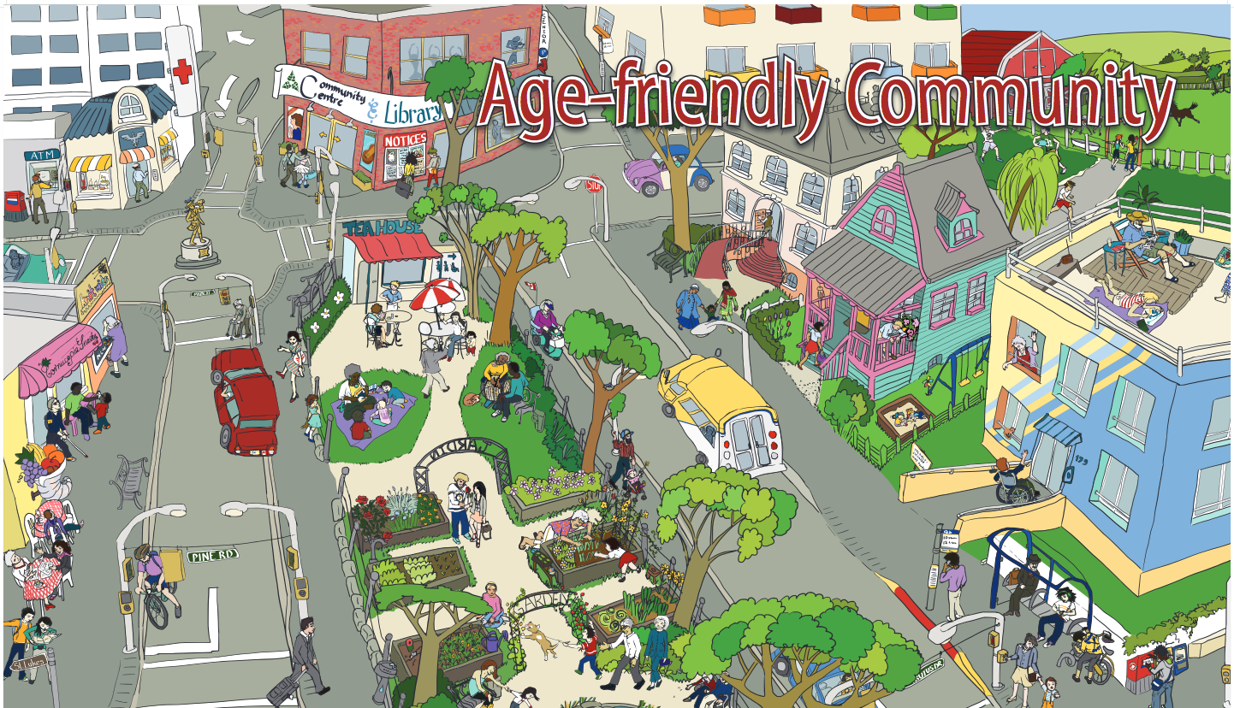
Access and mobility
Design a city for older people and you design it for everyone
Notes:
Develop holistic approaches such as age-friendly cities and public awareness campaigns (e.g. Dementia Friends)
Holistic approaches such as age-friendly cities and public awareness campaigns to push the issue up the social agenda. A civil education programme similar to Dementia Friends would ensure the wider public learn about causes of and ways to address loneliness and isolation in older adults.

Slide 9
Engage with Community

Slide 10
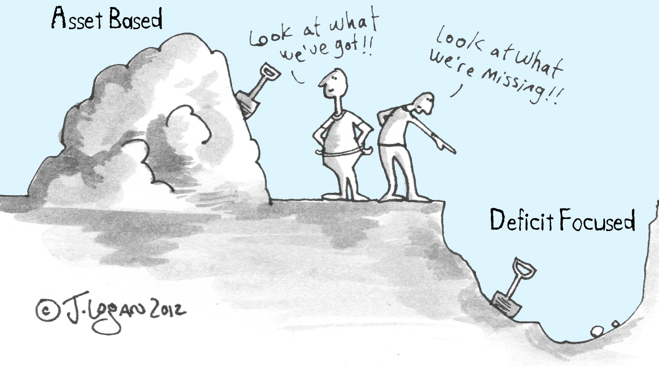

Slide 12
Transform Ageing is a community and design led initiative that aims to transform the experience of ageing for people in the south-west of England.

Slide 13
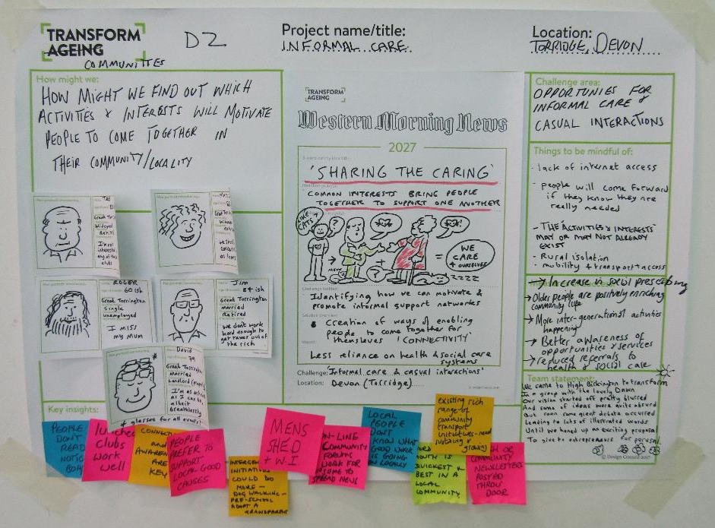

Slide 15
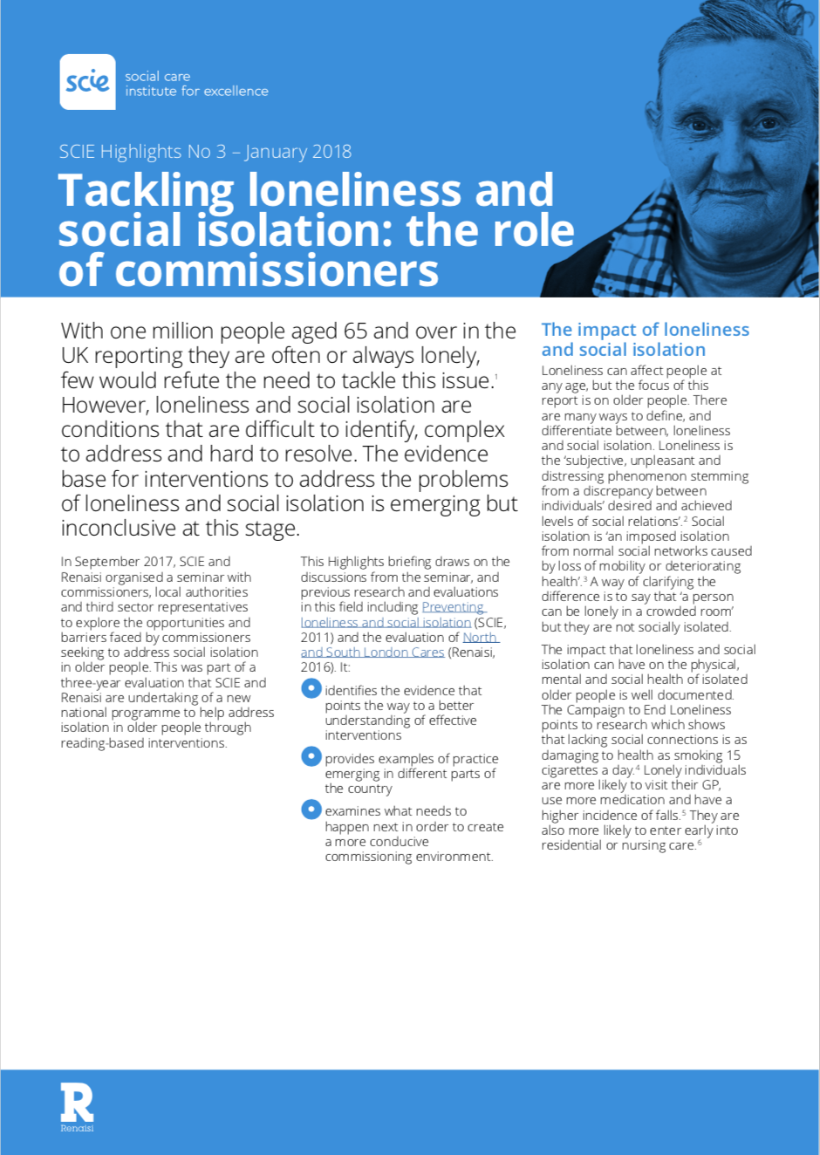
Micro commissioning.
Asset-based: connection and purpose.
Make it easier for small organisations to play.

Slide 16
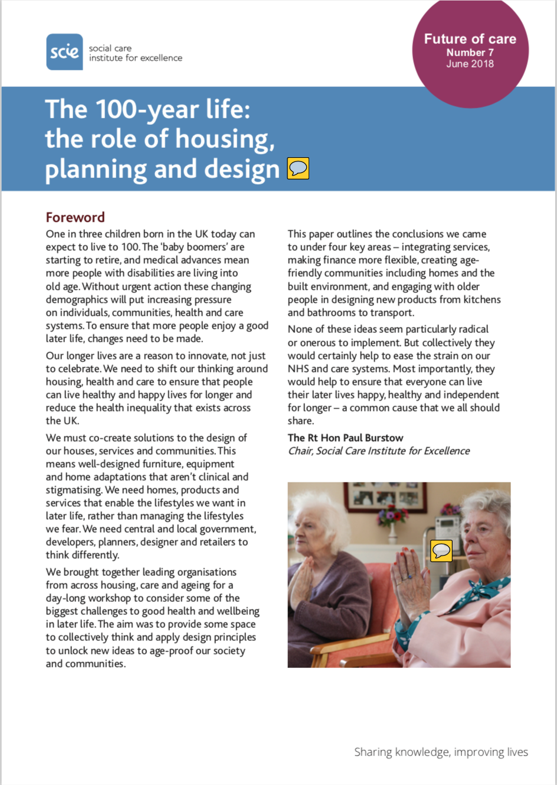
Launched TODAY
www.scie.org.uk/future-of-care

Slide 17
Create life-long homes: build to higher accessibility standards
Support age-friendly developments
Co-design solutions with older people: improve co-production skills of planners, policy makers, developers, designers etc.
www.scie.org.uk
Notes:
One of our recommendations is that the design of homes should meet the needs for the whole population as we age by providing a choice of high quality homes. Government should set a national mandatory requirement for 90 per cent of new homes to be built to accessibility standards M4(2) ‘accessible and adaptable dwellings’ - and 10ten per cent% built to be M4(3), ‘wheelchair user dwellings’, (i.e. is designed to be wheelchair accessible, or easily adaptable for residents who are wheelchair users) as is being done in London and other core cities across England.
Local plans: Local and neighbourhood plans must should include design principles that create age-friendly environments. This may involve Local Planning Authorities recommending that in order to receive planning approval, new developments must incorporate age-friendly housing and environments in their plans.

Slide 18
Social Care Green Paper
align health, housing & care systems?

Slide 19
Making the everyday inclusive

Slide 20
Keep in touch
Visit www.scie.org.uk
Register for SCIELine
Contact us on twitter @SCIE_socialcare

