Slide 1
The Air We Breathe
What Poor Air Quality means
for Older People Living with Allergy

Slide 2
The only national charity dedicated to providing advice, information and support for the 21 million people living with allergies in the UK
Allergy UK’s mission is to ‘raise the profile of allergy at all levels’
Our vision is that ‘everyone affected by allergy receives the best possible care and support’
Campaigning and raising awareness of the impact that allergens can have on health
Highlighting health problems related to poor air quality, such as respiratory problems and allergy, which can cause significant morbidity and mortality
Addressing these concerns with key people involved in the provision of materials and systems for new build properties as well as renovations and/or decorating of existing buildings.

Slide 3
What is Allergy?
It is driven by the immune system and is a multi system/organ disease
It impacts on the quality of life of those living with the disease
It can affect respiratory, gastro-intestinal, cardiovascular, eyes and skin..
E.g. Food allergy, skin allergy, pollen allergy, house dust mite allergy, drug allergy, venom allergy…..
Allergic reactions can come on suddenly or be persistent
Allergic reactions can be mild, moderate or severe – and fatal
Undiagnosed, untreated allergy has the potential to cause serious health problems
Allergic conditions need to be recognised early, diagnosed and managed appropriately.

Slide 4
Modern Epidemic - the Burden of Allergy in the UK
The UK is one of the top three countries in the world for the highest incidence of allergy
21 million adults in the UK suffer from at least one allergy (10m with 1+)
50% of children in the UK suffer from some form of allergic disease
1 in 50 children suffer from a nut allergy
Diagnosed allergic rhinitis and eczema in children have both trebled over last three decades
40% of children and 30% of adults have one or more allergic condition (i.e. asthma, eczema, hay-fever)
The prevalence of allergic disease in the elderly is estimated to be around 5-10% (globally)
Although allergic conditions are often thought of as childhood disorders, the disease often persists into older age and can occasionally make its initial appearance in the elderly

Slide 5
Poor Air Quality
Modern living, urbanisation and climate change are all impacting on air pollution
This affects our food, environment, air and water - and our health
Air pollution cannot always be seen or smelt but its impact can be dangerous!
Each year in the UK, around 40,000 deaths are attributable to exposure to outdoor air pollution, with more linked to exposure to indoor pollutants
High cost to society and business – estimated at £20billion per annum
Air pollution plays a role in many of the major health challenges of our day
Linked to cancer, asthma, stroke and heart disease, diabetes, obesity, dementia and life long diseases – like allergy!
(Every breath we take: the lifelong impact of air pollution, 2016)

Slide 6
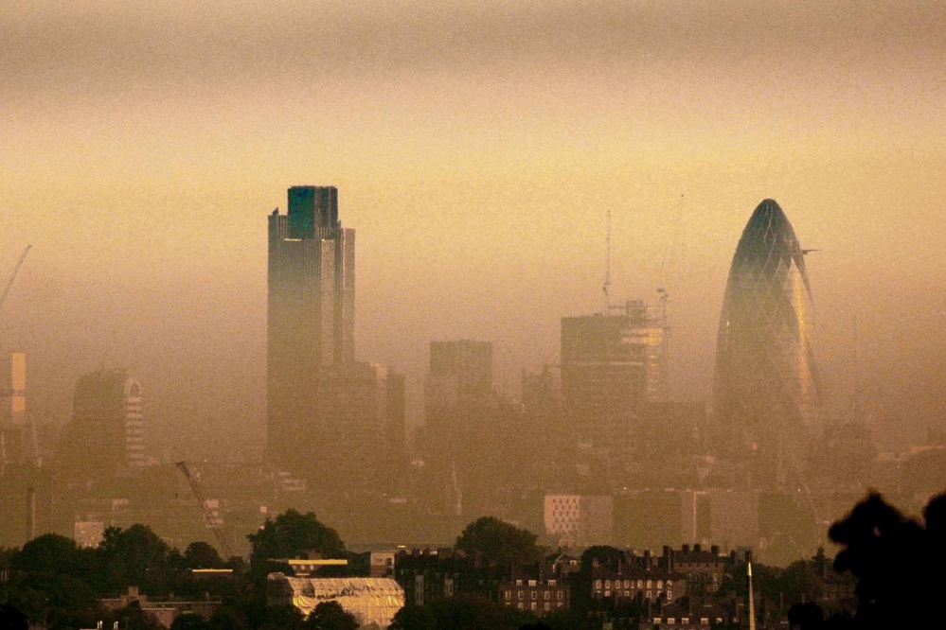
Poor Outdoor Air Quality
Volatile organic compounds (VOC), dust, pollen and toxicity of building materials, CO2 and ozone
Higher levels of pollutants due to temperature increase and relative humidity
Research suggests a causal link between air pollution and asthma, allergic rhinitis, and other allergic disorders.
Good evidence that outdoor air pollution causes lung cancer
In older asthmatic patients high daily exposure to traffic pollution is the strongest predictor of poorer asthma (Ventura et al, 2017)

Slide 7
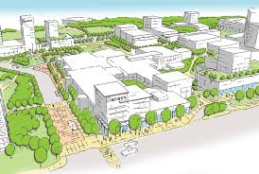
Poor Outdoor Air Quality
Modern air pollution in the UK mostly comprises of small, ultra-fine particles
Diesel
E.g. nitrogen dioxide and particulates from diesel engines
In the UK today, about half of cars run on diesel.
Nearly all buses, vans and lorries, forms of water transport, and many trains, use diesel in the UK, along with construction and farm machinery
Urban Planning - Trees
Birch, the ‘Tree of Life’ is being planted without awareness of its allergic potential
Birch pollen is light and fine – airborne
High prevalence of birch pollen allergy in UK and Europe
UK 3rd highest allergic rhinitis in the world
Highest rate of asthma in the world - & 80% of asthmatics have pollen allergy
Need biodiversity and varied tree planting to reduce excessive quantities of specific pollen

Slide 8
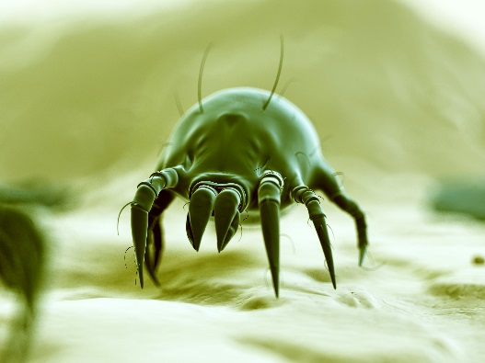
Poor Indoor Air Quality
A recent conservative estimate shows that between 1.5 and 2 million deaths a year worldwide could be attributed to indoor air pollution (HealthVent Project, 2013)
The main sources of pollutants in dwellings are: combustion of fuel, tobacco smoke, building fabric, furnishing and consumer products, office equipment, people, pets and outdoor air
Pollutants rise from these:
Particulate matter
Carbon monoxide
Nitrogen Oxide
Excess moisture
Volatile Organic Compounds (gases from solids or liquids)
Biological particulates such as bacteria and allergens from pets, house dust mites, and moulds (fungi)
Fungi are present in all homes - can be present in carpets, wall papers, mould on windows, walls, fridges, bathrooms etc. They can cause asthma, make asthma worse, make eczema worse
Levels of air pollutants and allergens are often higher indoors

Slide 9
Modern Day Housing, Living & Working Environments
Changes in house and building design etc. – Keeping the heat in! House dust mite and mould heaven!
Increasing evidence base suggesting linkages between indoor dampness, fungi, and human health
Research studies show importance of dry environments to limit the risk of asthma and other immune system-related diseases
Office buildings without windows
Reduced ventilation from energy conservation drives – CO2 targets
Lack of ventilation for cooking fumes etc.
Central heating – Most adverse health effects reduced via a relative humidity indoors between 40–60 %
Carpets - places for allergens to thrive!
Increased range of products e.g. DIY - many products can be irritants
Increased use of cleaning products, candles etc.
Cool wash detergents - so not destroying the allergens e.g. HDM need 60+ centigrade

Slide 10
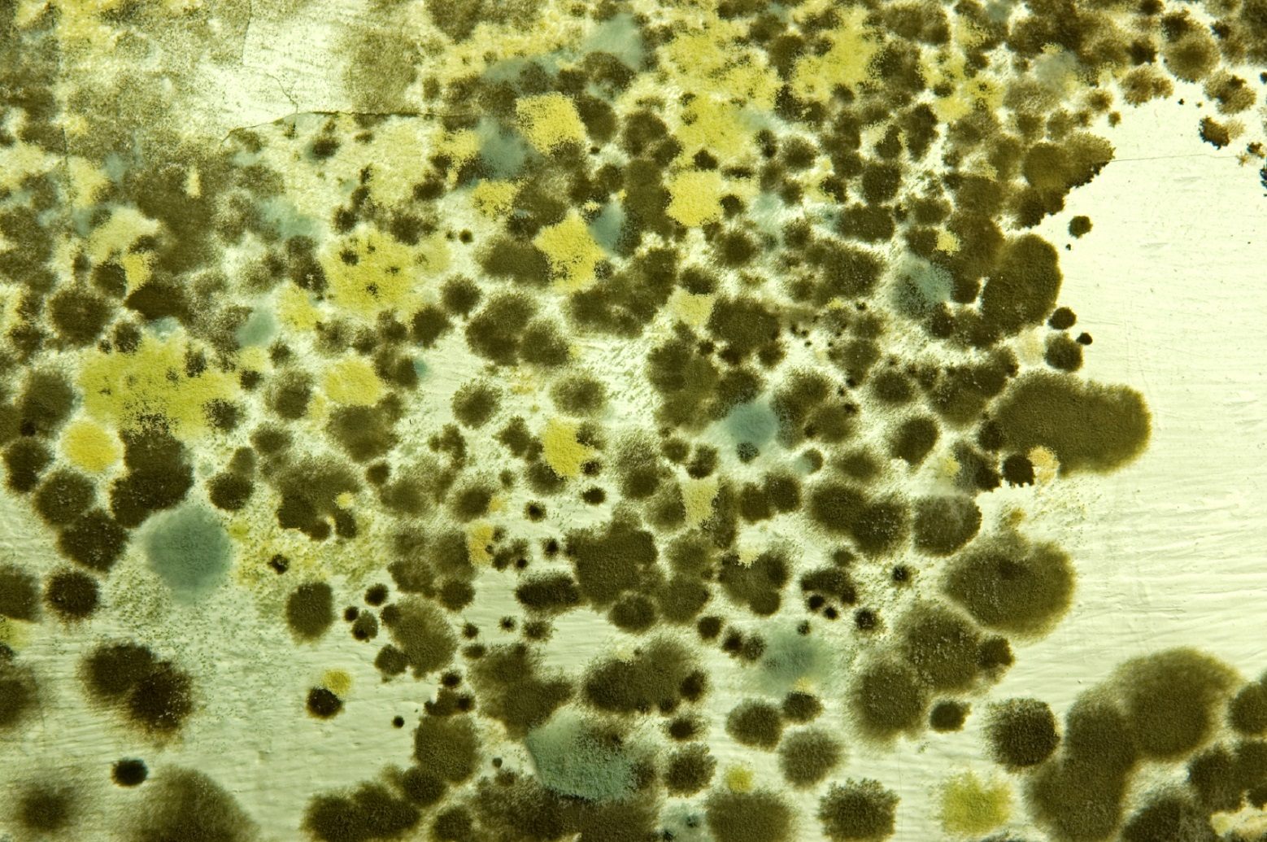
“There are strong associations between indoor fungi and initiation, promotion, and exacerbation of allergic respiratory disease.”
(Indoor Fungal Exposure and Allergic Respiratory Disease. N J Osborne et al 2015)

Slide 11
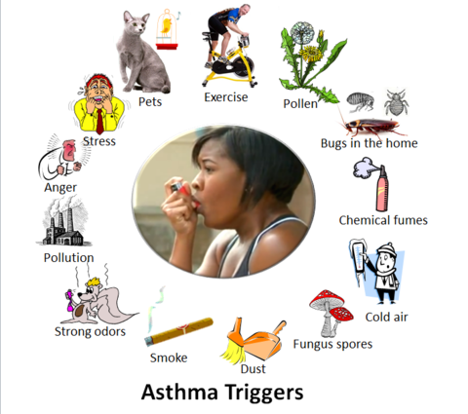
Allergy and the Older Population
Allergic rhinitis
Although the peak incidence is during adulthood, allergic rhinitis (AR) is prevalent among older people affecting around 5.4 to 10.7% of patients above 65 years
Asthma
Asthma affects older patients just as in any other age group. The prevalence of asthma in the elderly in developed societies is estimated around 6-10%. Fatalities are higher in older asthmatics compared to other age groups in which mortality is steadily decreasing.
Atopic dermatitis
Atopic dermatitis in the elderly is not uncommon. Topical medications, such as those used for leg ulcers, are a common cause of atopic dermatitis.
Allergies to chemicals
Many elderly patients have bladder and bowel complications which can lead to allergic irritation or allergic stoma dermatitis from adhesives, fragrances, rubber chemicals and acrylates used in medical products.

Slide 12
Older People and Air Quality
The age of the European population is rising!
Percentage of adults aged 65 years and older is projected to increase from 16% in 2000 to 20% in 2020
People spend 80–90% of their day indoors, and elderly people are likely to spend even more time at home. Thus, indoor air pollutants may have special significance for this age group (Simoni et al, 2003)
Older people at more risk from air pollution, even at low concentrates, because of reduced immunological defences and multiple underlying chronic diseases (Mendes et al, 2013)
As the aging process has an impaired impact on the immune system and our skin barrier function
Elderly people may be particularly vulnerable to air pollution because the ability to eliminate chemicals from the body decreases – e.g. reduced lung function and small particles inhaled.

Slide 13
Typical symptoms of allergic rhinitis like nasal obstruction, postnasal drip or cough may be worsened by physical changes of the nose that occur with age
It has recently been suggested that changes in breathing as we age impact on the severity of symptoms of allergic rhinitis (GreenFacts, 2017)
Sensitivity to particular allergens such as the indoor allergens, dust mite and cockroach, are more prominently associated with the presence of asthma in an elderly population
Older people may not be able to maintain house cleaning chores, may not open windows etc.
Many may live in social or rented accommodation, nursing homes which are poorly ventilated (Bentayeb et al, 2014)

Slide 14
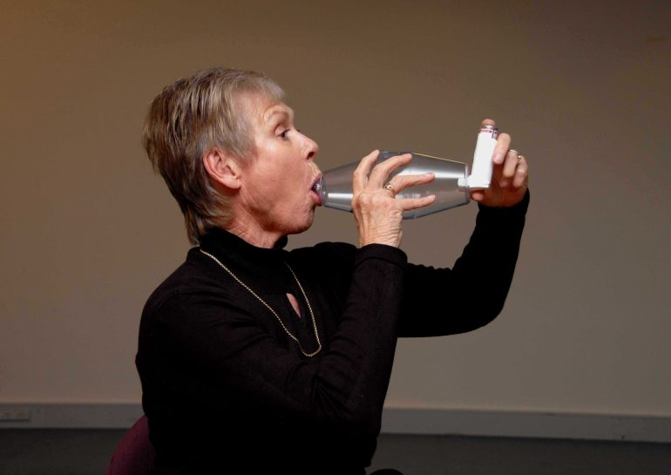
Allergy and the Older Population
Collected data has led to an increasing evidence base suggesting linkages between indoor dampness, fungi, and human health
Exposure to particulate matter, nitrogen dioxide, chemical pollutants, outdoor contaminants and biological agents in closed spaces has been associated with
Breathlessness and cough (PM10)
PM0.1 - wheeze
reduced lung function
bronchial hyper responsiveness#
respiratory infections
Formaldehyde - development/exacerbation of COPD
Associations were shown where indoor air pollutants were less than the international guidelines
Findings were enhanced in homes with poor ventilation and residents over 80. (Bentayeb et al, 2014)

Slide 15
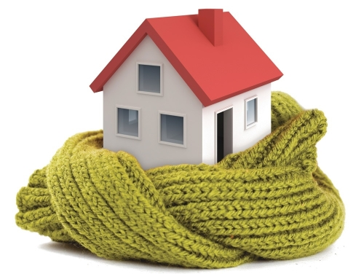
Older People and Warm Temperatures
Due to the elderly having reduced ability for thermo-regulation they will feel the cold more readily, so will want to keep warm.
To many older people this will mean:
having the windows shut – less ventilation
blocking out drafts – less ventilation
and turning the heating up.
This gives rise to increased temperature and humidity to the indoor environment having a direct impact on air quality as these are the exact conditions that house dust mite and mould thrive in
And this can exacerbate their allergic symptoms!

Slide 16
Every breath we take: the lifelong impact of air pollution
A report from the Royal College of Physicians and the Royal College of Paediatric and Child Health examines the impact of exposure to air pollution across the course of a lifetime
We must strengthen our understanding of the key risk factors and effects of poor air quality in our homes, schools and workplaces
A coordinated effort is required to develop and apply any necessary policy changes
We need to quantify the relationship between indoor air pollution and health.

Slide 17
Allergy UK Activities: Poor Air Quality
Lobbying at European Parliament as a Member of the European Federation of Allergy and Airways Disease Patient Organisations (EFA)
Lay Member for the NICE Committee for the guidelines on Indoor Air Quality
Members of the UK Indoor Environments Group
Members of the Association of Sustainable Building Products
Seal of Approval - Products which have passed high standards of scientific testing and prove efficiency in reducing/removing allergens from the indoor environment
Provide support and advice to 21million people living with allergic disease in the UK - Our Helpline receives over 500 calls a year from people whose allergic symptoms suggest that the cause was house dust mite or mould.

Slide 18
Moving Forward
Education!
Alternatives to petrol and diesel
New technologies to monitor air pollution effectively
Tackle inequality
Protect those at risk – e.g. older population
Protect future generations.
Improved government regulation
Building regulations need to consider health and wellbeing as a priority with eco and energy efficiency policies, as current regulations have potential to increase indoor pollutants levels
Improved guidance
For manufacturers and providers of construction/finishing materials/products, ventilation systems, double glazing, etc. which are used in the home
They need to be aware of and consider the effects these are having on health, not just how eco-friendly and energy efficient the home/building can be made.

Slide 19
Thank-you
Questions?

