Slide 1

Traffic Pollution and its impacts on our health?
Dr Ian Mudway

Slide 2
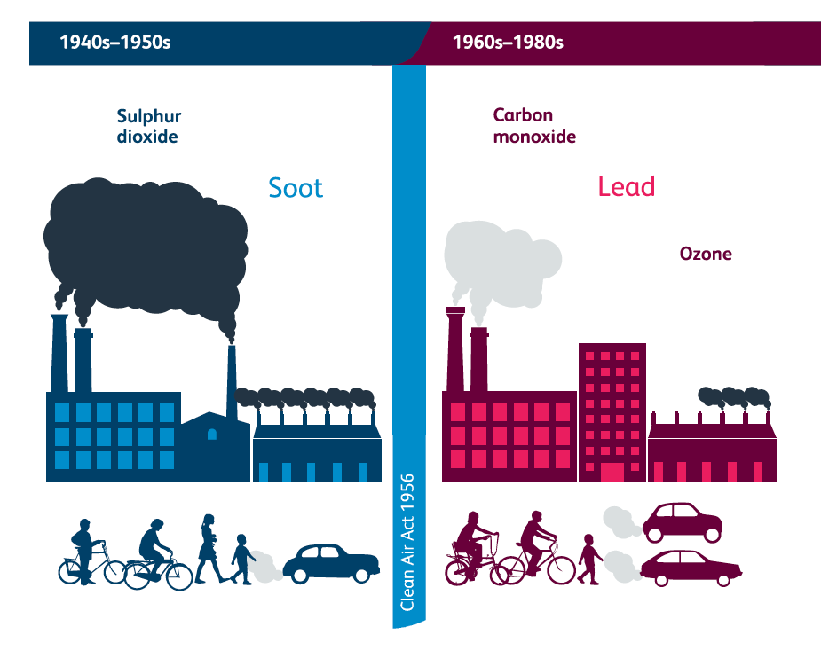
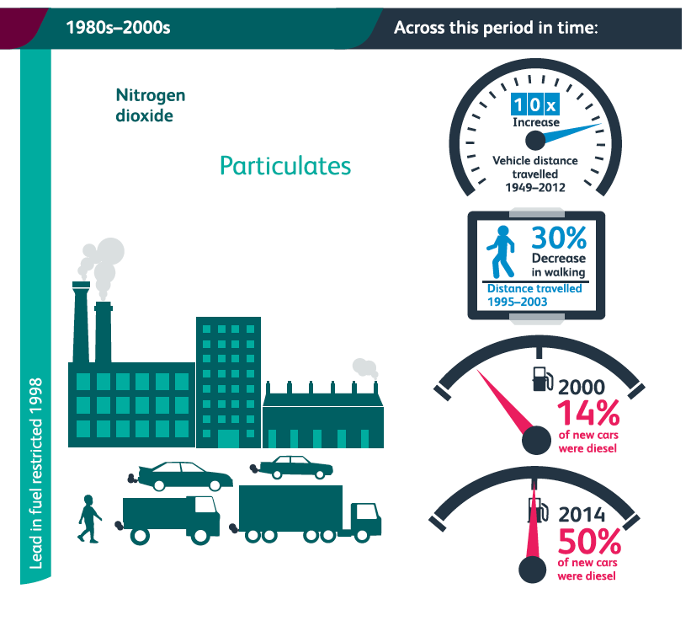
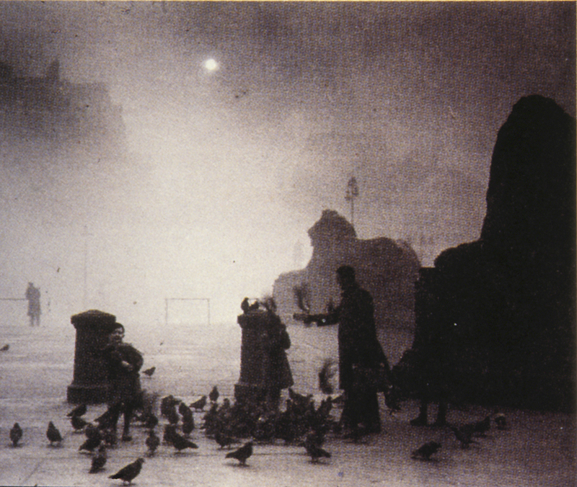
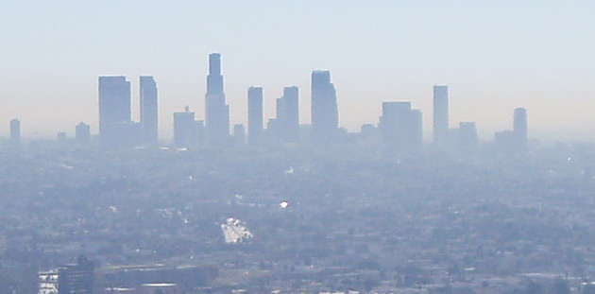
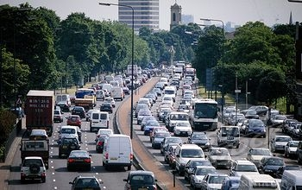
The changing face of air pollution

Slide 3
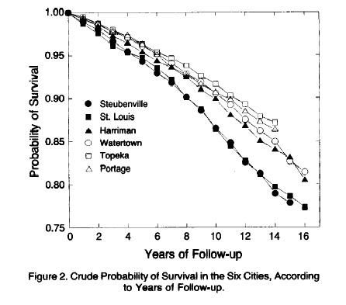
Health impact of ‘low’ concentrations of fine particulate pollution
Total particles (μg/m³)
Fine particles (μg/m³)
Sulfate particles (μg/m³)
Steubenville 89.9 29.6 12.8
St. Louis 72.5 19.0 8.1
Harrimen 49.4 20.8 8.1
Watertown 49.2 14.9 6.5
Topeka 56.6 12.5 4.8
Portage 34.1 11.0 5.3
Dockery DW, et al. N Engl J Med 1993;329(24):1753-9

Slide 4
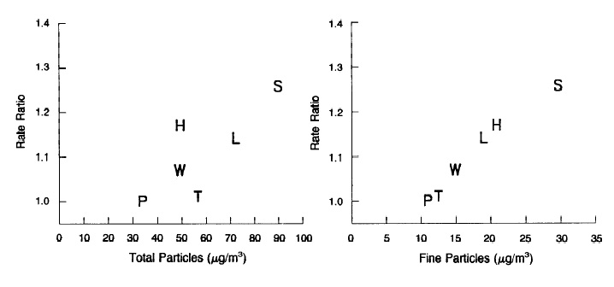
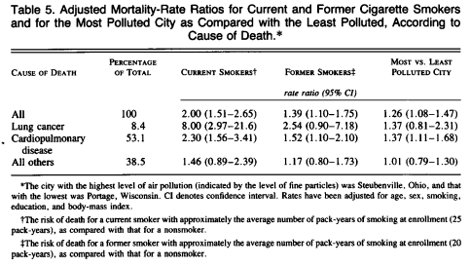
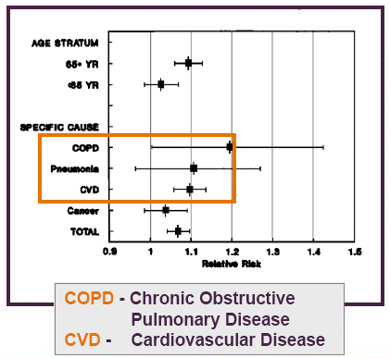
Dose response & susceptible groups

Slide 5
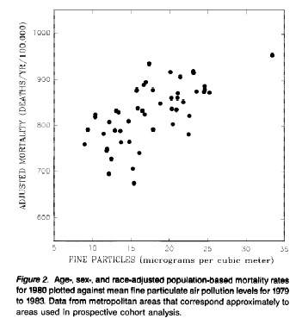
Scaling up the evidential base
American Cancer Study -151 US metropolitan areas
particulate air pollution was associated with cardio-pulmonary and lung cancer mortality
Increasing ambient fine particle mass was associated with increased mortality
Pope et al, AJRCCM; 1995

Slide 6
Short & long-term effects
Short Term
Long Term
Short Term = 0.4 – 1.3 %
Daily mortality rate using daily PM mass concentrations avgs
Harvard 6 cities
ACS LA cohort
10 µg m⁻³ PM_{2.5}
20 µg m⁻³ PM₁₀
ACS US cohort
Ischaemic heart disease; heart failure, stroke
Diabetes
COPD
Cancer
Dementia (?)
Long Term = 6 – 17%
Annual mortality rate using annual PM mass conc avgs
10 µg m⁻³ PM_{2.5}
Percent Mortality Risk Increase (95% CI)
Hypertension
Atherosclerosis
Hypercholesterolemia
Hyperglycaemia
Single US city studies
NMMAPS US cities
APHEA 2 cities
US 14 cities
US 6 cities
US 10 cities
Cali 9 cities
1-Klemm and Mason, 2003
2-Ostro et al., 2006
3-Anderson et al., 2005
4-Schwartz et al., 2000, 2003
5-Schwartz et al., 2004
6-Dominici et al., 2003
7-Katsouyanni et al. 2003, Analitis et al., 2006
8-Laden et al., 2006
9-Pope et al., 2002
10-Jerrett et al., 2005

Slide 7
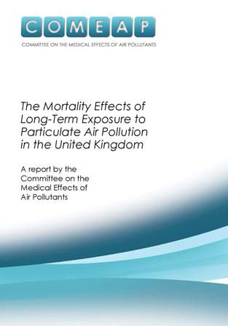
Short & long-term effects
As a result of poor air quality:
UK population lost 340,000 years of life in 2008
This loss of life is equivalent to 29,000 deaths
the average loss of life would have been 2 years, (though the actual amount would vary between individuals).
The burden can also be represented as a loss of life expectancy from birth (for everyone) of 6 months in susceptible populations
What about short term effects?
What about other pollutants?
Published December 2010

Slide 8
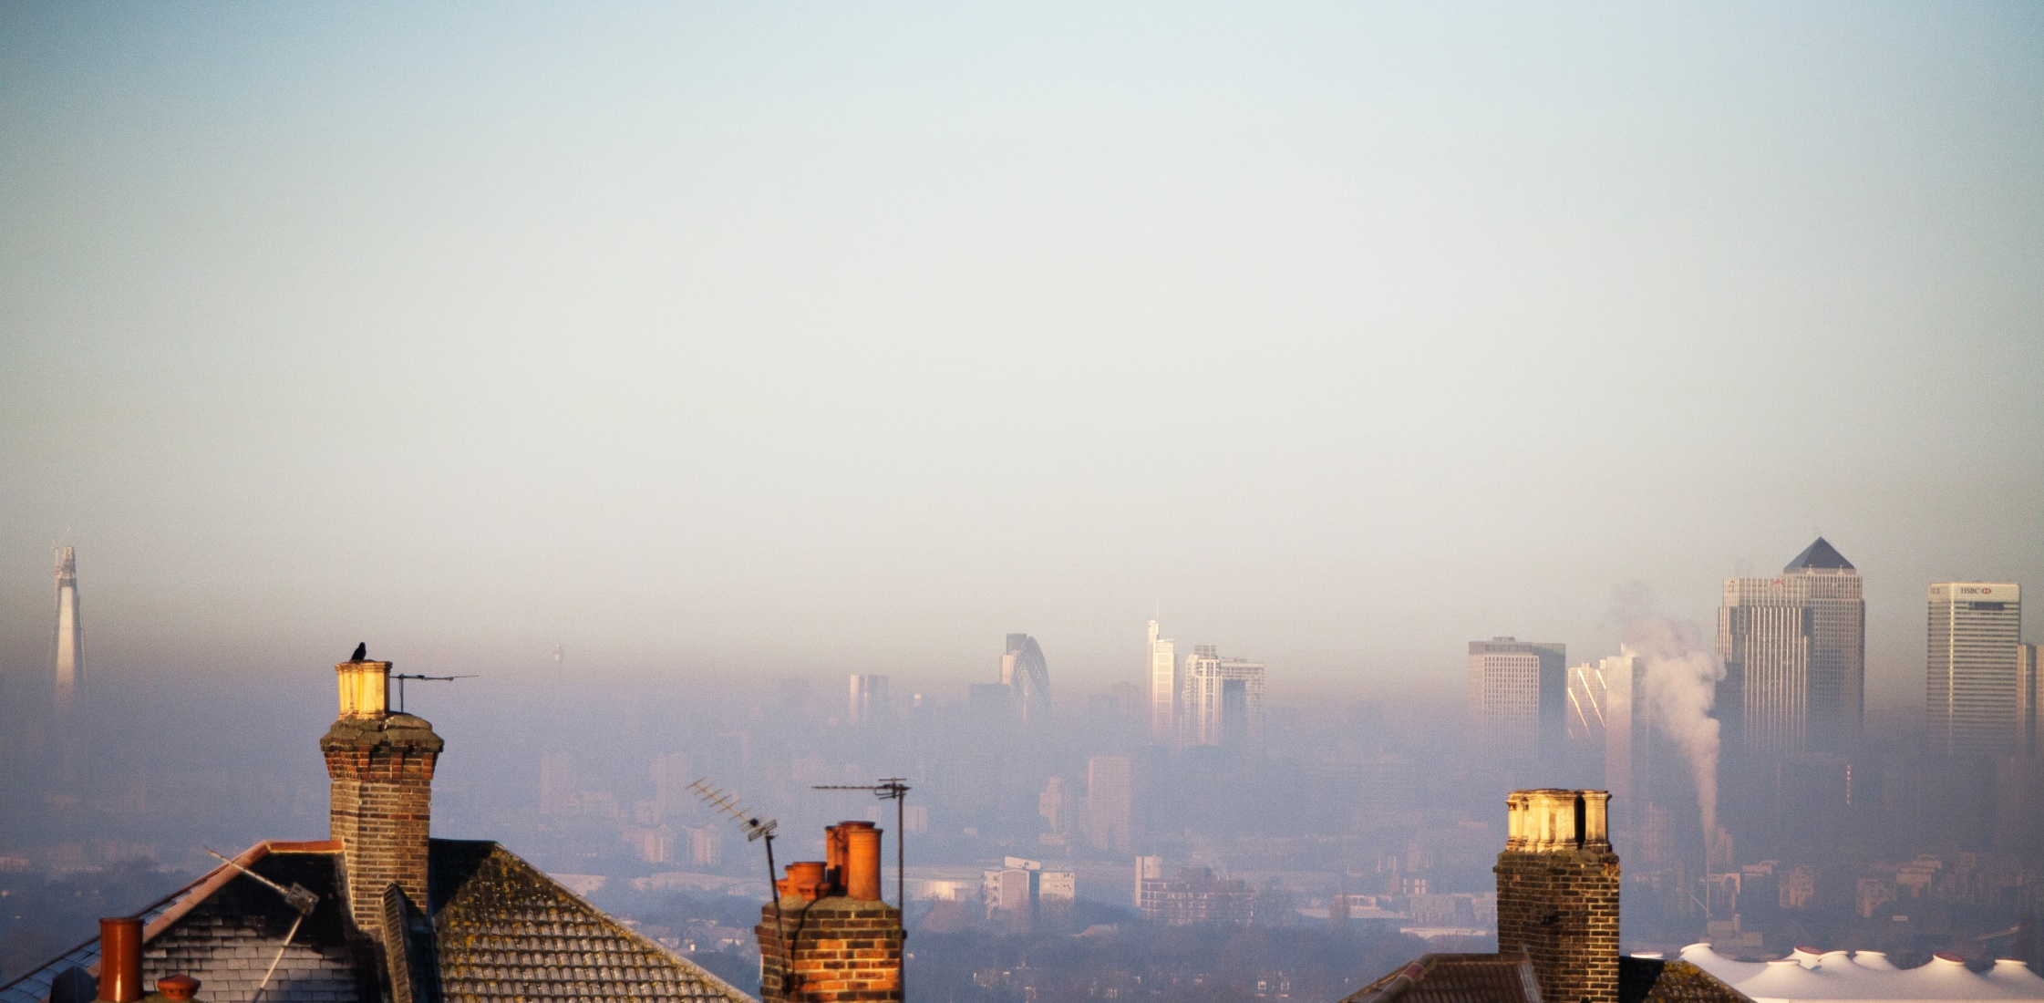
Air pollution is more complex than PM_{2.5}
Particulate matter (various definitions)
Oxides of nitrogen (nitrogen dioxide)
Ozone
Carbon monoxide
Ultrafine particles
Carbon black / elemental carbon
Organic carbon (VOCs, PAHs)
Metals
Biological components
Exhaust emissions
  Petrol
  Diesel
  Biodiesel
  Additives
Brake and tyre wear
Road dust
Local sources
Urban background
Regional
Indoor / outdoor

Slide 9
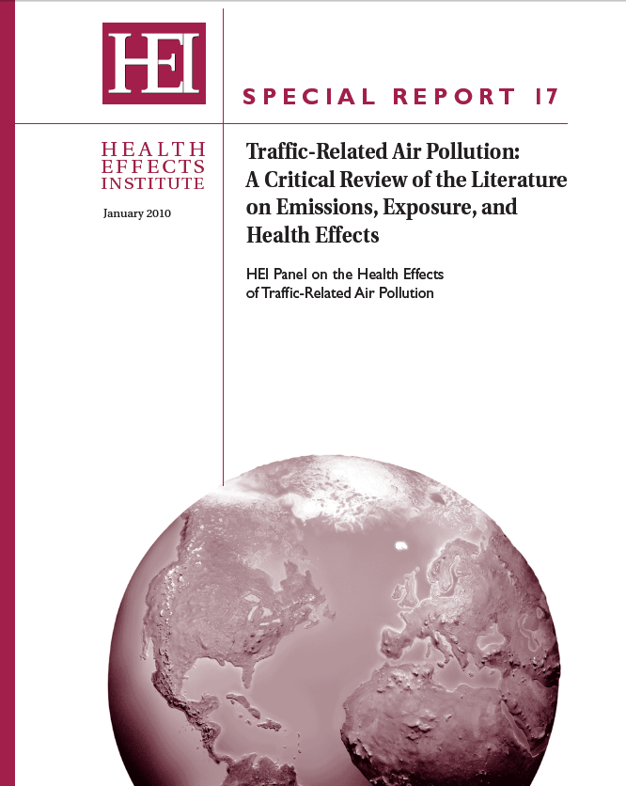
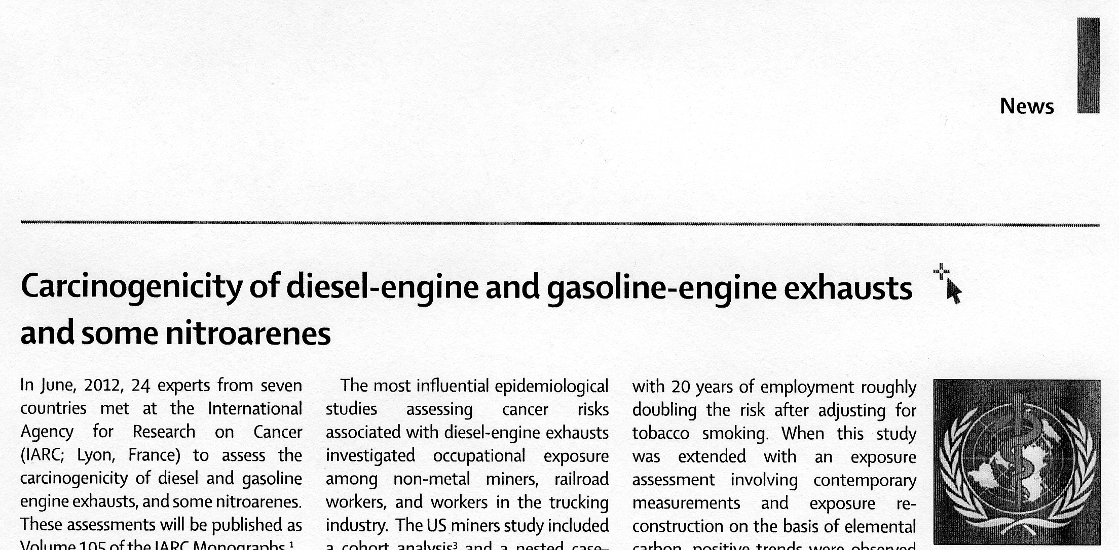
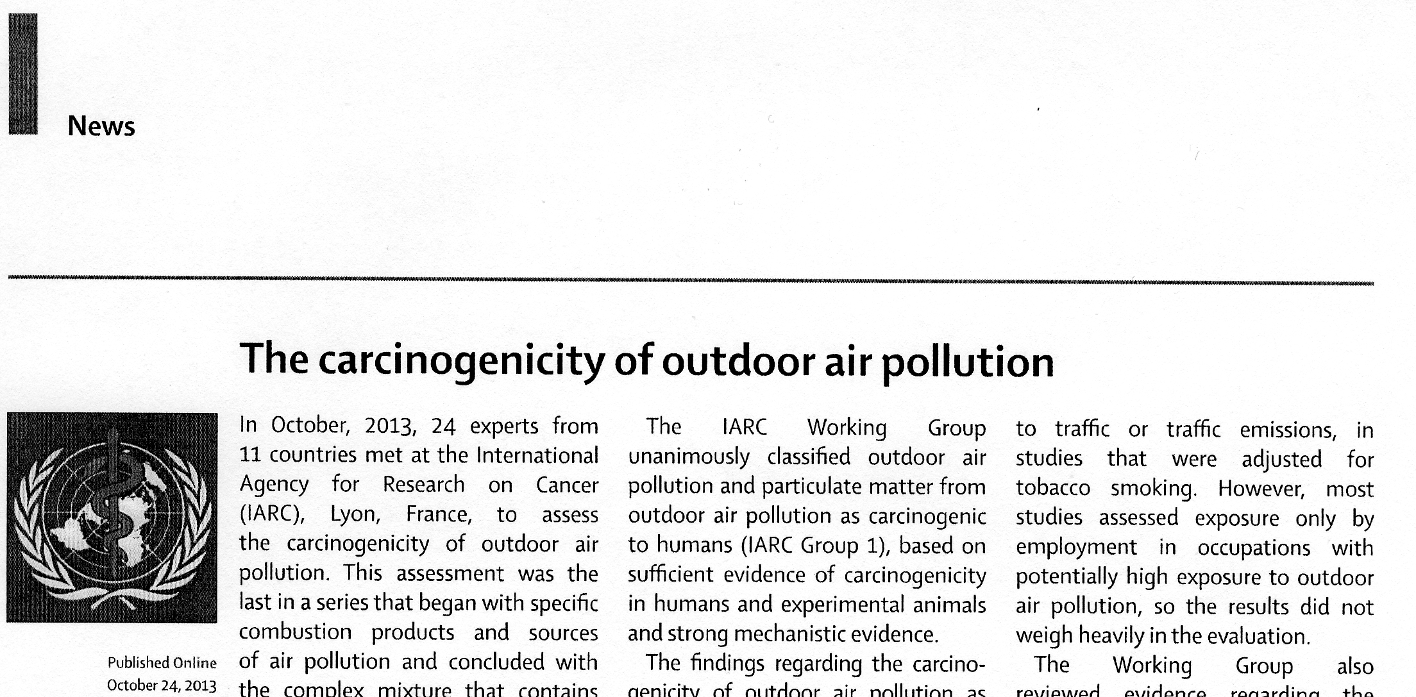
Lancet Oncology July 2012
Lancet Oncology Dec 2013

Slide 10
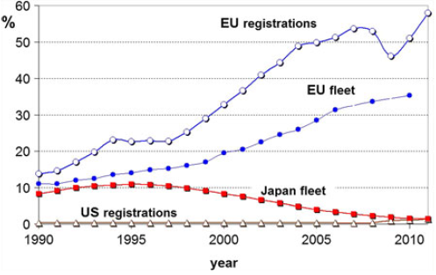
Dieselization
Cames and Helmers. Environmental Sciences Europe 2013

Slide 11
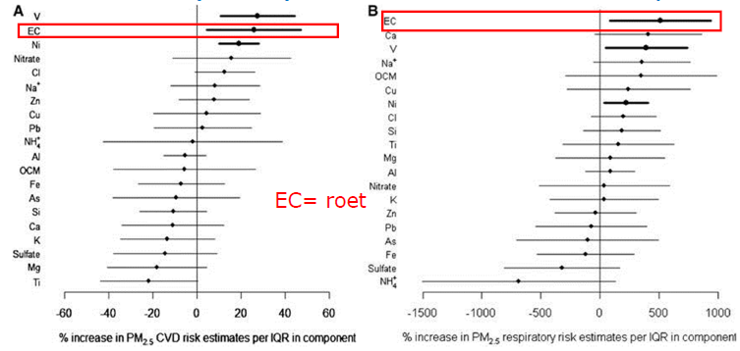
Toxic component or source indicator?

Slide 12
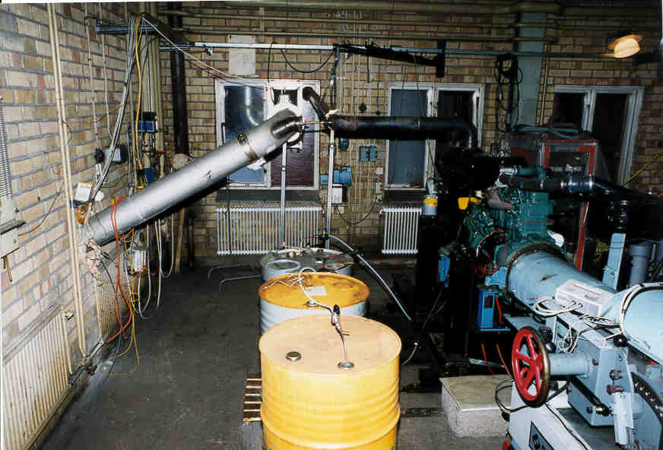
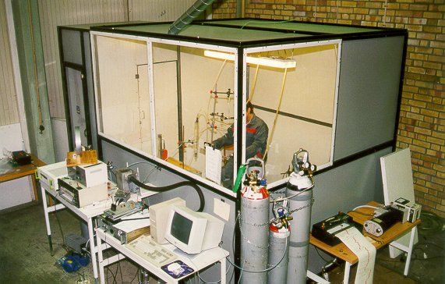
Controlled Diesel Exposures
Exposure to DE: PM₁₀ 300µg/m³ and filtered air for 1 hour & 100µg/m³ and filtered air for 2 hours
Notes:
12

Slide 13
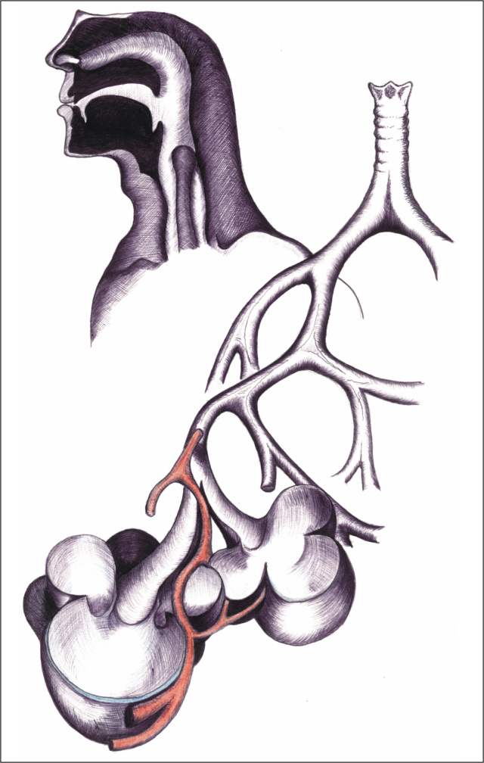
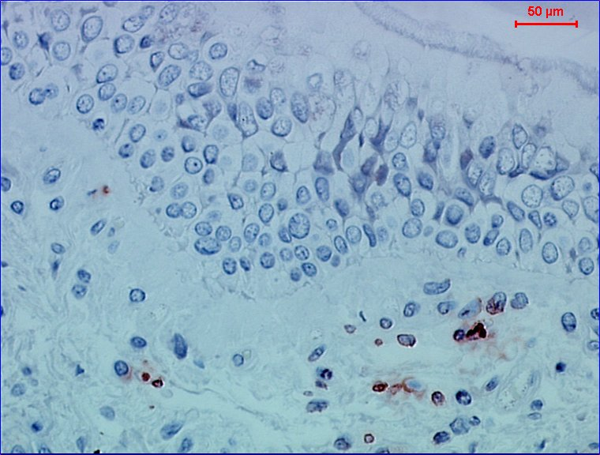
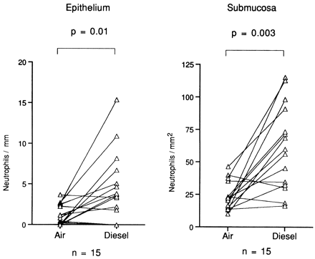
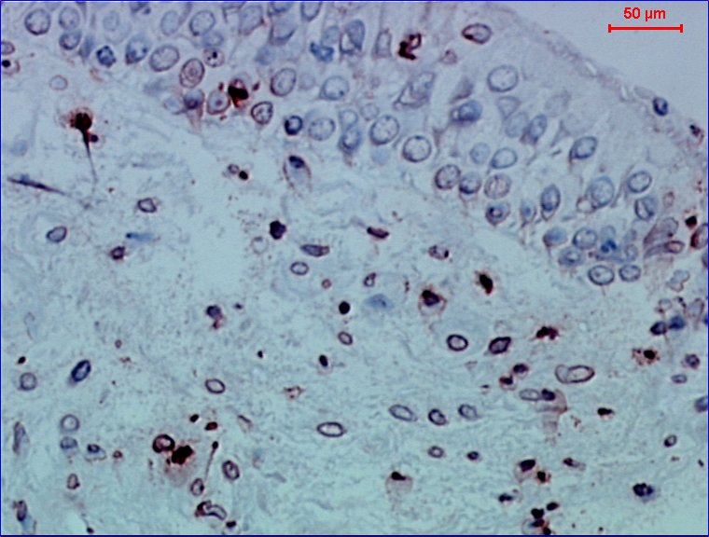
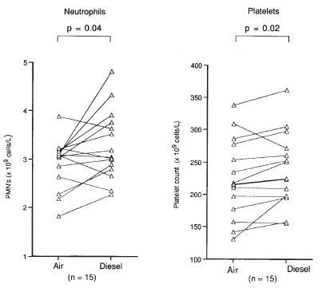
Diesel induces inflammation
Neutrophils after air
Neutrophils after DE
Blood viscosity
Promotes atherosclerosis
Impaired vascular function
Ischaemia
Arrhythmias
Inflammation
Impaired lung function
Impaired microbial defences
Notes:
13

Slide 14
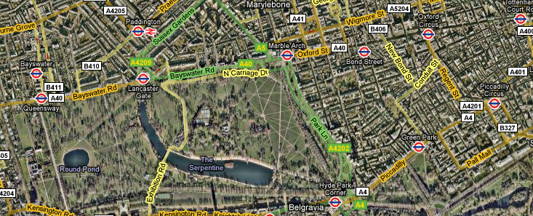
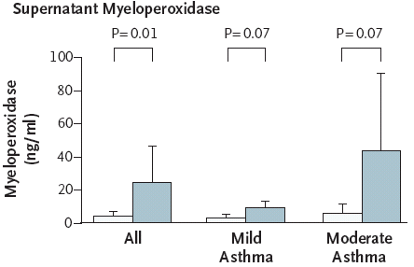
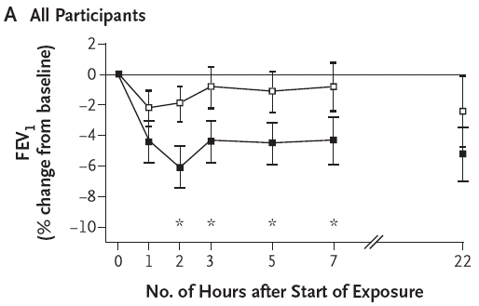
Responses to PM in the Real World
Does short term exposure to real world atmospheres (diesel traffic and background) cause respiratory effects in asthmatics?
PM₁₀ =72 µg m⁻³, PM_{2.5} =11.2 µg m⁻³,
11.7 ppb NO₂ 18,300 particles cm⁻³
PM₁₀ =125 µg m⁻³, PM_{2.5} =28.3 µg m⁻³,
76.5 ppb NO₂ 63,700 particles cm⁻³
McCreanor al. (2007) New Eng J Med 357: 2348-2358.

Slide 15
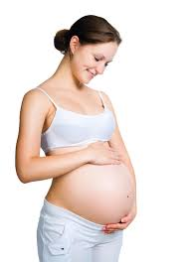
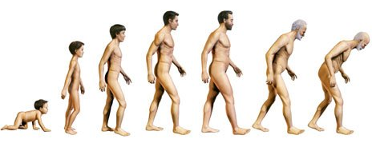
Impacts of Air Pollution across the Life Course
Quality of Life
Low birth weight
Smaller lungs
Cognitive ability?
Increased risk of chronic disease
Acute respiratory exacerbations
Acute and chronic
Premature death
Increased vulnerability

Slide 16
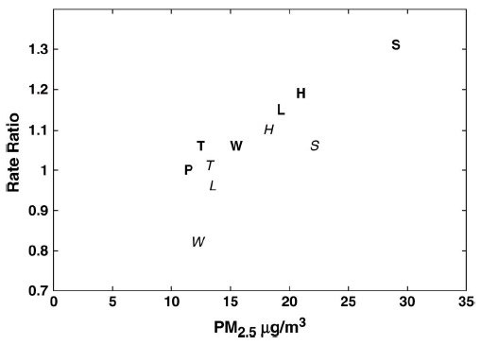
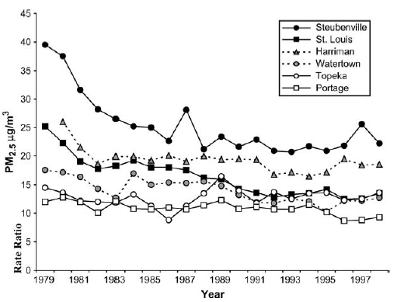
PM_{2.5} Reduction & Mortality: 6 Cities follow-up
Period 1: 1974-89
Period 2: 1990-98
Laden F et al. Am J Respir Crit Care Med. 2006 Mar 15;173(6):667-72.

Slide 17
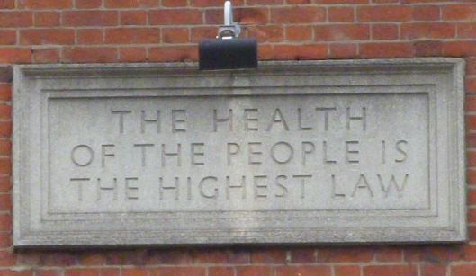
‘Salus populi suprema est lex’. Cicero

