Slide 1
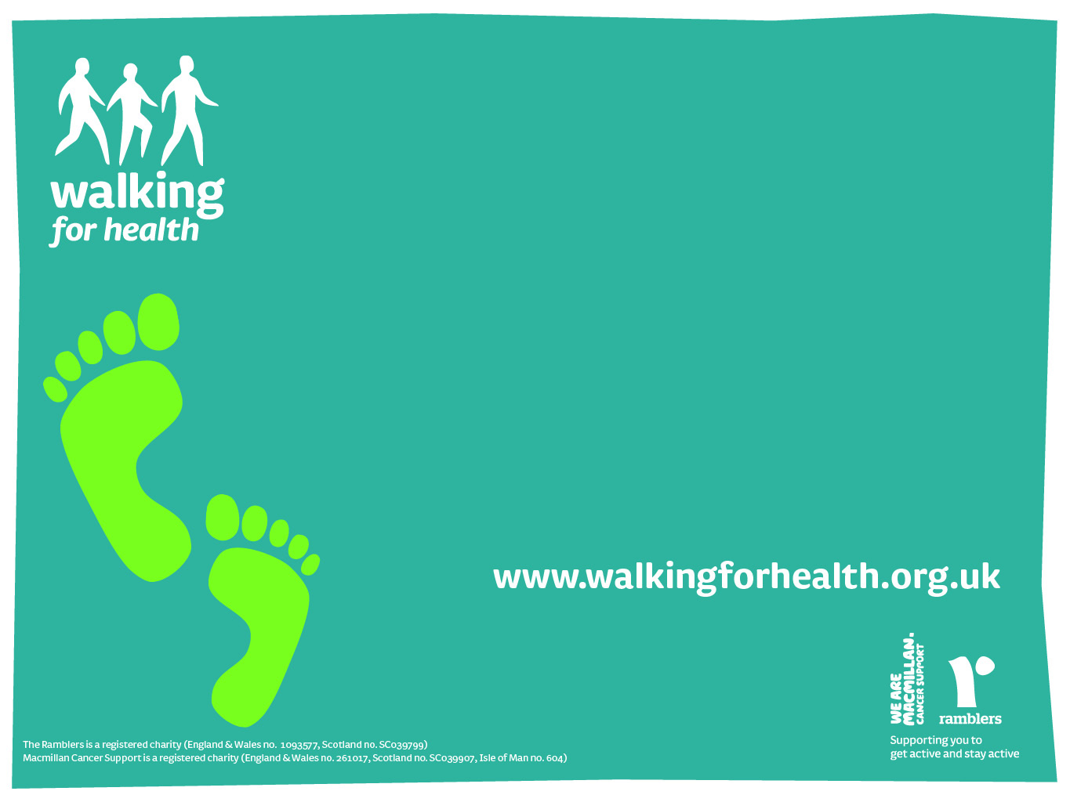
Why walk?

Slide 2
Why walk?
Walking is free
Almost anyone can do it
You don’t need any special equipment or training
It’s easy to make walking accessible to people with a wide range of disabilities, including wheelchair accessible walks

Slide 3
Why walk?
Less than 10% of adults achieve the 150 minutes of physical activity per week recommended by Public Health England
Physical inactivity is the principle cause of a huge number of common health conditions.
Research reveals that being inactive:
- increases your chances of developing cancer, heart disease or having a stroke by 25-30%
- can take three to five years off your life

Slide 4
Why walk?
Walking regularly also
  improves flexibility, muscle strength, and stamina
  Aids recovery from cancer, stroke, hip and knee surgery
  Helps people to live better with long term conditions

Slide 5
On top of all this, walking is great for mental health
Physical activity and fresh air promote positive mental wellbeing and can help prevent onset of dementia
Group walks are fun and sociable
Regular led walks give people a reason to leave the house and an incentive to exercise
Chatting while walking is an unpressured way to meet new people and make friends

Slide 6
What is
Walking for Health?

Slide 7
What is Walking for Health?
National scheme run by the Ramblers
Free
Volunteer-led
Entry to waking for people who are currently inactive
Health walk – 20 minutes of moderate exercise

Slide 8
What is Walking for Health?
Infrastructure provided by the national Walking for Health programme:
  Training for walk leaders
  Public liability insurance
  Database
  Accreditation

Slide 9
                - All documentation needed to run a walk
                Regular meetings of scheme co-ordinators to discuss best practice and get support
                Templates: posters and leaflets
                Free resources: high-vis jackets, pens, clipboards… everything you need

Slide 10
Setting up a health walk scheme

Slide 11
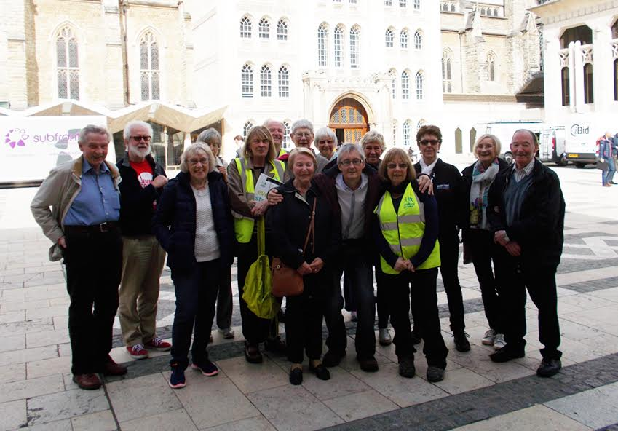
Square Mile Health Walks

Slide 12
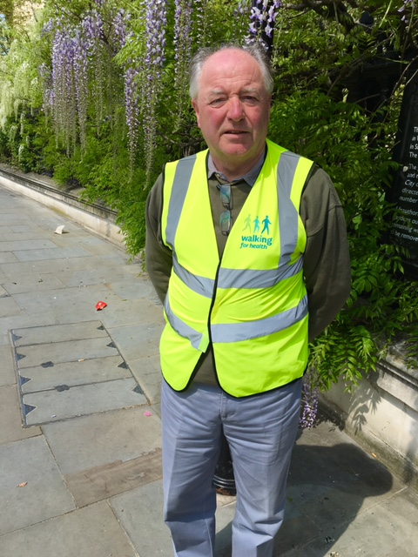
Setting up a health walk scheme
Started with 4 volunteers
Training –
  1 day free training from WfH
  Route planning
  Risk assessment
  Supporting walkers with a range of needs

Slide 13
Setting up a health walk scheme
Started with 2 walks a month
Promoted via word of mouth
Link with local leisure centre ‘Young at Heart’ programme
Leaflets in GP surgeries, libraries, advice centres
Walk leaders capitalised on local knowledge and enthusiasm for London’s history to devise varied and interesting routes

Slide 14
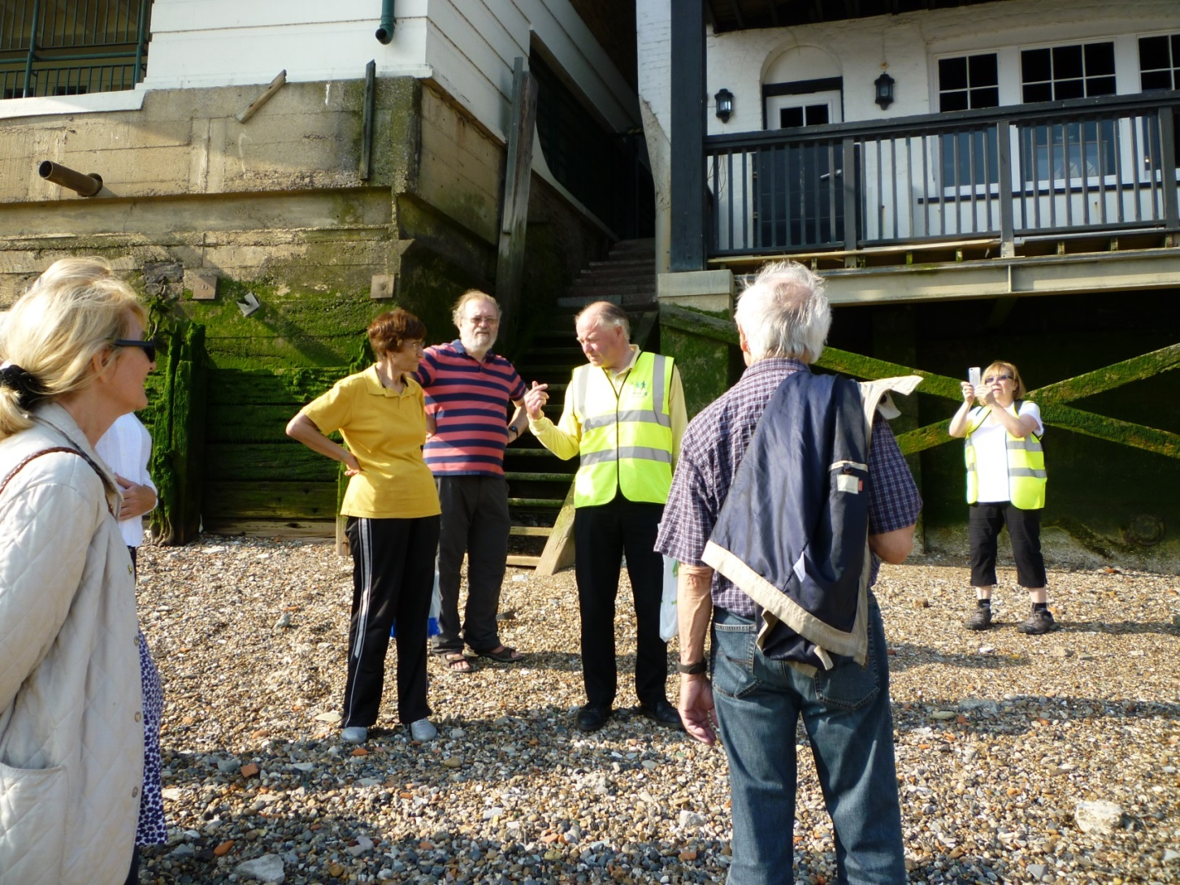

Slide 15
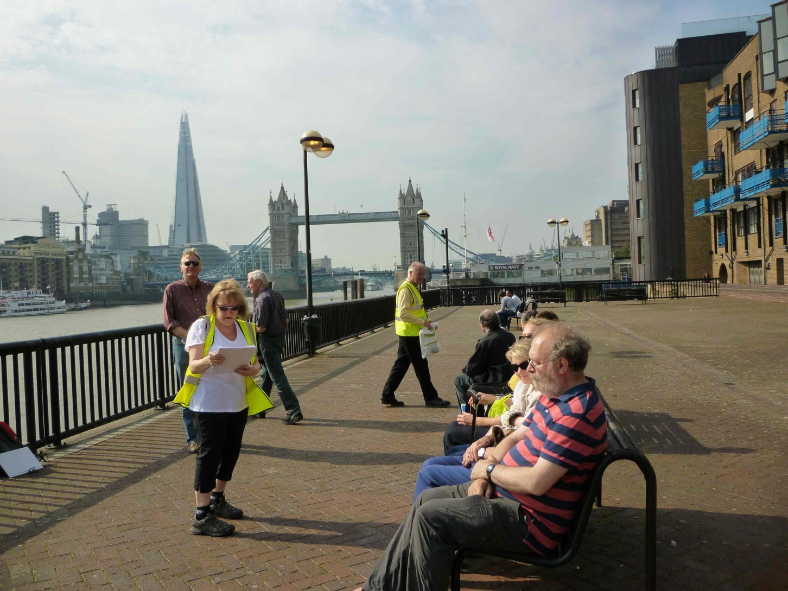

Slide 16
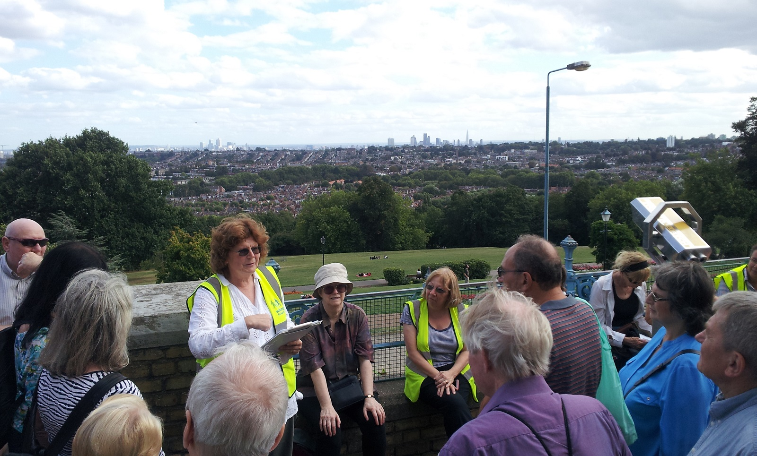

Slide 17
Where we are now
4 walks a month
9 walk leaders
Over 120 walkers on database
3 levels of walk for differing abilities
Link with local hospital – Barts

Slide 18
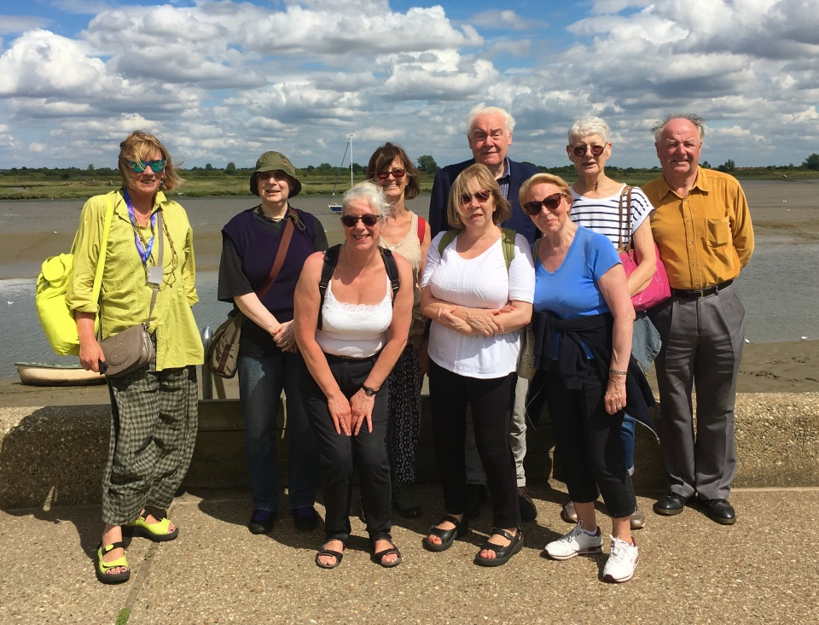
Many firm friendships formed
People linked into other activities
Engagement data to support funding bids
Happy, healthy walkers ☺

