Slide 1


London’s Water Supply and Power Distribution
Thames Water and Age UK London
Supporting Vulnerable Customers
#LDNWater
25th January 2019

Slide 2
WELCOME

Slide 3
Peter Cotton
Our history

Slide 4
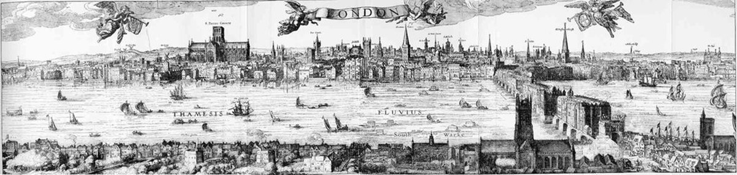
Notes:
Good morning, Im peter cotton, I m a civil engineer and have worked for 20 years in thames, and its my privaledge to lead our work to improve the services to customers in vulnerable circumstances, so thank you for being here today.
I’m going to tell you about 3 people and the work they did to create the infrastrucre that sustains life in London, apologies that they are all men
Story starts in 1600 – London has 200,000 residents, life expectancy is around 40 years and London has started to run out of clean water.
Various proposals are made to bring in fresh water, Queen Elizabeth 1st not too interested, but then in James’ 1s time a plague outbreak kills 30,000 Londoners.

Slide 5
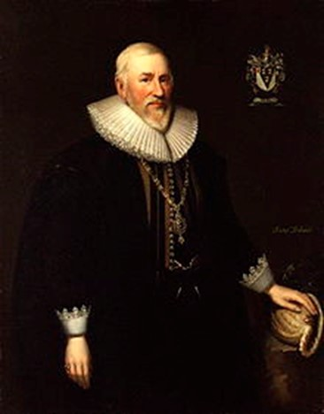
Notes:
This man then made it happen. Any guesses

Slide 6
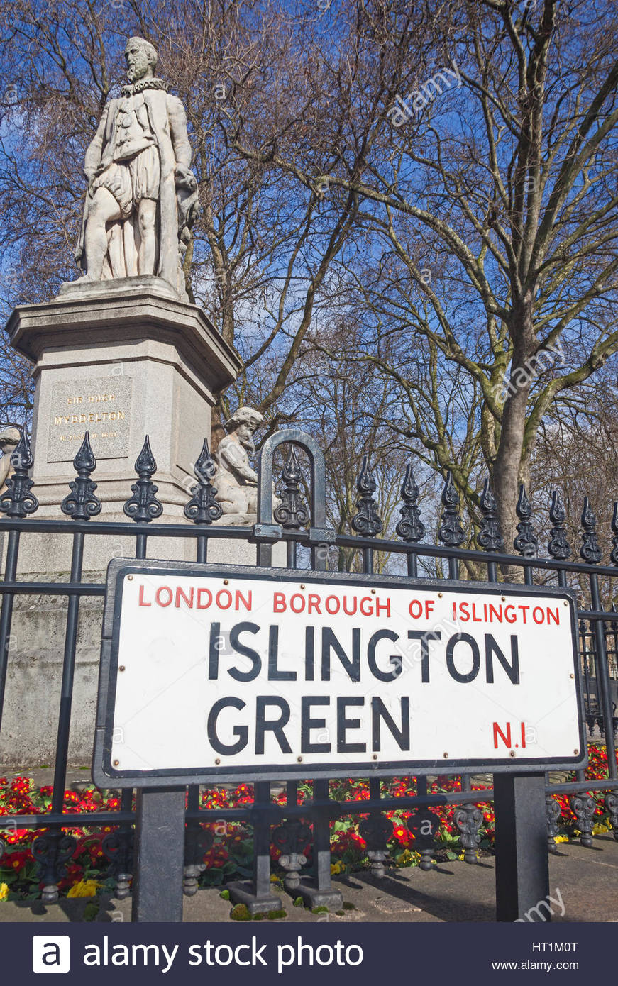
Notes:
Hugh Middleton was already a man of influence and he got a scheme finance called the New River.
Construction started in 1609 of a 39 mile canal from Broxbourne in Herts to the round pond in Islington.
Various smaller schemes had been put in but were getting polluted and did not have enough capacity.
The fall was only 5 inches per mile, which is basically flat. And only 20 miles as the crow flies, but they wanted to use the natural contours of the ground.
200 labourers worked for four years to open in 1613.
Ran out of money, king james 1 came to the rescue funding half and getting the landowners who were worried about their cattle falling in in line.

Slide 7
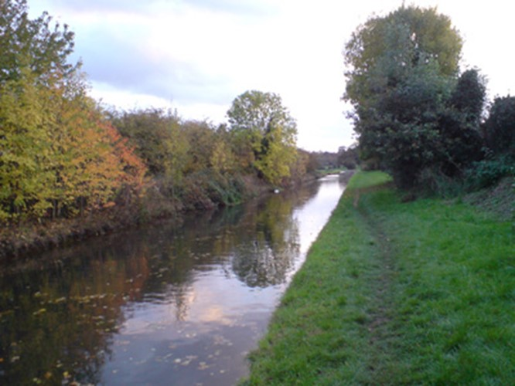

Slide 8
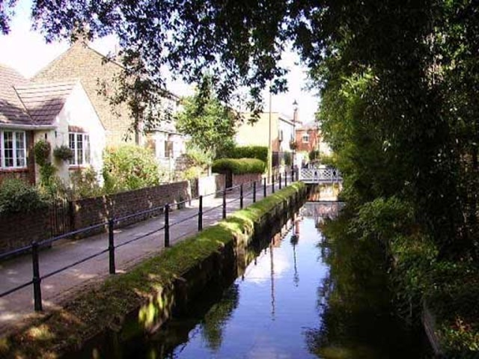

Slide 9
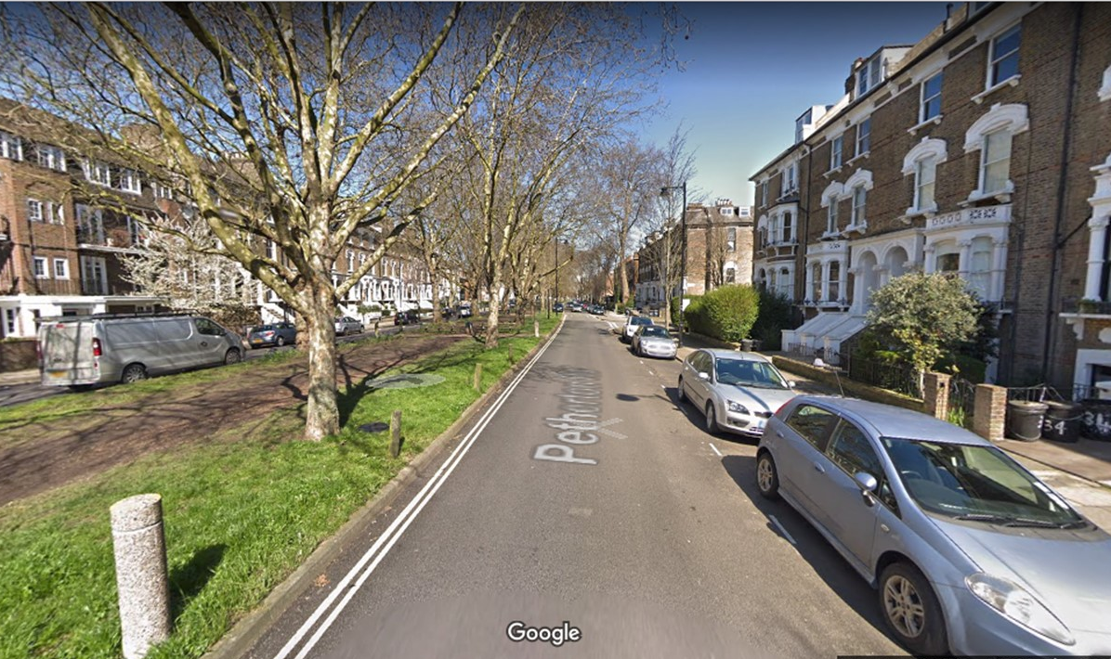
Notes:
Petherton Road its not longer there but you can still see the route

Slide 10
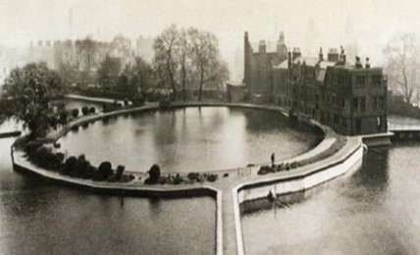
Notes:
Here is the round pond in 1910, From here it was distributed on into central London through pipes made from elm trees
In 1946 the new river was truncated at stoke Newington where it still feeds 2 reservoirs today.
So Hugh Middleton’s new river is still supplying top quality drinking water to London today, 406 years after being put into use….
On the building on the right is the Water House, the old HQ of the new river company

Slide 11
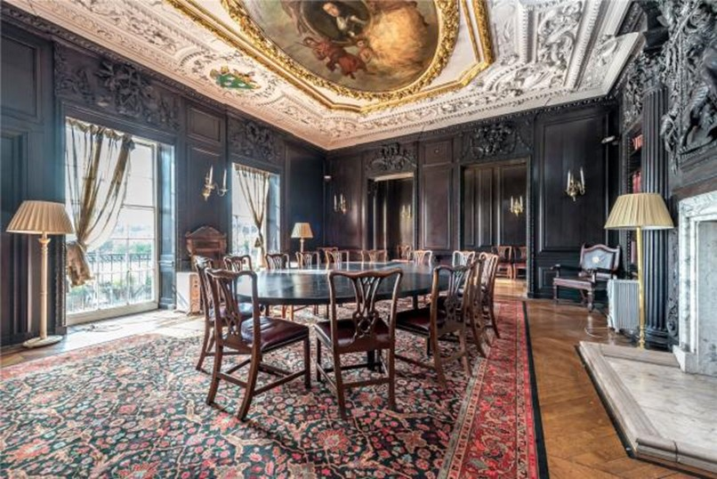
Notes:
Within which was this amazing room Called the Oak room, intricate carved oak panels and William 3rd on the ceiling. You can feel the history – has anyone visited it, you can on open house weekends.
Even more amazing is that this room has survived as the Water house is no longer there, it has been transplanted twice, once from the original water house to the new metropolitan water board hq on the same site, and then to prevent any damage during ww2 it was taken down panel by panel and stored under a nearby reservoir to ensure it didn’t get damaged

Slide 12
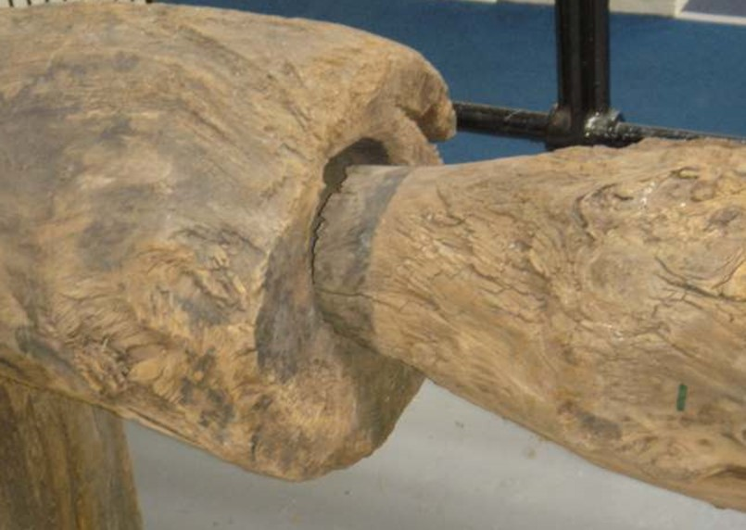
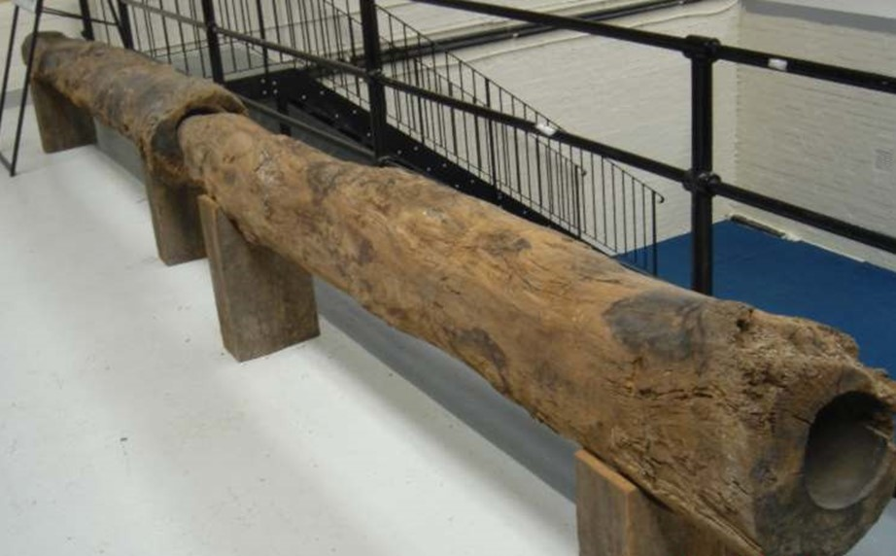
Notes:
This is what the original elm tree pipes looked like, all replaced by cast iron by 1819, but we still find them – my colleague called me a couple of years ago when doing work outside Kings Cross station very excited by finding a section of wooden pipe in the road, and we took it away and cleaned it up…

Slide 13
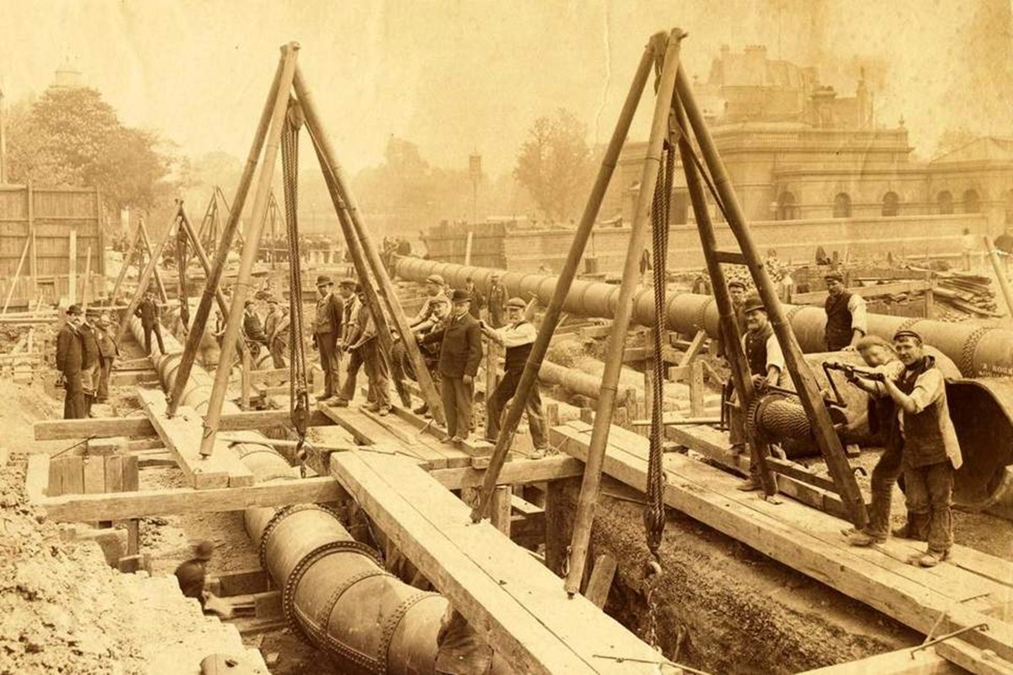
Notes:
Iron water mains started to be used in 1810, these are some from about 1900.
Today 1/3rd of the pipes in use are over 150 years old, and 2/3rds are over 100 years old

Slide 14
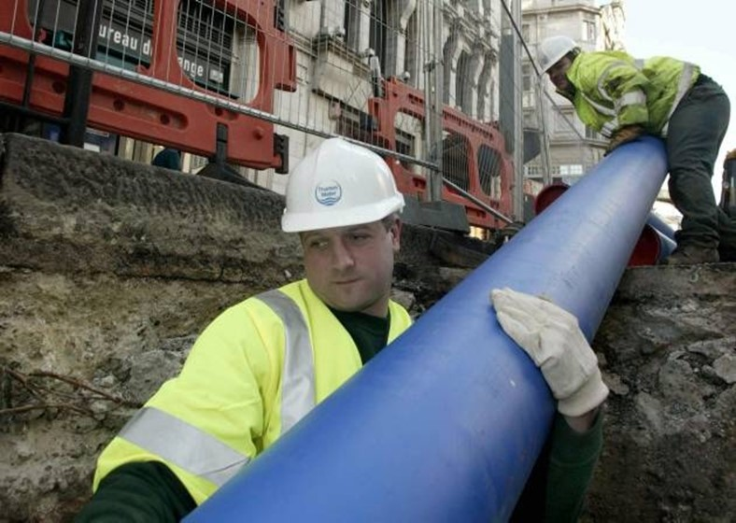
Notes:
We are still laying pipes today, this time made of polyethelene, which if welded correctly have no known failure mechamism, and only time will tell how long they will last.
Only problem is that London is quite a congested place, both in terms of traffic and services underground, so while the pipe costs £1 per meter, it costs £400 to dig the hole and put the road back, per meter

Slide 15
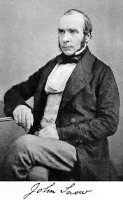
Notes:
Now we move to this chap, any guesses for this gentleman?

Slide 16
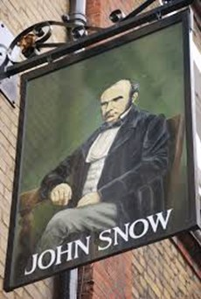
Notes:
Is that because you are regulars? This is the pub in soho named after him?
In 1854 there was another outbreak of disease, this time cholera. No one knew how the disease was transmitted, they thought it was ‘bad air’ or ‘miasma’ supported by leading figures such as Florence nightingale
In Soho thousands of people were infected, 600 died and it would have been a lot more but for this man, a local doctor.
He was familiar with cholera and he had a theory that it was acutally a waterbourne disease

Slide 17
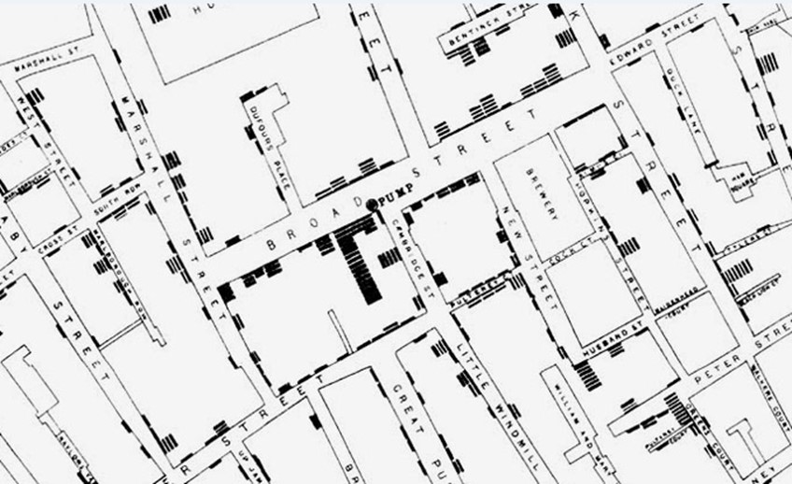
Notes:
He interviewed people afflicted and from hospital records plotted on a map the locations of people who had died.
First person to represent statistical information on a map

Slide 18
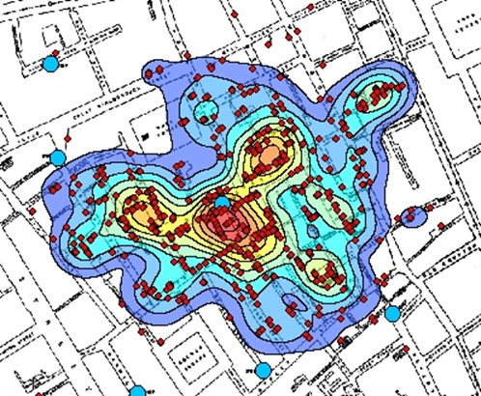
Notes:
If he had used google maps it would have looked like this
He persuaded the local authorities to take the handle of the pump and the outbreak came to an end
It turns out the well was in the close proximity of a cess pit, and a baby’s nappy who had contracted cholera had been washed into the well. Pretty grosse.

Slide 19
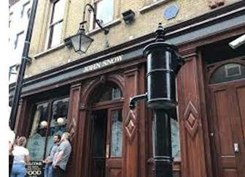
Notes:
So now there is a model of the pump, with its handle removed, in its original position and a pub named after his achievements,
Still his theory wasn’t full accepted, until the 1880s, and know we all know the importance of clean water, washing hands and sanitation.

Slide 20
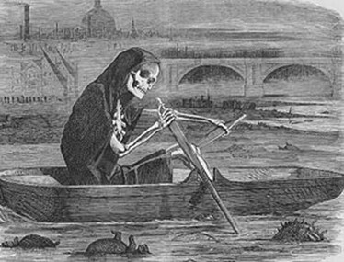
Notes:
Which brings us to the great stink of 1858.
With 2 million people now living in London, the thames was little more than an open sewer.
While abstracting water downstream of Teddington weir was banned in 1852 and quality of water treatment was better, the problem was with the waste.

Slide 21
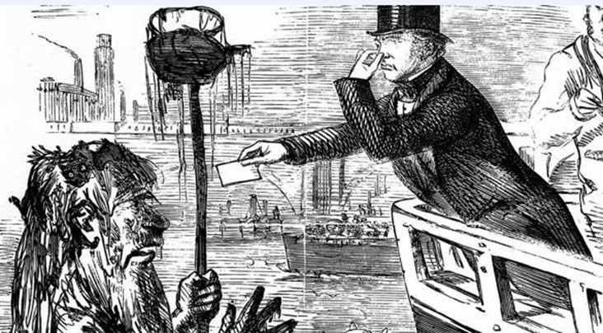
Notes:
The problem got particular bad in the hot summer in 1858.
Temperatures similar to last year and with low rain fall, at low tide the banks of the thames were basically six feet deep in rotting organic matter of a disgusting nature.
Queen Victoria went for a cruise down the river and turned round after 2 minutes because of the smell.
Sheets dipped in lime were hung on the windows of the houses of parliament to allow the MPs to sit, it didn’t work and MPs suggested they move to St Albans
Legislation was rushed through by the end of the summer and enter…

Slide 22
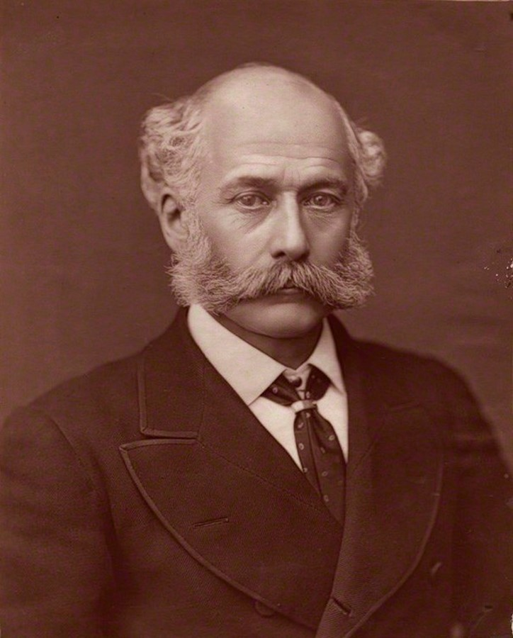
Notes:
This man – I’m sure you know this guy

Slide 23
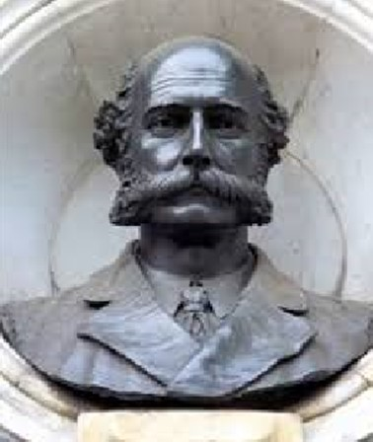
Notes:
Yes, Josepth Bazelgett, here he is on the victoria embankment

Slide 24
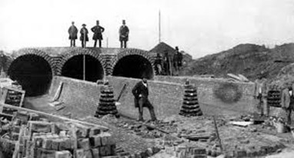
Notes:
Plans for 1,100 miles of additional street sewers and 82 miles of deeper intercepting sewers were drawn up by 400 draftsmen, and took 16 years to build.

Slide 25
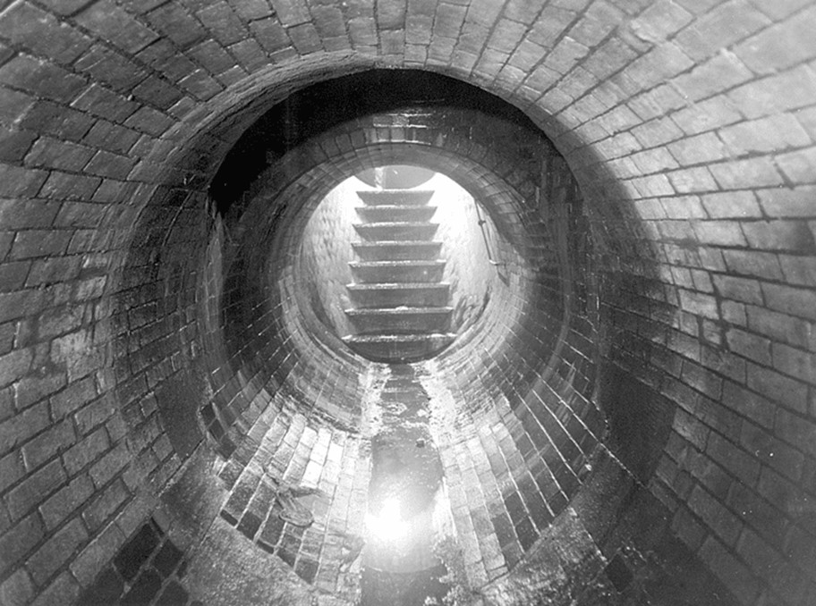
Notes:
The quality of the work manship was amazing, Bazelgette pioneered the development of Portland cement and the quality control processes required for it,
When laying bricks an inspector would get one of those old large penny coins, roll it from one side to the other, and if it bobbled the bricks were ripped out and the work redone.

Slide 26
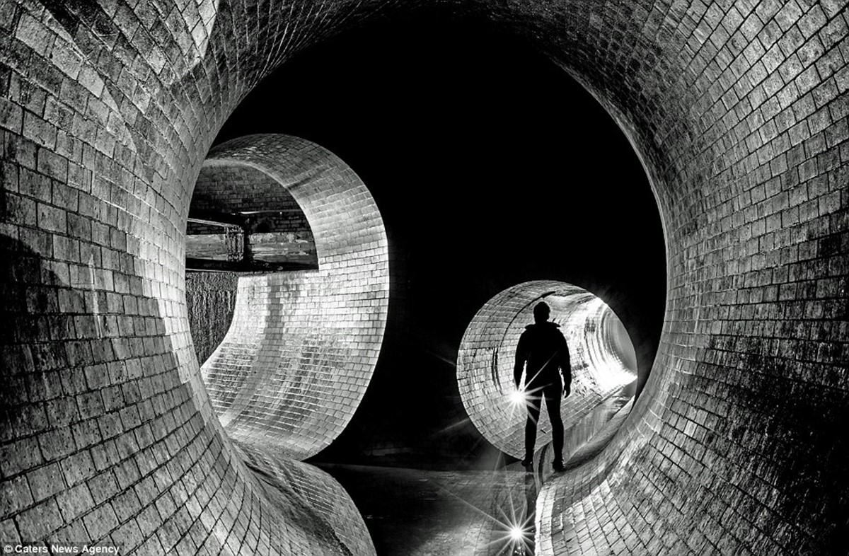
Notes:
And they are still going today, and the Victoria embankment, which was the most complex part of the works reclaiming 52 acres of land from the river.

Slide 27
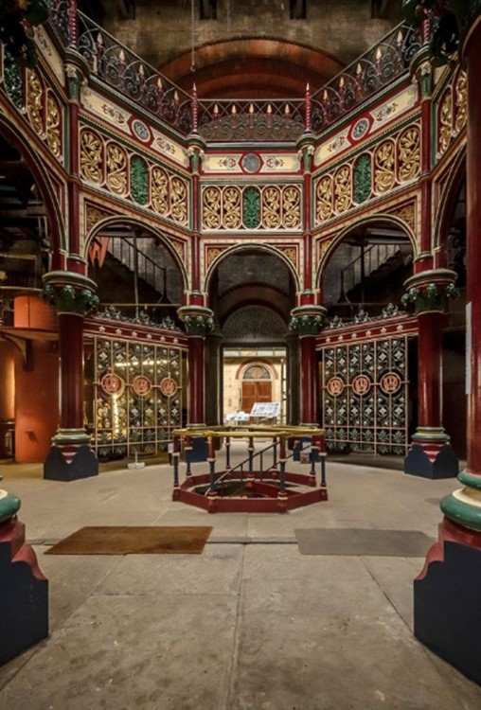
Notes:
Pumping stations were required, anyone been to this one at Abbey Mills, which is more like a cathedral than a pumping station?

Slide 28
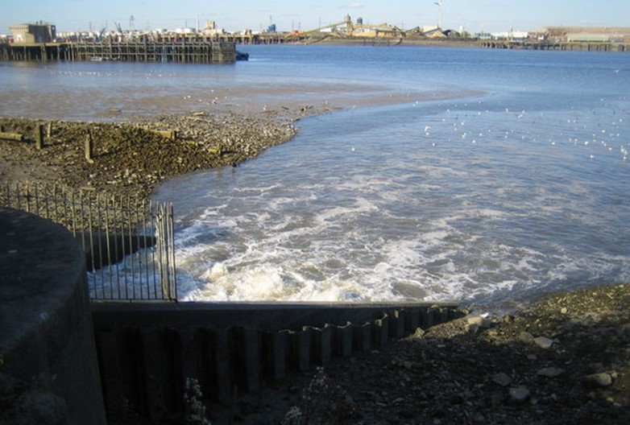
Notes:
Before flowing into the thames, initially not treated, but now to the heightest standards.
Incidently, do you the largest tributary to the thames?
Trick question – its thames water!

Slide 29
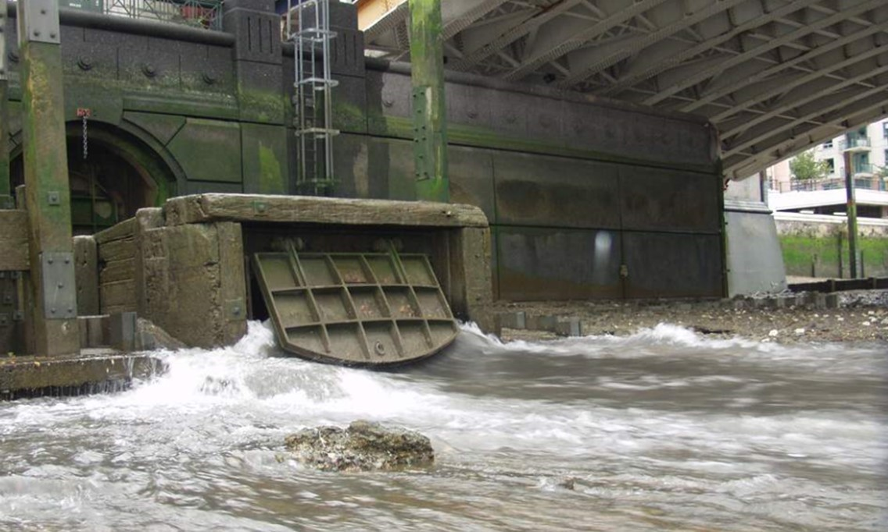
Notes:
Unfortunately with London’s population now at 8million and many front gardens paved over, after storms untreated discharges, like this one at Battersea, still happen.

Slide 30
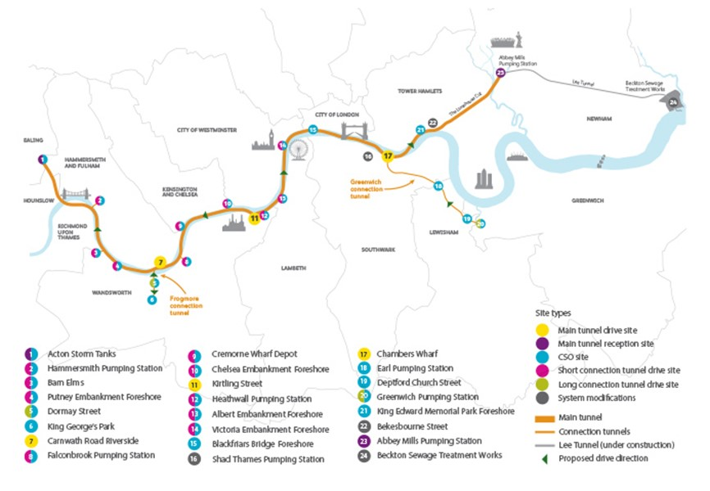
Notes:
Hence the tideway project, the largest construction project in Europe costing 4.2 billion, to build 16 miles of tunnels.
The Tideway entity now is separate from Thames Water and has its own licence from Ofwat , but TW will bill customers for the cost

Slide 31
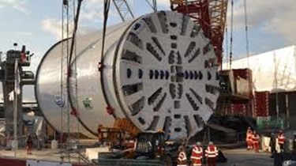
Notes:
The lee tunnel has already been built, with this ridiculously massive tunnelling machine

Slide 32
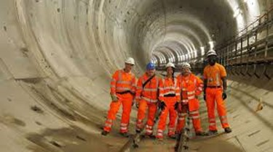
Notes:
Opened in 2016, you can drive a double decker bus through it…

Slide 33
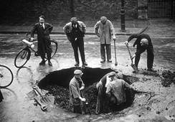
Notes:
So building this infrastructure is inspiring, but most of our focus now is on maintaining it.
Here is the tranditional situation of more people looking down the hole than working…
This guy here with his bike is the Water Board inspector, his plans in a tube on the front and his key and bar for operating valves strapped to the frame.
One of my colleagues when he first started with Thames in the in the 1960s used to cycle one of these and he said they were terrifying – the rod brakes weren’t too good and one time the bar jumped off the frame into his wheels going down swains land and he went flying…

Slide 34
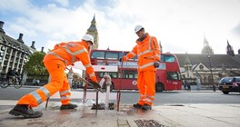
Notes:
So we work around the clock to maintain the network

Slide 35
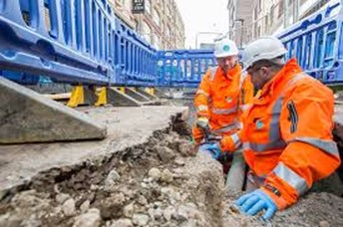
Notes:
Spending over £1m / day tackling leakage

Slide 36
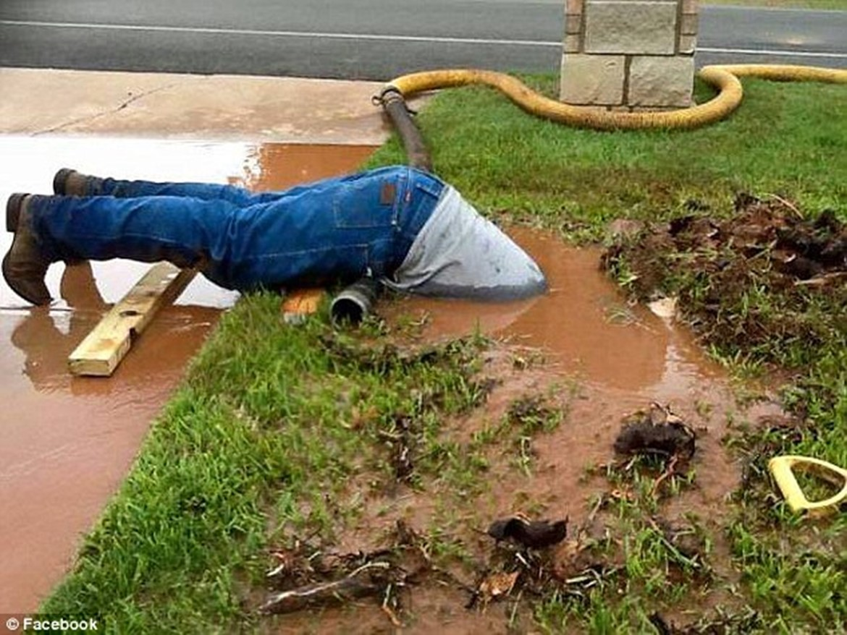
Notes:
Clearly this isn’t a Thames water employee, would not be caught wearing boots like that

Slide 37

Notes:
But either planned maintance or busts can cause supply interruptions, and we totally recognise the impact that this can have on people.
Half a million properites per year will experience a disruption across our region, and every year we work hard to reduce the incidence and duration of those interruptiosn. 80% are less than 4 hours, but we recognise any interruption can be distressing.
And here is a 100 year old

Slide 38
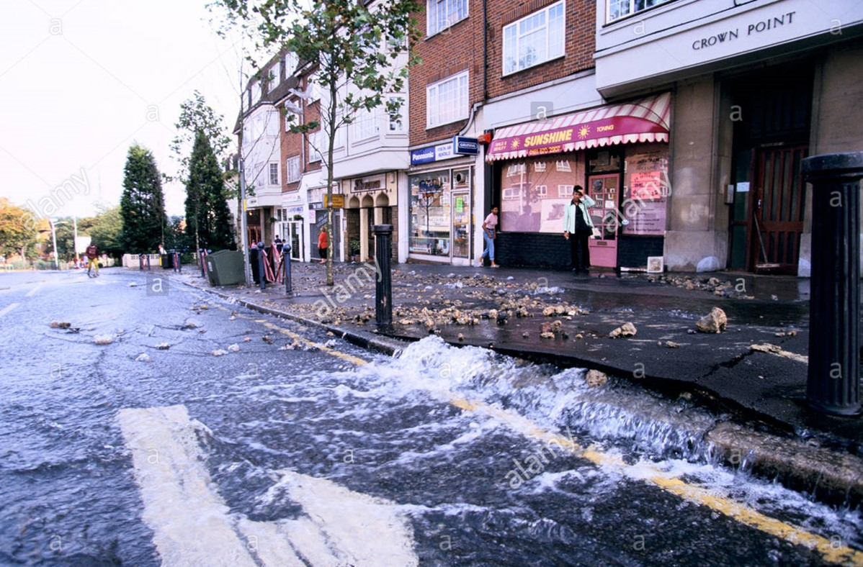
Notes:
While 97% of our leakage is not visible, it’s the visible leaks that people notice, of if they are big can really cause disruption, look at what has happened to the surface, forced up by the water here

Slide 39
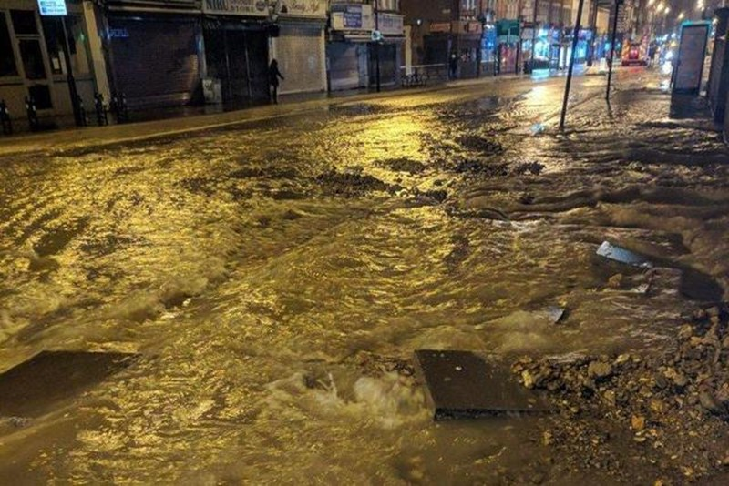

Slide 40
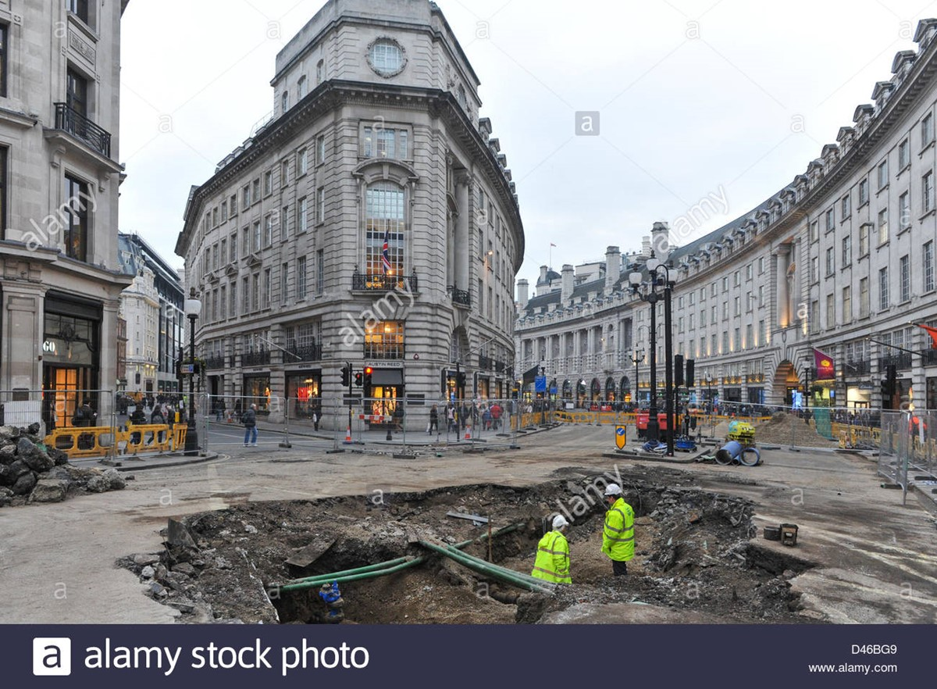
Notes:
This looks like a bomb crater at Regents street..

Slide 41
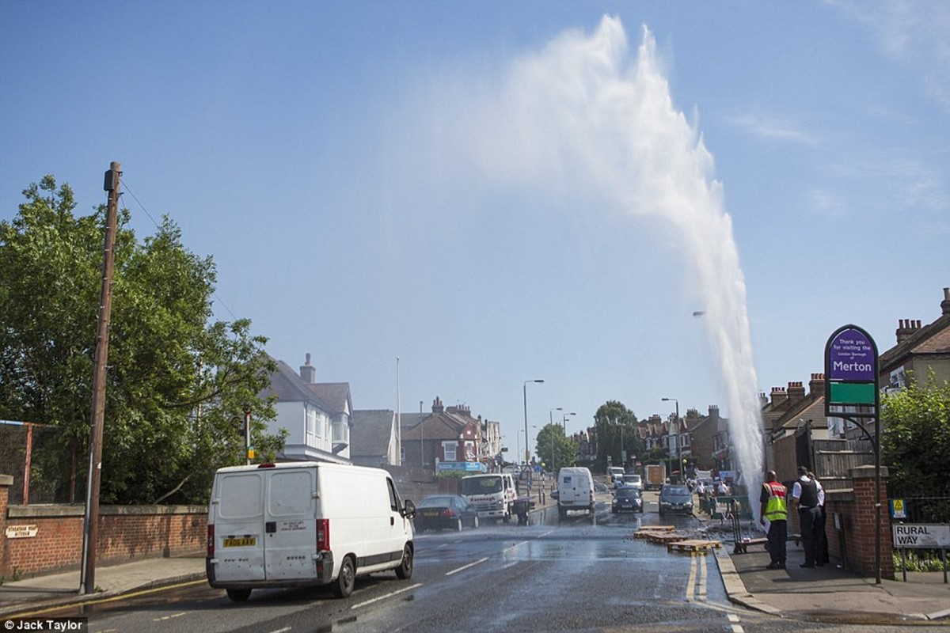
Notes:
This one in Merton was quite photo graphic, but not pleasant for those immediately under it.

Slide 42
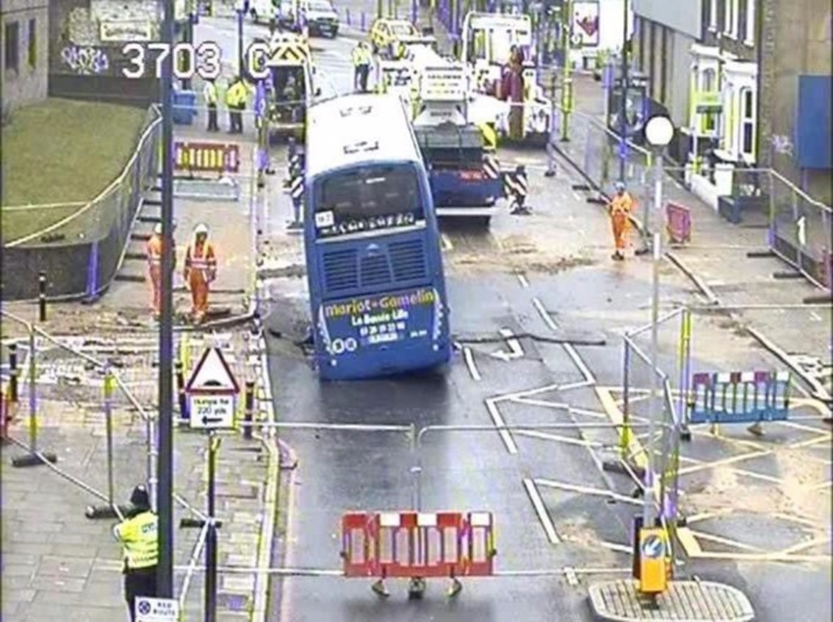
Notes:
This was one of my favourite phone calls – we have a bus stuck on one of our pipes…
A French bus driver thought he could make it over a burst main in East London, but the road collapsed

Slide 43
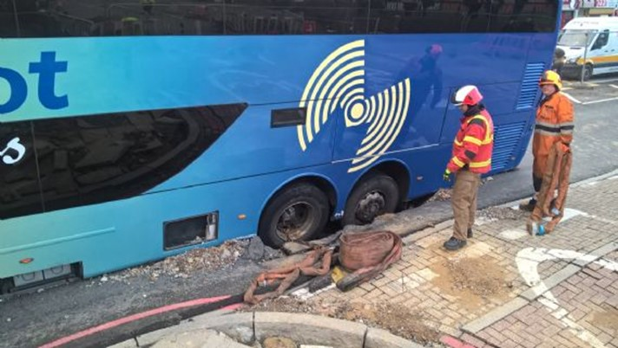
Notes:
And the road collapsed, with water spilling out and a high pressure gas main and a high voltage cable all in the same hole, they didn’t want to lift the buss out without cutting off the electricity which would have impacted 20,000 people and the police had to make the decision of what were were going to do. PC Sherlock actually, never forget that.… .and all the while our customers are out of water…. Customers supplies were interrupted for about 11 hours that day….

Slide 44
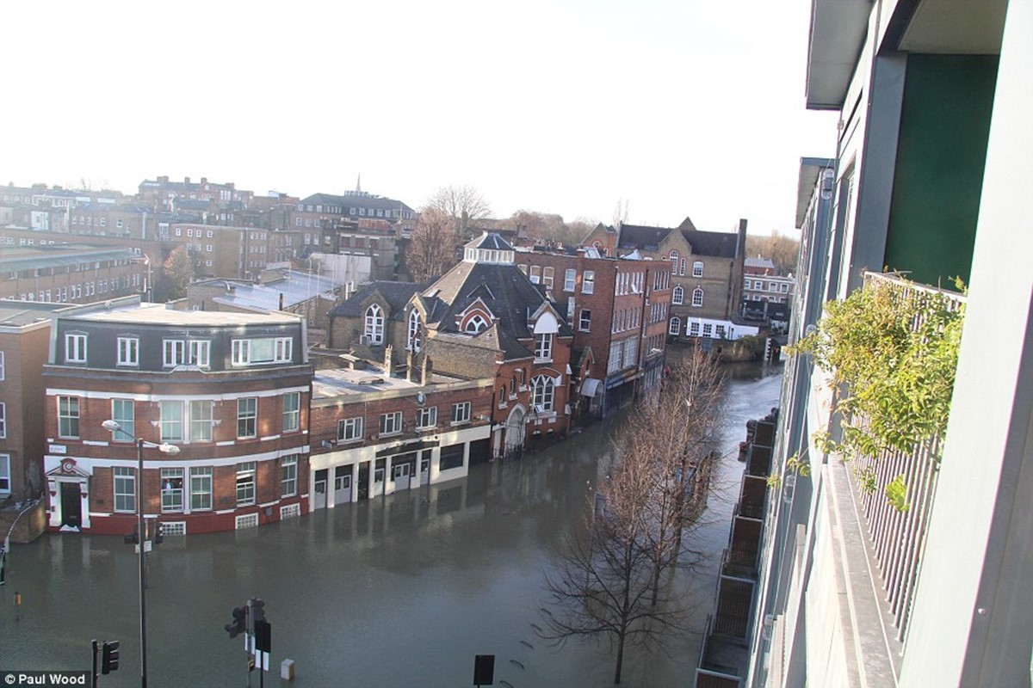
Notes:
And when things go wrong , they can really go wron, this is my nightmare scenario. This is stoke Newington in 2017.
Look at those windows of ground floor properties, and there are basements too

Slide 45
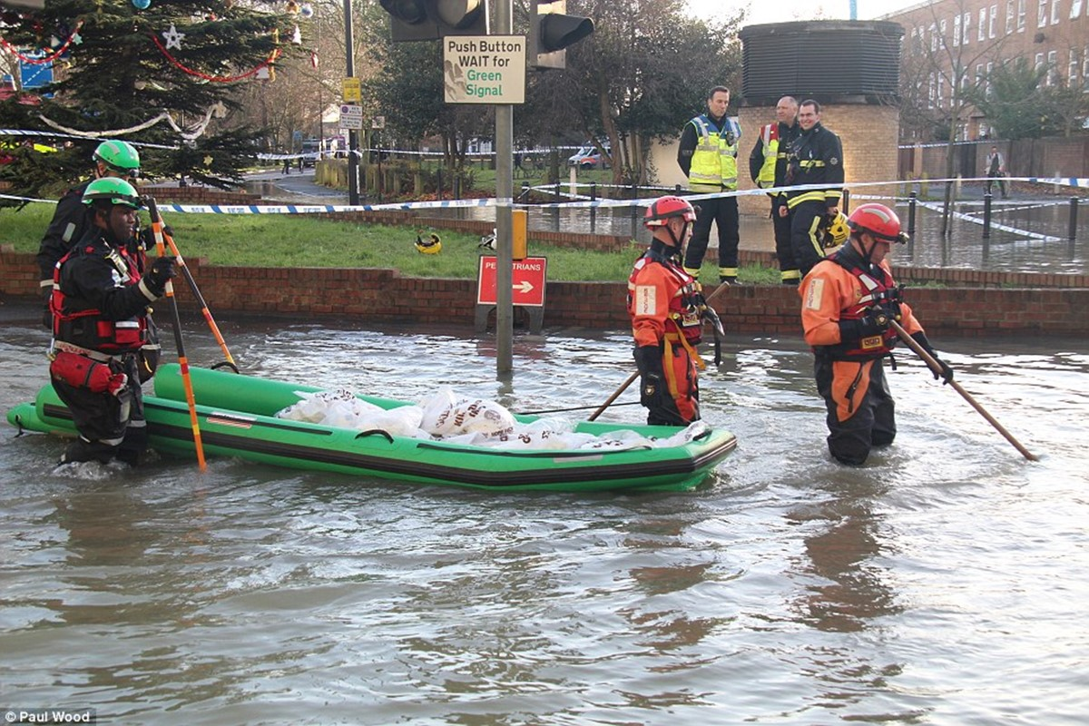
Notes:
When this happens we work closely with the emergency services to ensure everyone is safe, and then it’s a long process to put it all right

Slide 46
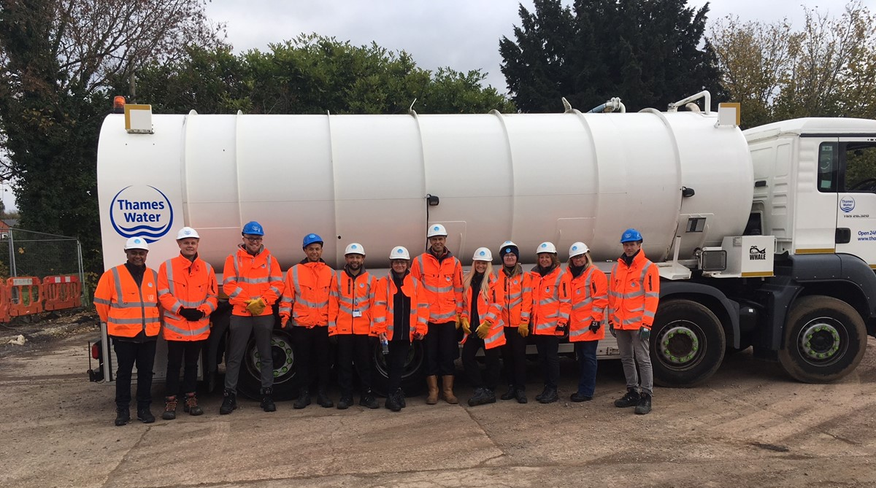
Notes:
We have a team of 26 employees whose job is to support customers during supply interruptiosn and other incidents, here are a dozen of them next to one of our water tankers.
We are committed to supporting our customers when they are impacted….
That’s a rather potted history, I’m going to hand over too…..

Slide 47
Kerry Potter
London’s power infrastructure

Slide 48





UK Power Networks
Delivering your electricity

Slide 49
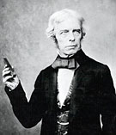
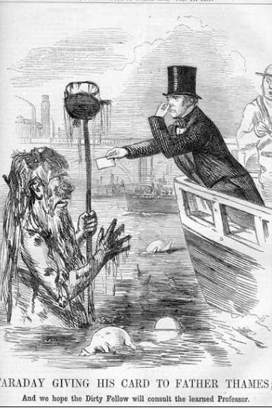
Delivering your electricity; London’s history
1791-1867
The father of Electricity London resident Michael Faraday, remembered for his scientific discoveries in electricity which are seen as laying the basis for modern electrical engineering.
His scientific justifications of the Great Stink and the cholera outbreak led to the sanctions of the new sewer system – improving the quality of the Thames
Notes:
We start our story
Electricity and Water

Slide 50
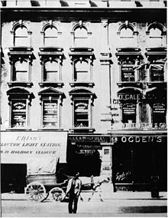
Delivering your electricity; London’s history
1878
Power Stations
Holborn Viaduct, named the Edison Electric Light Station, was the world's first coal-fired power station, generating electricity for public use
The Holborn Viaduct project was preceded by two months by an electricity supply from a water wheel in Godalming, Surrey – the world's first public electricity supply

Slide 51
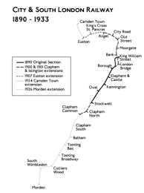
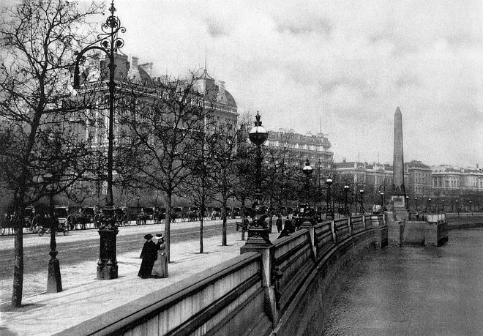
Delivering your electricity; London’s history
1878 - 1900
Street lighting and Transport
The first streets in London lit with the electrical arc lamp were by the Holborn Viaduct and Thames Embankment in 1878
The first deep-level tube line, the City and South London Railway, opened in 1890 with electric trains
Notes:
Trains – the City and South London Railway
When opened in 1890, the line had six stations and ran for 3.2 miles (5.1 km)^{[2]} in a pair of tunnels between the City of London and Stockwell, passing under the River Thames. The diameter of the tunnels restricted the size of the trains, and the small carriages with their high-backed seating were nicknamed padded cells. The railway was extended several times north and south, eventually serving 22 stations over a distance of 13.5 miles (21.7 km) from Camden Town in north London to Morden in Surrey.^{[2]}
Moving from steam

Slide 52
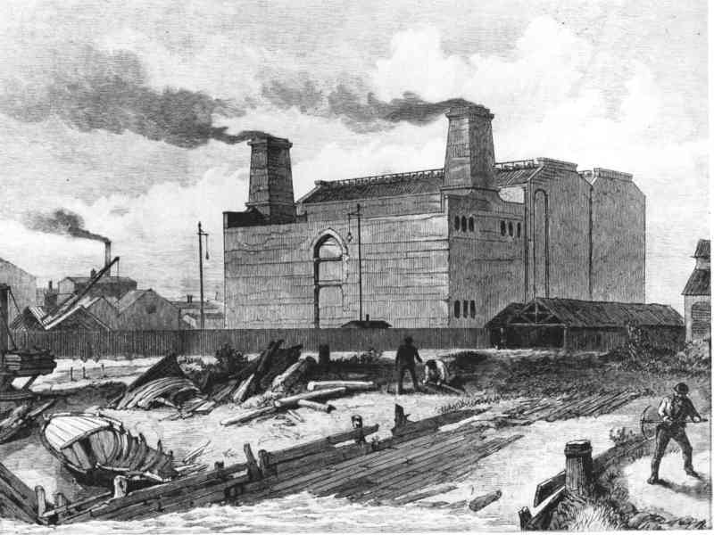
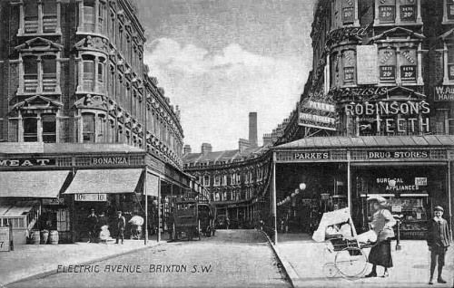
Delivering your electricity; London’s history
1878 - 1900
Introducing domestic electricity networks
London Electric Supply Corporation opened Deptford Power Station, UK's first AC power system, and the worlds first HV power station.
Electric Avenue in Brixton, named because is was one of the first streets in London to use electricity

Slide 53





Delivering your electricity; London’s history
1915 - 1950
Demand, destruction and demand widespread electrification of industry and homes
Notes:
Asset management – Paul Elliot

Slide 54


Delivering your electricity; London’s history
1948 – London Electricity Board & National Grid
London Electric Supply Corporation
Growth in demand for electricity
19 independent companies form London Electricity Board
Formed as the London Electricity Board on 1 April 1948 as part of the nationalisation of the electricity industry by the Electricity Act 1947.
Notes:
505 across UK – moving to 19 for LEB
Largely this structure has stayed the same – there are now a few less licence areas and only 6 large distribution areas

Slide 55


Delivering your electricity; London’s history
1952 – the Great Smog
The Great Smog of London, severe air-pollution affecting London in early December 1952.
Cold weather, windless conditions
and airborne pollutants arising
mostly from the use of coal formed
a thick fog over London.
It led to several changes in practices and regulations, including the Clean Air Act 1956.
Notes:
Clear air act – similar policy and challenges are faced in London today

Slide 56


Delivering your electricity; London’s history
1970’s – Peak Load shedding – the Miners Strikes
The three-day week one of several measures introduced to conserve electricity, the generation of which was severely restricted owing to industrial action by coal miners.
From 1 January until 7 March 1974 commercial users of electricity were limited to three specified consecutive days consumption each week and prohibited from working longer hours on those days.

Slide 57

Delivering your electricity; London’s history
1980’s and 1990’s Digitisation of the network
– a game changer for customer performance

Slide 58


Delivering your electricity; London’s history
2003 – The big power cut
The 2003 London blackout was a serious power outage that occurred in parts of southern London and north-west Kent on 28 August 2003 affecting an estimated 500,000 people.
Power went off at about 18:26 and came back on after 34 minutes at 19:00

Slide 59
Delivering your electricity; London today and tomorrow
PLAY

Slide 60

UK Power Networks – Who we are;
187,992km – total cable length and 120,000+ substations
8.3 million homes and businesses of which 1.6 million are on our Priority Services Register
18 million + people rely on our service every day

Slide 61

Serving our customers – a strong track record
The safest
Our best ever customer satisfaction score
87%
improvement
18%
improvement
Lost Time Incident Frequency Rate (per 100k hours worked)
Ofgem broad measure of customer satisfaction
Reduction in the frequency of power cuts
Reduction in the duration of power cuts
42% improvement
48%
improvement
Customer interruptions per 100 customers
Customer minutes lost per customer

Slide 62



Olivia Johnson & Kerry Potter
Supporting customers

Slide 63







What does it mean to be in a vulnerable circumstance?
Stop and think….
Rely upon medical equipment
Chronic or serious illness eg. Kidney disease, diabetes or cancer
Poor or restricted mobility
Living with dementia
Living with mental health difficulties
Are of pensionable age
Life changes eg. Bereavement
Struggling to pay bills?
And what about communication needs?
Deaf of hard of hearing
Blind or partially sighted
Unable to speak in English
Speech difficulties
Developmental conditions including Downs Syndrome & Autism

Slide 64





Priority Services Register
Why we hold a priority register
Supply
Communication
Provides visibility of who will be impacted in an incident and this can be taken into consideration during planned works or an emergency.
Ability to proactively offer additional support for eg alternative water or power supplies to those with specific needs
Proactive engagement regarding supply interruption enables these customers to make alternative arrangements
Enables staff to be sensitive to needs of customer’s condition
Allows us to keep in contact with customers prior to, during and after an event
Allows storage of important details such as mobility, to allow services such as ‘knock and wait’ or requirements for bills or outage notices in different formats.
Non-Household
Commercial properties such as hospitals, prisons, schools, farms etc.
Specific arrangements eg. alternative electricity or water for public health interests
Notes:
Update and add two slides on services for energy

Slide 65











UK Power Networks
- Our services including priority services
Ways we ensure that we are easily accessible to all of our communities
Inclusive services that provide peace of mind in 2018 we;
over 430,000 customers helped in how to be better prepared if they experience a power cut
over 700,000 customers supported during a power cut
resulting in a satisfaction rating of 9.23/10
We’re here to help and not just in a power cut
In 2018 we provided over 300,000 customers with energy advice and practical measures to address the underlying causes of fuel poverty

Slide 66


UK Power Networks
- and if there is a power cut?
We will contact you where we know that your electricity supply is affected
A priority number that you can call 24 hours a day
A dedicated team who will contact you to keep you updated during a power cut
Tailored support including hot meals, practical help and keeping your friends and relatives updated
Password scheme – if you are worried about your personal safety
In certain scenarios we may also provide a temporary generator or offer a free hotel overnight and transport to the hotel
Interpreter support for over 200 languages, video relay in BSL and our operational teams have translation tools

Slide 67
Services for customers in vulnerable circumstances

Slide 68
What are the services we offer?
Alternative water
Comms
Notify you of planned work = water dependant, Dialysis
24hr Team/NST/Customer Rep attempt contact and assist those who are on the register and prioritise them in an incident
We aim to deliver bottled water to your door or check you know where you can go to collect it if able
Alternative bill & letter formats
Doorstep password
Priority phone line – Feb
Over the phone language interpretation
Nominated contact on your account
Website accessibility

Slide 69



What are the services we offer?
Helping Customers Pay
WaterSure Plus Social Tariff - discounts for low incomes
WaterSure – capped bills for metered high use due to medical need / large family
Customer Assistance Fund – Financial help and advice if in debt
Thames Water Trust Fund – emergency grants
Water Direct – bills paid directly from benefits
Water Efficiency – Smarter Home Visits, free devices, water metering
Payment options – DD, cards
Pension Credit is a good indicator of qualification for WaterSure Plus

Slide 70

UK Power Networks
– Power Partners & energy advice programmes
We deliver tailored and personal advice for customers in the comfort of their community or homes to address energy concerns.
Every year we run Community Energy Events and personalised consultations to help people become more energy efficient and more confident dealing with their energy bills.
We provide guides and video materials to support the training of frontline support workers and charities.
Our new £300,000 fund, which will sponsor the activity of community organisations offering energy efficiency and money saving advice.
The fund will finance the activity of 40 not-for-profit organisations and community groups, helping households across London, the South East and East of England save money by being more energy efficient.

Slide 71
How do we find customers in vulnerable circumstances?

Slide 72




















Here are some of our external partners
Notes:
Update slide so UKPN/Thames can use it
We have partnered with Kidney Care UK, Age UK, British Red Cross, Sovereign Housing, NHS teams, Police, Fire and Rescue, Adult Social Care, Reablement Teams from all councils in our area and a multitude of smaller organisations and charities.
Our external partners disseminate our vulnerability message, they raise awareness of our services and they can signpost or they can help register people on our priority register on our behalf.

Slide 73








Slide 74
Olivia Johnson & Fiona Price
Age UK Berkshire

Slide 75




Age UK Partnership
Partnership of Thames Water, SSEN and Age UK Berkshire to offer a short, medium and long term solution to encouraging more older people to sign up to the priority register.
Short term- Winter 2018/19
Collaboration with winter in mind
Local press release and social media highlighted priority register and its benefits to older people.
Fitted in well with loneliness, social isolation, winter and Christmas messages.
This partnership has already got some headlines in the region -BBC Berkshire, Newbury Weekly News, That’s Thames Valley TV.

Slide 76



Age UK Partnership
Medium Term (throughout 2019)
We are piloting face to face opportunities for trained Age UK Berkshire staff to refer the elderly when they are doing:
Winter Warmth home visits
Home from hospital Support
Social prescribing
Information and Advice
The aim is to offer a one stop shop for our clients and adding value to each of our service offerings. Leaflet with Reference number to track success.
Longer Term
A closer partnership that we hope will result in a change in their registration process, giving direct referrals from Age UK Berkshire via Charitylog. Charitylog is also used by 90% of the other Age UK regions which represents a significant opportunity to ensure older people we support sign up as easily as possible
Learning- Press always better from a local Charity!
GDPR- adding additional complications and barriers!

Slide 77
Questions?

Slide 78


Slide 79
WELCOME BACK

Slide 80
Howz
Jonathan Burr
CEO

Slide 81


Slide 82






Thames Water and Howz Pilot
Length
Size
Purpose
Integrate water data into the Howz app
6 months
100 people
Looking for any potential interest from Age UK organisations who would like to be a part of this

Slide 83

What this could look like…

Slide 84
Being a socially responsible business.
Rosemary Waugh
Corporate responsibility manager

Slide 85




Being a socially responsible business.
Engage with local communities -community projects, volunteering and charitable giving
.
Enhance biodiversity on land owned by us or our partners
Provide access to our sites to support health and wellbeing
Educate our customers, both young and not so young, on our place in the water cycle and environment

Slide 86








Community engagement.
67 community projects across the catchment have received funding from us since 2014. Delivered by trusted partners to enhance the environment and educate customers
All our employees get two days volunteering leave to work in communities – in 2016/17 we had more than 990 volunteering activities, collectively investing over 7,000 hours across our region
Our small charitable grants programme supports local charities with grants that fulfil our criteria of water and health and/or water and the environment, in 2016/17 we donated £55,783 to 17 charities

Slide 87



Our education programme.
We proactively encourage schools to engage with our education programme – through a termly email campaign to 7,000 teachers - as a result last year we reached 21,000 students at our education centres and through outreach programmes.
We support schools and community groups by providing TW volunteers to give talks on what we do – reaching around 8,000 customers a year
Our Network Challenge workshop brings engineering to life at schools and community events
Give Someone a Start is a three week work experience programme we provide for customers looking to return to work provides a useful platform to help them ease back into the workplace

Slide 88




Enjoying our sites.
Over 100 of our sites have some form of public access
70 leaseholders look after our estate on our behalf – focussing on a range of activities from bird ringing to golfing to heritage enthusiasts to bee keeping to sailing
We manage directly five nature reserves and two recreational fisheries
Our green corridor sites – Greenway, Ridgeway and New River had benefitted from investment
Notes:
CCG sub group saw this slide last time so you may want to remove, but I would keep as sets the scene again

Slide 89



Enhancing biodiversity.
253 of our sites are Sites of Biodiversity Interest – eg have rare orchids present and 12 of our sites are SSSIs
Our Wild About Thames programme engages employees with the ecological importance of our sites
In 2016/17 we left 100,000m² of grassland habitat uncut to make sure there was enough foraging sources and habitats available for both domestic bees and their wild cousins.

Slide 90





Walthamstow Wetlands.
£10.6m project to open up our operational site as one of Europe’s largest urban nature reserves
Unique opportunity to provide local residents and others with access to green space – over 250,000 visitors since October 2017
Nearest tube Tottenham Hale or Blackhorse Road (carpark available)

Slide 91




Other wetlands to visit in London.
Woodberry Wetlands, Stoke Newington, Manor House
.
Firs Farm, Winchmore Hill,
Enfield, N21 2PJ
231 bus from Turnpike Lane
London Wetland Centre, Barnes
Hammersmith or Barnes then bus 33 or 72
Prince of Wales open space
Enfield Lock

Slide 92






Heritage sites.
London Museum of Water and Steam, Brentford, Kew Bridge
www.waterandsteam.org.uk
Kempton Great Engines Trust, Sunbury-on-Thames, Sunbury then 290 bus
www.kemptonsteam.org
Crossness Engines Trust, Thamesmead, visit website for shuttle bus times, carpark available
www.crossness.org.uk

Slide 93



The Ridgeway is our southern outfall sewer that runs above ground for 3.5 miles from Plumstead to Crossness. Recent improvements include accessible entry points and paths on top of the sewer - a great traffic free route for cycling and walking
The Greenway is our northern outfall sewer that runs above ground for 4.5 miles through Tower Hamlets and Newham - a great traffic free route for cycling and walking
The New River – a 32 mile, 400 year old water supply starting in Ware, Herts and ending in Islington near Saddlers Wells – still in operation and can be walked in sections (we have a leaflet)
iFootpath is a useful website as a guide for all three
www.ifootpath.com
Walking and cycling.

Slide 94
Thank you and any questions?

Slide 96
How can you help?

Slide 97
At your tables.
What can your organisations do to promote and sign up?

Slide 98



Slide 99
Contact us.
Peter.cotton@thameswater.co.uk
Olivia.johnson@thameswater.co.uk
Tania.christie@thameswater.co.uk
Mike.bingham@thameswater.co.uk
Rosemary.waugh@thameswater.co.uk
Kerry.potter@ukpowernetworks.co.uk
Fiona.price@ageukberkshire.org.uk
Jonathan@intelesant.com

