Slide 1
Digital Campaigning Workshop Using local government websites to support campaigning AUKL Workshop
Thursday 18th may, 2023
In partnership with

Slide 2
House keeping
Fire exit & Toilets
Group work with feedback
We are all at different digital stages and using different devices
Slides will be sent out
Let us know if there is any issue with the sound
Evaluation and Equalities Form
Let us know other topics for future sessions

Slide 3
Today’s Programme
Two sessions: - A: Using your local council website to support a campaign. - B: Using the London Assembly website to support a campaign.
Each session will cover: - Knowing who your representatives are. - Finding out information to support your camp. - How local government websites can allow you to be heard and have influence.
Each session will be followed by an activity with time for questions.

Slide 4
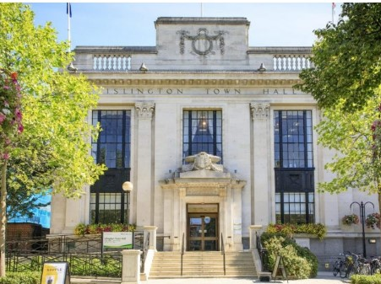
Session 1: Using your local council website to support campaigning
In this session we are going to explore: - Knowing who your councillors are and how to contact them using your council website. - How you can use your local council website to find out information for your campaign. - - Using your council website to take amplify your campaign.

Slide 5
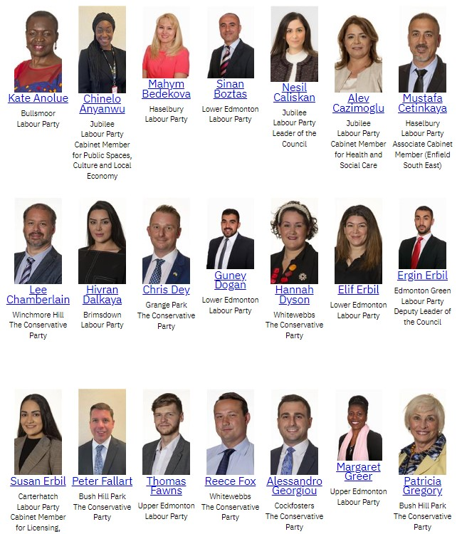
Councillors: Finding out who your councillors are and how to contact them using
On the homepage of your local council website you can: - Search ‘councillors’ in the search. - Or, navigate the website. First look for a section often called ‘Democracy’ or ‘Decision making’.
Notes:
What co councillors do?: What do councils do?: - Councils have powers and responsibility for local services, local transport, social care, education, planning the environment and housing. On some of these things they have more responsibility but there isn’t anything that isn’t influenced by national government (including how much they have to spend) and sometimes regional government (e.g. the GLA for London). - E.g. for transport: DfT - national services and big infrastructure e.g. Cross Rail
Transport for London – running Tube, Buses, Trams, setting fares
London Boroughs - responsible for road maintenance, LTNs, freedom pass administration
Councillors: There are 1,800 councillors in London across, 679 wards in 33 local authority areas (32 of which are boroughs and 1 is the City of London corporation. Councillors not only represent their communities and residents, they also help to make and shape the policies of the council.
Some councillors from lead parties have specific responsibilities e.g. Cabinet Members, Executive Members, Committee Chairs, Scrutiny responsibilities etc.
--ACTION: https://www.enfield.gov.uk/

Slide 6
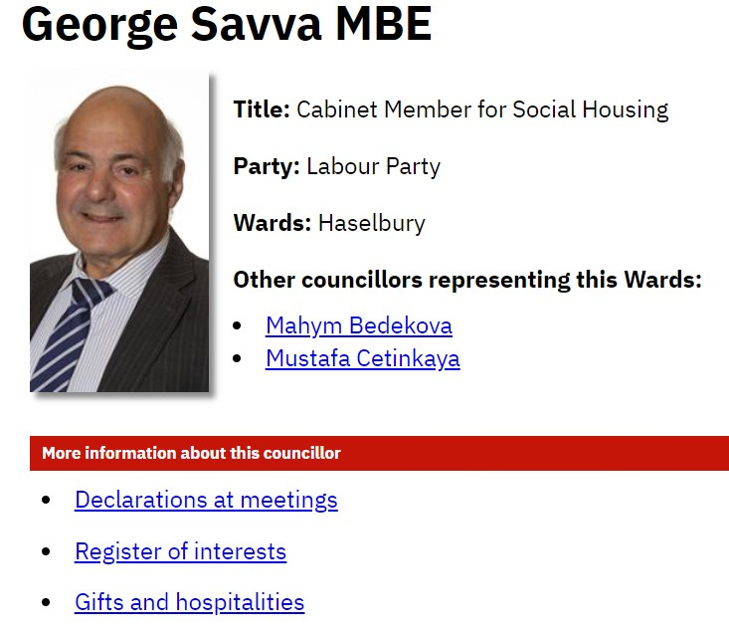
Councillors: About your councillor
After you have found the councillor you were looking for you can often click a link to find out more information about them such as which committees they are on.
It is not only your local councillor that you may be interested in. It may be a councillor with a specific responsibility like a Cabinet Member or committee Chair.
Notes:
--ACTION: https://www.enfield.gov.uk/ -- ACTION: https://governance.enfield.gov.uk/mgUserInfo.aspx?UID=178 -- https://governance.enfield.gov.uk/mgCommitteeDetails.aspx?ID=107

Slide 7
Other websites you can use to find out who your councillor is:
London Councils: Local government directory. https://directory.londoncouncils.gov.uk/
Write To Them. https://www.writetothem.com/
Notes:
https://directory.londoncouncils.gov.uk/

Slide 8
Your councillors email address
The webpage about your councillor should have your councillors email address.
All councillor emails end in …@NameOfCouncil.gov.uk BUT the formatting is different.
Cllr.Jane.Smith@brent.gov.uk
councillor.Jane.Smith@bexley.gov.uk
Jane.Smith@bromley.gov.uk
cllr.J.Smith@wandsworth.gov.uk
3. Or you can go to https://www.writetothem.com/
Notes:
ACTION: https://governance.enfield.gov.uk/mgUserInfo.aspx?UID=24169

Slide 9
Using council websites to find out information
Find key policies and plans:
e.g. https://www.lbbd.gov.uk/council-and-democracy/plans-and-priorities
2. Some council websites have ‘decision making portals’ https://democracy.islington.gov.uk/mgDelegatedDecisions.aspx
3. Information published before or agreed at meetings such as questions from councillors e.g. https://democracy.islington.gov.uk/ieListDocuments.aspx?CId=267&MId=4205&Ver=4
Notes:
Knowledge is power – Being confident in your ‘evidence base’ is important.
ACTION: https://www.lbbd.gov.uk/council-and-democracy/plans-and-priorities
ACTION: https://democracy.islington.gov.uk/mgDelegatedDecisions.aspx

Slide 10
Asking questions to the council.
You can ask a councillor to ask a question for you should be able to ask a question yourself. This could be: - Submitting a question in writing - Attending a council meeting and asking a question in-person.
Finding out how to ask a question.
Some council websites have webpages that give details (often these are on webpages called ‘Attending meetings’)
E.g. https://www.merton.gov.uk/council-and-local-democracy/decision-making/attending-meetings or https://www.barnet.gov.uk/your-council/democracy-barnet/resident-decision-making/get-involved-your-council/ask-public
Notes:
https://www.merton.gov.uk/council-and-local-democracy/decision-making/attending-meetings

Slide 11
Council ‘democracy teams’ will be able to help
All councils have staff members in a ‘democracy team’. Sometimes these are called ‘Democratic services’ departments.
Part of their role is to help residents engage in democratic processes and they will be happy to provide information about asking questions and other ways to engage with your council.
Notes:
https://www.merton.gov.uk/council-and-local-democracy/decision-making/attending-meetings

Slide 12
Council ‘democracy teams’ will be able to help
DemocraticServices@walthamforest.gov.uk
democratic.services@merton.gov.uk
They should be able to advise on specific processes and deadlines for asking questions ahead of meetings.

Slide 13
Using online calendars to find out about future and past meetings
You can use the calendar to find out about future meetings (agendas, reports etc.). It may be that you would like to ask a question at an upcoming meeting.
You can find details of webcasts as you may be able to watch a meeting online.
You can find the minutes and reports from previous meetings including questions that have been asked and the answers given.

Slide 14
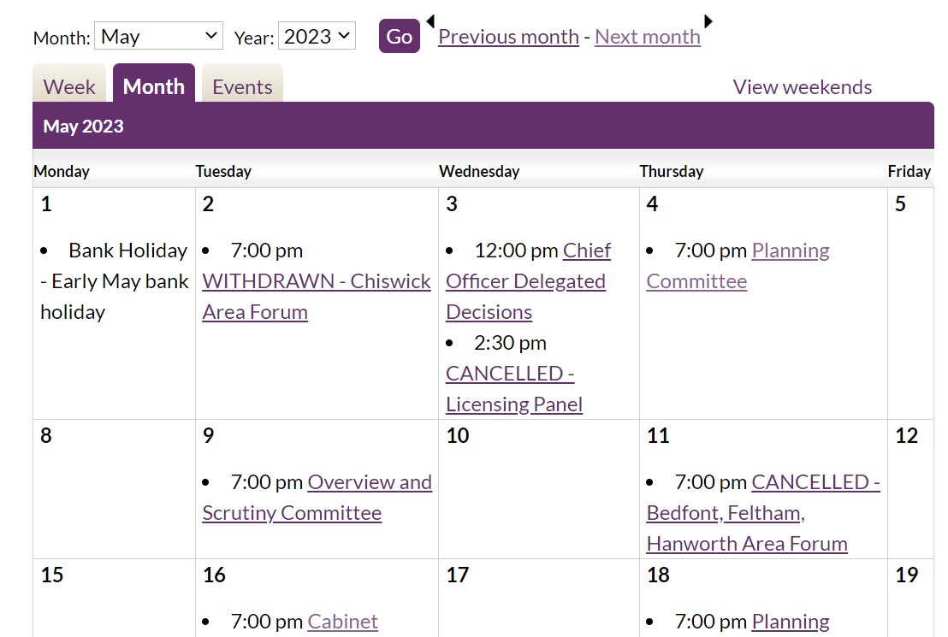
Using online calendars to find out about future and past meetings
Notes:
https://democraticservices.hounslow.gov.uk/mgCalendarMonthView.aspx?GL=1&bcr=1

Slide 15
If it’s not possible to find the information you want on a council website:
You could make Freedom of Information (FOI) request.
Under the Freedom of Information Act and Environmental Information Regulations you have the right to request any recorded information held by a public authority.
https://www.whatdotheyknow.com/
FOI email addresses (every council) – Database
Usually FOI emails are foi@councilname.gov.uk
Notes:
https://www.whatdotheyknow.com/
https://docs.google.com/spreadsheets/d/1YLc1mFSZQgBJ2Jj6htTOyjWeQp0GPPr_x25k_vscKeM/edit#gid=0a

Slide 16
How council websites can help amplify your campaign: Petitions
If you want to demonstrate that there is (local) public support for the council to take a particular action you can submit a petition (the more signatures the better but signatories must live in the borough).
You can use petition websites like change.org or 38degrees to set up an online petition
Many councils offer their own website as a way to set-up and submit a petition. You can search for these in the democracy sections of the website or contact the democracy team if you can’t find them.
Notes:
https://www.change.org/
https://home.38degrees.org.uk/

Slide 17
How council websites can help amplify your campaign: Petitions
Councils should offer information about:
Your petition being heard at a full council meeting
Petition thresholds. E.g. Islington…
If the petition has received between 1,000 and 2,000 signatures, the petition organiser can request a meeting with the Leader of the Council or the Executive Member with the relevant portfolio responsibilities.
If the petition has received 2,000 signatures or more, a debate of up to 15 minutes, will be held on the subject of the petitions
Examples include: https://democracy.islington.gov.uk/mgEPetitionListDisplay.aspx
https://moderngov.sutton.gov.uk/mgEPetitionListDisplay.aspx?bcr=1
Notes:
https://democracy.islington.gov.uk/mgEPetitionListDisplay.aspx
https://moderngov.sutton.gov.uk/mgEPetitionListDisplay.aspx?bcr=1
There are advantages and disadvantages of using council provided petition tools. Advantages include easier access into processes (the petition becomes part of the system, which can open doors – e.g. petitioning at meetings). Disadvantages: Some council provided petition tools require a login, which can act as a barrier for people that don’t want to set up an account.

Slide 18
How council websites can help amplify your campaign: Deputations
You can also use your council website to find out about how to form a deputation.
Deputations are a way of lobbying the council to let them know about a concern you have that is shared with people who you live or work near to.
A number of people (deputation) can send in a requisition (written request) to the council together with a written statement saying what their deputation is about.
If the request is agreed they will be invited to the meeting and have the opportunity to speak directly to the Members of the council.

Slide 19
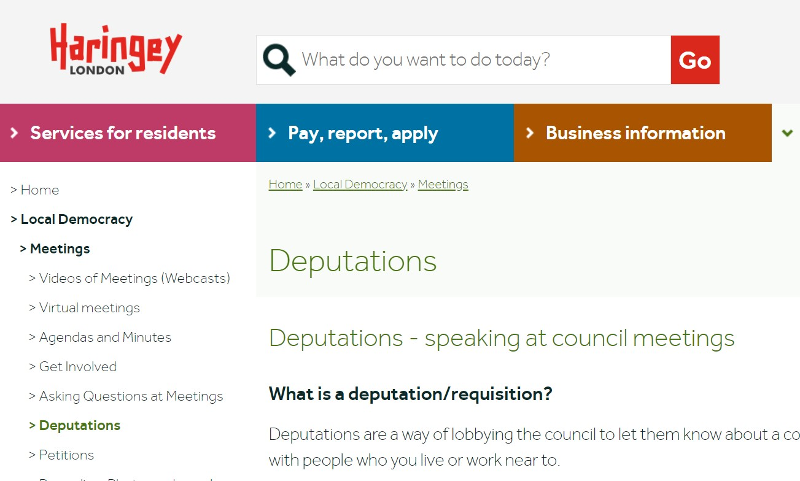
How council websites can help amplify your campaign: Deputations
You will often find details of how to prepare for and submit a deputation in the ‘meetings’ section of a council website. E.g. Haringey: https://www.haringey.gov.uk/local-democracy/meetings/deputations
Notes:
https://www.haringey.gov.uk/local-democracy/meetings/deputations

Slide 20
Activity
Find out the email address of one of your local councillors and the name of at least one committee that they are on. And if you have time…
Find out the date of the next Full Council Meeting in your borough.

Slide 21
Councillors: Finding out who your councillors are and how to contact them using
On the homepage of your local council website you can: - Search ‘councillors’ in the search. - Or, navigate the website. First look for a section often called ‘Democracy’ or ‘Decision making’.
Notes:
What co councillors do?: What do councils do?: - Councils have powers and responsibility for local services, local transport, social care, education, planning the environment and housing. On some of these things they have more responsibility but there isn’t anything that isn’t influenced by national government (including how much they have to spend) and sometimes regional government (e.g. the GLA for London). - E.g. for transport: DfT - national services and big infrastructure e.g. Cross Rail
Transport for London – running Tube, Buses, Trams, setting fares
London Boroughs - responsible for road maintenance, LTNs, freedom pass administration
Councillors: There are 1,800 councillors in London across, 679 wards in 33 local authority areas (32 of which are boroughs and 1 is the City of London corporation. Councillors not only represent their communities and residents, they also help to make and shape the policies of the council.
Some councillors from lead parties have specific responsibilities e.g. Cabinet Members, Executive Members, Committee Chairs, Scrutiny responsibilities etc.
--ACTION: https://www.enfield.gov.uk/

Slide 22
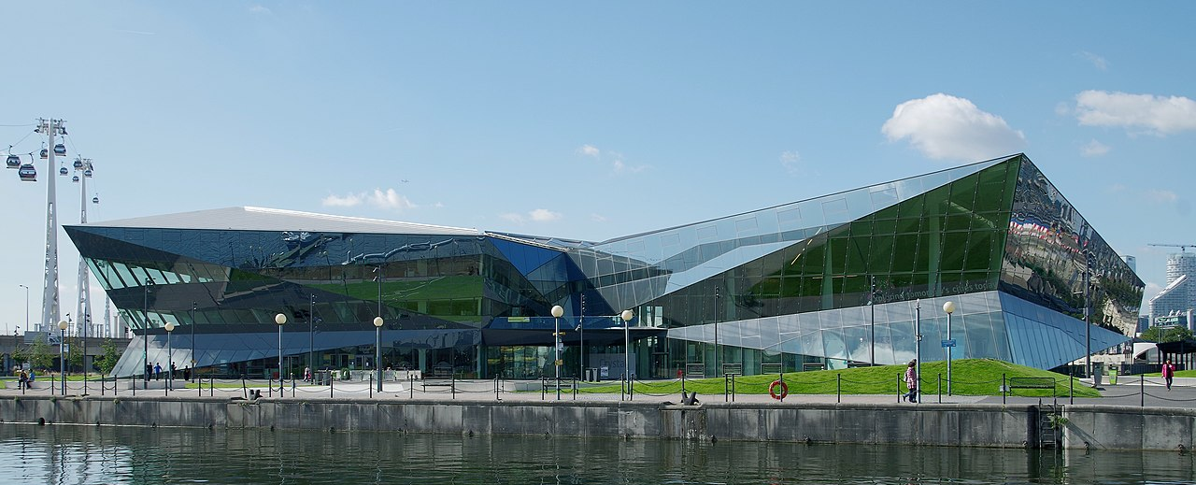
Session 2: Using www.london.gov.uk to support campaigning

Slide 23
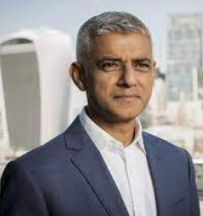
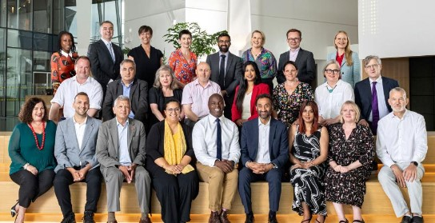
The Greater London Authority
Mayor of London
London Assembly
Functional bodies
London Fire Commissioner
Notes:
The GLA has 2 political arms;
The Mayor of London – who has powers in relation to (for example) transport; housing and strategic planning as well the ability to convene and lobby.
The London Assembly, comprised on 25, Assembly Members (14 represent constituencies, 11 are Londonwide) – the current political make up is 11 Labour, 9 Conservatives, 3 Greens, 2 Liberal Democrat. - There are 12 committees including the Transport committee,
Assembly Members have limited decision making power, there role is instead to hold the Mayor to account, which they do through questioning, investigations, passing motions and voting on the Mayors budget each tear
The GLA has some functional bodies such as Transport for London.

Slide 24
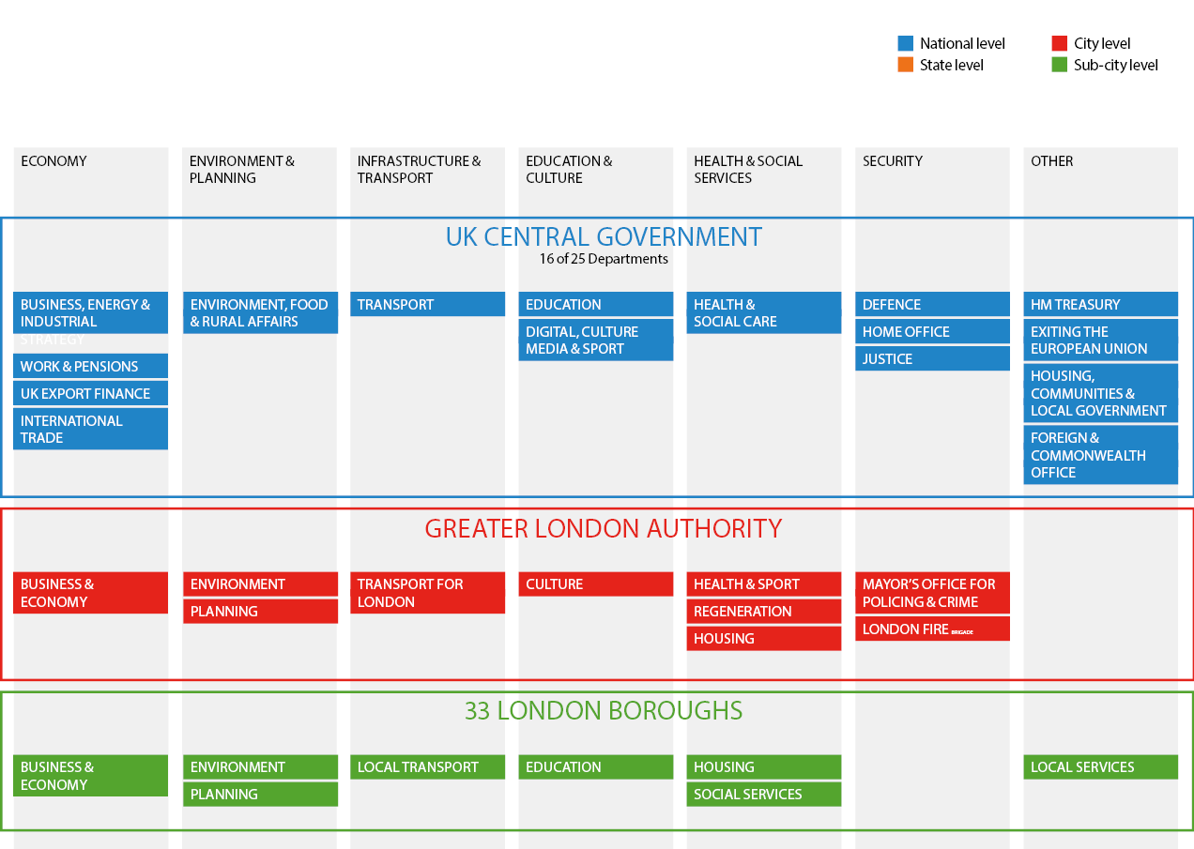
Notes:
Different levels of government can be responsible for different aspects of the same policy area.

Slide 25
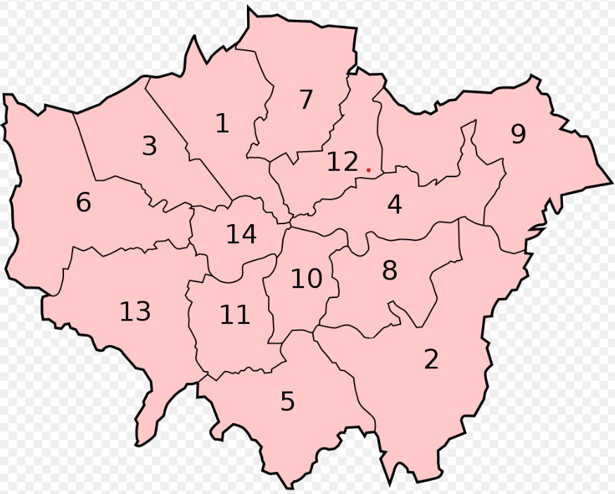
14 of the 25 Assembly Members represent constituencies.
These ‘supe-constituencies’ can incorporate up to 3 boroughs
Notes:
Barnet and Camden - - Bexley and Bromley - - Brent and Harrow - - City and East(Barking and Dagenham, Newham Tower Hamlets) - - Croydon and Sutton - - Ealing and Hillingdon - - Enfield and Haringey - - Greenwich and Lewisham - - Havering and Redbridge - - Lambeth and Southwark Merton and Wandsworth - - North East (Hackney, Islington, Waltham Forest) - - South West (Hounslow, Kingston, Richmond - - West Central (Hammersmith and Fulham, Kensington and Chelsea, Westminster)

Slide 26
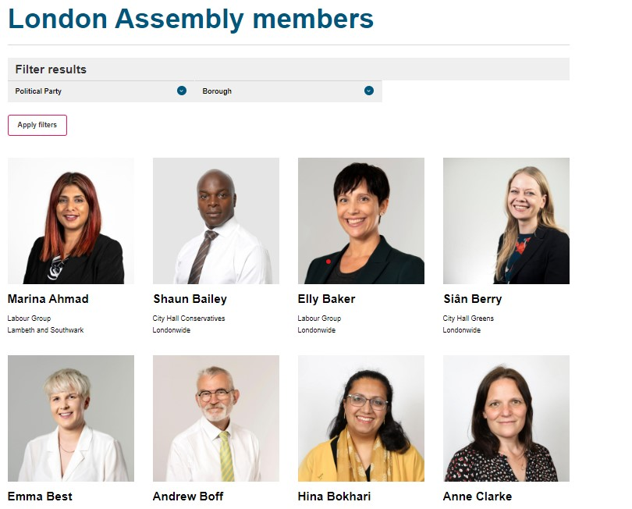
London Assembly Members: Finding out who your Assembly Members are and how to contact them
Go to https://www.london.gov.uk/who-we-are/what-london-assembly-does/london-assembly-members

Slide 27
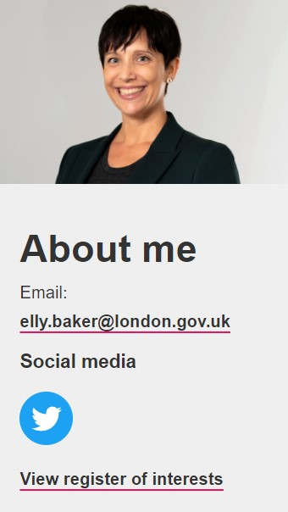
Councillors: About your Assembly Member
After you have found the Assembly Member (AM) you were looking for you can click on their photo to find out more information about them such as which committees they are on.
As well as your constituency Assembly Member there are ‘Londonwide’ AMs you can contact.
Notes:
https://www.london.gov.uk/who-we-are/what-london-assembly-does/london-assembly-members/elly-baker

Slide 28
Your Assembly Member’s email
This is always
Firstname.surname@london.gov.uk

Slide 29
You can also use:
Write To Them. https://www.writetothem.com/
Notes:
https://directory.londoncouncils.gov.uk/

Slide 30
You can sign up for updates about the London Assembly:
https://www.london.gov.uk/who-we-are/what-london-assembly-does/connect-us
Other useful pages
https://www.london.gov.uk/who-we-are/what-london-assembly-does/about-london-assembly
https://www.london.gov.uk/who-we-are/what-london-assembly-does/assembly-member-press-releases
Notes:
https://www.london.gov.uk/who-we-are/what-london-assembly-does/connect-us
https://www.london.gov.uk/who-we-are/what-london-assembly-does/about-london-assembly
https://www.london.gov.uk/who-we-are/what-london-assembly-does/assembly-member-press-releases

Slide 31
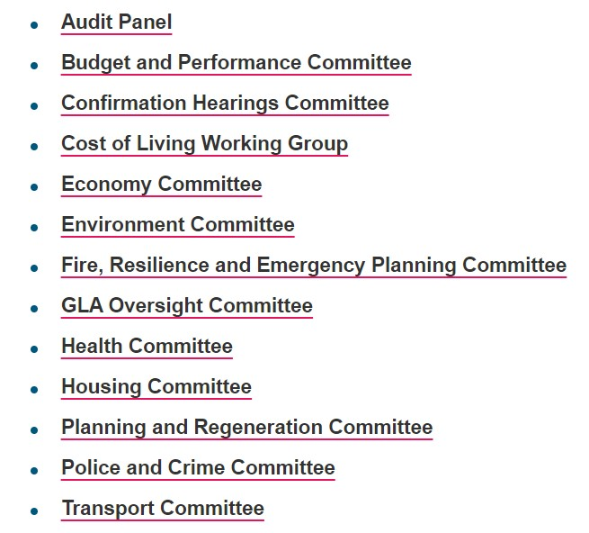
London Assembly Committees
https://www.london.gov.uk/who-we-are/what-london-assembly-does/london-assembly-work/london-assembly-committees
Notes:
https://www.london.gov.uk/who-we-are/what-london-assembly-does/london-assembly-work/london-assembly-committees
https://www.london.gov.uk/who-we-are/what-london-assembly-does/london-assembly-committees/health-committee

Slide 32
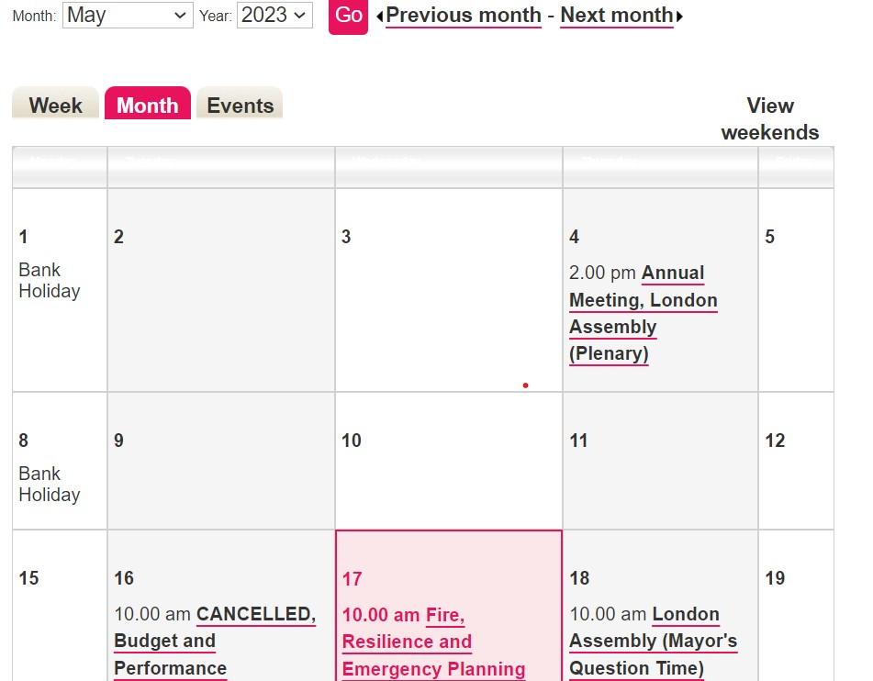
Using the online calendars to find out about future and past committee meetings, Mayor’s Question Times
https://www.london.gov.uk/about-us/londonassembly/meetings/mgCalendarMonthView.aspx?
Meetings are livestreamed and you can watch past meetings
Notes:
https://www.london.gov.uk/about-us/londonassembly/meetings/mgCalendarMonthView.aspx?

Slide 33
Asking questions to the Mayor
Suggest a question
Only Assembly Members can put questions to the Mayor at Mayor's Question Time, but you can suggest a question to be asked by emailing suggestaquestion@london.gov.uk.
Please state whether you would like your question to be forwarded to a particular Assembly Member or to a political group (Conservative, Labour, Liberal Democrat, Green).
You could also email an Assembly Member directly

Slide 34
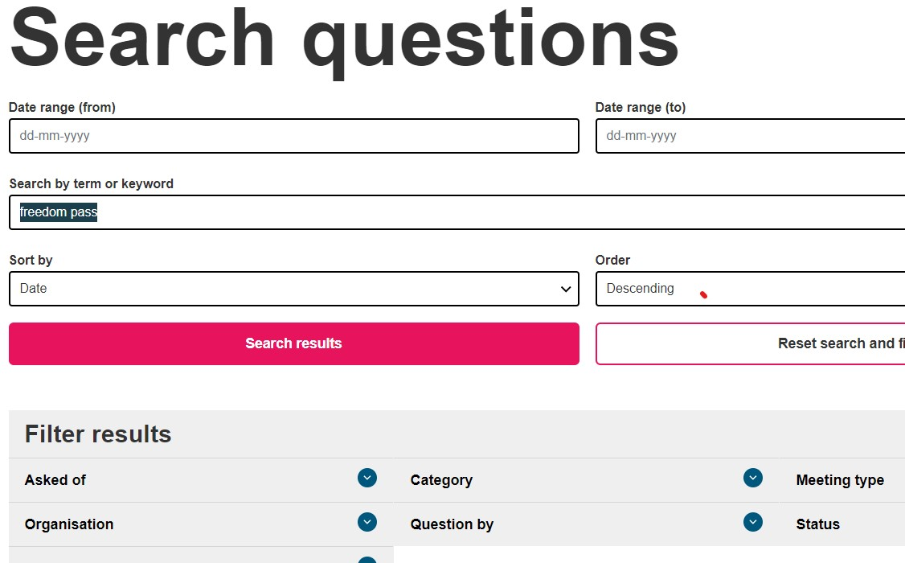
Find an answer to a previously asked question
https://www.london.gov.uk/who-we-are/what-london-assembly-does/questions-mayor/find-an-answer?
You can search thousands of questions asked over the past 10 years
Notes:
https://www.london.gov.uk/about-us/londonassembly/meetings/mgCalendarMonthView.aspx?

Slide 35
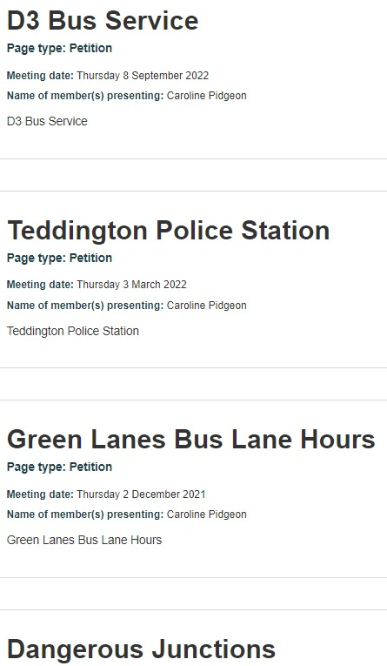
You can ask an Assembly Member to submit a petition on your behalf
Information about petitions can be found at: https://www.london.gov.uk/who-we-are/what-london-assembly-does/petitions
Notes:
https://www.london.gov.uk/who-we-are/what-london-assembly-does/petitions

Slide 36
Questions

