Slide 1


Campaigning for change using digital tools
Age UK London Workshop
Tuesday 25th July, 2023
In partnership with

Slide 2
Aims of Workshop
Better understand how groups and orgs working with and for older Londoners can have their say and campaign online
Understand a range of digital campaigning tools and how to use them in live campaigns to improve the quality of life for older Londoners
To share good practice in digital campaigning for older Londoners
Notes:
One of series of 4 workshops
1. Finding out - whats out there to digitally engage?
2. Responses and Consultations
E= Petitions – responding to and setting up
Write to them
3. Spreading the Word
Social Media – focus on Twitter and Facebook
Blogging
4. Joining up – the campaigning journey
Case study and exercise- based on London Loos using range of tools
Funded by WCIT
Supported by GLF
The first one is an introduction
Others cover xxx

Slide 3
Staying safe online
Create strong passwords (3 words)
Make Sure Your Internet Connection is Secure
Update internet browser
Learn to spot fake emails and websites
Log out from services
Beware of phishing attacks
Privacy Settings
Anti-virus software
Notes:
If you want more info Sharron to add on this area see link xxxx

Slide 4
ETHICS ONLINE
Be transparent: do good - avoid harm
Explicability: understandable, transparent
Ensure that when you select, analyse or report on data, it is done in a fair, non-judgemental and promote equality in accordance with the Equality Act
Be aware of any personal conflicts of interest or barriers that may affect your integrity or objectivity.

Slide 5
Examples of Digital Tools
Online consultations
E petitions
Online Surveys e.g. SurveyMonkey
Twitter
Facebook/Ads
Instagram
Freedom of Information requests
Blogs
Webpages
Notes:
Don’t show slide
Write up on Flip chart as they call out
Then show slide

Slide 6
What is digital campaigning & why is it important?
  Digital campaigning uses technology to create change, whether through emails and petitions or platforms such as Facebook, Twitter, Instagram, WhatsApp and many more.
  Deepen your engagement with your members
  Get your message out to a wider audience

Slide 7
SOCIAL MEDIA

Slide 8
Why use Social Media?
Reach a new, local audience
  Other individuals, organisations, councillors, media
Raise awareness of the vital campaigning work you are doing
Immerse yourself in local community chatter

Slide 9
Making a profile that stands out
Establish your brand
  Profile picture – the first thing people will see
  Succinct and effective bio – who you are and what you’re doing
Consider a separate account for your campaign
Notes:
Having a good profile is key to being taken seriously by others.
Profile picture – preferably a photo of yourself – the key here is to not leave your profile picture blank.
Bio – keep it simple – who you are and what you’re doing – e.g. ‘Retired teacher and Lambeth resident. Campaigning to save the Number 99 bus route!”

Slide 10
Making digital content
Platform – tailor the content to the platform’s audience
  Facebook; Typically, older user-base – search for relevant ‘groups’ and ‘pages’
  LinkedIn; Professional audience –representatives, officials and people of working age here
  Twitter; All of the above
Engaging; photos, statistics, quotes
Notes:
Facebook – useful for finding others with shared community interests – try searching for your borough, or an interest group that you're curious about working with.
LinkedIn – This is how you're going to best engage decision-makers. The content you're posting here can be a little more technical.
Twitter – A bit of a free-for-all – keep your content short and accessible here – simple sentences.

Slide 11
Making digital content
Call to action – what do you want people seeing your post to do?
#Hashtags – short, snappy and likely to be searched, but not vague. Capitalise the beginning of each word for easier reading.
Mention other campaigners/organisations with the ‘@’ function

Slide 12
Making digital content
  “Great to see so many #campaigningtosavethenumber99busroute today! #campaigning #bus #number99”
  vs
  “Great to see so many #LambethCampaigners out in force today, petitioning @TfL to save the 99 bus route! Follow our campaign @SaveThe99Route!”

Slide 13
Joining the conversation
#Hashtags - search for topics relevant to you and engage accordingly
Like, share and follow - streamlines your feed, so you see more of what you want to see and signals to other users what you are interested in
Comment – thoughts, reflections and questions on someone’s work
Persistence – post regularly and consistently, regardless of how many people interact with your content.
Notes:
#Hashtags – The same way you’ll use hashtags in your content to signal other users, you’ll search hashtags to find relevant content. Try mapping out potential keywords related to your campaign.
Persistence – You could make a post that’s ‘perfect’ on paper, but might not get much of a reception. The key is to not be discouraged; people are more likely to engage with you if you’re seen to be an active online user.

Slide 14
ENGAGING WITH
YOUR ELECTED REPRESENTATIVES

Slide 15

Our representatives
www.writetothem.com
Enter postcode to get contact details for local Councillors, MPs, or London Assembly Members

Slide 16

Local government directory
London Councils website hosts this directory which lists names, addresses & contact numbers for councillors and officers in all 33 London boroughs incl City of London corporation https://directory.londoncouncils.gov.uk/
“Essential guide to London local government” https://www.londoncouncils.gov.uk/who-runs-london/essential-guide-london-local-government
Notes:
https://directory.londoncouncils.gov.uk/

Slide 17
Council ‘DEMOCRACY TEAMS ’
All councils have staff members in a ‘democracy team’. Sometimes these are called ‘Democratic services’ departments
Part of their role is to help residents engage in democratic processes and they will be happy to provide information about asking questions and other ways to engage with your council
Notes:
https://www.merton.gov.uk/council-and-local-democracy/decision-making/attending-meetings

Slide 18

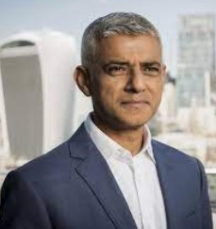
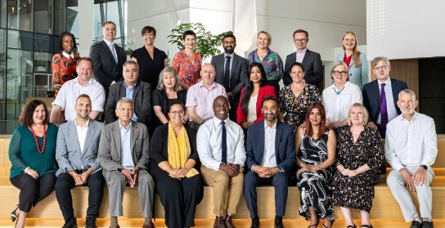

Greater London Authority
Mayor of London
London Assembly
Functional bodies
London Fire Commissioner
Notes:
The GLA has 2 political arms;
The Mayor of London – who has powers in relation to (for example) transport; housing and strategic planning as well the ability to convene and lobby.
The London Assembly, comprised on 25, Assembly Members (14 represent constituencies, 11 are Londonwide) – the current political make up is 11 Labour, 9 Conservatives, 3 Greens, 2 Liberal Democrat. - There are 12 committees including the Transport committee,
Assembly Members have limited decision making power, there role is instead to hold the Mayor to account, which they do through questioning, investigations, passing motions and voting on the Mayors budget each tear
The GLA has some functional bodies such as Transport for London.

Slide 19
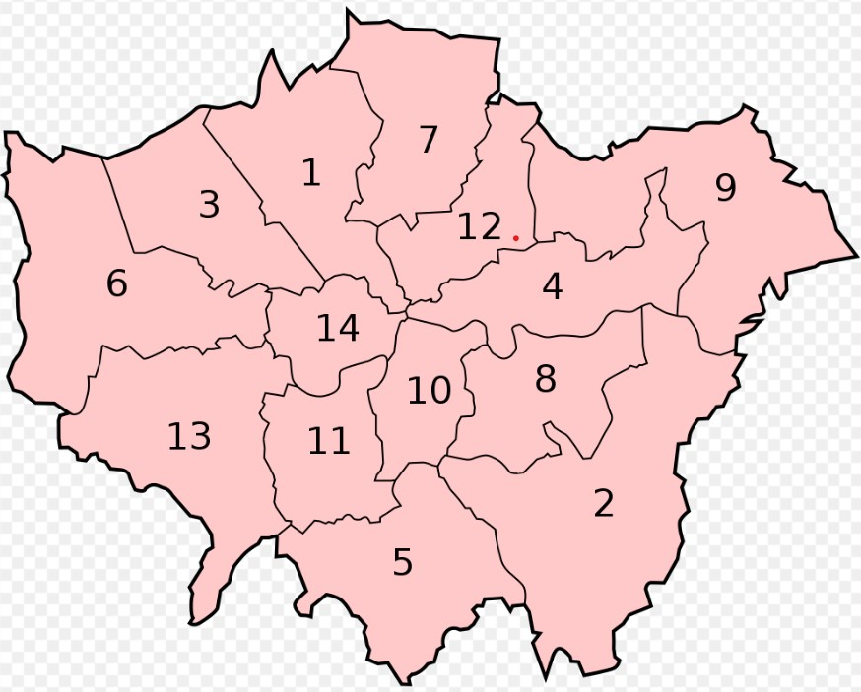
14 of the 25 Assembly Members represent constituencies.
These ‘supe-constituencies’ can incorporate up to 3 boroughs
Notes:
Barnet and Camden - - Bexley and Bromley - - Brent and Harrow - - City and East(Barking and Dagenham, Newham Tower Hamlets) - - Croydon and Sutton - - Ealing and Hillingdon - - Enfield and Haringey - - Greenwich and Lewisham - - Havering and Redbridge - - Lambeth and Southwark
Merton and Wandsworth - - North East (Hackney, Islington, Waltham Forest) - - South West (Hounslow, Kingston, Richmond - - West Central (Hammersmith and Fulham, Kensington and Chelsea, Westminster)

Slide 20
HAVE YOUR SAY ONLINE
https://www.london.gov.uk/take-part
Public meetings calendar, and how to have your say on big issues and help shape London's plans and policies
https://www.london.gov.uk/take-part-with-us/mail-mayor
Sign up for emails from the Mayor & City Hall

Slide 21
Engaging & influencing online
Talk London an active online community
A place to discuss London's big issues and shape and steer the policy decisions of the future
The online feedback, along with other research, is used to influence policy for London and so it is a good example of how people can get involved digitally to make a difference
http://talklondon.london.gov.uk

Slide 22
www.fixmystreet.com
Report, view, or discuss local Problems, graffiti, fly tipping, broken paving slabs, street lighting
Enter a nearby UK postcode, or street name and area
Notes:
Use link to show data showing repair times – to motivate interest

Slide 23
DIGITAL DEMOCRACY TOOLS

Slide 24
FREEDOM OF INFORMATION REQUESTS
Under the Freedom of Information Act & Environmental Information Regulations you have the right to request any recorded information held by a public authority.
When submitting an FOI to your council or public bodies:
Don’t be vague, Don’t ask too much at once, Don’t be rude
Include your full name and a contact email or postal address
Finding your evidence
You can write a request by email, letter or social media, or by using WhatDoTheyKnow.com. They should respond in 20 working days.
You DO NOT need to tell them why you want the information.
Notes:
See model FOI Template letter – Dee set up

Slide 25
Consultations
Postcode search on Gov.uk website linking to consultations on Council websites so you can have your say about local issues, on the way they plan, manage and deliver services.
https://www.gov.uk/find-local-consultations

Slide 26
NEXT STEPS
Consider what you’d like to campaign on
Consider what digital tools you could use for this campaign
Look at AUKL’s website for ideas if helpful-resources and examples
Are there any issues you need to consider?
Notes:
If necessary prompt
Blog
Web page

Slide 27
Summary
Range of specific resources available on digital tools for campaigning – see aukl website
Don’t be afraid to ask how to use a tool
Share your successes and learning – let us know
Evaluation form & Equalities monitoring form

