Slide 1

Dementia
The Regional & National Picture
Willie Cruickshank

Slide 2

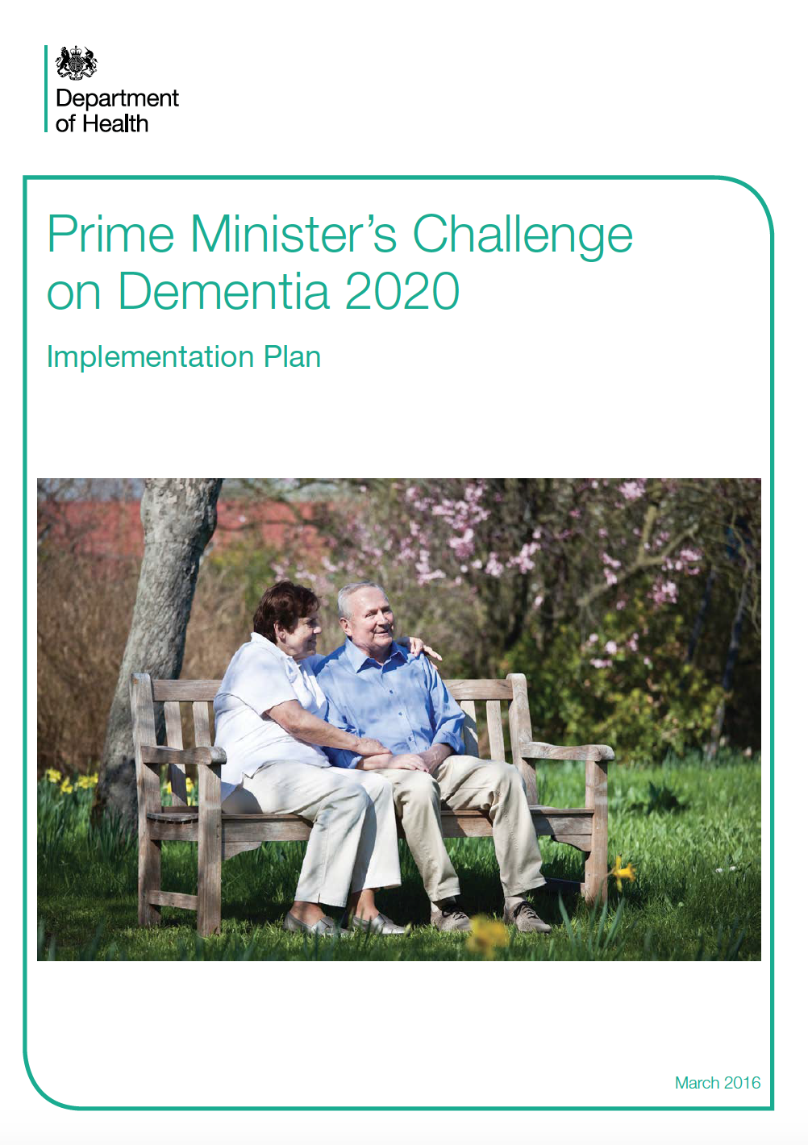

Slide 3
Context
And
Challenge

Slide 4
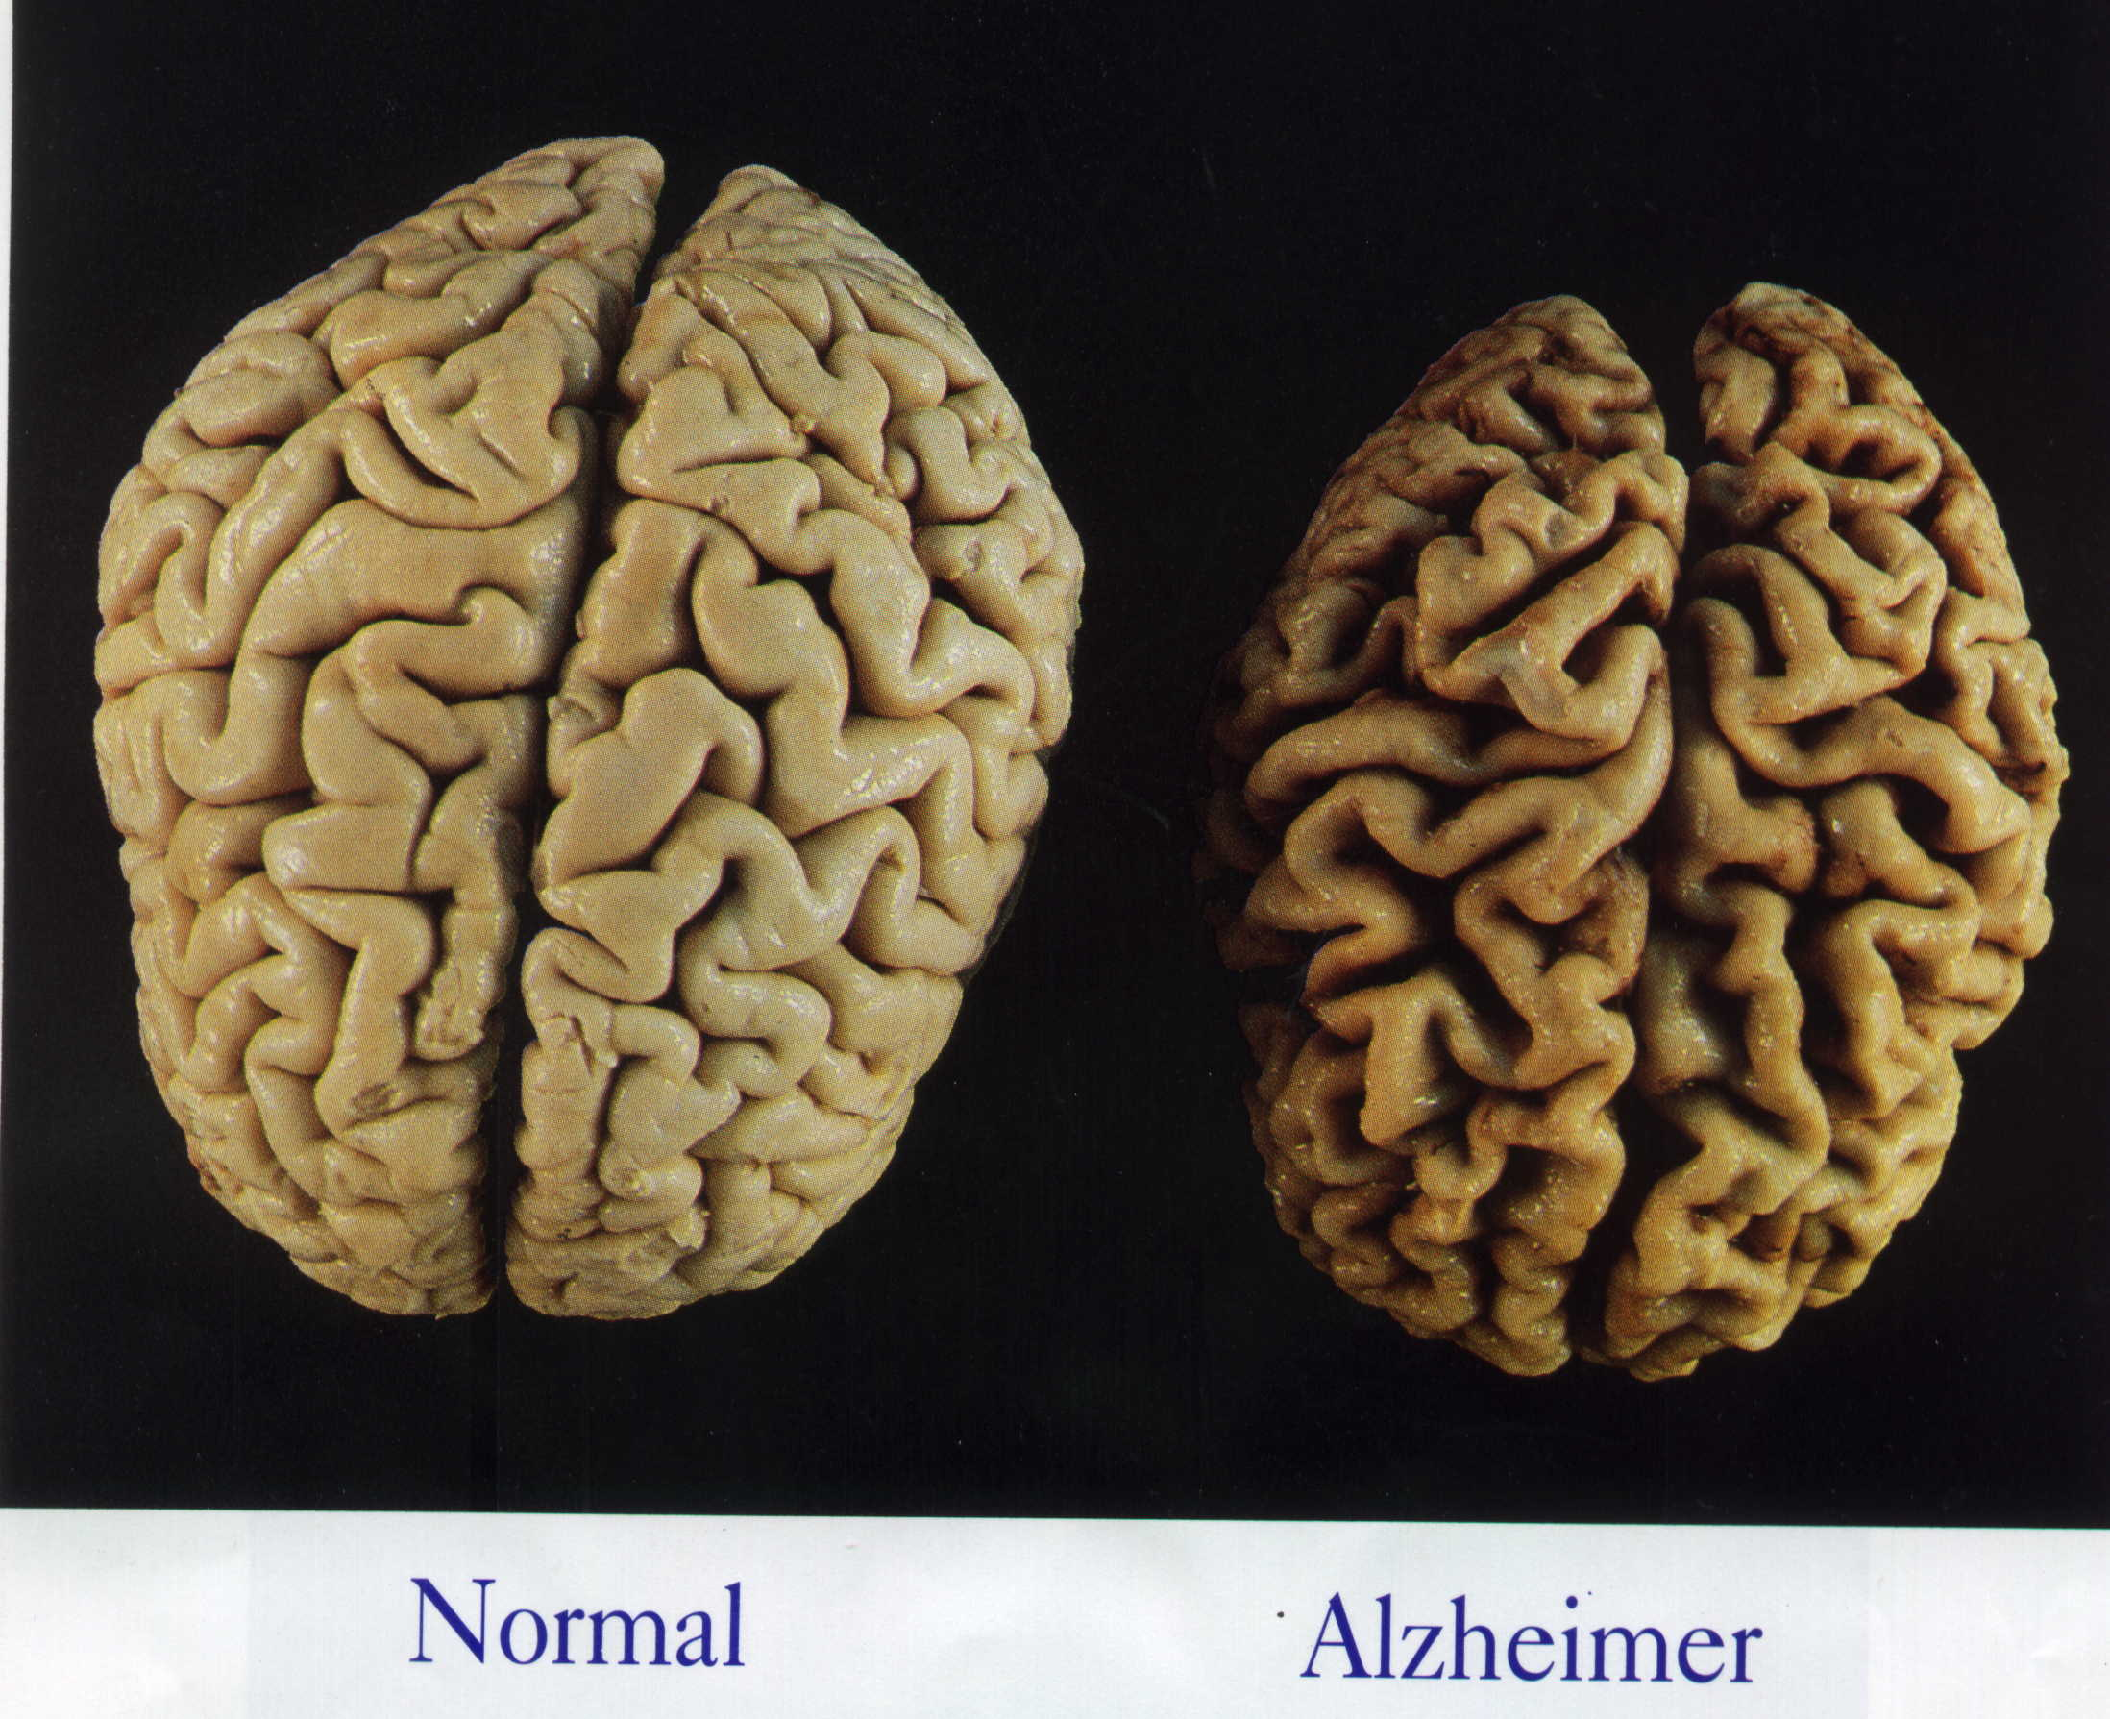

Context & Challenge
What is Dementia?

Slide 5
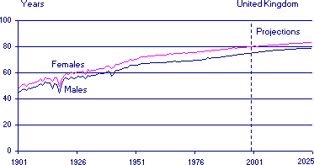
UK – Life Expectancy

Slide 6
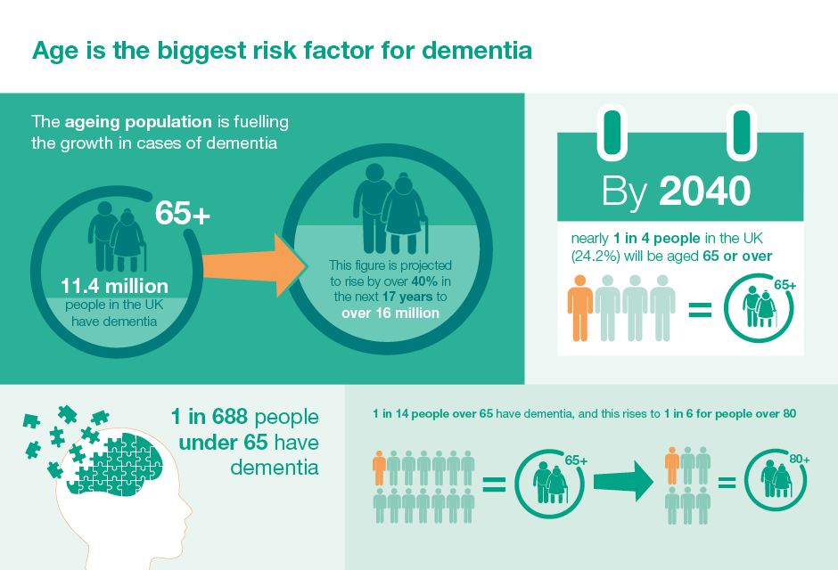

Slide 7
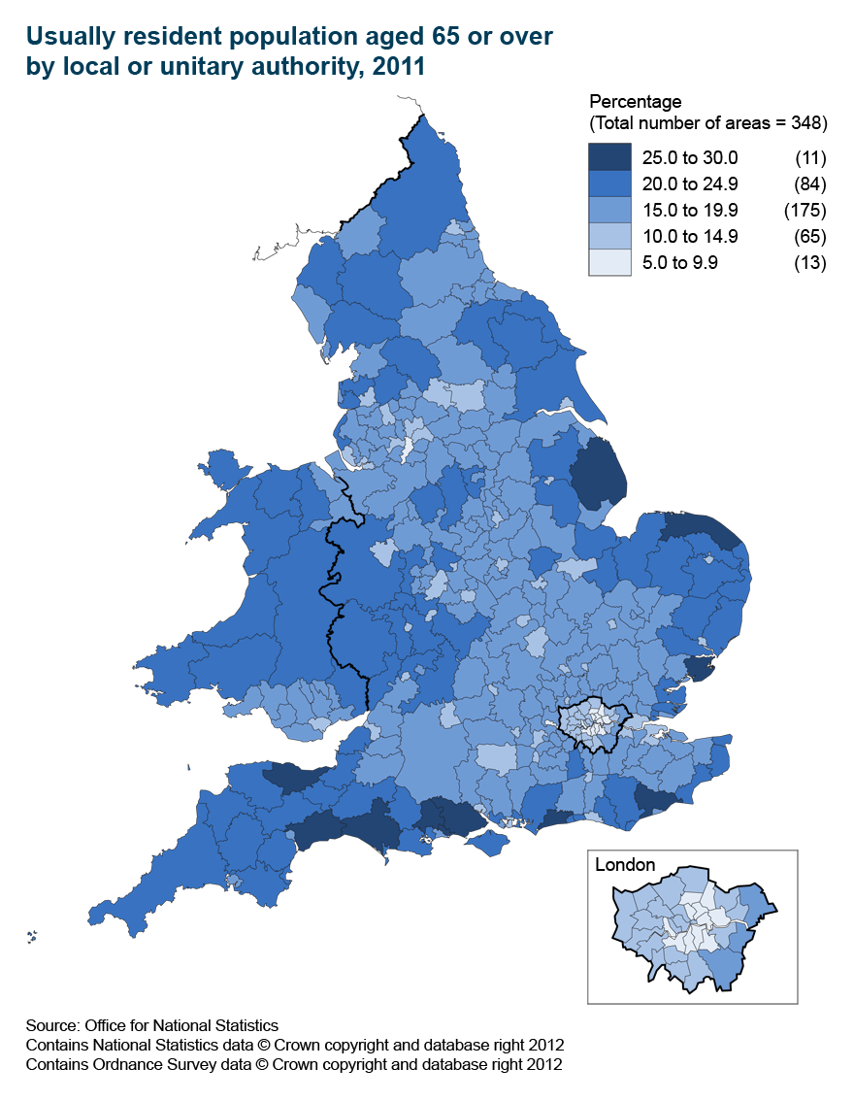

Slide 8
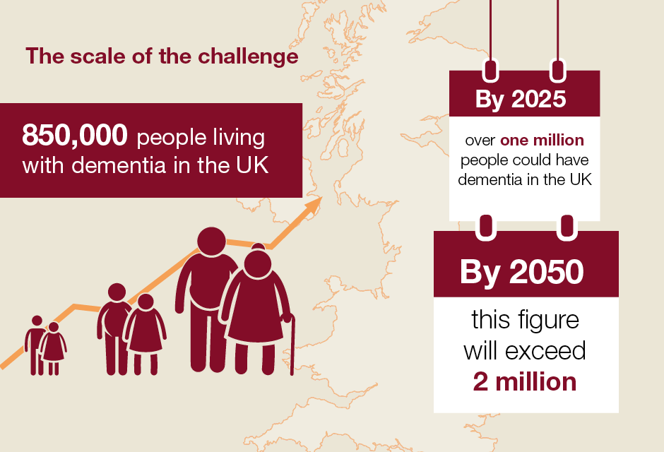

Slide 9
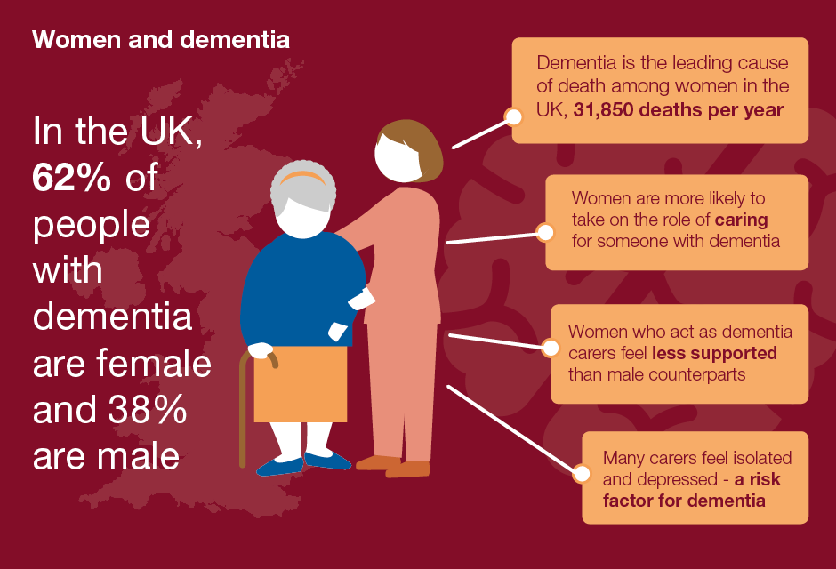

Slide 10
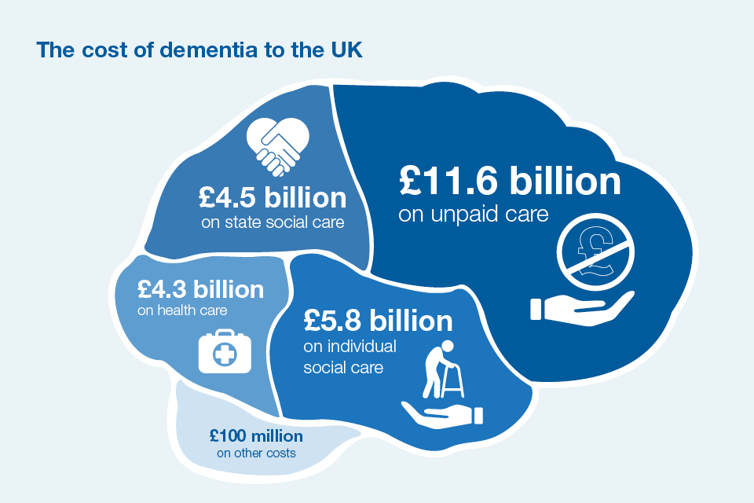
Notes:
WITH DEMENTIA AS SINGLE ISSUE NEED TO WORK ACROSS HEALTH AND CARE
EGOS AND ARROGANCE
EGO IS INVERSLY PROPORTIONATE TO SIZE OF COST
INNOVATION FLOW FROM FAMILY TO CARE PROVIDER TO HEALTH UNHEARD OF. ARROGANCE ASSUMES THE REVERSE
HIEC NEEDS TO PROVIDE SOFT LEADERSHIP TO ADRESS

Slide 11
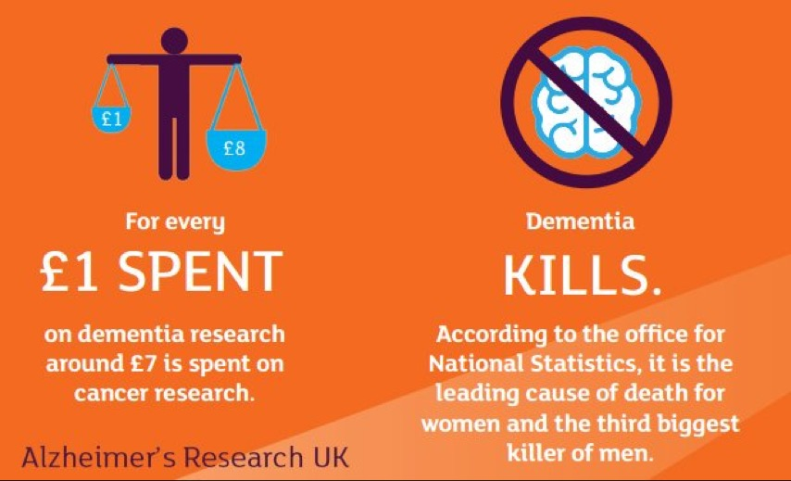
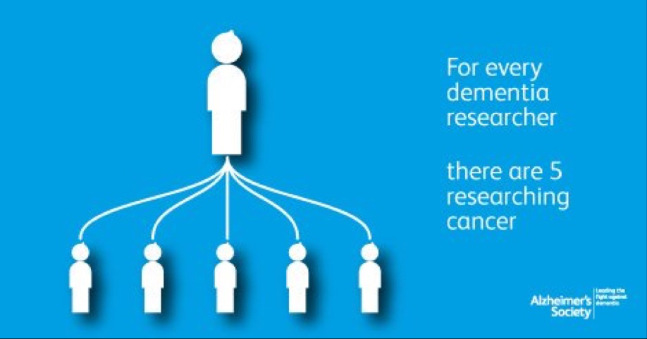

Slide 13
The Prime Minister’s Challenge on Dementia 20202
Risk Reduction
Health & Care Delivery
Workforce Training & Development
Dementia Awareness
And Social Action
Research

Slide 14

Risk Reduction
Blackfiriar’s Consensus (2014)
lack of physical activity
high blood pressure
Smoking
excessive drinking
Diabetets

Slide 15
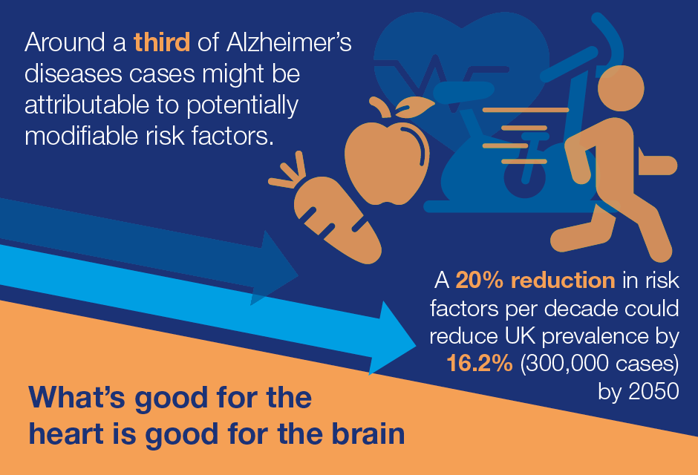

Slide 16
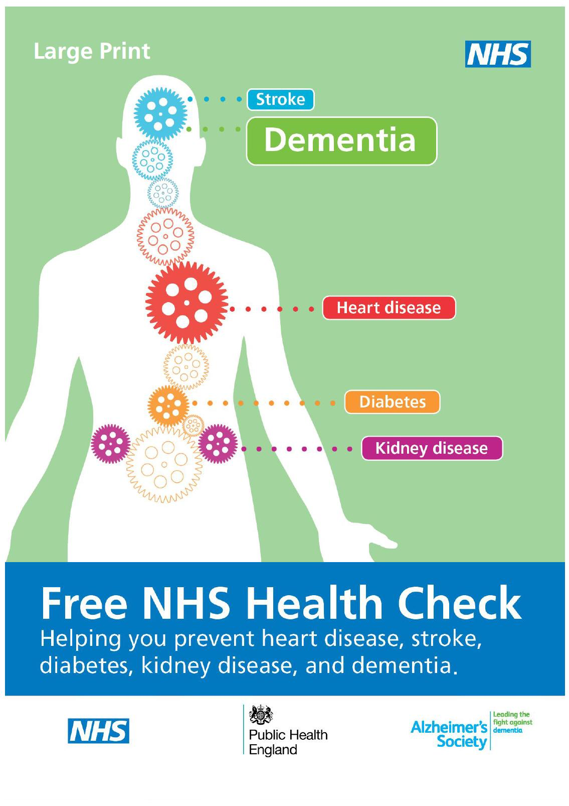

Priorities
Raising awareness of the risks
Building the Evidence Base
Promoting Dementia Risk Reduction
Enhancing Dementia component of NHS Health Checks
“One You”

Slide 17
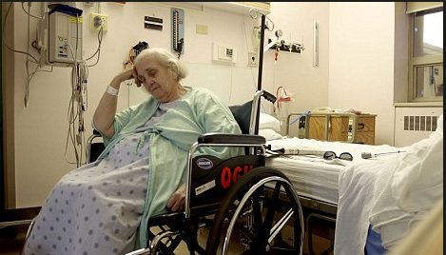
Health & Care
Improve quality and levels of care, so that England is recognised as the best country in the world for dementia care and support.

Slide 18
Priorities
Improving diagnosis
Support and care after diagnosis
Enabling people to live well in their own homes for longer
End of life care
Education training and workforce

Slide 19

67.2% national dementia diagnosis rate (60%)
Stopped GP incentives (£55)
“Shared commitment to………………….. deliver better quality post-diagnostic care.”
In reality?

Slide 20
NHS Dementia Mandate
NHS Trusts are to ensure availability of:
Dementia awareness training to all staff
and
All staff treating NHS patients working regularly with people with dementia undertake more in depth training.

Slide 21
Social Care Mandate
The Department of Health will commission a study to:
identify relative levels of education and training for this workforce;
identify gaps and challenges to up-skilling the social care workforce supporting people with dementia;
identify options to address these challenges and gaps by 2020.

Slide 22

Dementia Awareness And Social Action
Our vision is for a country where there is widespread awareness and understanding of dementia, so that everyone with dementia can live fulfilling lives.

Slide 23
Priorities
Delivering three million additional Dementia Friends
Developing communities to be Dementia Friendly
by 2020, over half of people with dementia are living in Dementia Friendly Communities
Encouraging businesses to be Dementia Friendly
Ensuring national and local Government play a leadership role in increasing public sector dementia awareness.

Slide 24
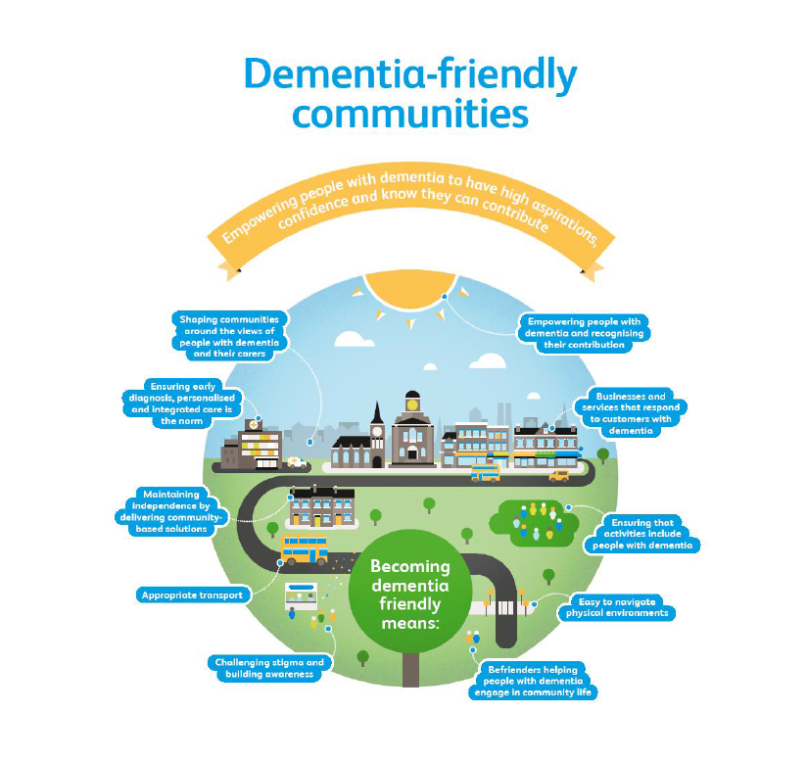

Slide 25

Research
National Dementia Research Institute - £150M
VR Dementia Discovery Fund - £100M
Creating a successful drug can cost a company $1bn (£642m)
UEA
Michael Hornberger
Eneida Mioshi

Slide 26


Slide 27
Dementia
The Regional & National Picture
Willie Cruickshank

