Slide 1

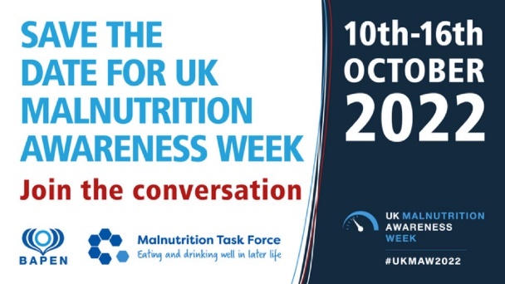
Greater Manchester
Nutrition and Hydration Programme
A Brief Guide to Prevent Malnutrition and Dehydration in Older Age
Preventing avoidable harm
Maintaining independence
Improving health and quality of life

Slide 2

Malnutrition - What is it ?
Over-nutrition (obesity)
Malnutrition (meaning poor or bad nutrition) and
Under-nutrition
For many older people it is characterised by low body weight or weight loss,
meaning simply that some older people are not eating well enough to maintain
their health and wellbeing.
NICE defines a person as malnourished if they have:
A BMI (Body Mass Index) of less than 18.5
Unintentional weight loss greater than 10%, within the past 3-6 months
A BMI of less than 20 and unintentional weight loss greater than 5% within the past 3-6 months
Notes:
DEFINE malnutrition and consider the two different extremes – obesity / malnutrition.
This training concentrates on UNDERNUTRITION in relation to OVER 65s.
READ the slide (animations can be removed if they are distracting).
The PAPERWEIGHT ARMBAND has been developed to indicate a BMI of 20 if it fits around the mid-part of the upper non-dominant arm and 18.5 if it is lose / slips up and down this part of the arm.

Slide 3
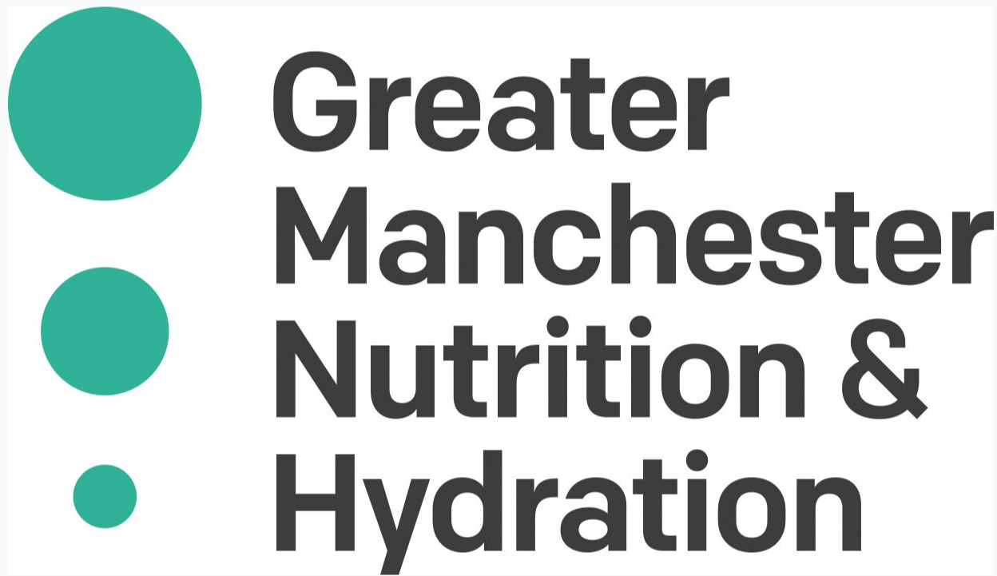
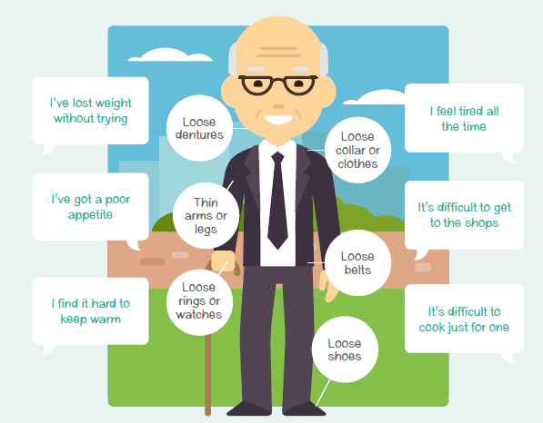
Signs to look out for
Verbal
Visual

Slide 4
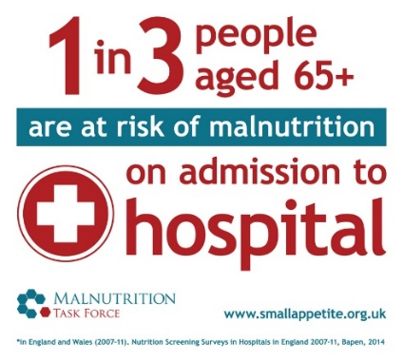

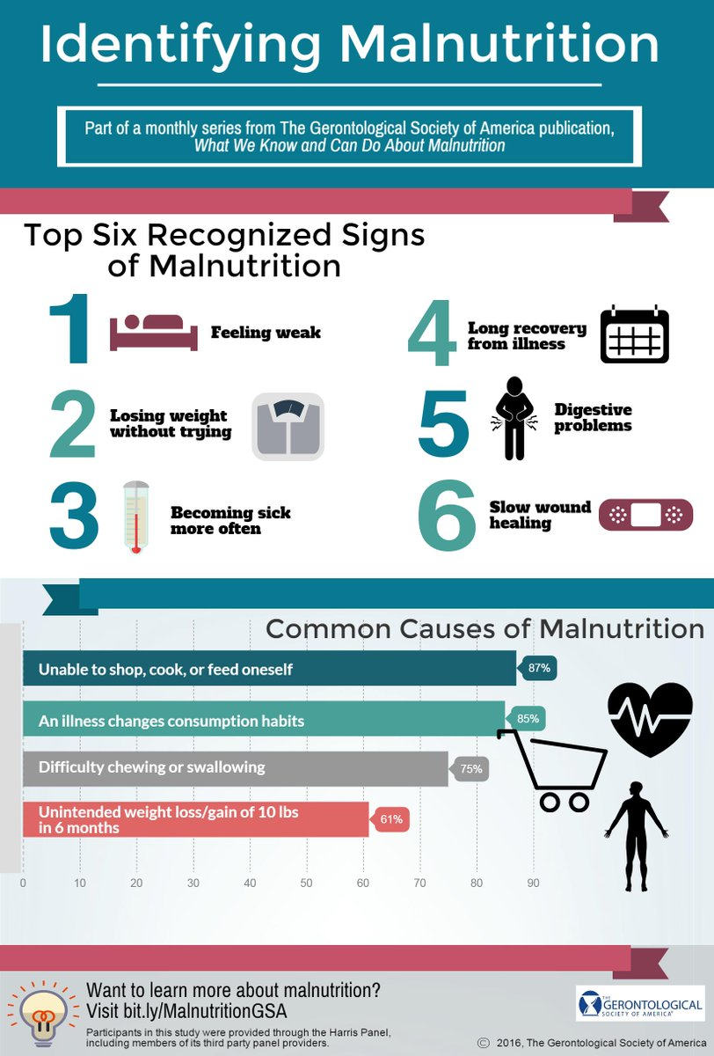
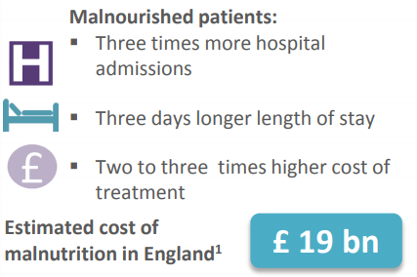
Why focus on malnutrition?
47%
of all people who fall are malnourished
Images from Malnutritiontaskforce.org.uk
Notes:
It’s a hidden problem
It’s all around us - A third of recent arrivals to hospitals and care homes are already malnourished (or at risk)
The consequences - For every 10 days a person over the age of 80 is in hospital they lose 10% of muscle mass, they have slower healing wounds, a longer recovery time and generally become sick more often
It is preventable – Losing weight is not a natural part of growing old
It’s expensive – Malnutrition costs the health and social care system around £19-20bn per year – relate this to longer stays in hospital, higher costs of treatment and being admitted more often. A&E presentation for older people for a fall has huge costs attached
It affects vulnerable people most – The older you are, the more likely you will be at risk

Slide 5
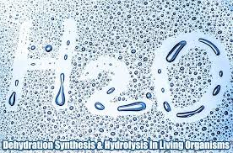
Dehydration - What is it?
Dehydration is fluid loss
Loss can occur from conditions such as sweating, diarrhoea, vomiting, medications.
Thirst is a useful indicator of daily fluid needs but most people are already mildly dehydrated by the time they feel thirsty.
Risk factors
Age-related changes include a reduced sensation of thirst, which may be more pronounced in those with Alzheimer’s disease or who have had a stroke. Incontinence
Source: British Nutrition Foundation
Notes:
READ the slide
HIGHLIGHT that a reduced sense of thirst due to age or a condition, may mean that prompts to drink are needed.
DRAW attention to the many different signs & symptoms of dehydration – these will have some baring if the case study ‘Emily’s story’ is used at slide 15.

Slide 6
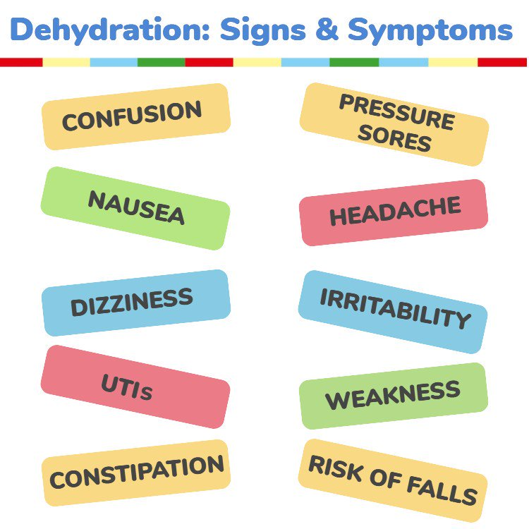
Dry mouth, lips and tongue and sunken eyes.
Fatigue, Headaches, Dizziness, Memory issues, Behavioural issues.
Low or no urine output / dark concentrated urine
Source: British Nutrition Foundation
Notes:
READ the slide
HIGHLIGHT that a reduced sense of thirst due to age or a condition, may mean that prompts to drink are needed.
DRAW attention to the many different signs & symptoms of dehydration – these will have some baring if the case study ‘Emily’s story’ is used at slide 15.

Slide 7
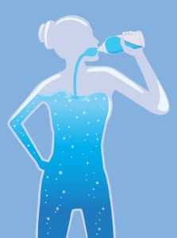

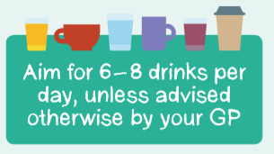

Some key stats - dehydration
20%
28%
of older people are dehydrated
have impending dehydration
This leads to admissions to hospital for:
  Confusion
  UTIs
  Falls
  Constipation
  Increased risk of infection / sepsis
  Low mood and energy so loss of independence and mobility
Notes:
READ the slide
HIGHLIGHT the number of drinks needed in a day and how dehydration can lead to hospital admissions – this can be referred back to the costs mentioned in SLIDES 6 & 7.

Slide 8
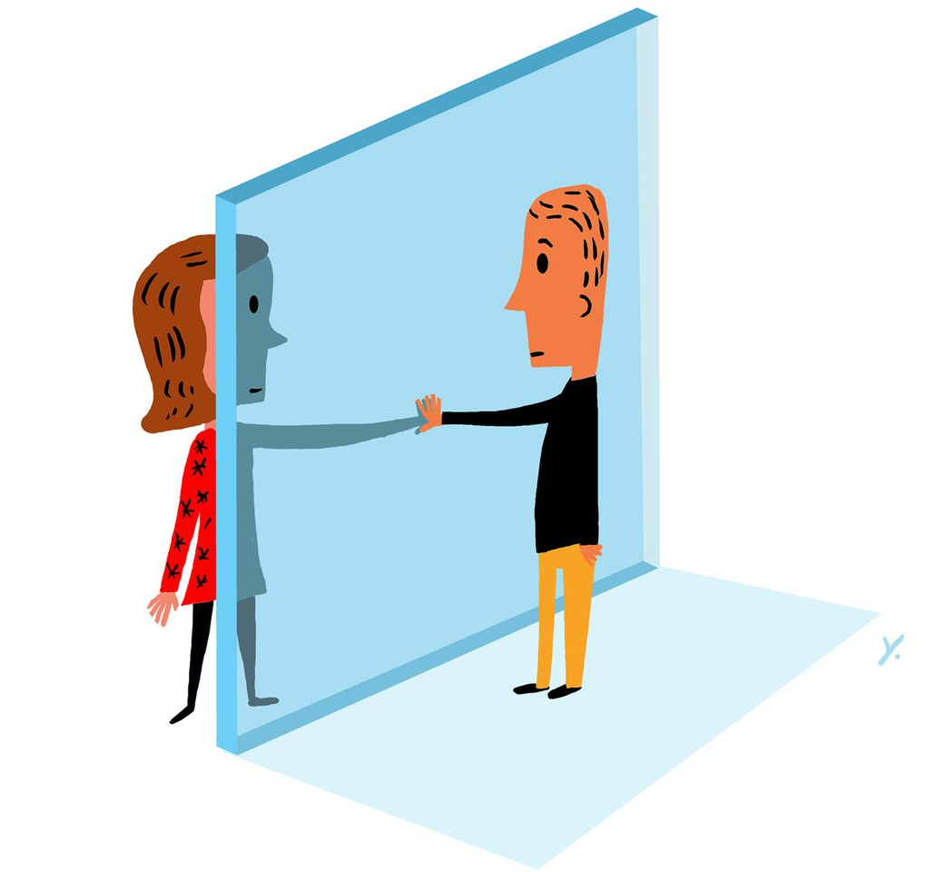
Increased risk due to COVID-19
Many risk factors are increased due to current social distancing measures
Increased risk for those who are vulnerable and shielding; have limited food access and from social isolation
Also, people who have been in hospital with COVID-19, are experiencing high levels of weight loss
https://www.ageuk.org.uk/salford/our-services/information-and-advice/staying-well-during-the-coronavirus-pandemicoronav
Notes:
Unintentional weight loss, especially if rapid weight loss usually reflects loss of muscle mass, which may be particularly relevant for people recovering after a period of intensive care
Malnutrition can increase a person’s risk of infection as well as slow down their recovery
Weight loss, especially if rapid weight loss usually reflects loss of muscle mass, which may be particularly relevant for people recovering after a period of intensive care
In turn this slows their recovery and may consequently result in readmission to hospital and further complications

Slide 9

Impact of Long COVID
Loss of weight attributed to:
• The effects of the virus itself
• Lack of energy meaning they are not cooking for themselves
• Breathlessness, making it difficult to eat
• Loss of taste and smell
General feelings of anxiety, fear and isolation

Slide 10
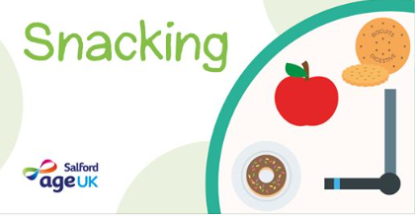

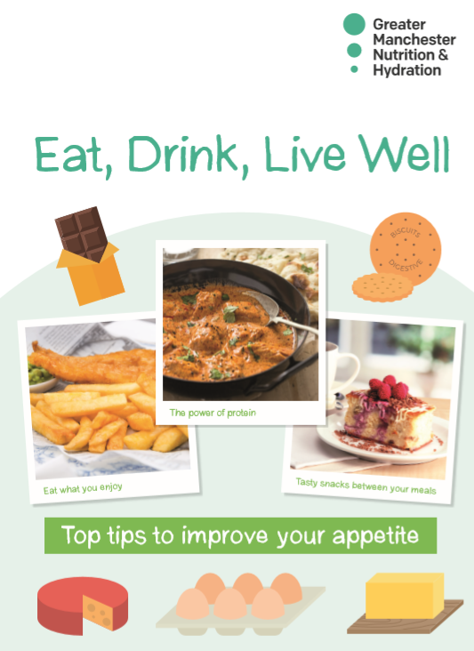
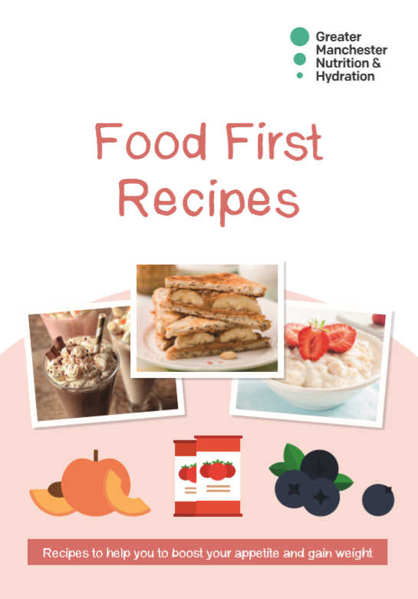
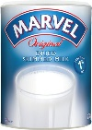

IF…
You notice that someone is not eating and drinking well, you can:
Discuss their diet and fluid intake with them, encourage them to eat little and often, have regular snacks and ask them to choose full fat foods and drinks and fortify their diets
Encourage to access social support where possible
Encourage them to make meal preparation easier for themselves
Encourage them to access financial support
Discuss this with their family members/carers
Refer to the right health care professional for extra support
Which of these do you currently do?

Slide 11
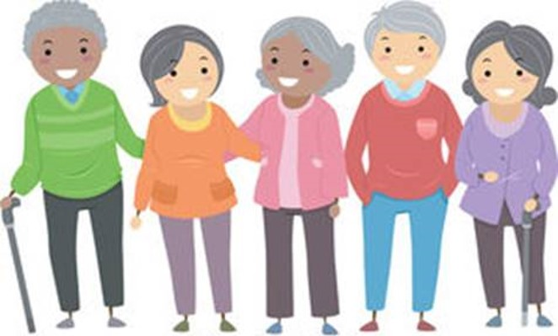
Raising Awareness
What could you do as a team to raise awareness of the importance of eating and drinking well in later life?
Please share your thoughts, actions and good practice with us on
our Twitter page @GMNandH
If you want to learn more or download any of our resources, visit:
https://www.ageuk.org.uk/salford/about-us/improving-nutrition-and
hydration
or contact your programme manager for an order form.

Slide 12
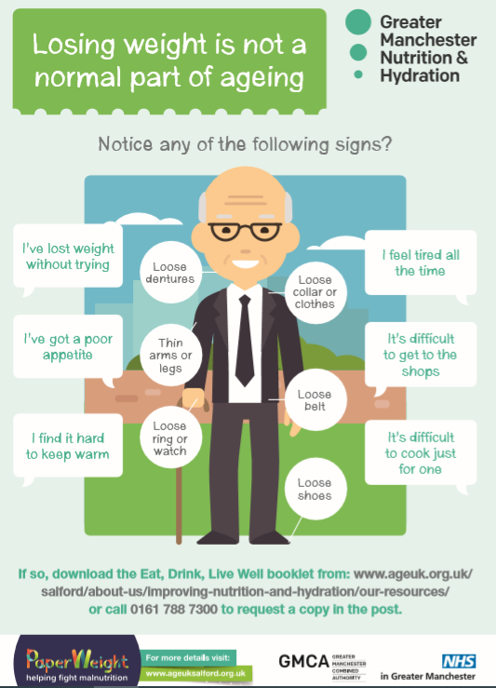
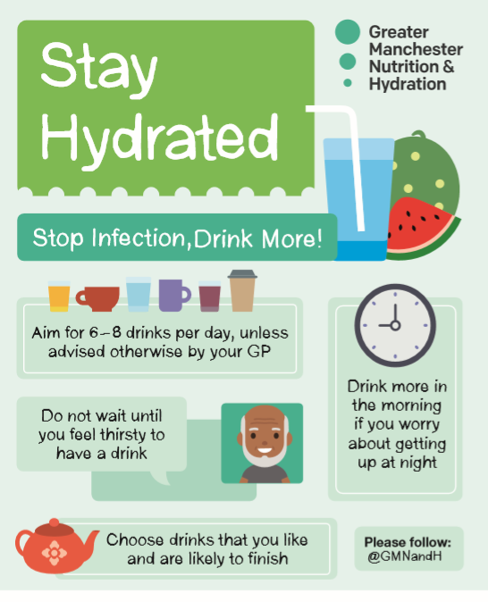
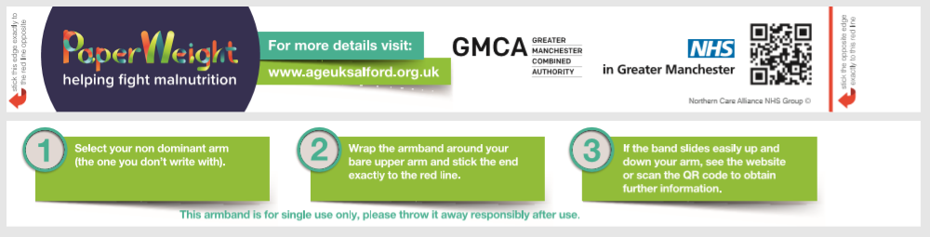
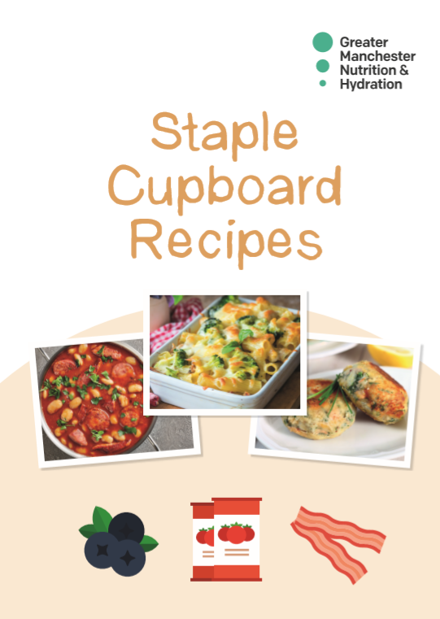
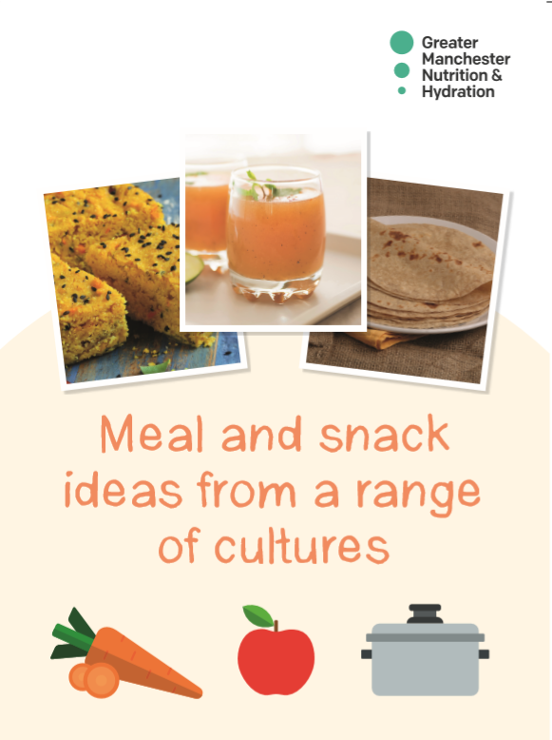
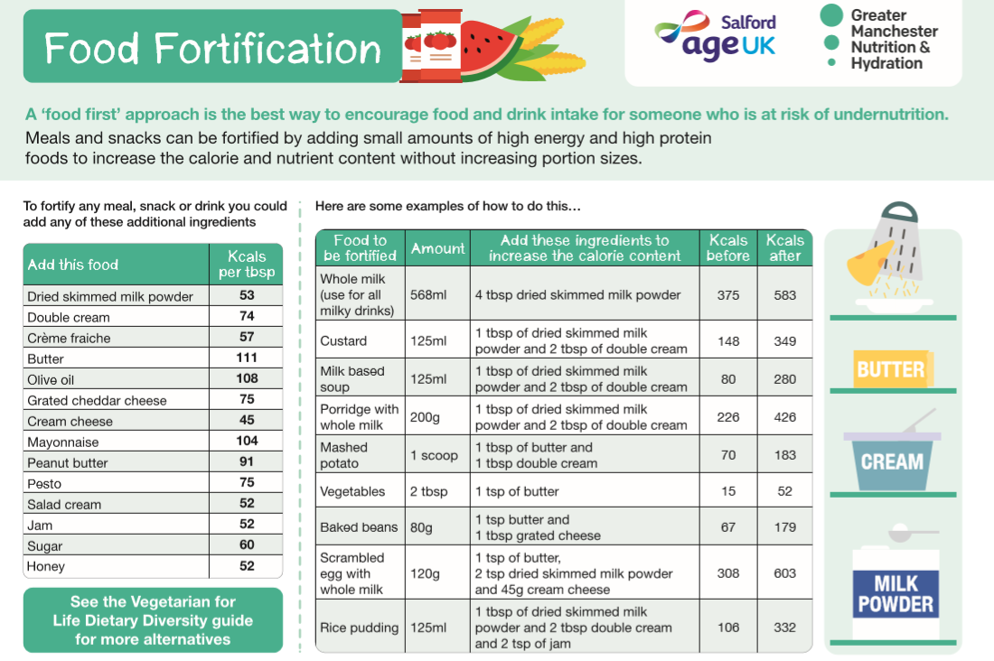
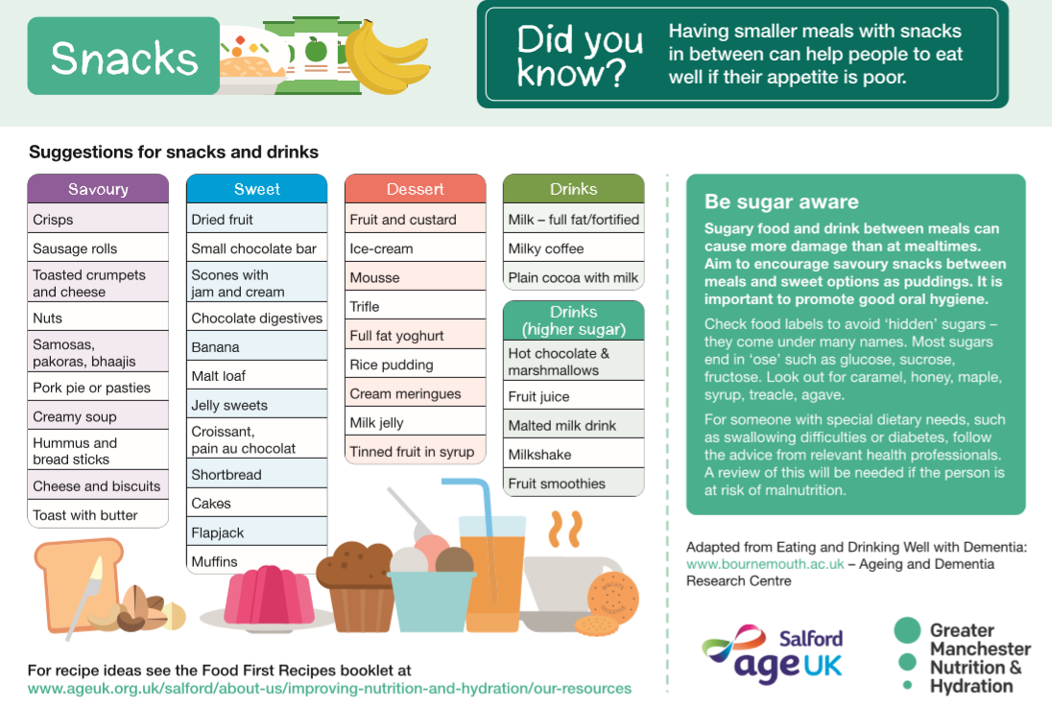
Available Resources
Paperweight Armbands
Eat, Drink, Live well booklet – tips to boost appetite and fortify food
A5 Hydration Leaflet & Malnutrition Signs & Symptoms
Staple cupboard recipes – simple recipes using mainly tinned and frozen food
Food first recipes – recipe ideas for high energy meals and snacks
Meal and snack ideas from a range of cultures – different ideas and recipes to try from different cultures
Hydration Posters & Coasters
Care Home kitchen posters – Food fortification/snacks

Slide 13
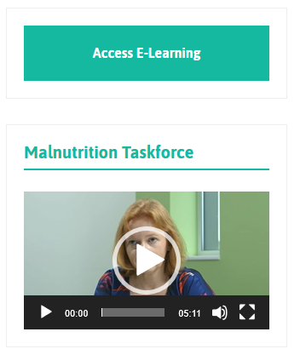
Nutrition and Hydration Programme
Further information and learning.
All information regarding the programme, is available at:
Age UK Salford | Improving Nutrition and Hydration in Greater Manchester
Nutrition and Hydration Toolkit:
https://www.ageuk.org.uk/salford/about-us/contact-us/nutrition-and-hydration-toolkit/
All resources are available to download and print via:
Greater Manchester Malnutrition and Hydration Programme Resources (ageuk.org.uk)
Training slides and presentations are available at: https://www.ageuk.org.uk/salford/about-us/improving-nutrition-and-hydration/nutrition-and-hydration-training/
Malnutrition and Swallowing difficulties e-learning tool:
The PaperWeight Armband
Carmel Berke, Programme Director: CarmelBerke@ageuksalford.org.uk

