Slide 1



Introduction to the Greater Manchester Nutrition & Hydration Programme – useful strategies to promote good nutrition & hydration
www.ageuk.org.uk/salford/about-us/improving-nutrition-and-hydration
www.facebook.com/GMNandH
@GMNandH

Slide 2
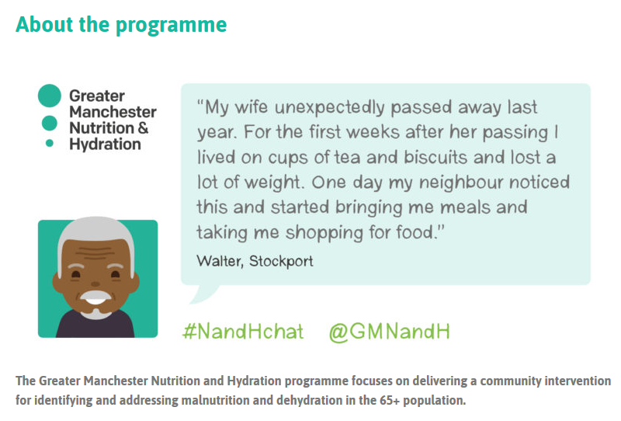
Content:
Why Focus on Malnutrition
COVID19 & Risk of Malnutrition
How to Spot Signs & Symptoms of Malnutrition
What You Can Do To Signpost and Offer Simple
Advice
Support & Resources
Notes:
The GM Nutrition & Hydration Programme has been developed and piloted across GM to deliver a non-clinical community intervention for identifying and addressing malnutrition and dehydration in the 65+ population. The programme vision is to ensure the dignity, health and well-being of older people are met by understanding and promoting their hydration needs by:
Educating
Raising Awareness
Engaging with services and organisations who in their daily tasks, come into contact with older adults.

Slide 3
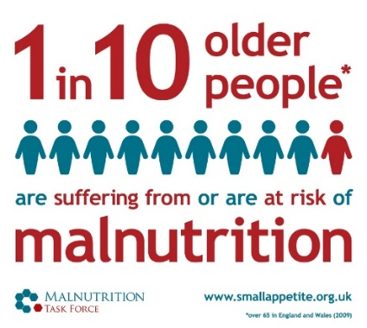
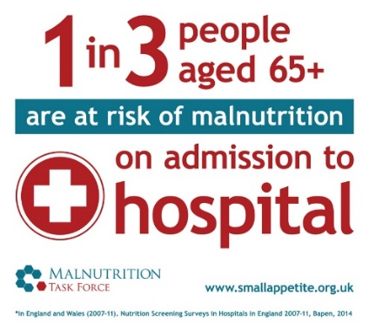
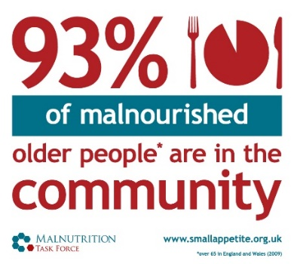
Overview – why focus on malnutrition?
It’s a hidden problem – 1 million people (1 in10) over the age of 65 are at risk of malnutrition and 93% of these are living at home
It’s all around us - A third of recent arrivals to hospitals and care homes are already malnourished (or at risk)
The consequences - For every 10 days a person over the age of 80 is in hospital they lose 10% of muscle mass
It is preventable – Losing weight is not a natural part of growing old
It’s expensive – Malnutrition costs the health and social care system around £20bn per year
It affects vulnerable people most – The older you are, the more likely you will be at risk
Notes:
The prevalence of malnutrition is more commonplace than we might expect.
14% of people living in the community are suffering from or at risk of malnutrition. It usually develops over the medium to long term and often goes unidentified and therefore untreated until it becomes a serious problem and people are admitted to hospital or a care home because their health and independence have deteriorated.
At the point of admission to hospital the prevalence rises to a third and on admission to care homes it is as much as 35% of people who are at risk. We can see, therefore, the direct link between malnutrition, consequences for the individual’s health, wellbeing and quality of life and cost to the health and care services.
We have a wide range of services that interact with older people who may notice if someone is looking thin or has lost weight, however, it is not common for this to be raised as an issue – partly due to the myth that losing weight is a natural part of ageing and partly due to lack of knowledge of how to support.
The GM Nutrition and Hydration programme was established to reverse this situation– by providing simple tools and resources so that everyone working with or caring for older people have the knowledge they need to identify malnutrition and to enable the person to take a self-care approach to stimulating weight gain.

Slide 4
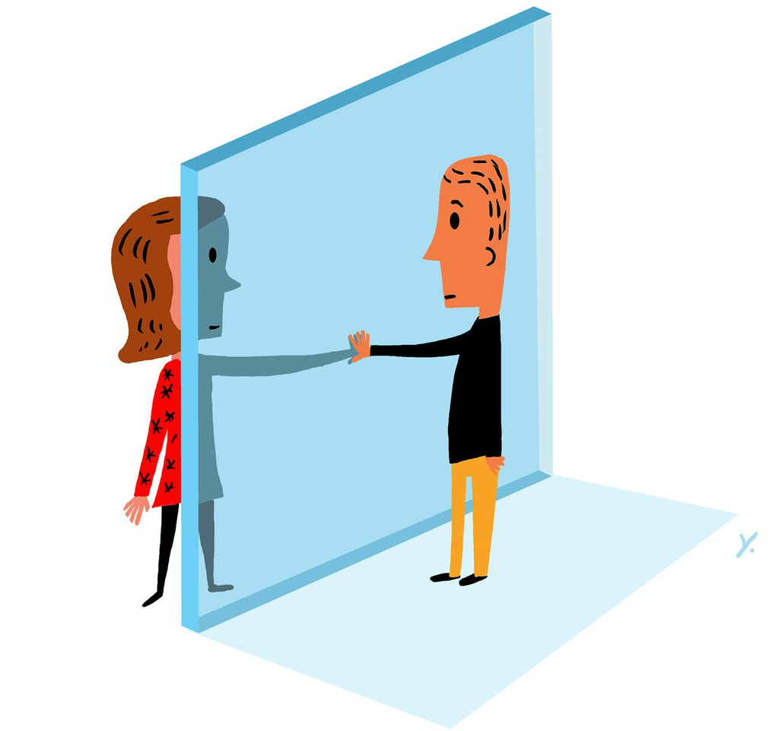
Increased Risk Due to COVID-19
Many risk factors are increased due to current social distancing measures
Increased risk for those who are vulnerable and shielding; have limited food access and from social isolation
Also, people who have been in hospital with COVID-19, are experiencing high levels of weight loss
https://www.ageuk.org.uk/salford/our-services/information-and-advice/staying-well-during-the-coronavirus-pandemicoronav
Notes:
We anticipate that older adults will be at increased risk of malnutrition as a result of direct and indirect consequences of the COVID-19 pandemic, either by contracting the virus or as a result of barriers to good nutrition due to social distancing measures, isolation and shielding.

Slide 5

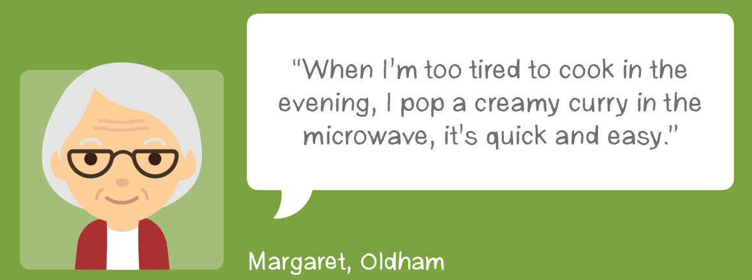
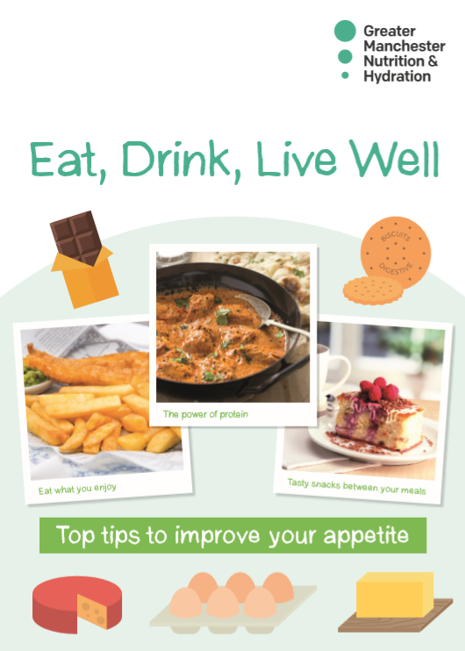


Research by University of Manchester has found that simple conversations can make a big difference for older people at risk of malnutrition.
1. Simple advice
2. Gentle encouragement
What have you had for tea tonight?
What kind of things have you been eating?
How are you getting your food supplies?
3. Social support
Notes:
Evidence from delivery of the programme shows that simple conversations about the importance of nutrition and hydration can make a big difference.
In many cases malnutrition is entirely preventable, if we intervene early and proactively:
We can do this by:
Firstly, giving simple advice – to encourage a person to eat little and often and fortify food.
Use gentle encouragement and offer support – ask if someone is getting out to the shops, can they establish a mealtime routine, what do they really like to eat, are cupboards well stocked if they don’t feel like going out?
Social support and prompting – are they connected with family, friends or services who can provide social or practical support

Slide 6
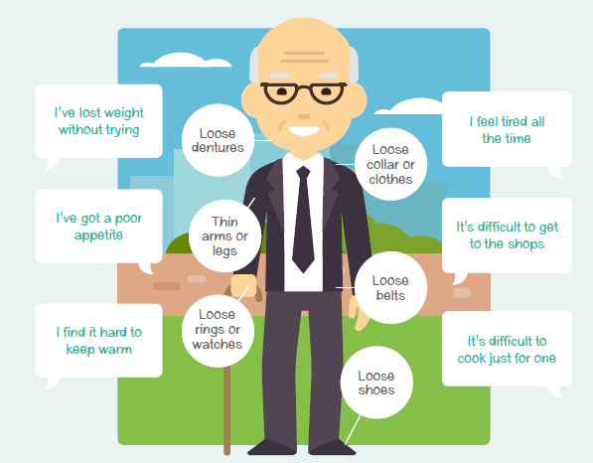
Signs to look out for
Verbal
Visual
Notes:
What are the signs to look out for if you may have concerns about someone you care for or support.
This slide illustrates examples of visual as well as verbal prompts ( verbal prompts are useful if supporting clients/persons over the phone)
Visual signs might include:
Loss of muscle mass – thin arms and legs ( although this can sometimes be masked by layers of clothing)
Loose clothes such as collars, belts, waistbands, shoes or slippers
Verbal prompts may include comments such as
Feeling cold all the time
Feeling tired
Low mood
Poor appetite
Lack of motivation to cook, shop or prepare foods

Slide 7
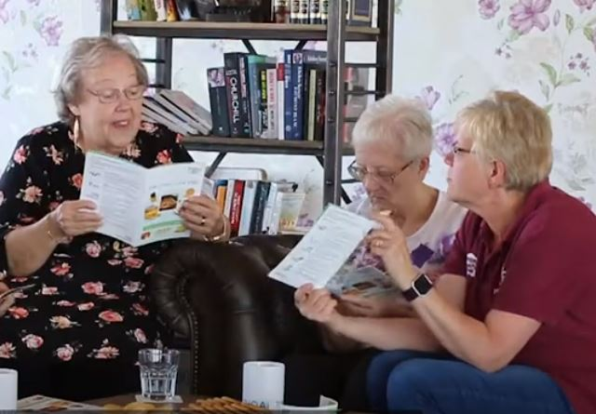
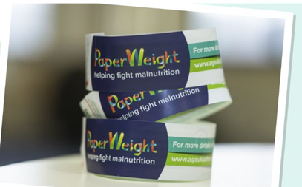
Simple Conversations
Encouraging people to eat and drink well through simple conversations
Ask key questions to see if people may need to change their diet:
  Have you lost weight without meaning to?
  Have you had a poor appetite, low energy or low mood?
  Do your clothes, shoes, jewellery or dentures look or feel loose?
  Do you think you might be underweight?
Highlight key messages from the Eat, Drink, Live well booklet if they answer yes to any of the questions above
Give or post materials and reinforce messages through future support
Using the PaperWeight Armband© to engage in simple conversations: https://www.youtube.com/watch?v=I3cr8b8F3wE
Notes:
If you should have concerns about someone consider asking the key questions on the slide or indirectly start a conversation about how someone is feeling, how they are managing to get their shopping etc?
You can view a short film clip via the link of the slide which demonstrates how to use the PaperWeight Armband and simple conversations to encourage people to eat and drink well.

Slide 8
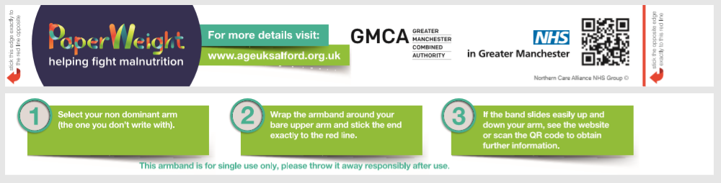
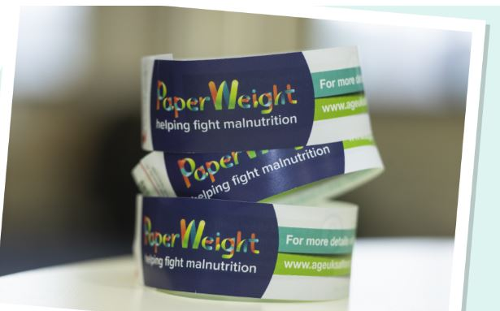
The PaperWeight Armband
81%
Positive outcomes from University of Manchester evaluation
Full evaluation available at:
https://www.ageuk.org.uk/bp-assets/globalassets/salford/images/nutrition-and-hydration/nutrition-and-hydration-programme-final-report-4th-june-2020.pdf
Notes:
Encourage colleagues, carers and family members to try the paperweight armband, this is a simple, non-clinical tool used to gauge whether someone may be at risk of malnutrition. The armband is simply wrapped around the middle of the upper arm ( non-dominant arm) and if the armband can be fastened together and can be moved freely up and down this suggests that someone is underweight and at risk of malnutrition.
It may then be appropriate to offer simple advice to help a person make simple changes to their eating habits to help them manage or increase their weight, using a food first approach.
An independent evaluation of the programme, by the University of Manchester, has shown positive outcomes as a result of using the PWA and simple conversations to address malnutrition risk.
In a study of older adults 65+ who were identified as at risk and given simple food first advice, at 12 week follow up 81% had a positive outcome. Often it was 1 or 2 simple changes that made a huge difference.

Slide 9
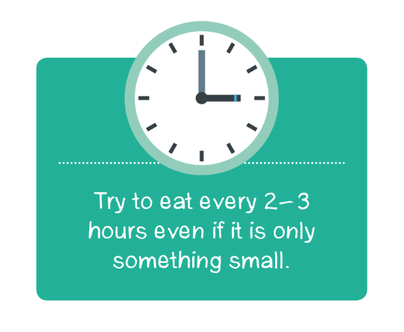

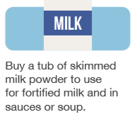
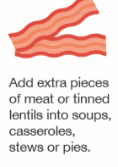
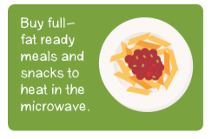
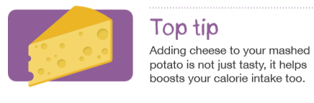
Main Tips from the Eat, Drink, Live Well Booklet
Eat little and often
Use milk powder to fortify milk, sauces and soup
Eat with others
Some people are having a shared lunch over a video call or watching a favourite programme while eating
Add to your food to increase energy without increasing portion size
Have more protein
Make meal preparation easier
This is called fortifying food
Notes:
1. Eat little and often – some people may be over faced by a big meal so they should try having smaller portion sizes, encourage snacks between their meals. 6 small meals or snacks are as good as 3 big meals.
2. Add cream, butter, cheese and milk powder to meals and snacks. This helps to increase energy without increasing portion size.
3.Adding skimmed milk powder to food and drinks can be a very easy way to get extra calories and nutrients.
4. Consider protein foods, these will add extra nutrition eggs, beans, lentils, meat and fish can all help.
5. Ready meals and pre-prepared sauces can help to make meal preparation easier. There are lots of meal delivery services available. Also, tinned and frozen fruit and veg is just as good as fresh.
6. Eating with others can really help improve appetite and make mealtimes enjoyable.
.

Slide 10
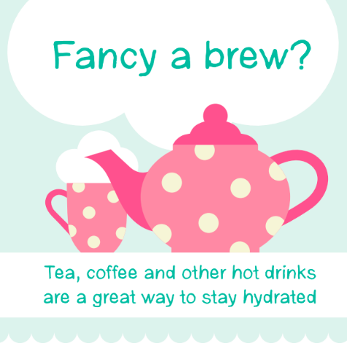
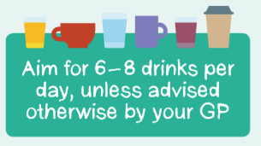
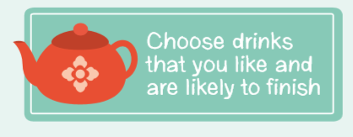
Stay Hydrated
To stay hydrated we need to drink 6-8 cups/glasses of fluid a day
This includes tea, coffee, juice, milk, squash and water
Many of us don’t drink enough, particularly as we get older.
It is safe and healthy to encourage everyone to drink more and stay well hydrated.
Notes:
Many of us don’t drink enough, particularly as we get older.
Approximately 20% of older adults may be dehydrated at any one time, with a further 28% having impending dehydration.

Slide 11
Simple Tips and Advice
Food first approach:
Food is much more than just fuel – it is linked to enjoyment, socialisation and routine
Social support:
Eating in company and talking about our diet can help to boost appetite and keep interest in food and drink
Access:
Some people may need support to access and prepare food and drink
Mental health:
Poor nutrition and hydration can be a cause and consequence of poor mental health. An improvement in one of these can lead to an improvement in the other.
Notes:
In summary simple tips and advice to help improve appetite and nutrition and hydration:

Slide 12
Final Messages
You don’t need to be an expert, often it is about encouraging people to make small changes that will make a big difference.
Many people may not have realised they were underweight or that they could do something about this.
If you are worried, you can encourage them to see their GP or contact the local community Dietitian. Check the red flag questions if you are concerned.
Notes:
In summary, final key messages:

Slide 13
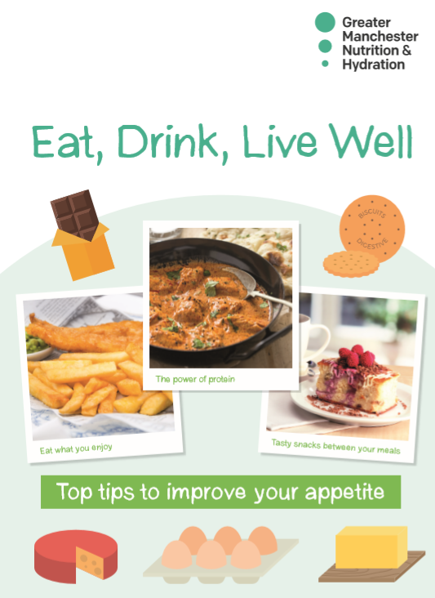
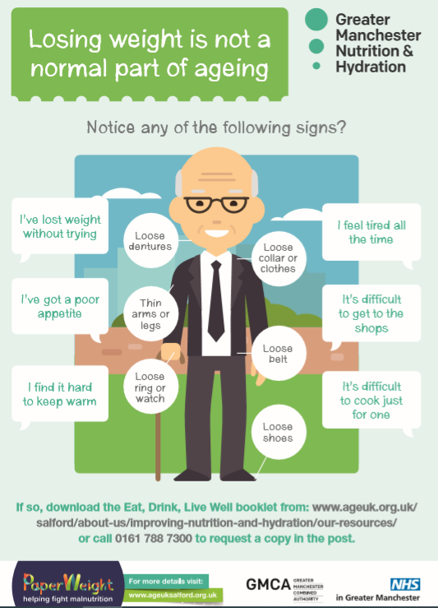
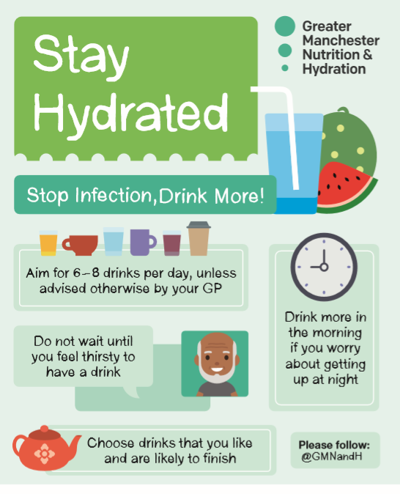
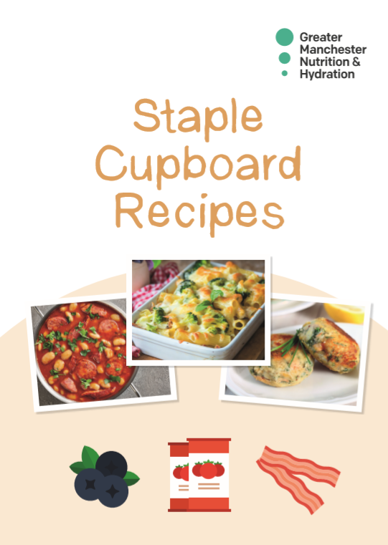
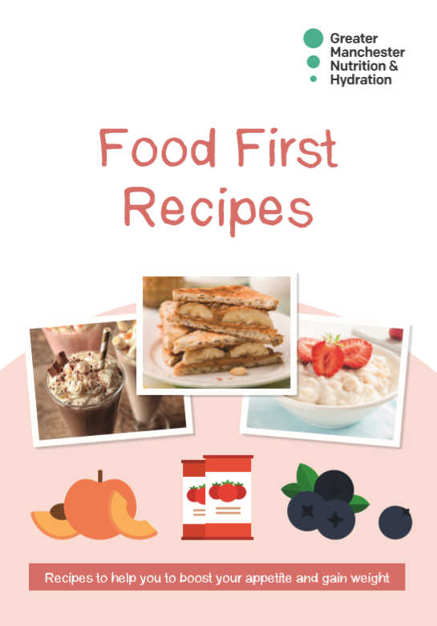
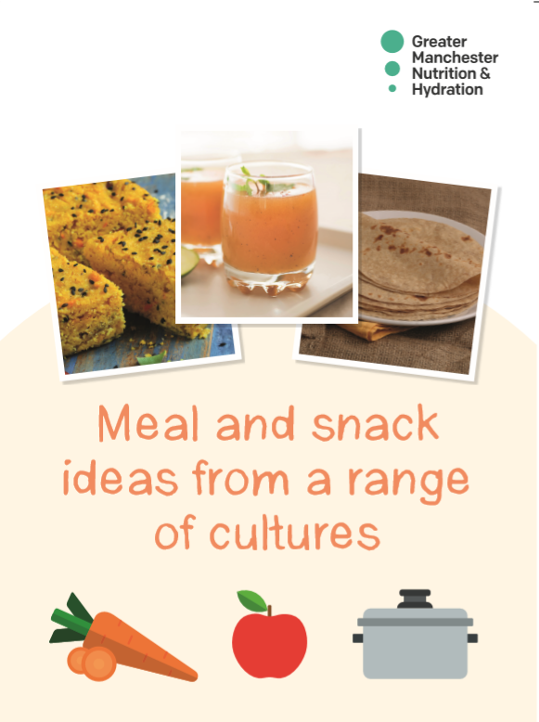
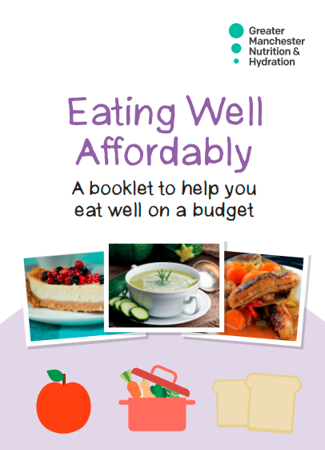
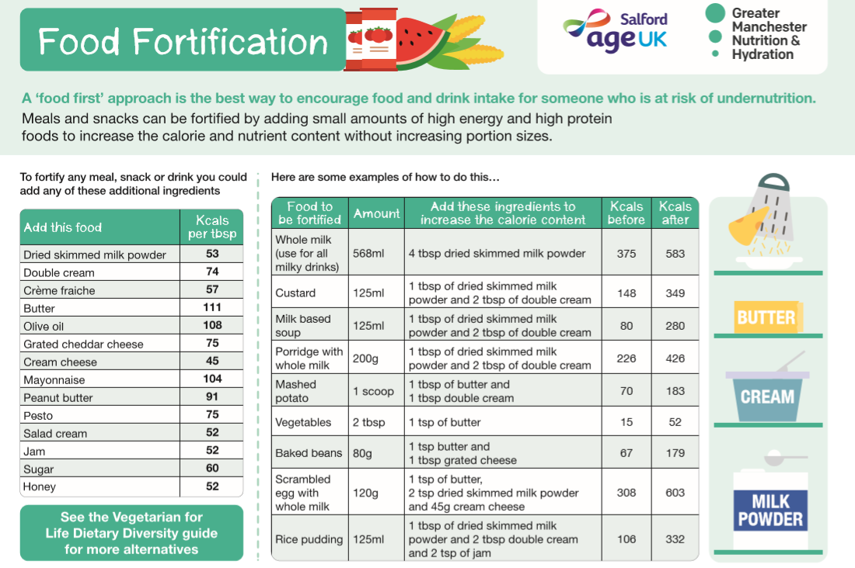
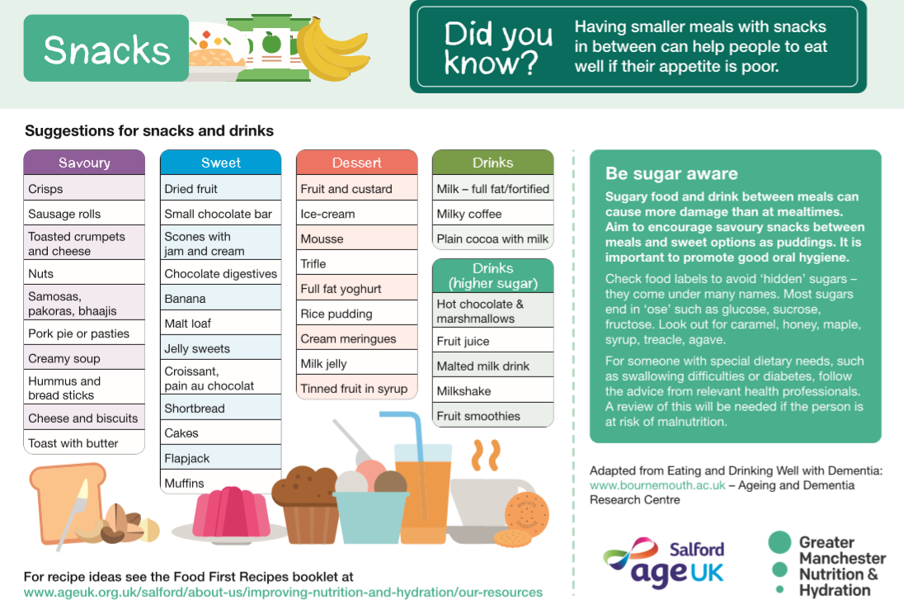
Available Resources
PaperWeight Armbands
Eat, Drink, Live well booklet – tips to boost appetite and fortify food
Food first recipes – recipe ideas for high energy meals and snacks
A5 Hydration Leaflet & Malnutrition Signs & Symptoms for raising awareness
Staple cupboard recipes – simple recipes using mainly tinned and frozen food
Eating Well Affordably – budgeting tips, entitlements & recipes
Meal and snack ideas from a range of cultures – different ideas and recipes to try from different cultures
Care Home kitchen posters – Food fortification/snacks
Notes:
READ the slide – the resource descriptions in RED are only to be given to older people, if there is a concern (undernourished / poor appetite / loosing weight), they are NOT to be given to older people of an average / above average weight. The other resources are for all older people over 65.
All RESOURCES are available at:
https://www.ageuk.org.uk/salford/about-us/improving-nutrition-and-hydration/our-resources/

Slide 14
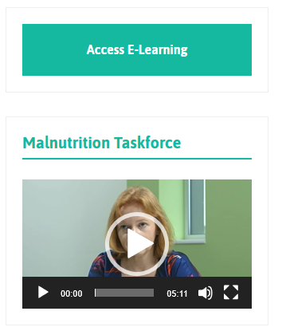
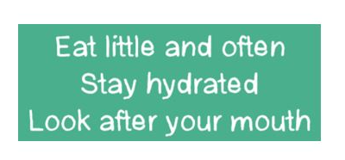
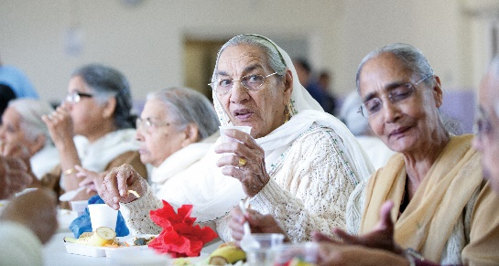
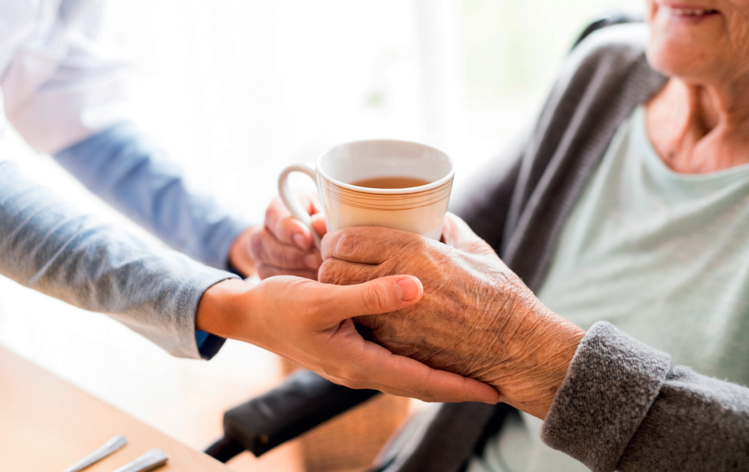
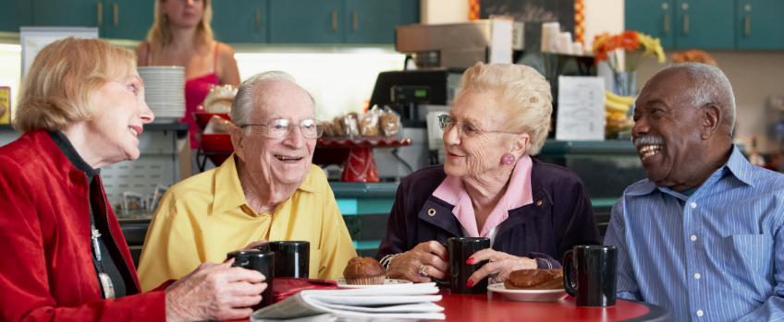
Want to Learn More?
Access our e-learning tool for malnutrition and swallowing difficulties:
http://paperweightarmband.org.uk/
Further Information & Resources:
https://www.ageuk.org.uk/salford/about-us/improving-nutrition-and-hydration/
NB: printable versions of all our resources are available to download via the link
Notes:
E-learning tool takes around an hour or so to complete and can help to extend your learning and knowledge of how to prevent malnutrition and dehydration. Designed initially for use in care homes, however relevant to all health and social care staff working with older adults.
Further information about the GM Nutrition & Hydration Programme and associated resources are available via the AGE UK Salford website.

