Slide 1
Nutrition and Hydration Week 14th March – 20th March
Preventing avoidable harm
Maintaining independence
Improving health and quality of life

Slide 2
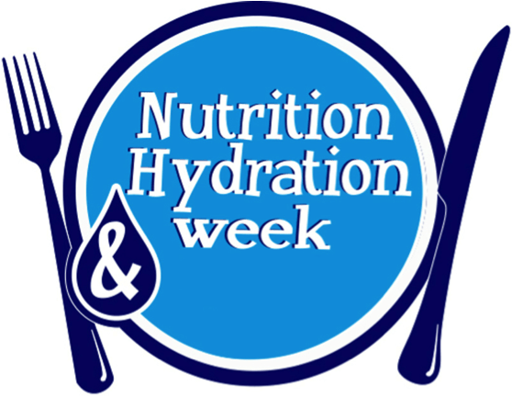
Nutrition and Hydration week 2022
Annual event to share, highlight and promote improvements in the provision of Nutrition and Hydration locally, nationally and globally
Takes place in March and has been celebrated since 2012
Purpose is to bring people together to create energy, focus and fun to educate on the importance of food and drink
Organisations from around the world and from all areas of health and social care take part in the fun

Slide 3
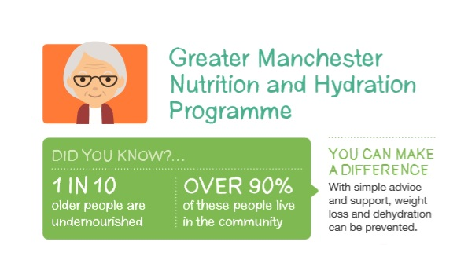
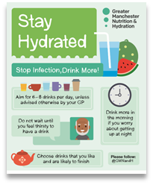
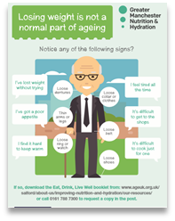
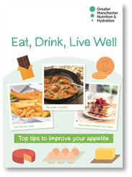
What are we asking you to do?
Raise awareness
Spreading positive messages on importance of food and drink
Educating & informing
Using the week to make as much noise as possible about eating and drinking well, especially in later life

Slide 4
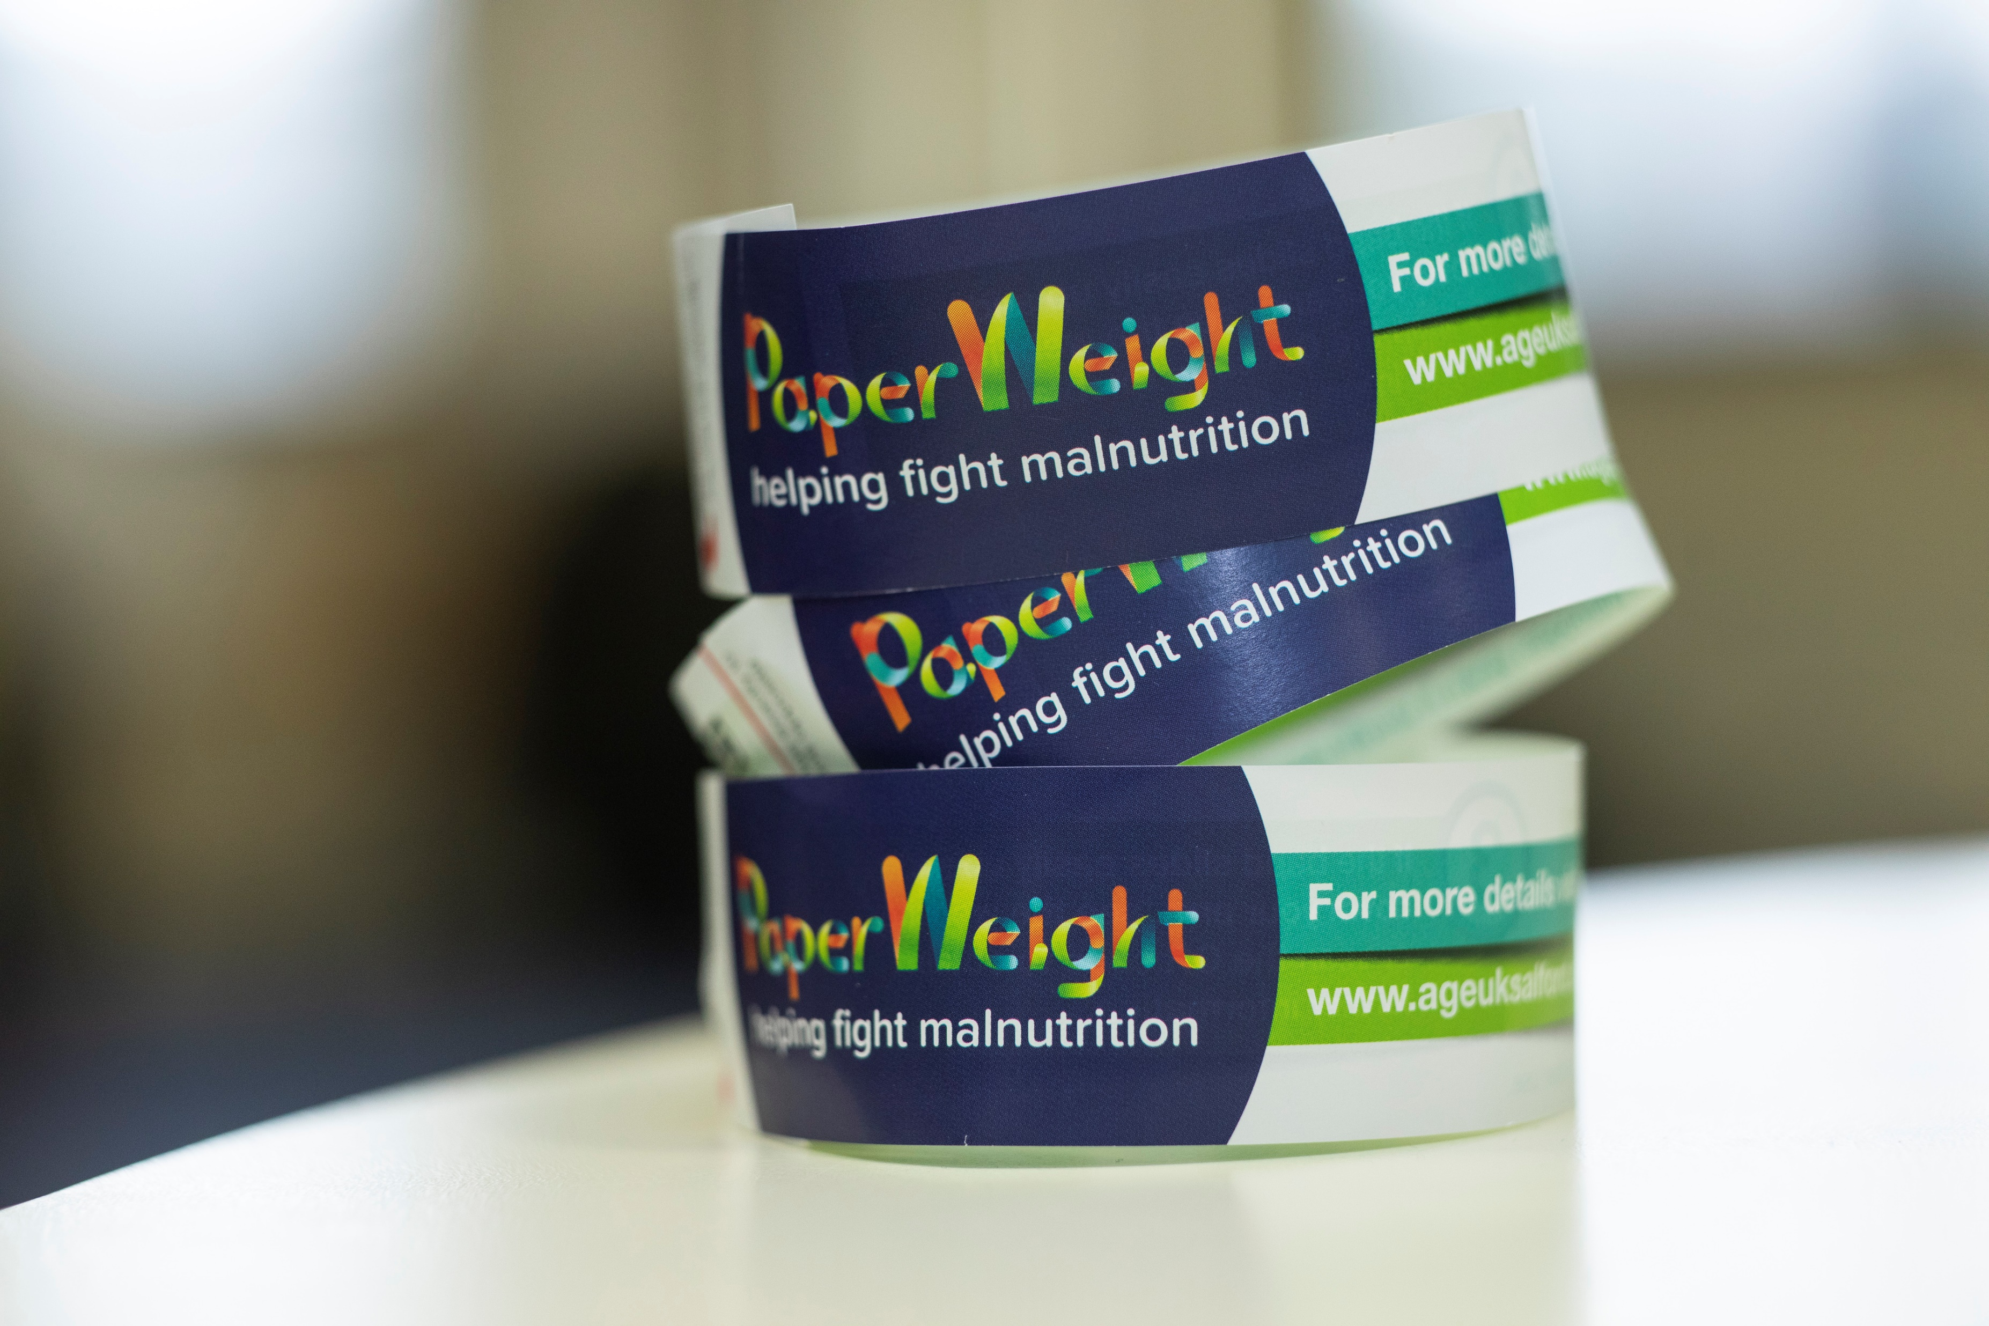
https://nutritionandhydrationweek.co.uk/
XXX

Slide 5
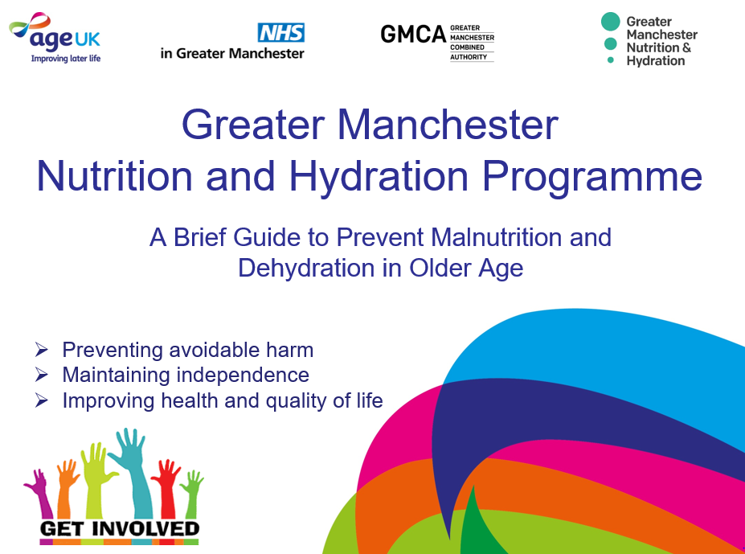
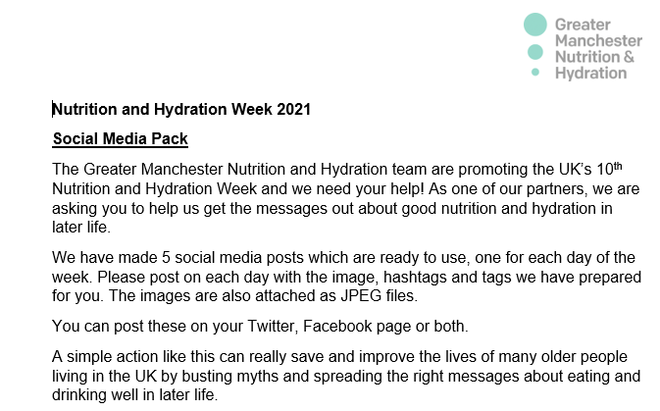
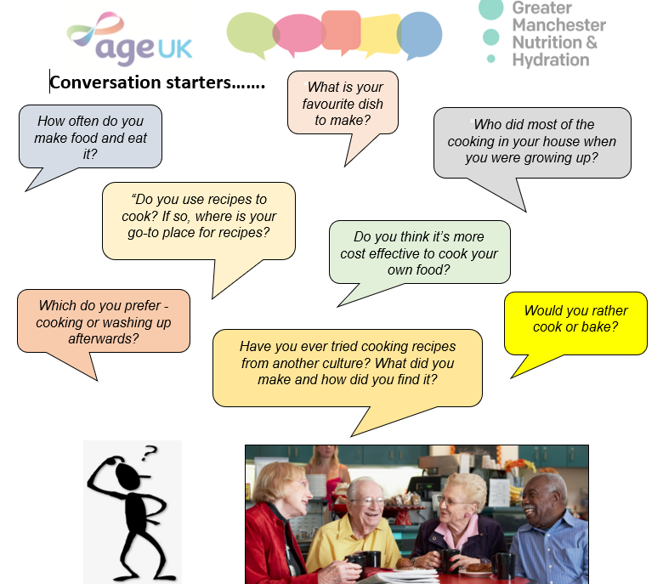
Short presentation for awareness raising with a script
Social media pack- ready to tweet/post social media messages with images and hashtags
Conversation starters and ideas

Slide 6
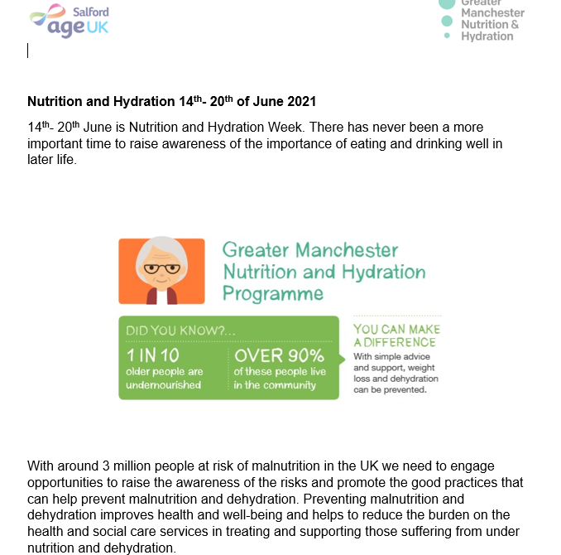
Newsletter insert
Did you know- food facts
Did you know- hydration facts

Slide 7
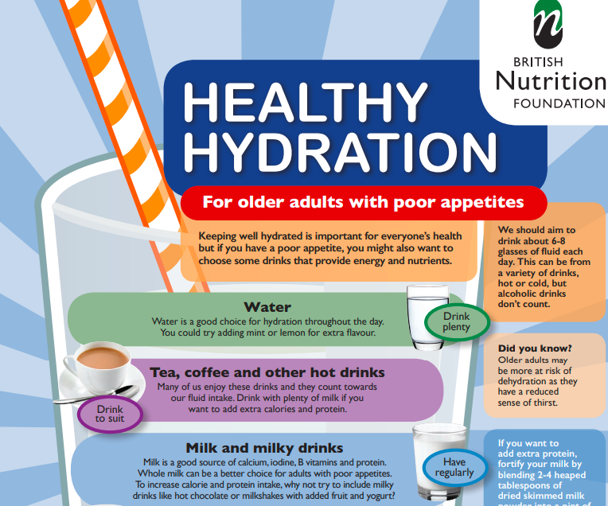
McVities Afternoon Tea activity pack
Healthy hydration ideas for older adults at risk of malnutrition

Slide 8
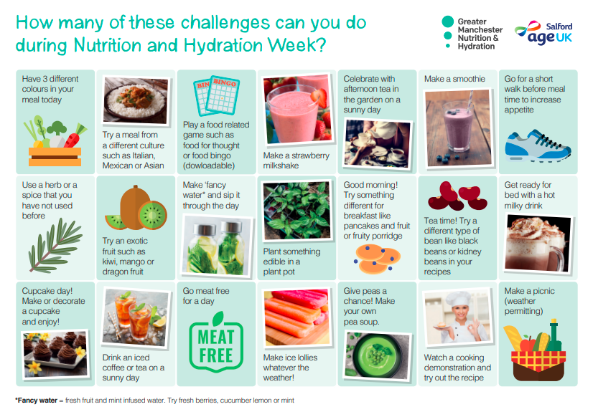
Challenge Calendar

Slide 9
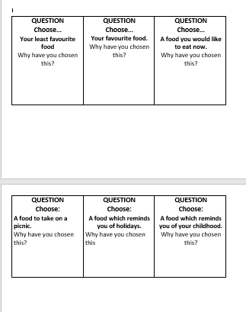
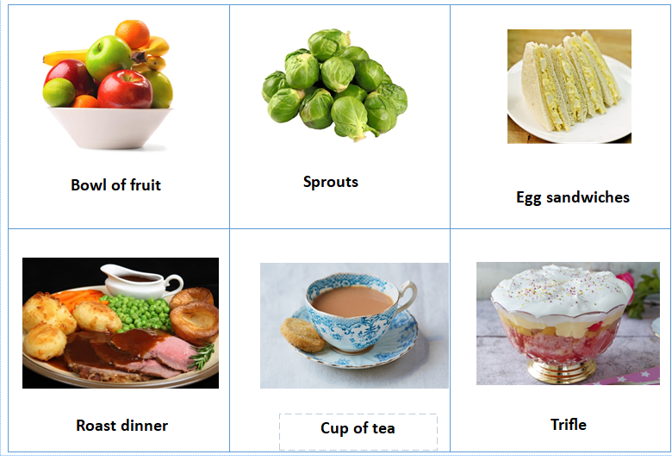
Food for thought game

Slide 10
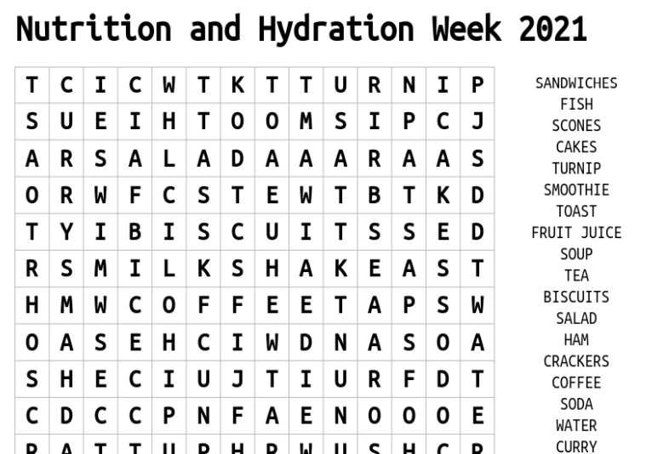
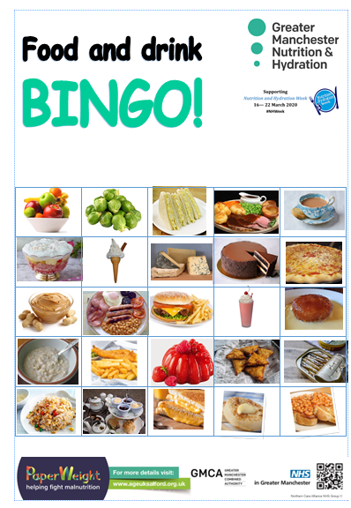
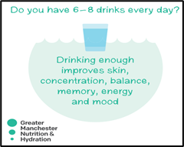
Word search
Bingo
Fancy a Brew - Jigsaw Challenge 2021
Front of the coaster…
https://www.jigsawplanet.com/?rc=play&pid=3646a7105a73
Back of the coaster…
https://www.jigsawplanet.com/?rc=play&pid=1aa24c135ad0

Slide 11
There has never been a more important time to raise awareness of the importance of eating and drinking well in later life and you can get on board within your organisation.
As the public health environment becomes more challenging with even tighter budget constraints coming into place Nutrition and Hydration Week is one of the most cost-effective health interventions possible.
We all have a role to play in helping people to notice if they have started to lose weight without meaning to or if they are not drinking enough.
It is everyone’s responsibility to encourage good nutrition and hydration intake and to raise awareness of simple tips, to better nutrition and hydration intake.
Let’s get talking about Nutrition and Hydration and make a big impact!

