Slide 1
Eat, Drink, Live Well
Bitesize Training Series
Introduction to Dehydration
Notes:
This is the Bitesize Training Series about Nutrition and Hydration in the Older Population

Slide 2
Welcome Back to the Nutrition and Hydration Bitesize Series! Bitesize 2.
2 | Introduction to Dehydration | Definition Sign and Symptoms Prevalence and consequences
Notes:
Read the headings. Here we learn about the definition,, signs and symptoms and the prevalence of dehydration in older people.

Slide 3
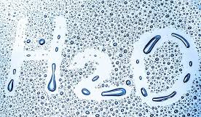
Dehydration - Definition
Dehydration means the body loses more fluids than it takes in
If it is not treated it can become a serious problem
Losses can occur from conditions such as diarrhoea, vomiting, medications.
Thirst is a useful indicator of daily fluid needs but most people are already mildly dehydrated by the time they feel thirsty.
Risk factors that prevent a person from drinking enough:
Age-related changes include a reduced sensation of thirst, which may be more pronounced in those with Alzheimer’s disease or who have had a stroke.
Incontinence – may prevent a person from drinking.
Source: British Nutrition Foundation
Notes:
Read the headings. Losses can occur from conditions such as diarrhoea, vomiting, and some medications.
Thirst is a useful indicator of daily fluid needs but most people are already mildly dehydrated by the time they feel thirsty. It is important therefore not to wait until you are thirsty but to drink throughout the day. However, some people don’t realise that they are thirsty … as we get older we lose the sensation of thirst, which may be more pronounced in those with Alzheimer’s disease or who have had a stroke. This is why it is important to ensure that older people drink regularly even if they don’t think they are thirsty.
Another risk factor is Incontinence which may prevent a person from drinking – especially if they are not mobile and it is difficult to get to the kitchen to prepare a drink or to the bathroom to go to the toilet. Even if they are active, they may not drink because they are unsure when or where they can get to the toilet if they are out and about.

Slide 4
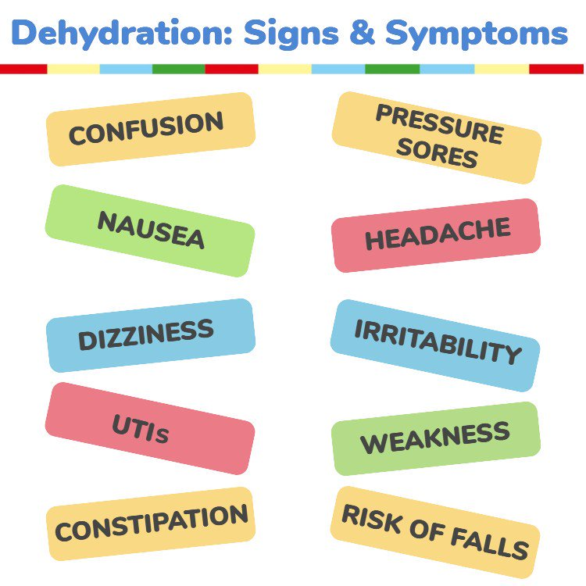
Dry mouth, lips and tongue and sunken eyes.
Fatigue, Headaches, Dizziness, Memory issues, Behavioural issues.
Low or no urine output / dark concentrated urine
Source: British Nutrition Foundation
Notes:
Here are some signs and symptoms of dehydration. Some are quite obvious such as dry mouth, lips and tongue and sunken eyes. You may notice someone is more irritable, confused or forgetful than usual. They may say they have a headache, feel dizzy, weak or nauseous. But would you know how often they went to the toilet and the colour of their urine? They may not want to say if they had constipation, a UTI or pressure sores. These symptoms are not always obvious, so it is important to have conversations. The risk of falling and serious conditions are higher if they are dehydrated. Some of these are listed on the next slide.

Slide 5
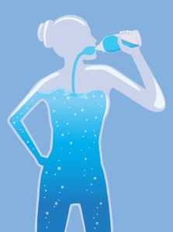
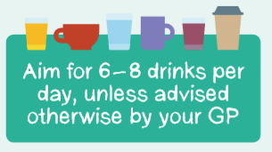
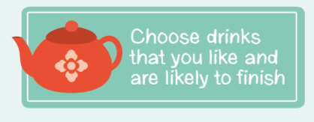
Prevalence and consequences
20%
28%
of older people are dehydrated
have impending dehydration
This leads to admissions to hospital for:
Confusion
UTIs
Falls
Constipation
Increased risk of infection / Sepsis
Low mood and energy
Notes:
This is what is known about dehydration. 20% of older people are currently dehydrated. Do you know how many people that would be within your service? 28% of older people have impending dehydration - meaning that if a person does not drink their required amount of 6-8 glasses a day they can become dehydrated very quickly. It is important to note that this does not have to be water – although this is the healthiest option and it is good to encourage a variety of drinks, it is more important that a person drinks what they enjoy as they are likely to finish these.
The conditions on the left are recorded admissions to hospital: Read the list. However, all of these are related to dehydration.

Slide 6
Questions
What is the recommended amount of drinks per day to stay well hydrated?
3-4
5-6
6-8
9-10
2. How many older people are dehydrated?
10%
20%
30%
40%
Notes:
Here are your questions to reflect on your learning. If you get a question incorrect try again.
Read the questions. Click the mouse when you are ready to move on.

Slide 7
Well done!
You have completed Bitesize 2 –
‘Introduction to Dehydration
Now move onto Bitesize 3 –
Drink Well:
Tips to prevent dehydration’
by following the link here

Slide 9
That’s right!
Go to the next question
Or if you have completed both questions, click here

Slide 10
That’s Wrong,
try again

