Slide 1
Bitesize Training Series
Drink Well:
Tips to prevent dehydration
@GMNandH
Notes:
This is the Bitesize Training Series about Nutrition and Hydration in the Older Population

Slide 2
Welcome Back to the Nutrition and Hydration Bitesize Series!
3 | Drink Well: Tips to prevent dehydration | Recap signs and symptoms 3 Cs: Conversations, Check, Care.
Notes:
Read the title.
Here we recap the signs and symptoms of dehydration and learn about what we can do to help people to stay hydrated using Food First resources and the 3 Cs: Conversations, Check, Care

Slide 3
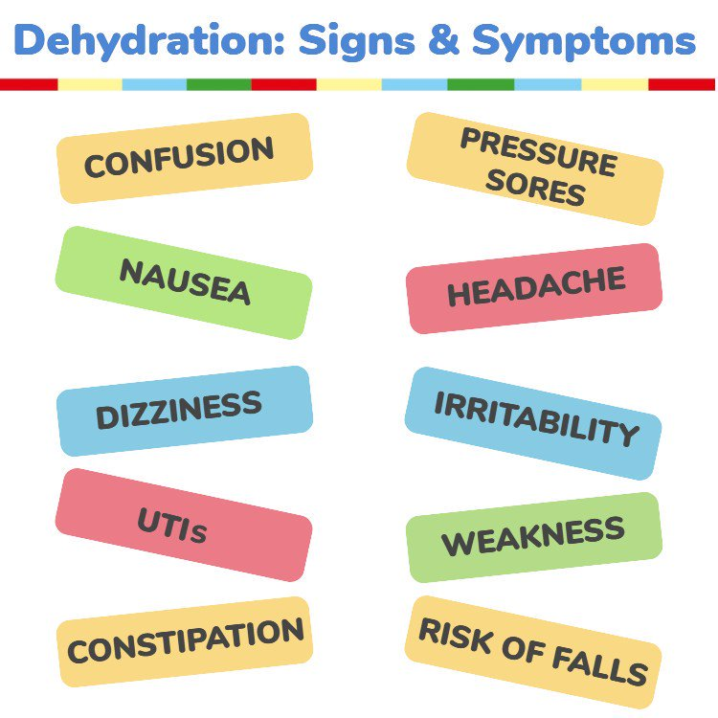
Dry mouth, lips and tongue and sunken eyes.
Fatigue, Headaches, Dizziness, Memory issues, Behavioural issues.
Low or no urine output / dark concentrated urine
Source: British Nutrition Foundation
Notes:
Let’s recap signs and symptoms of dehydration. Some are quite obvious such as dry mouth, lips and tongue but others are not so obvious like pressure sores, constipation and UTIs so it is important to have conversations..

Slide 4
Be a Nutrition and Hydration Champion
3 Cs - to Good Nutrition and Hydration
Conversations
Check
Care
Notes:
The following slides will show how to use the 3 cs to good nutrition and hydration.

Slide 5
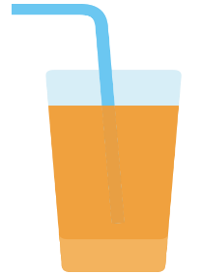
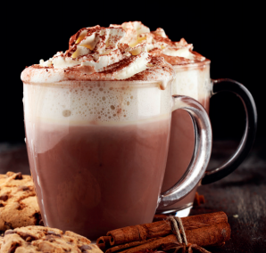
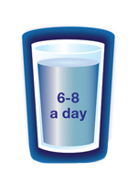
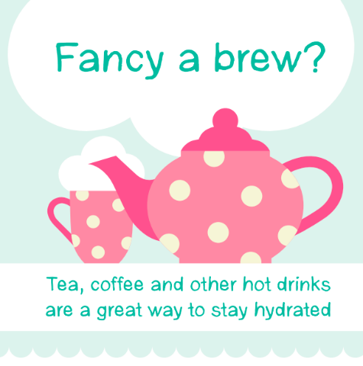
1. Conversations - Hydration
What drinks do you like?
What have you had to drink today?
Are you having 6-8 drinks a day?
Many of us don’t drink enough,
particularly as we get older
It is safe and healthy to encourage
everyone to drink more and stay
well hydrated
Notes:
Conversations about hydration could simply be asking What drinks do you like? What have you had to drink today?
Are you having 6-8 drinks a day?
Read the rest of the slide.

Slide 6
2. Check - food, fluid intake and oral hygiene
To stay healthy adults need to drink 1 to 1.5 litres of water per day (unless advised differently by a GP). This equates to 6 to 8 cups. Cross the cup out once a cup of fluid has been drunk.
Water is the healthiest option as it contains no sugar or caffeine, however, tea, coffee, milk, squash, and juice will count, though be mindful of high sugar drinks as they can rot your teeth.
Alcohol does not count!
Mouthcare | Mouthcare | Mouthcare
Breakfast | Lunch | Evening meal | Snacks
I ate | I ate | I ate | I ate
REMEMBER – PRESUME DEHYDRATION
Confusion, constipation, feeling dizzy, falls, peeing more often, headaches = DEHYDRATION
Notes:
A great way to check whether a person is drinking enough is by using a simple visual chart which can be displayed on a fridge or cupboard and filled in by the older person, a carer or family member. This is a one example of a chart that monitors food and fluid intake and also oral hygiene. There are others that can be downloaded off the internet or you may like to create your own.

Slide 7
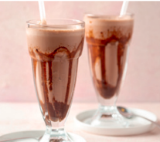
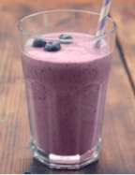
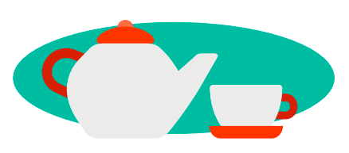
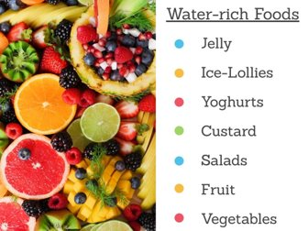
Ask which drinks they enjoy Talk about tasty, refreshing drinks. Have they tried…….. a smoothie or a mocktail? Identify water-rich foods Make a brew! Suggest an alarm reminder or use TV programmes ending or starting as a prompt
3. Care
Image from Eatwellagewell.org.uk
Notes:
The way we can care is by encouraging older people to drink more and making it an enjoyable experience. Read the slide.

Slide 8
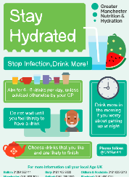
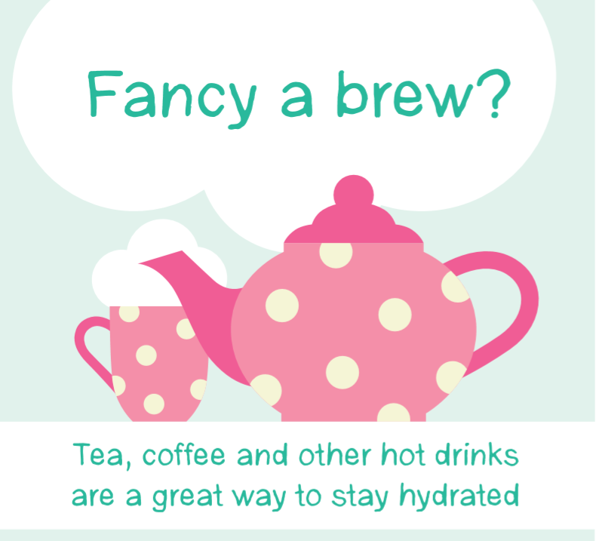
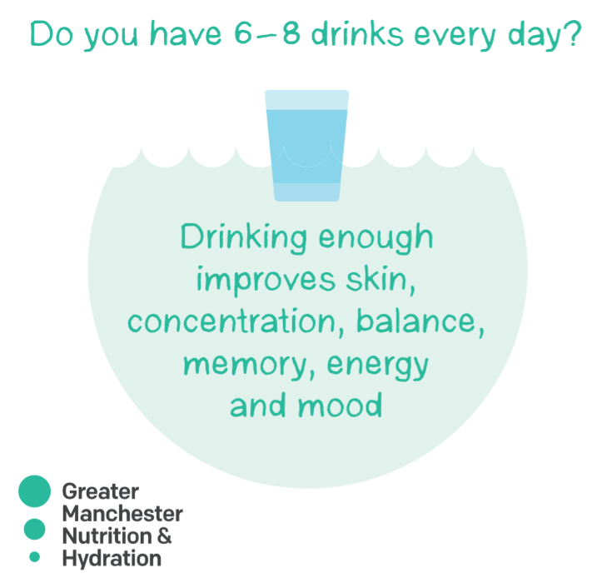
3. Care – Share resources to stay hydrated
A5 Hydration tips leaflet and poster
Coaster – Good Hydration tips & prompts
Notes:
Sharing these resources with all older people will raise awareness and to help prevent dehydration.
The A5 leaflet has some good tips to help people stay hydrated and the coaster can be a prompt to remind people to get a drink.

Slide 9
Questions
1 Which could be signs and symptoms of dehydration?
Falling frequently
Confusion and dizziness
Having frequent infections
All of the above
2. Which of these can count towards fluid intake?
Water, tea and soup
Vodka and orange juice
Milk Stout
Wine Gums
Notes:
Here are your questions. Read the slide. . Click the mouse to move on.

Slide 10
Well done!
You have completed Bitesize 3 –
Drink Well:
Top tips to prevent dehydration
Now move onto Bitesize 4 –
Introduction to Malnutrition
Notes:
Read slide

Slide 12
That’s right!
Go to the next question
Or if you have completed both questions, click here

Slide 13
That’s Wrong,
try again

