Slide 1



Eat, Drink, Live Well
Bitesize Training Series
Introduction to Malnutrition
@GMNandH
Notes:
This is the Bitesize Training Series about Nutrition and Hydration in the Older Population

Slide 2
Welcome Back to the Nutrition and Hydration Bitesize Series!
4 | Introduction to Malnutrition | Definition Prevalence Sign and Symptoms Why focus on malnutrition
Notes:
Read the headings. Here we learn about the definition, prevalence, signs and symptoms and the importance of focussing on malnutrition in older people.

Slide 3

Malnutrition - Definition
Over-nutrition (obesity)
Malnutrition (means poor or bad nutrition) and
Under-nutrition
For many older people it is characterised by low body weight or weight loss,
meaning simply that some older people are not eating well enough to maintain
their health and wellbeing.
The National Institute for Clinical Excellence (NICE) defines a person as malnourished if they have:
A BMI (Body Mass Index) of less than 18.5
Unintentional weight loss greater than 10%, within the past 3-6 months
A BMI of less than 20 and unintentional weight loss greater than 5% within the past 3-6 months
Notes:
Malnutrition means poor or bad nutrition and this can refer to both overnutrition which can lead to overweight and obesity or undernutrition..
This programme concentrates on UNDERNUTRITION in older people.
READ the next paragraph and the NICE definition.
The NICE definition may be hard to remember if you don’t work in the field of nutrition and dietetics. However, in a later session you will discover the paperweight armband which has been developed in line with these guidelines.

Slide 4
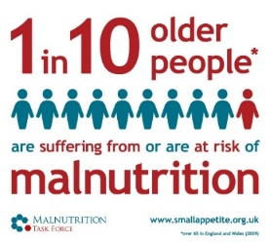
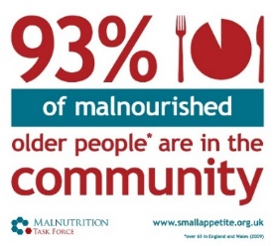
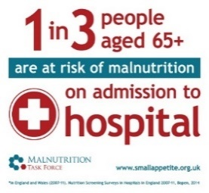
Prevalence of malnutrition
    It’s a hidden problem – 1 million people (1 in10)
    over the age of 65 are at risk of malnutrition and
    most of these (93%) are living at home.
    It affects vulnerable people most – The older you are, the higher the risk
    It’s all around us - A third of recent arrivals to hospitals and care homes are already malnourished (or at risk)
‘in recent years, it has largely remained under the radar –
older people are starving in their homes’
Malnutrition Task Force www.malnutritiontaskforce.org.uk. Malnutrition in Later life: Prevention and Early Intervention. Best Practice Principles & Implementation Guide. A Local Community Approach. Feeding Britain
Notes:
1 million people (1 in 10) over the age of 65 are at risk of malnutrition. Most of the older people who are at risk of malnutrition (93%) live at home and may not come into regular contact with different services so malnutrition may be hidden or missed. The risk and prevalence increase with age. People over 75 years have the highest risk. .
A third of recent arrivals to hospitals and care homes are already malnourished (or at risk) however there are structures in place in those settings so that people have regular contact with nurses, doctors, and, care workers but do we know enough about the people living in their own homes? This quote is taken from a report on hunger by the malnutrition task force which highlights that people at home may be overlooked. Read the quote.

Slide 5
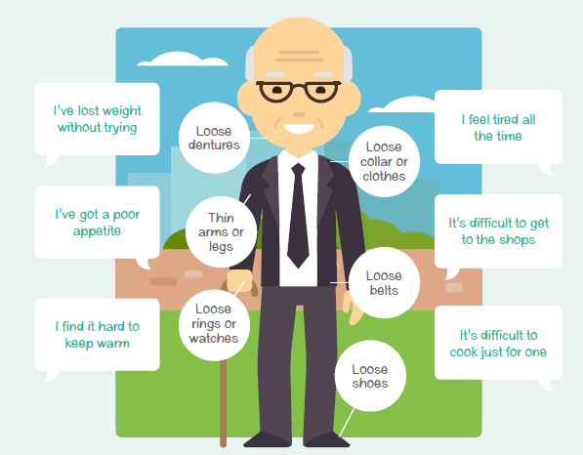
Signs to look out for
Verbal
Visual
Notes:
How can we check if somebody may not be eating well? Here are some verbal and visual indicators. For example a person may say that …
READ the speech bubbles on the picture . You or the person (or others) may have noticed for example that clothes, jewellery,, shoes and dentures are loose (shoes, jewellery and dentures are better indicators than clothes as clothes sizes differ). However these signs are to always obvious so important to have conversations about it.

Slide 6
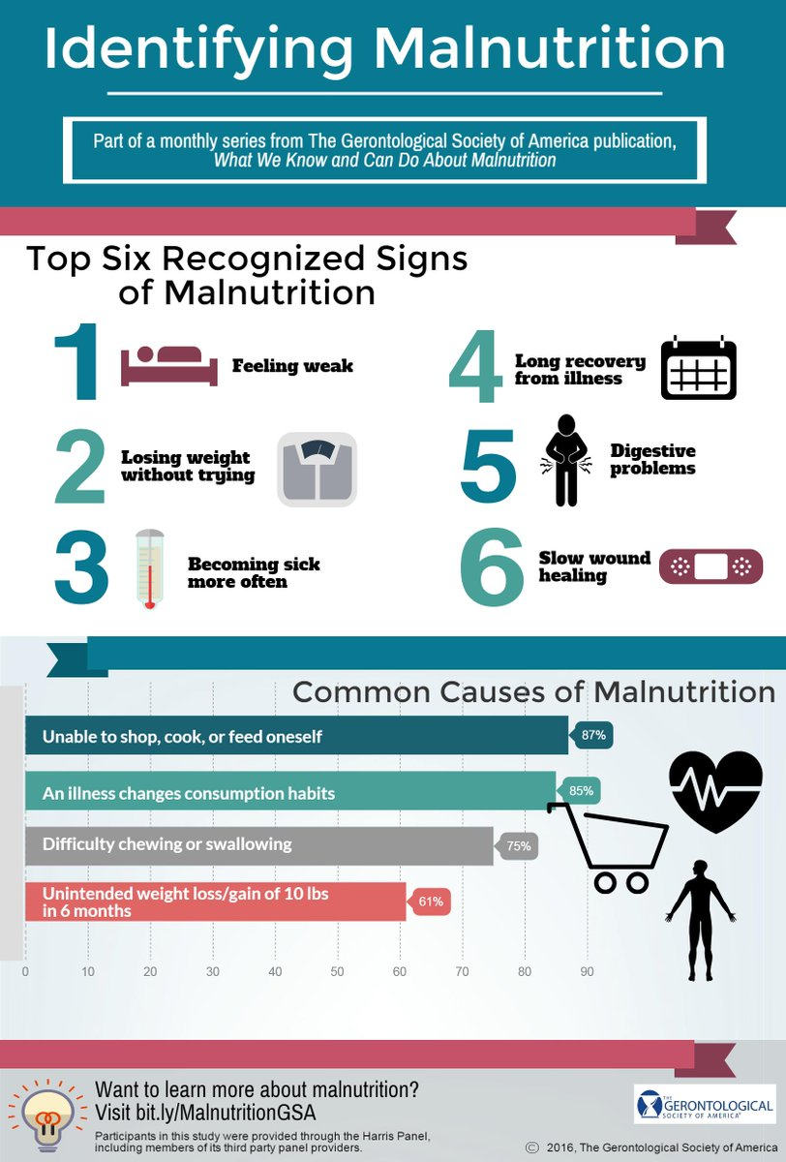

Why focus on malnutrition?
47%
Malnourished People:
Twice as likely to visit a GP
Have three times more hospital admissions
Stay in hospital on average three
days longer
Than someone who is well-nourished.
of all people who fall are malnourished
Impact on the patient: For every 10 days a person over the age of 80 is in hospital they lose 10% of muscle mass, which is important for recovery.
Impact on the health and social care system: it is expensive - in excess of £20bn per year.
It is preventable – Losing weight is not a natural part of growing old!
Images from Malnutritiontaskforce.org.uk
Notes:
Malnourished people generally become sick more often and nearly half the people who fall are malnourished.
They take longer to recover - are twice as likely to visit a GP, have three times more hospital admissions and stay in hospital for longer than someone who is well-nourished.
This has a huge impact on the individual and the health and social care system – read the rest of the slide..

Slide 7
Questions
1. How many older people over 65 are at risk of malnutrition?
750,000
500,000
1,000,000
2. How many of these are living at home?
93%
2%
5%
3. How many older people fall as a result of malnutrition?
Nearly a -
quarter
half
third
Notes:
Here are your questions to reflect on your learning. If you get a question incorrect try again.
Read the questions but not the options. Click the mouse when you are ready to move on.

Slide 8
Well done!
You have completed Bitesize 4 –
‘Introduction to Malnutrition’
Now move onto Bitesize 5 –
‘Eat Well: Top tips to prevent malnutrition
by following this link: Link here
Notes:
Read slide

Slide 10

That’s right!
Go to the next question
Or if you have completed all questions, click here

Slide 11

That’s Wrong,
try again

