Slide 1
Bitesize Training Series
Eat Well:
Tips to prevent malnutrition
@GMNandH
Notes:
This is the Bitesize Training Series about Nutrition and Hydration in the Older Population

Slide 2
Welcome Back to the Nutrition and Hydration Bitesize Series!
5 | Eat Well: Tips to prevent malnutrition | Recap signs and symptoms 3 Cs: Conversations, Check, Care. Resources Embedding the 3Cs Final messages Progression
Notes:
Read the title. Here we learn about what we can do to help people to improve their appetite and to gain weight using Food First resources. We also look at the 3 Cs: - Conversations, Check, Care and how to embed these in your everyday work. Finally, you will see how you can progress your learning.
.

Slide 3
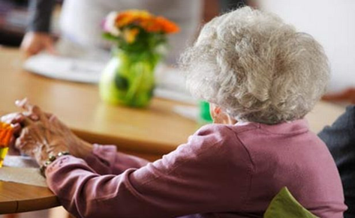
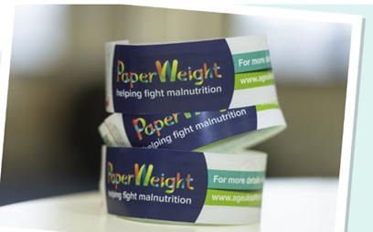
1. Conversations - Nutrition Raise the issue by having a chat
You don’t seem your smiley self today….. Is everything ok?
‘How are things with you,
are you well?’
Have you seen these Paperweight Armbands before? Do you want to give it a go?
How is your appetite these days?
Notes:
Let’s start with conversations about nutrition. Raise the issue by having a chat about how they are and their appetite.
Some suggestions are in these speech bubbles.. Read the speech bubbles

Slide 4
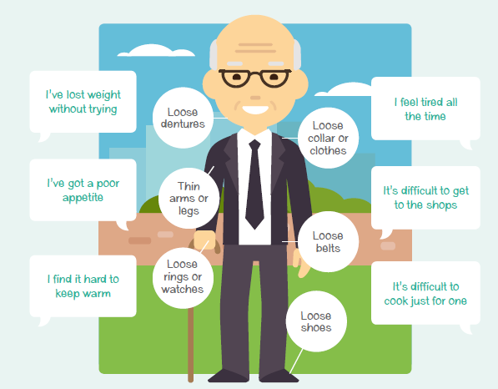
Signs to look out for
Verbal
Visual
Notes:
Now that you have started a conversation, lets recap the signs to look out for. You might find that the person may say some of the things on here
Read the speech bubbles.
or they may say something else that could indicate they are not eating well. .

Slide 5
Conversations: Nutrition
This is a good time to discuss any barriers to eating well, for example, the person may not be able to afford much food, so they could be signposted to local services such as your local Age UK who could check whether they are receiving all the benefits they are entitled to.
Notes:
If the person indicates they may not be eating well, keep chatting to find out the answers to these key questions. Read the questions and the rest of the slide.

Slide 6
Conversations: Nutrition When should I refer to a health professional? You can use the ‘RED FLAG’ questions below as a guide
Have you noticed sudden weight loss (10% of body weight in 3 months)?
Do you have difficulty swallowing food or drinks?
Do you get a pain in your tummy when you eat?
Have you had a recent persistent change in your bowel movements?
Do you have a sore mouth?
If the answer is Yes to any of the questions1-4 , signpost to their GP.
If the answer is Yes to question 5 signpost to their dentist.
If the answer is No then we can continue with the 3cs.
Notes:
In some circumstances a person may need to seek professional advice. These RED FLAG questions will help to check whether there may be an underlying cause.
If the answer is yes to any of the previous key questions, ask these RED FLAG questions. Read the questions.
If the answer is yes to any of the questions1-4 , signpost to their GP, if the answer is Yes to question 5 signpost to a dentist.
If the answer is No then we can continue with the 3cs.

Slide 7
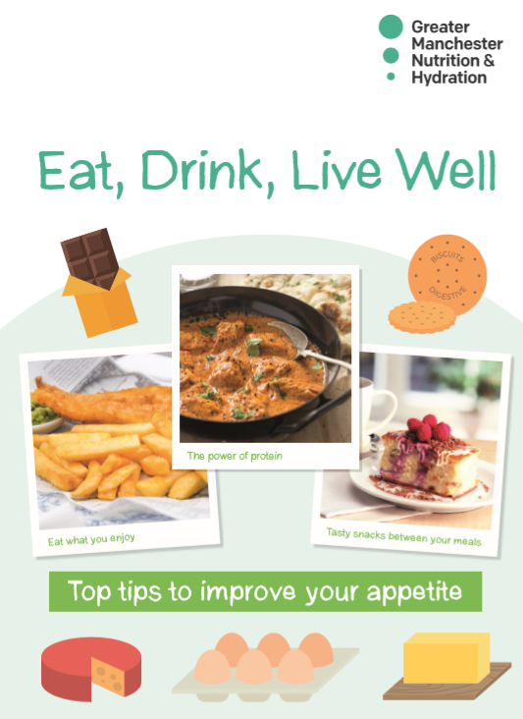
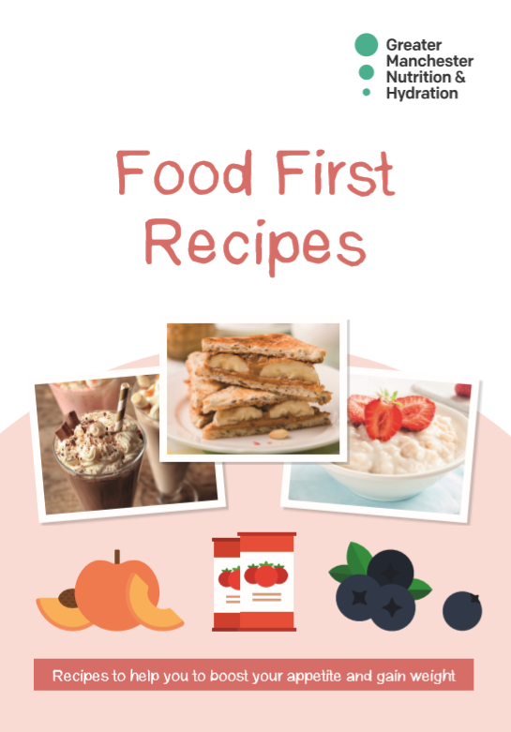
Food First materials:
1.Paperweight armband (Clinical staff use the Malnutrition Universal Screening Tool - MUST)
2. Eat, Drink, Live well booklet – tips to boost appetite and fortify food
3. Food first recipes – recipe ideas for high energy meals and snacks
Notes:
Now you have chatted about their appetite and weight loss and you are concerned that they may not be eating well, we can use these Food First resources.
The Paperweight armband is a simple tool that can be used by anyone. The Malnutrition Universal Screening Tool or MUST for short, is used by clinical staff.
The Eat, Drink Live Well and Food First recipe booklets are only to be given to those older people identified to be at risk or with malnutrition. They are NOT to be given to people with a healthy weight or who are overweight.
All RESOURCES are available at the link shown

Slide 8
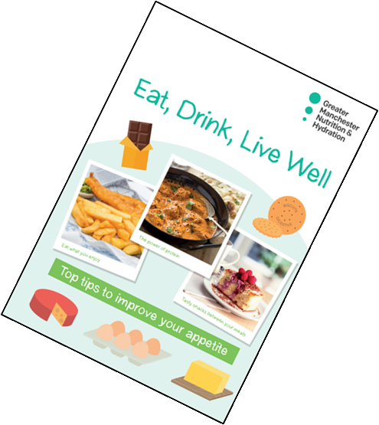
2. Check (i) Ask if you can try the Paperweight Armband© (ii) Put the armband around the upper non-dominant, bare arm (iii) If it fits then offer the ‘Eat, Drink, Live Well’ booklet
Notes:
The next step is used to check risk with the Paperweight Armband© (if not using MUST) Read the slide/

Slide 9
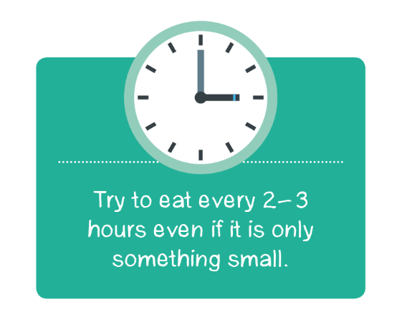
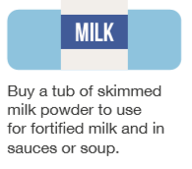
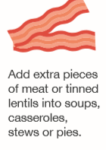
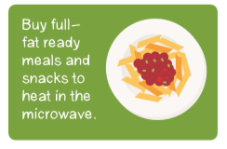
3. Care: Share the Eat, Drink, Live Well booklet
Eat little and often
Use milk powder to fortify milk, sauces and soup
Eat with others
Some people are having a shared lunch over a video call or watching a favourite programme while eating
Add to your food to increase energy without increasing portion size
Have more protein
Make meal preparation easier
This is called fortifying food
Notes:
Now we will look at how we care for others and help them to self-care by offering frontline advice from the Eat, Drink Live Well booklet . Here are the main tips from the booklet.
Eat little and often – some people may be over-faced by a big meal so they should try having smaller portion sizes, if they do this, they will need to have snacks between their meals. 6 small meals or snacks are as good as 3 big meals.
Add cream, butter, cheese and milk powder to meals and snacks. This helps to increase energy without increasing portion size..
Adding skimmed milk powder to food and drinks can be a very easy way to get extra calories and nutrients.. This doesn’t make it any thicker and should not change the taste.
Protein foods can help keep us strong and help with recovery from illness or wound healing.
Eating with others is usually a good way for people to enjoy and finish their meals. It does not have to be in person – they could chat over the phone or video call to friends and family while eating a meal,.
If a person does not want to cook, ready meals and pre-prepared sauces can help to make meal preparation easier. There are lots of meal delivery services and also, tinned and frozen fruit and veg are just as good as fresh.

Slide 10
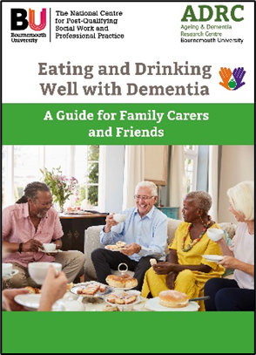
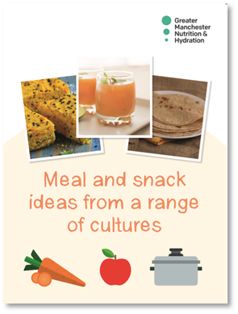
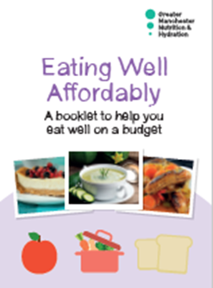
Food First: Directed Approach.
Meal and snack ideas from a range of cultures – different ideas and recipes to try from different cultures
Eating and Drinking well with Dementia – a guide for family carers and friends
Eating Well affordably – for those on a low budget
Vegetarian for life resources – recipe ideas and information for older vegetarians and vegans
Notes:
Some people may need extra information. These booklets are to be given only where appropriate. The Meal and Snacks from a range of cultures is to be given together with the Eat, Drink, Live Well booklet to people from BAME communities. Read the rest of the slide.

Slide 11
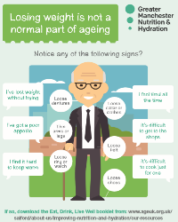
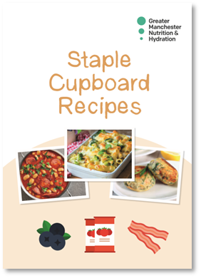
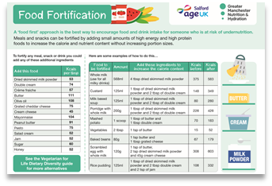
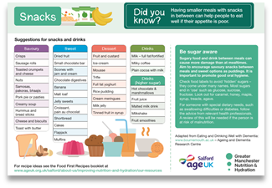
Other available resources
A5 Nutrition & Hydration tips leaflet
Staple cupboard recipes – simple recipes using mainly everyday tinned and frozen food
Posters – Good Nutrition / Hydration & Care Home Kitchen food fortification – can be used in kitchens catering for residents or patients.
Notes:
There are other resources from the programme. The signs of malnutrition leaflet and staple cupboard recipes can given to all older people as a preventative measure.
The posters can be used in kitchens catering for residents or patients

Slide 12
Show how you have made a difference!
Embed this in your role
Record it and report it.
Share your achievements!
Notes:
It is important to show how you have made a difference. If you embed this within your role, it demonstrates that a holistic approach is being used and malnutrition and dehydration will not remain invisible. But remember! - ‘if it isn’t written down, it didn’t happen’
If you have nutrition and hydration conversations documented, then you can report it wider to show how you and your organisation are making a difference. It will also give a picture of the prevalence of malnutrition and dehydration in your area and so may help to sustain funding or justifying future funding.

Slide 13
Remember -
You don’t need to be an expert - often it is about having conversation and encouraging people to make small changes that will make a big difference.
Many people may not have realised that they were underweight or dehydrated or that they could do something about this.
If you are worried, you can encourage them to see their GP or refer to the local community dietitians. Check the red flag questions if you are concerned.
Notes:
READ the slide.

Slide 14
Benefits of Good Nutrition and Hydration
Greater Independence
Improved
Health and Wellbeing Energy levels Mobility Concentration
U
P
D
O
W
N
Reduced
Urinary Tract Infections (UTIs)
Use of Anti-biotics
Falls
Notes:
The benefits of good nutrition and hydration include greater independence - which older people want to keep for as long as they can. Other things that are improved when someone is well-nourished and hydrated include their general health and wellbeing, energy levels, mobility and concentration. If a person is eating and drinking well they are less likely to have an infection including UTIs and therefore reduce the need for antibiotics and they are less likely to fall. This is not only better for the individual but will also save on costs for health and social care services.

Slide 15
Questions
1. Which resource isn’t usually used by clinical staff?
Food First recipes
Paperweight armband
Eat Drink Live well booklet
2. Who can be given the Eat, Drink Live Well booklet?
Anyone
Those at risk of malnutrition
Anyone over 65
Notes:
Here are your questions. Read the slide. . Click the mouse to move on.

Slide 16
Well done!
You have completed Bitesize 5 –
Eat Well: Tips to prevent malnutrition
To further your learning follow the links on the following ‘Progression’ slide.
Notes:
Read slide

Slide 17
Progression
E-learning Tool Malnutrition & Dysphagia: http://paperweightarmband.org.uk/
Emily’s story: https://www.ageuk.org.uk/bp-assets/globalassets/salford/forms/nutrition-and-hydration/emilys-story-1.pdf
Grandad’s Story https://vimeo.com/403103060
YouTube Tips and Tutorials
Hydration Top Tips: https://www.youtube.com/watch?v=yHk5VMhEyyQ
Nutrition Top Tips: https://www.youtube.com/watch?v=KDN-_Bs4kFo
How to use the Paperweight Armband: https://www.youtube.com/watch?v=I3cr8b8F3wE
Blogs and All resources:
https://www.ageuk.org.uk/salford/about-us/improving-nutrition-and-hydration/
Nutrition and Hydration Toolkit for managers:
https://www.ageuk.org.uk/salford/about-us/contact-us/nutrition-and-hydration-toolkit/
Notes:
Here are some great links to progress your learning. All of these will enhance your knowledge and help you to understand more about nutrition and hydration.

Slide 19
That’s right!
Go to the next question
Or if you have completed both questions, click here

Slide 20
That’s Wrong,
try again

