Slide 1


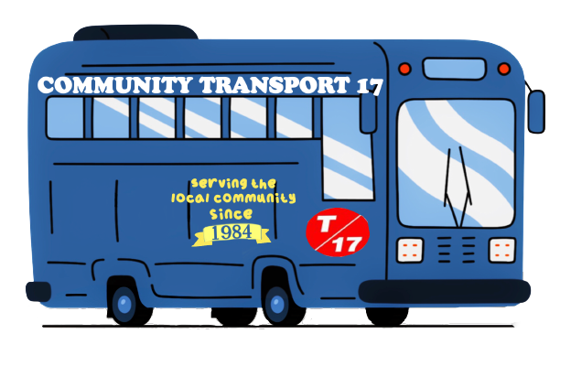
Transport 17
A charitable organisation
providing Community Transport to
older and vulnerable people in Sheffield
Transport 17, 172, Baslow Road, Sheffield, S17 4DR Tel: 0114 236 2962
Email: admin@transport17.co.uk

Slide 2


What do we do?
Transport 17 provides transport services to older and vulnerable people predominantly - but not exclusively - living in SW Sheffield who would otherwise be unable to leave home.
Getting out provides the opportunity for them to socialise in the local community which reduces isolation, has a positive impact on their mental health, and improves not only their own quality of life, but that of their friends and families.
T17 is dependent on volunteers to provide our transport services. This in turn provides opportunities for individuals across the age range to develop their skills, confidence, and friendship groups.

Slide 3
Our history
T17 was established in 1983 by a group of local volunteers led by Alan Jockel, former minister at All Saints Church.
The first bus went into service in June 1984 following a fundraising campaign by the local community, with funds matched by Help the Aged. T17 has been based at 172 Baslow Road since 1990.
We bought our first bus for £10,000 and our most recent bus (in 2016) for £50,000. Currently, a brand new bus with matching specifications would cost £90,000.

Slide 4
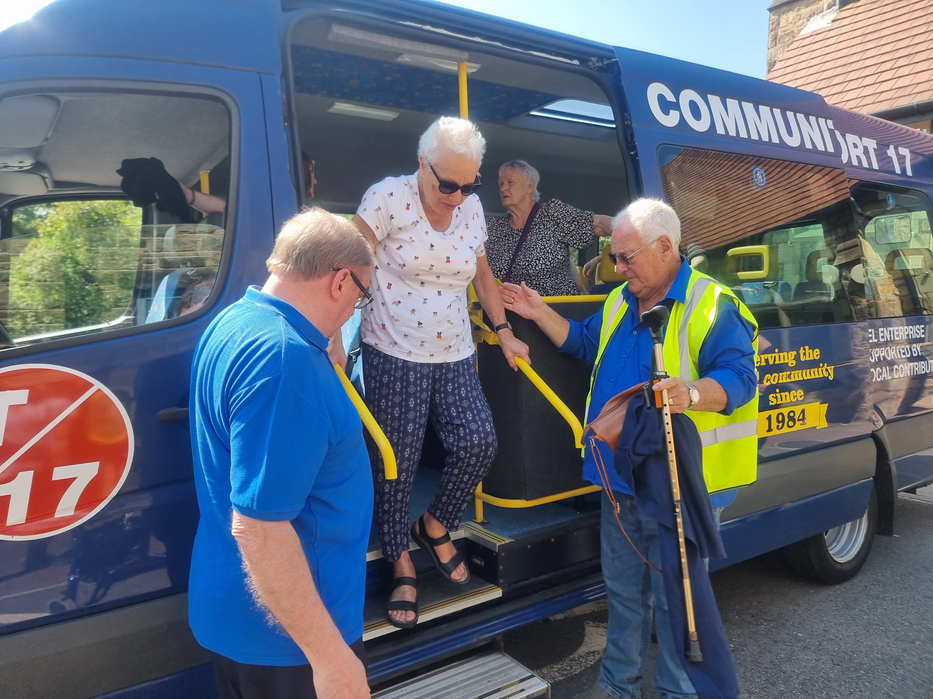
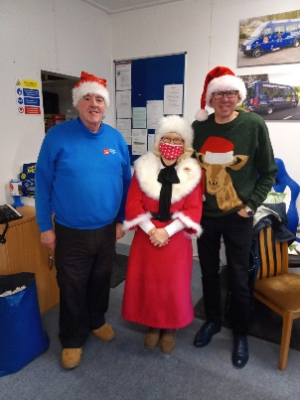
      Our volunteers
We have 11 Drivers and 11 Passenger Assistants
With this number we currently struggle to cover all the journeys in a week when volunteers are on holiday or unable to come in.
We continue to explore new avenues for advertising and recruiting new volunteers.
Lunch and social clubs
T17 currently provides regular weekly transport to 11 lunch and social clubs, and fortnightly transport to 2 more.
Passengers are collected from Sheffield postcodes S2, S7, S8, S10, S11, S12, S14, and S17.

Slide 5
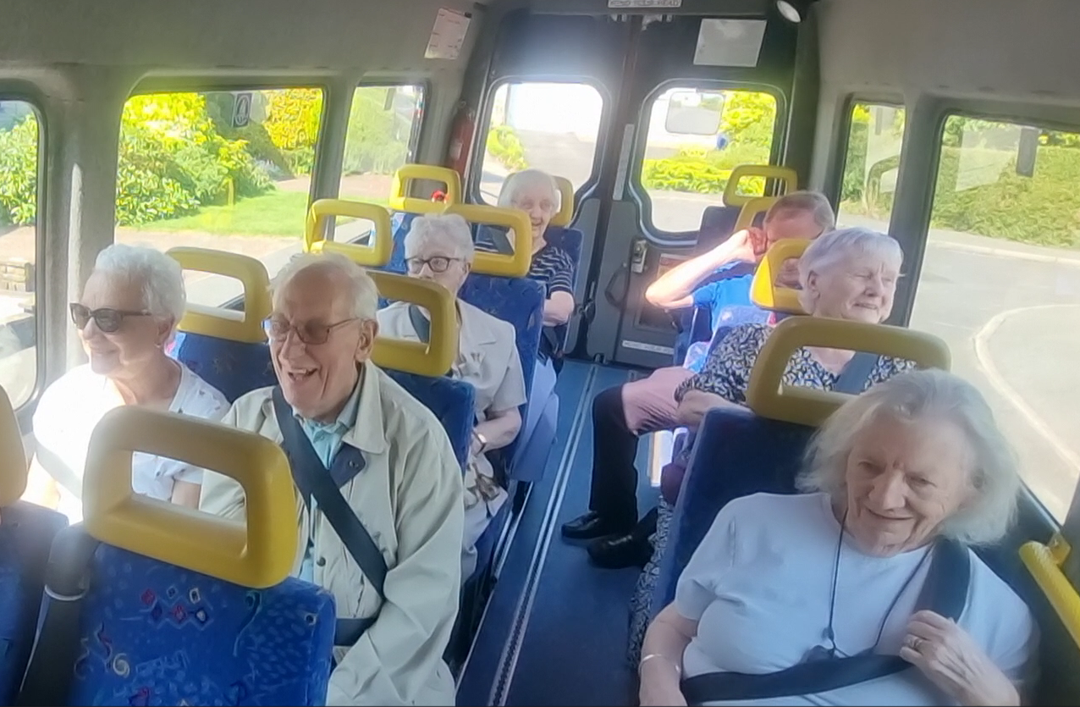
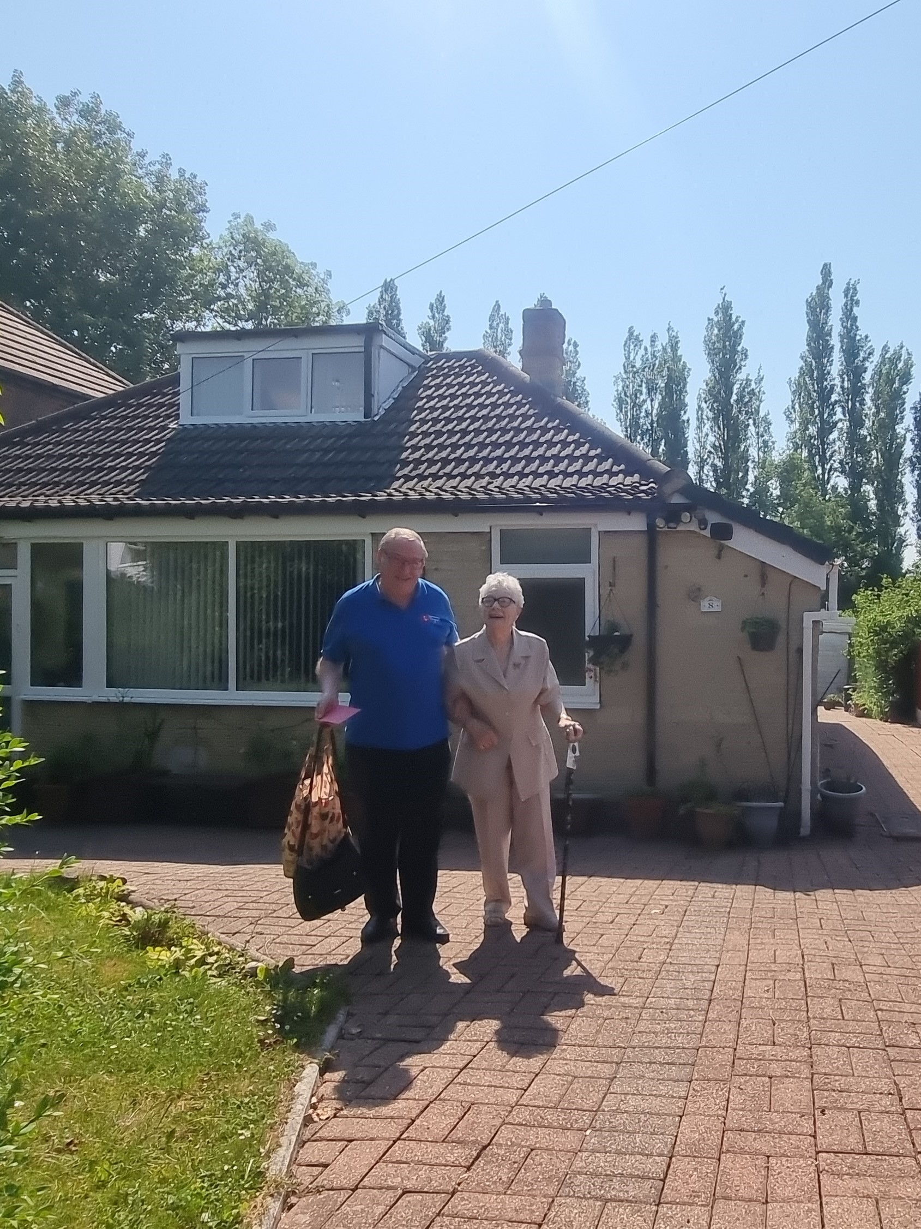
Passenger journeys
In 2023, T17 made 7033 passenger journeys.
This was a 20% increase on the total journeys made in 2022 (our first full year of operating post-covid shutdown).
In the first half of 2024, we have provided 3879 passenger journeys.
This is an 11% increase on the first 6mths of 2023.
Increase in demand - In 2023 we had to decline 4 requests for accessible group transport.
In 2024, in the first 6mths alone, we have had to decline 9 requests from new groups needing accessible transport to enable their members to attend.

Slide 6
    Fundraising
We continue to receive some funding from the South Yorkshire Mayoral Combined Authority (SYMCA), formerly South Yorkshire Passenger Travel Executive (SYPTE).
However we rely on funding from grants, nominal charge to clubs for transport, donations and legacies, and local fundraising events for the majority of our income.

Slide 7
Challenges facing Transport 17
(Community Transport)
Difficulty recruiting volunteers (less people volunteering post-Covid – other commitments, need for paid work))
A smaller pool of volunteers with the necessary driving licence (D1)
Volunteers are often older themselves and facing health issues
Managing an aging fleet of vehicles
Facing increased costs (e.g. vehicles - maintenance and replacing, insurance, energy costs)
More passengers using Community Transport than previously
Increased need and increased complexity of passengers - they are frailer and more vulnerable, require more support and assistance to get into and off the bus as well as reminders (locking house, personal belongings)

Slide 8
Transport 17
A charitable organisation
providing Community Transport to
older and vulnerable people in Sheffield
Transport 17, 172, Baslow Road, Sheffield, S17 4DR Tel: 0114 236 2962
Email: admin@transport17.co.uk

