Slide 1

South Yorkshire Funding Advice Bureau
We provide advice, information, and training to improve fundraising skills and confidence.

Slide 2
South Yorkshire Funding Advice Bureau
Weekly Funding News email
Database of around 40 funders. Grantway for funding over £10k
Resources covering a variety of funding topics (Know How)
Training programme

Slide 3
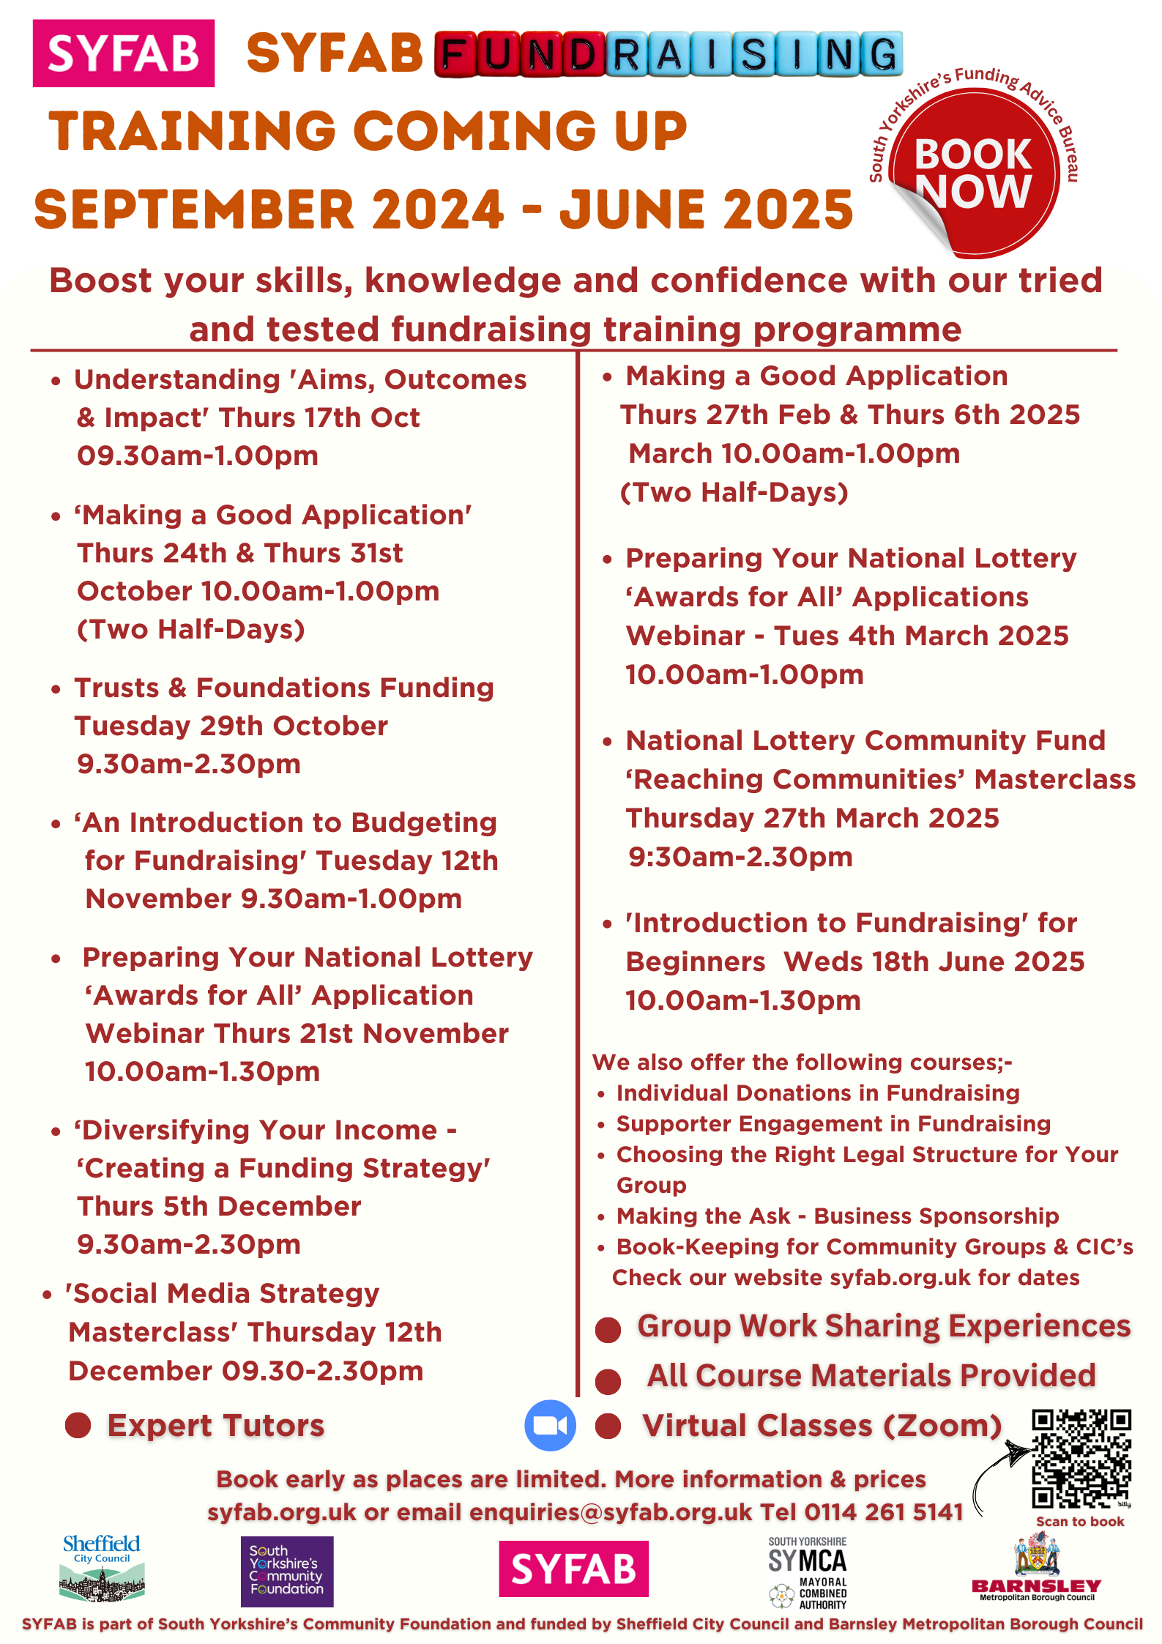

Slide 4
South Yorkshire Funding Advice Bureau
Sheffield & Barnsley support:
One-to-one support
Making sense of criteria
Draft applications
Community events/surgeries

Slide 5
South Yorkshire Funding Advice Bureau
Karen Walke
Head of SYFAB
E: karen@syfab.org.uk
T: 07529 323 342
W: www.syfab.org.uk

