Slide 1


Digital Champion Programme

Slide 2
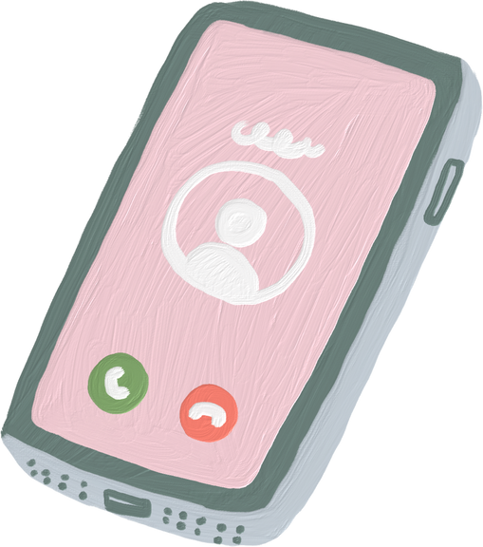
What is the Digital Champion Programme?
  Funded project from Age UK for the next year
  Aim to help people over 50 become more confident online and with technology
  Offers tailored and personalised support
  Help people achieve their own goals for their own needs
  Completely flexible and learner-led support and guidance
  Making technology fun and safe

Slide 3

What can we offer you?
  Digital Support for Welcome Place Providers
    Support setting up Facebook pages and learning how to use social media
  Digital support for Welcome Place Attendees
    Drop-in sessions, ability to ask questions about their technology
    Possibility to run themed session around particular interest of the group

Slide 4

Thank you
Please find me to discuss how Age UK Sheffield could help your Welcome Place get online and support your visitors to learn new skills.
You can also email me at eilis.kinsella@ageuksheffield.org.uk

