Slide 1













WELCOME
PLACES

Slide 2





IMPORTANCE OF SOCIAL MEDIA FOR WELCOME PLACES
  Social media creates visibility and awareness for local community services.
  It effectively connects with all generations, especially caregivers and families of older adults.
  Provides real-time updates on events, services, and opportunities to engage.
  Strengthens the sense of belonging by showcasing community stories, testimonials, and achievements.

Slide 3
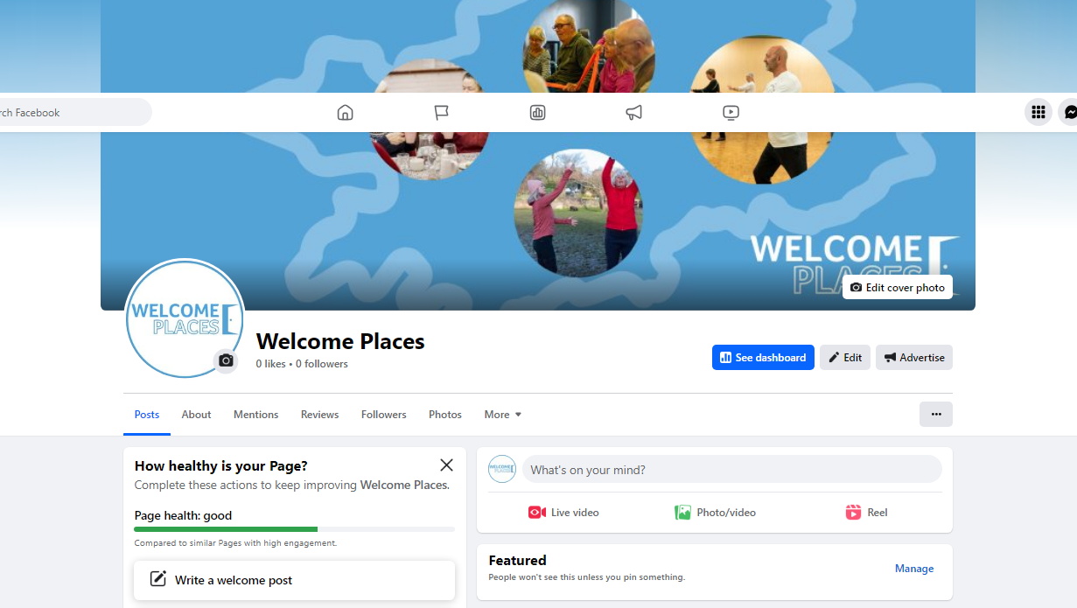

Slide 4
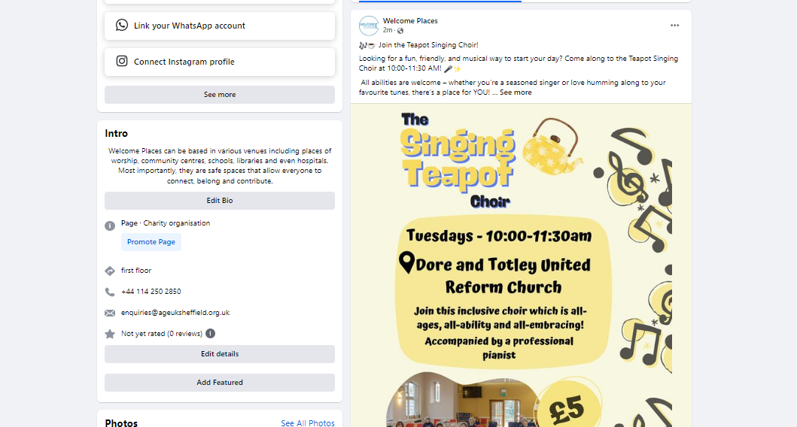

Slide 5

EFFECTIVE SOCIAL MEDIA STRATEGIES FOR WELCOME PLACES
  Platform Selection: Prioritise platforms like Facebook (ideal for older demographics) and optionally use Instagram for visuals.
  Content Ideas: Announce events, and services (e.g., coffee mornings, support sessions etc.).
  Share success stories, and testimonials from participants.
  Post images of events/activities to engage community experience.
  Promote partnerships (e.g., Council and Age UK).
  Engagement Tactics: Encourage community members to share their experiences.
  Use hashtags to widen reach (e.g., #WelcomePlaces, #AgeUKSheffield).

