Slide 1
What does Dementia Friendly Sheffield look like? What can you do to help?
Sheffield Dementia Action Alliance regular workshop

Slide 2

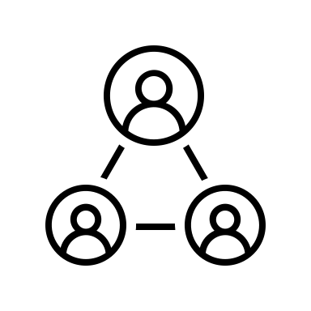




Dementia friendly Sheffield. What might it look like?
Receiving quality health, care and support
People with dementia are understood and supported
People with dementia feel confident to access their high street
Involving people with dementia
People with dementia can travel safely
Access to arts, culture and leisure

Slide 3
People with dementia are understood and supported
As a dementia friendly city people with dementia should feel included and that their experience is understood by everyone in the community.
What can your organisation do?
Consider access to your organisation
Train your staff in understanding dementia through the Sheffield dementia advice service or dementia stars
Explore your services and look at whether they support people living with dementia well
Share your successes with the Sheffield Dementia Action Alliance

Slide 4
Involve people with dementia
In a Dementia Friendly Sheffield all types of organisations will support people affected by dementia to give their feedback, which will then be used to help improve services.
What can your organisation do?
Consider having focus groups for people living with dementia to feedback on your organisation
Ask a person with dementia to be part of your organisations governance
Implement changes based on a person with dementia’s experience
Share your successes with the Sheffield Dementia Action Alliance

Slide 5
People with dementia can travel safely
A Dementia Friendly Sheffield aims for people with dementia and their carers to easily access and travel to places that are important to them, such as shops, theatres, social groups and appointments.
What can your organisation do?
Consider how people with dementia can get to your organisation
Link feedback about transport experiences back to the provider and to the Sheffield Dementia Action Alliance
Share dementia travel aids such as the sunflower lanyard and communication cards
Share your successes with the Sheffield Dementia Action Alliance

Slide 6
People with dementia feel confident to access their high street
A dementia friendly Sheffield enables people with dementia to continue to do the things that matters most, accessing the high street is one of them.
What can your organisation do?
Explore the environment of the high street with the audit tool as a starting point
Understand the barriers to the high street from people living with dementia
Work together to minimize the barriers people with dementia face
Share your successes with the Sheffield Dementia Action Alliance

Slide 7
Access to arts, culture and leisure
A dementia friendly Sheffield looks to enable equal access to all aspects of leisure for people living with dementia.
What can your organisation do?
Consider the environment
Look to make all activities accessible to a person with dementia
Create dementia specific engagement
Share your successes with the Sheffield Dementia Action Alliance

Slide 8
Receiving quality health, care and support
A person with dementia may have many interactions with health, care and support, it is our role in a dementia friendly Sheffield to support excellent standards.
What can your organisation do?
Make links with GP surgeries and become an organisation they refer to
Simplify the care pathway for people you support
Educate your staff and volunteers in navigating through the dementia system in Sheffield
Share your successes with the Sheffield Dementia Action Alliance

