Slide 1
Memory Loss Advice Service
People accessing our service will be offered a dedicated adviser prior to a diagnosis of dementia or Mild Cognitive Impairment (MCI), then further advice with understanding any confirmed diagnosis and regular support reviews:
ACCESSING CARE SUPPORT
Accessing home care services via social care assessments
or privately funded care agencies, and within our specialist day service
BENEFITS SUPPORT
Support to complete applications for Attendance Allowance
and other linked benefits (specific criteria apply)
PLANNING AHEAD
Planning for the future, including Advance Care Planning, Lasting Power of Attorney, Advance Decisions and Advance Statements
SUPPORT FOR CARERS
Referral to Trafford Carers Centre for carer specific services and access to therapeutic support and respite services
BI-MONTHLY NEWSLETTER
Newsletter for information on our services,
research and news articles relating to memory loss,
Mild Cognitive Impairment (MCI) and dementia
REGULAR HUBS, DROP-INS & ACTIVITIES
Contact our service for one-to-one adviser support,
or to connect with our MCI or dementia support meetings
www.twitter.com/dementiaadviser or www.twitter.com/ageuktrafford
0161 746 3944
www.facebook.com/ageuktrafford
dementia.adviser@ageuktrafford.org.uk

Slide 2
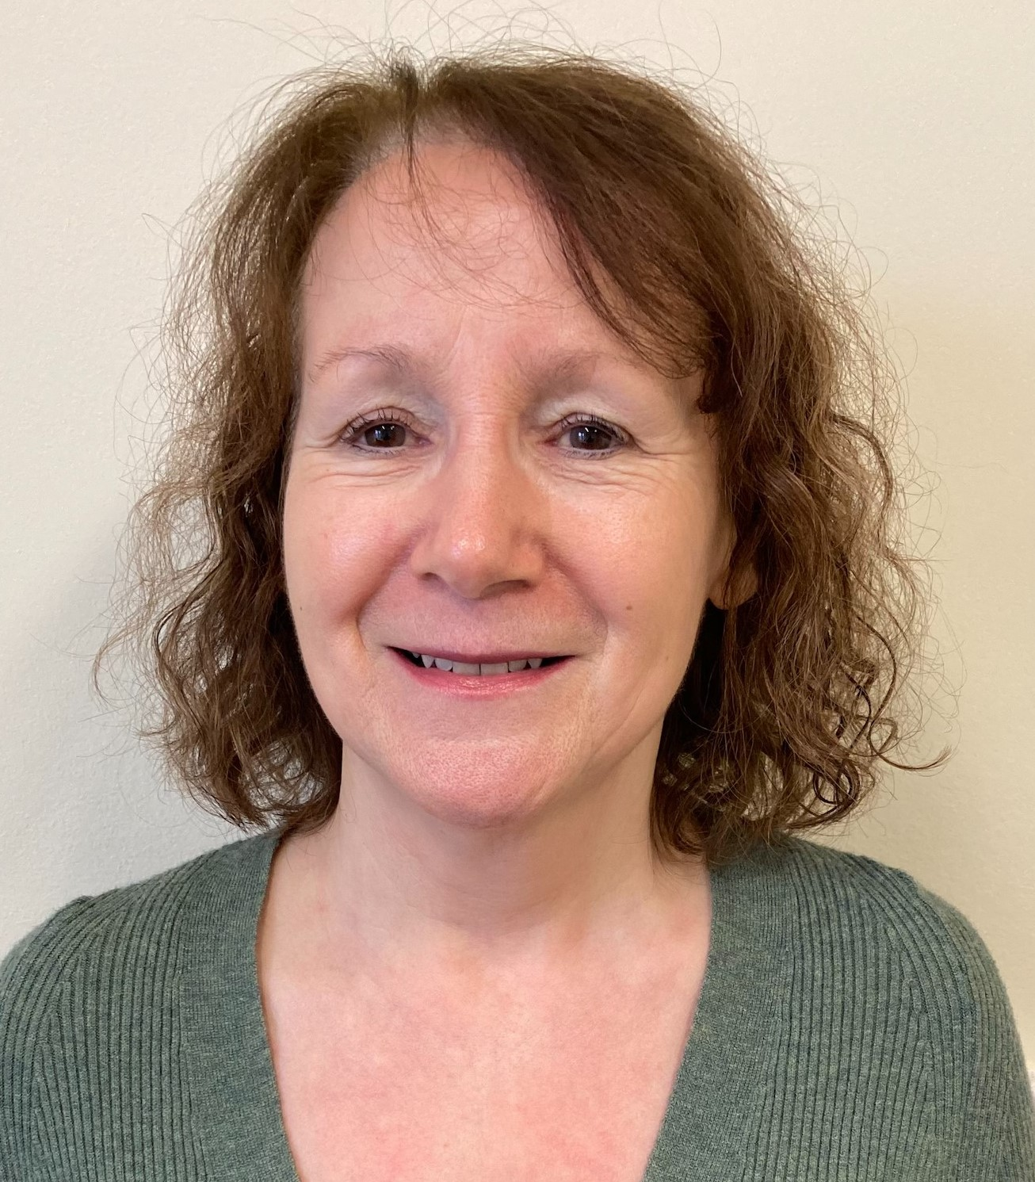
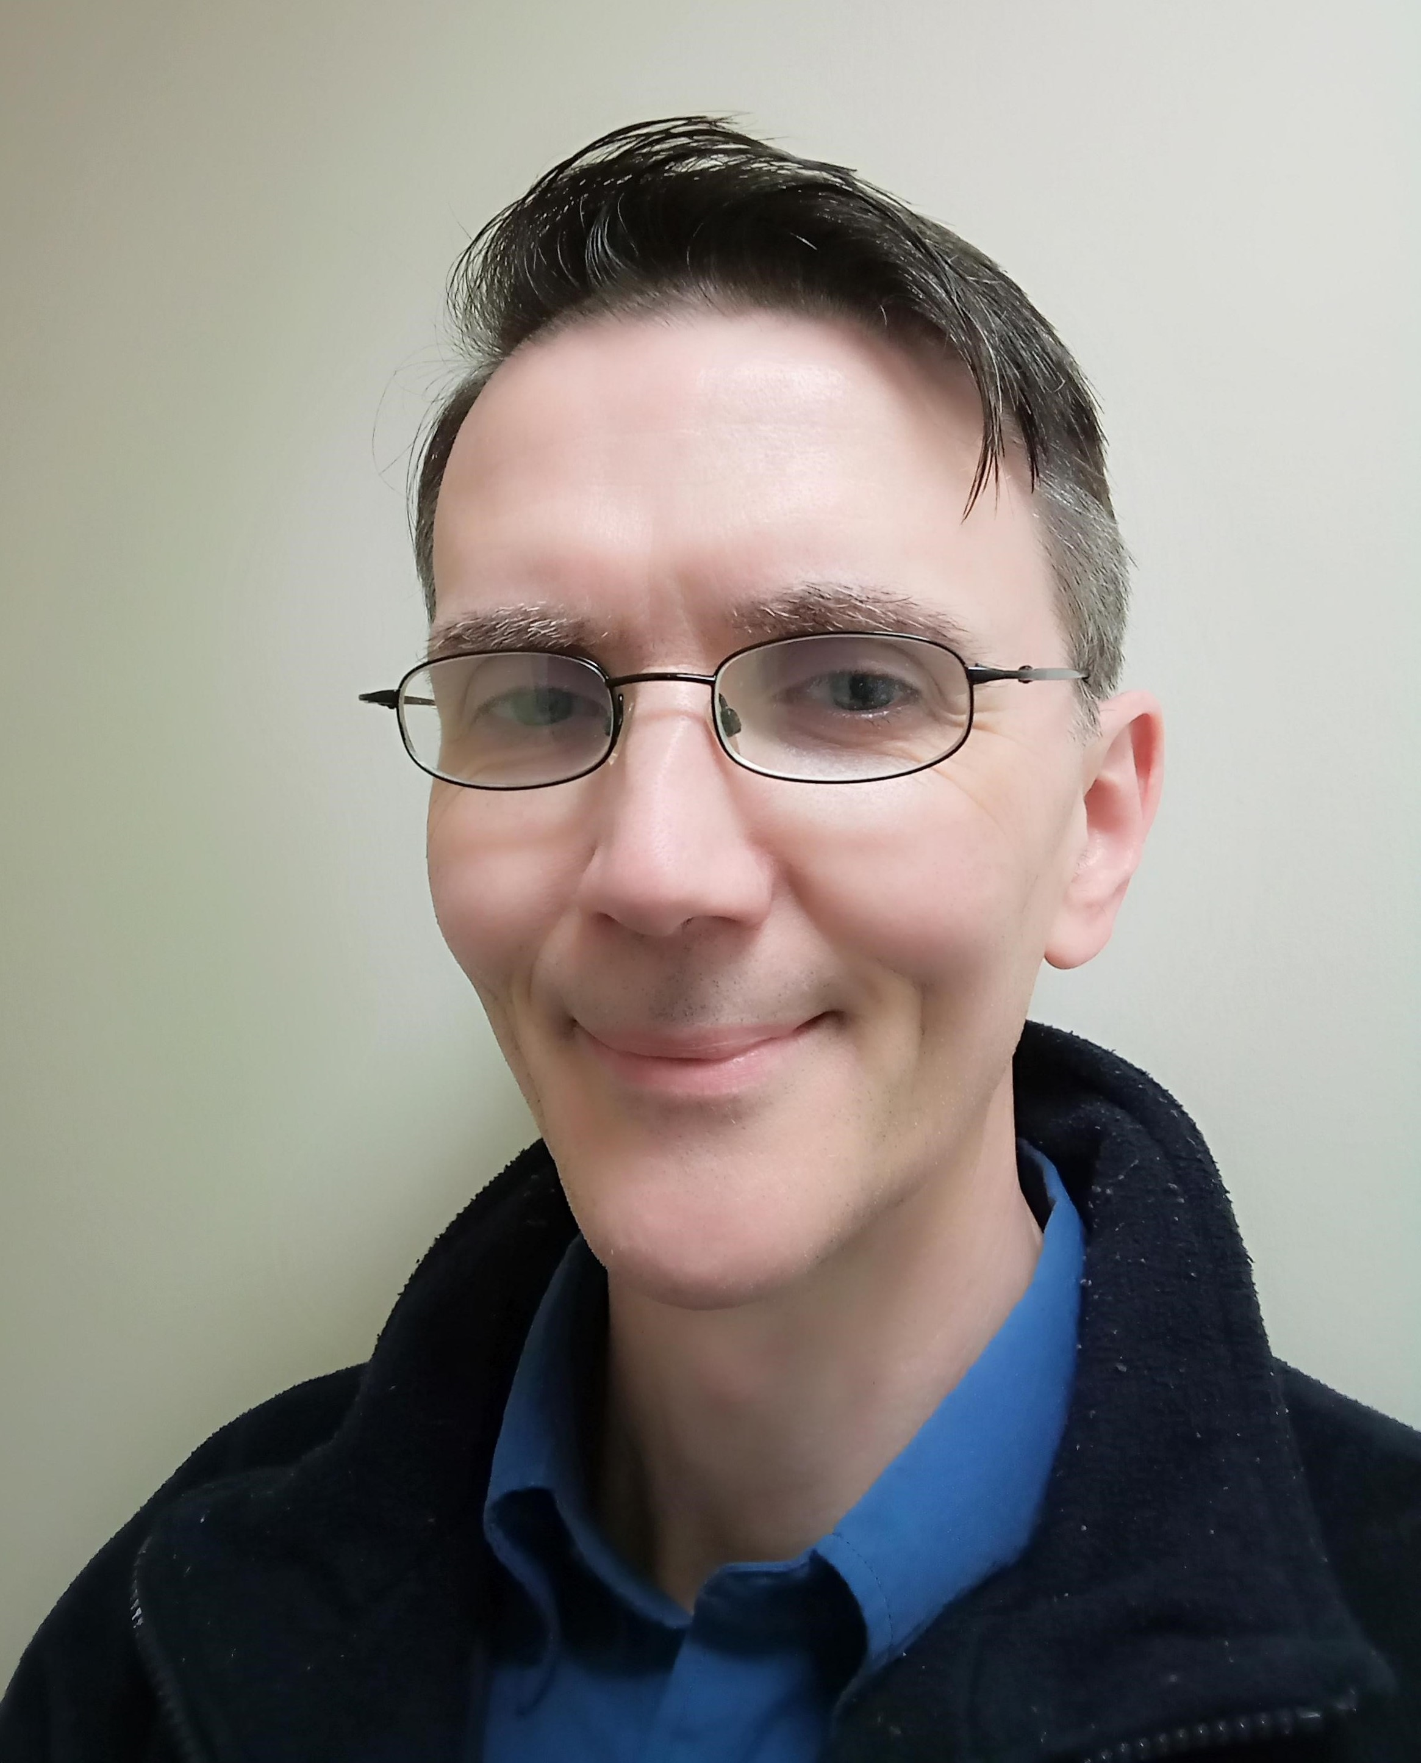
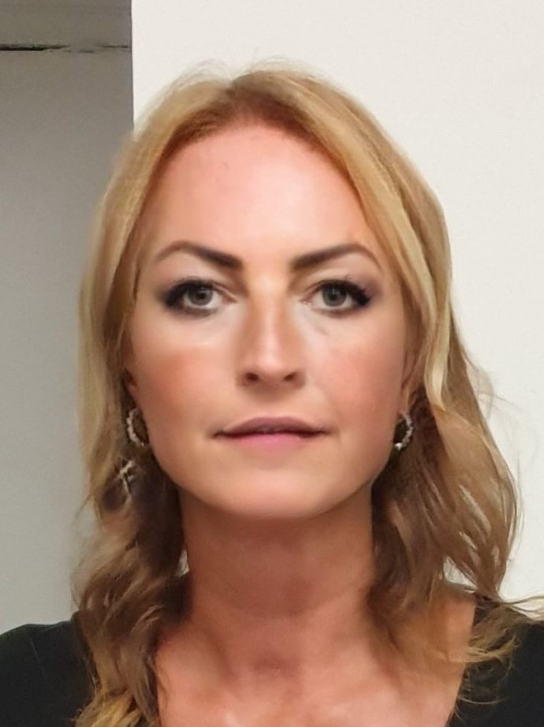
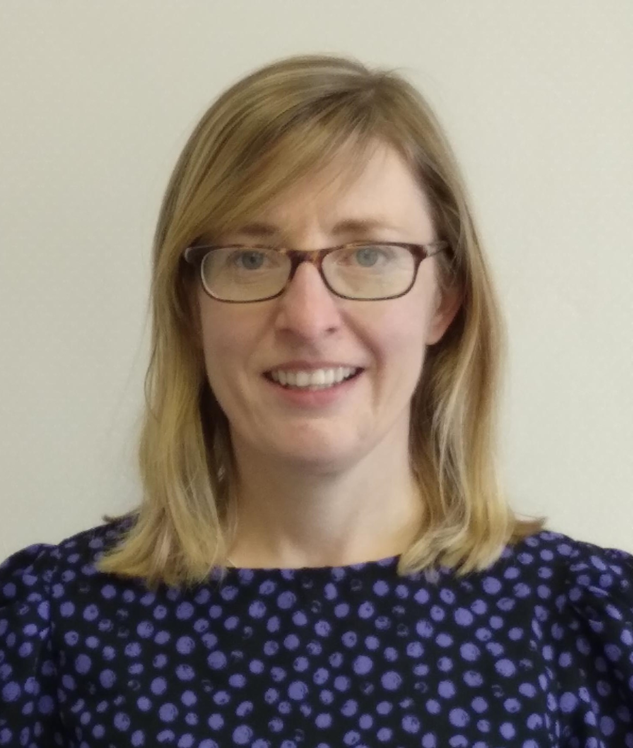
Meet The Team
Maureen
Memory Loss Adviser
Patrick
Admin Support
Louise
Memory Loss Adviser
There are in-person peer support meetings for those diagnosed with dementia and their carers, and several drop-in sessions each month across Trafford for confidential adviser support.
Mild Cognitive Impairment
Support is available for those with a diagnosis of Mild Cognitive Impairment (MCI) with advice on issues such as lifestyle adjustments, prompts to support memory difficulties, future planning and the annual review process.
For those diagnosed with MCI we have a weekly group that meets called Blossom Out. During the sessions research and developments are discussed, as well as cognitive stimulation in the form of quizzes, games and physical activity.
Sarah
Mild Cognitive Impairment (MCI) Adviser
For more information on any aspects of our service or support, please call: 0161 746 3944
Age UK Trafford, 1-3 Church Road, Urmston M41 9EH
Registered Charity No. 1109047 Company N0. 5384301

