Slide 1
Suicide PostVention Practitioner
Supporting young people aged 16-25y olds who have been affected by suicide
These will change as the service develops and grows..

Slide 2
Suicide Postvention Practitioner
Started December 2020
Post is based within the community, host organisation - Young Lives Consortium
Work with Public Health (one day a week)
Work closely with STAR bereavement as the service will transition to them next year
Establish links with the Leeds Mind – Suicide Postvention Worker
First steps are to establish a working group (community, third sector, emergency services, education, health, social care)

Slide 3
ethos
Our aim, is for young people in the Wakefield district who has been affected by suicide, to receive postvention support and learn prevention strategies.
The term postvention describes activities developed by, with, or for people who have been bereaved by suicide, to support their recovery and to prevent adverse outcomes, including suicide and suicidal ideation (ref PHE)

Slide 4
The service provides emotional and practical support to young people aged 16-25y who are affected by Suicide of someone they knew or knew of.
Young people will work with the practitioner on an individual basis to talk things through about how the suicide has affected them and they will have the opportunity to work in groups to learn how to look after their themselves and support each other.
They can also be signposted to organisations locally, regionally and nationally who can support needs such as Counselling therapy, Substance misuse, Housing etc…
This service is not replacing any support or intervention that is already in place or used in the community, schools, particular groups or individuals.

Slide 5
We can only do this if we work together. Having the right kind of services in place to provide support, makes it easier to create a Holistic Approach that will benefit young people whose lives have been impacted by suicide.
We want to improve and maintain emotional wellbeing, build resilience to everyday pressures and reduce mental health issues that can develop when we are dealing with grief.

Slide 6
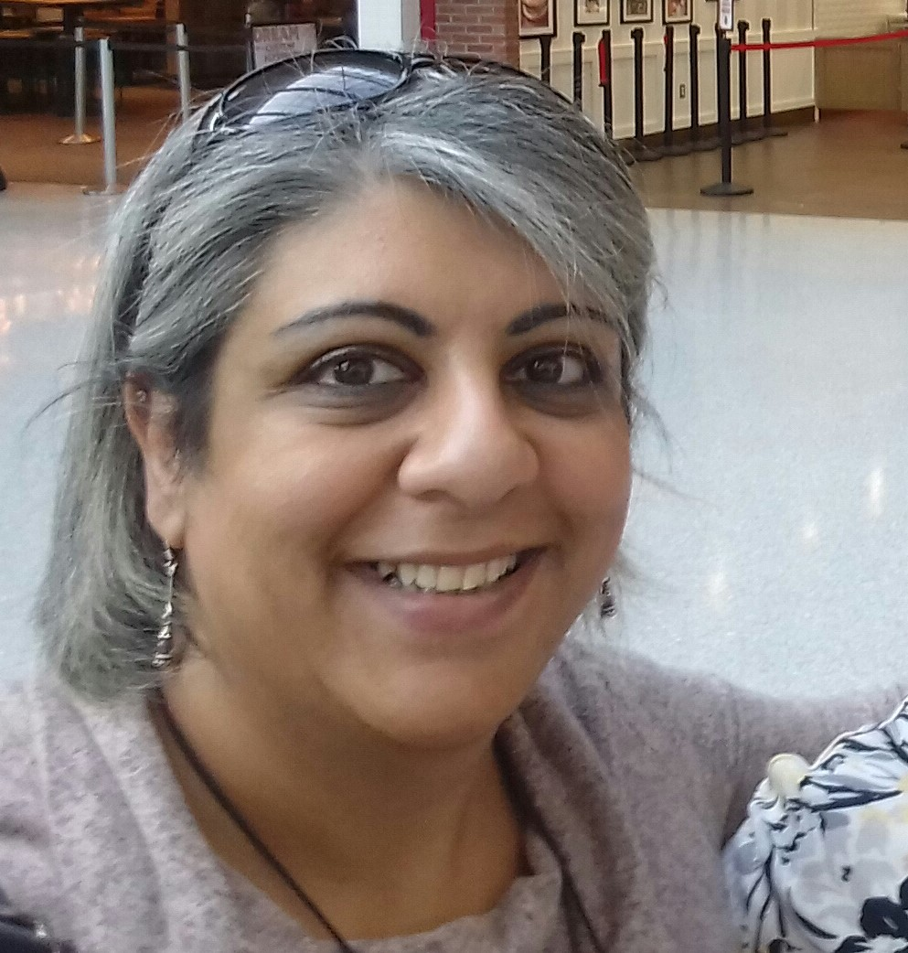
Suicide Postvention Practitioner
Waheeda Janmohamed
Waheeda@ylc.org.uk
07708 471 670
I don’t work on Wednesdays
starbereavement.org.uk

